Slide 1
🧠
Alzheimer’s Disease Prediction
Machine Learning • Classification • Streamlit Application
Project Focus
Final Model
Classify Alzheimer’s Disease diagnosis from demographic, lifestyle, medical, cognitive, functional and symptom-related information.
Tuned Random Forest
94.42% Accuracy • 91.89% F1
Data Science Project

Slide 2
02
Mentor & Team Members
Project presentation
MENTOR
TEAM MEMBERS
[Mentor Name]
1
VANDANA DURGA PRASANTH
2
CHAITRA
Faculty Mentor
Department / Institution
[Add details here]
3
RAHUL SWAIN
4
CHANDRA SEKHAR PADHY
5
SANTOSH KUMAR MAHARANA
6
MOHD ASIM KHAN
Alzheimer’s Disease Classification • Machine Learning Project

Slide 3
03
Objective
What the project is designed to achieve
01
Detect patterns
02
Identify informative factors
Explore patient-level patterns associated with Alzheimer’s diagnosis.
Assess cognitive, functional, symptom, lifestyle and medical variables.
03
Build classification models
04
Support data-driven decisions
Compare supervised binary classification algorithms.
Provide an interactive demonstration for risk-pattern classification.
Alzheimer’s Disease Classification • Machine Learning Project

Slide 4
04
Dataset Details
Scope and structure of the patient dataset
2,149
35
32
1
patient records
original columns
predictive features
binary target
Variable groups
Target variable
• Demographics: Age, Gender, Ethnicity, Education
• Lifestyle: BMI, smoking, alcohol, activity, diet, sleep
• Medical & clinical: cardiovascular disease, diabetes, depression, BP, cholesterol
• Cognitive / functional / symptoms: MMSE, FunctionalAssessment, ADL and symptom indicators
Diagnosis
0 → No Alzheimer’s Disease
1 → Alzheimer’s Disease
PatientID and DoctorInCharge were excluded from predictive modelling.
Alzheimer’s Disease Classification • Machine Learning Project

Slide 5
05
Data Preprocessing
Preparing a clean and leakage-controlled modelling dataset
Data quality
Feature cleanup
Target setup
Model matrix
→
→
→
No missing values
No duplicate records
Remove PatientID
Remove constant DoctorInCharge
Diagnosis as binary target
0 / 1 classification
32 predictive features
2,149 rows
Preprocessing inference
The dataset was already clean enough that no missing-value imputation or major IQR-based outlier treatment was required.
Alzheimer’s Disease Classification • Machine Learning Project

Slide 6
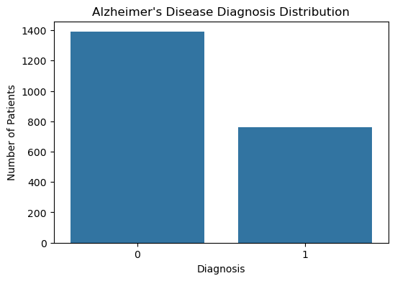
06
Target Variable Analysis
Diagnosis distribution in the dataset
1,389
760
64.63%
No Alzheimer’s cases
Alzheimer’s cases
non-Alzheimer share
Inference
• The target is moderately imbalanced.
• Non-Alzheimer cases are more frequent.
• Stratified splitting helps preserve the class proportion during evaluation.
Alzheimer’s Disease Classification • Machine Learning Project

Slide 7
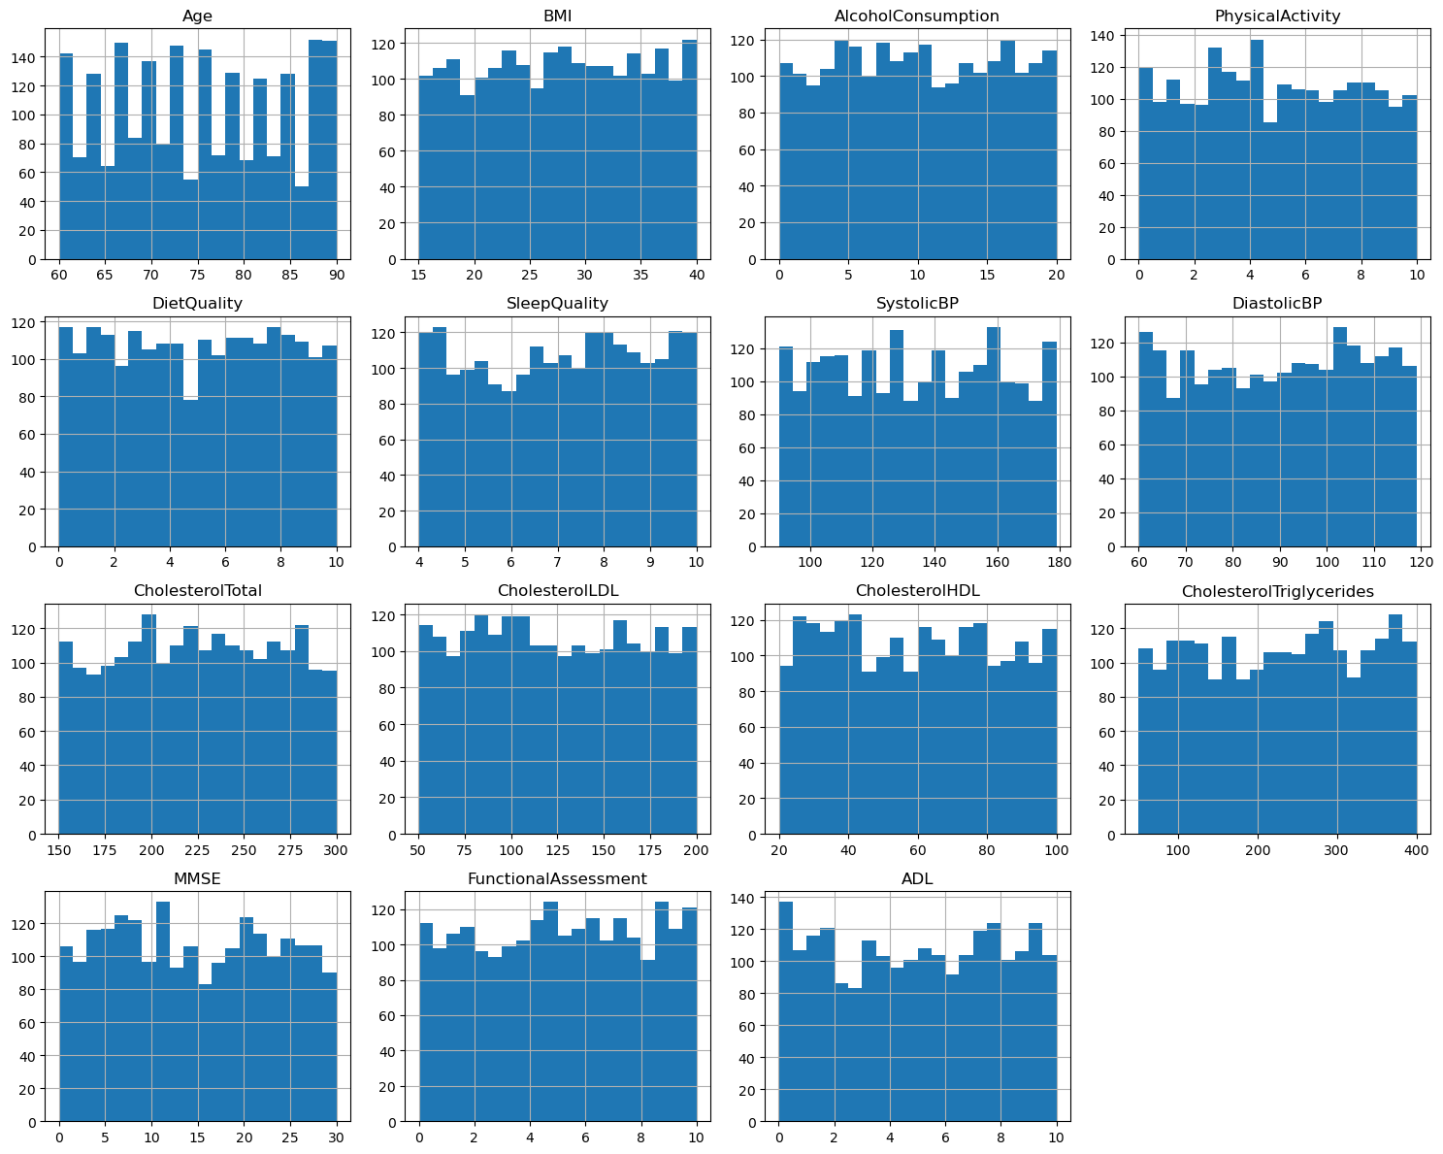
07
Continuous Variable Analysis
Distribution and spread of numerical patient attributes
Inference
• Numerical variables cover demographic, lifestyle, clinical and cognitive measurements.
• The feature scales differ substantially, supporting scaling for distance- and coefficient-based models.
• No major distributional issue was identified that required removal of a continuous feature.
Alzheimer’s Disease Classification • Machine Learning Project

Slide 8
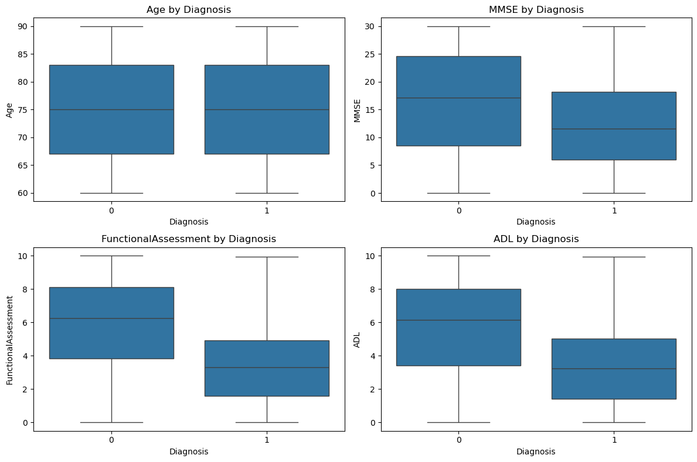
08
Outlier & Boxplot Analysis
Checking whether extreme values could distort the modelling process
Inference
• The key cognitive and functional variables show clear separation between diagnosis groups.
• IQR checks found no significant outlier counts across the continuous variables.
• Therefore, no outlier treatment was required before modelling.
Alzheimer’s Disease Classification • Machine Learning Project

Slide 9
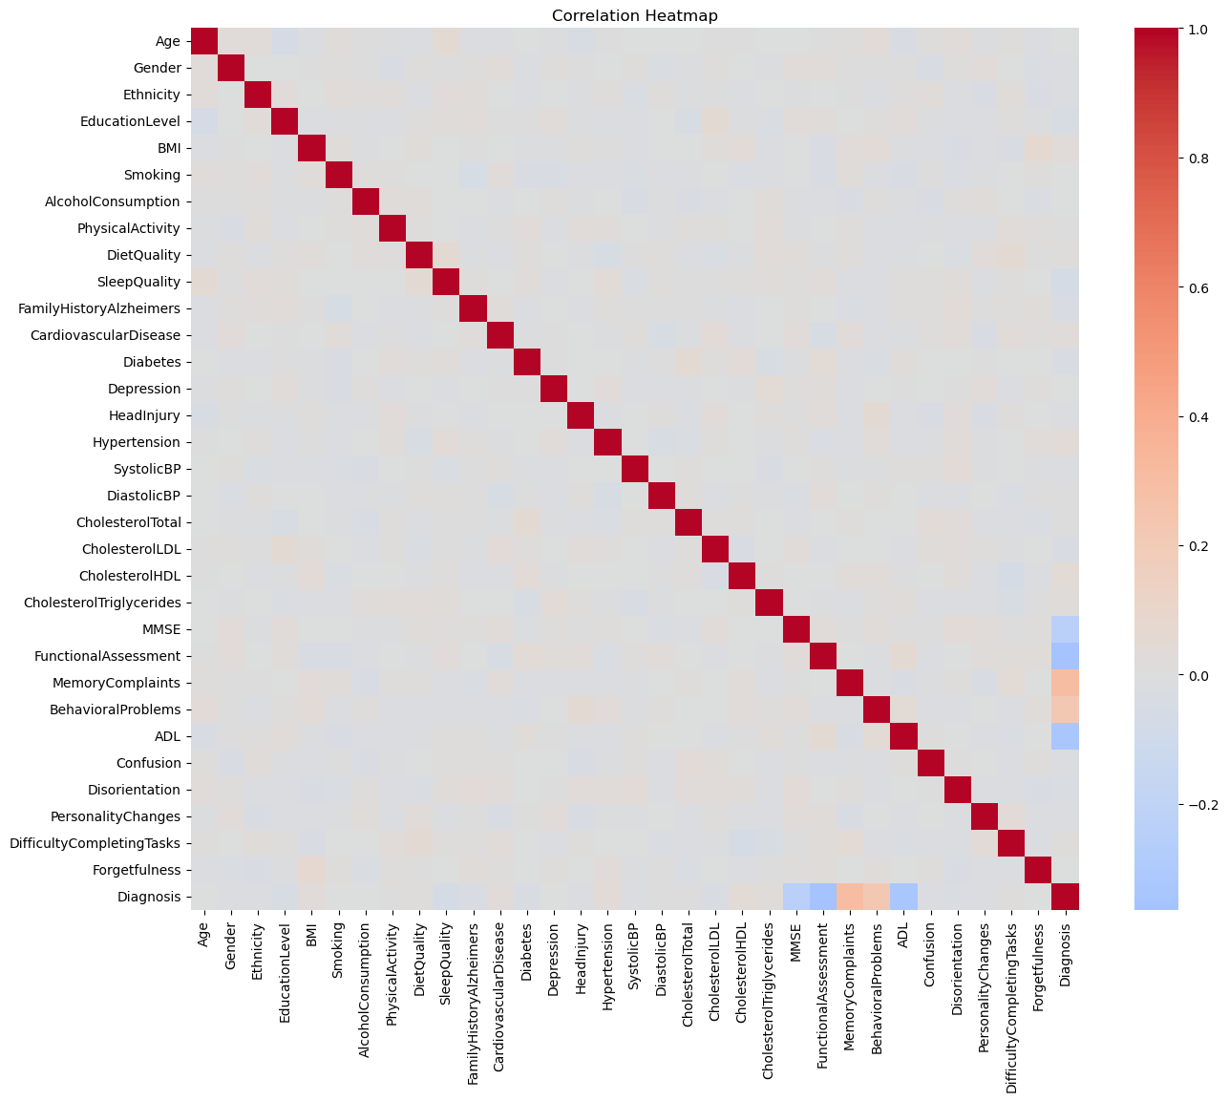
09
Correlation Analysis
Identifying variables most associated with the diagnosis outcome
Top associations
FunctionalAssessment
−0.365
ADL
−0.332
MemoryComplaints
+0.307
MMSE
−0.237
BehavioralProblems
+0.224
Alzheimer’s Disease Classification • Machine Learning Project

Slide 10
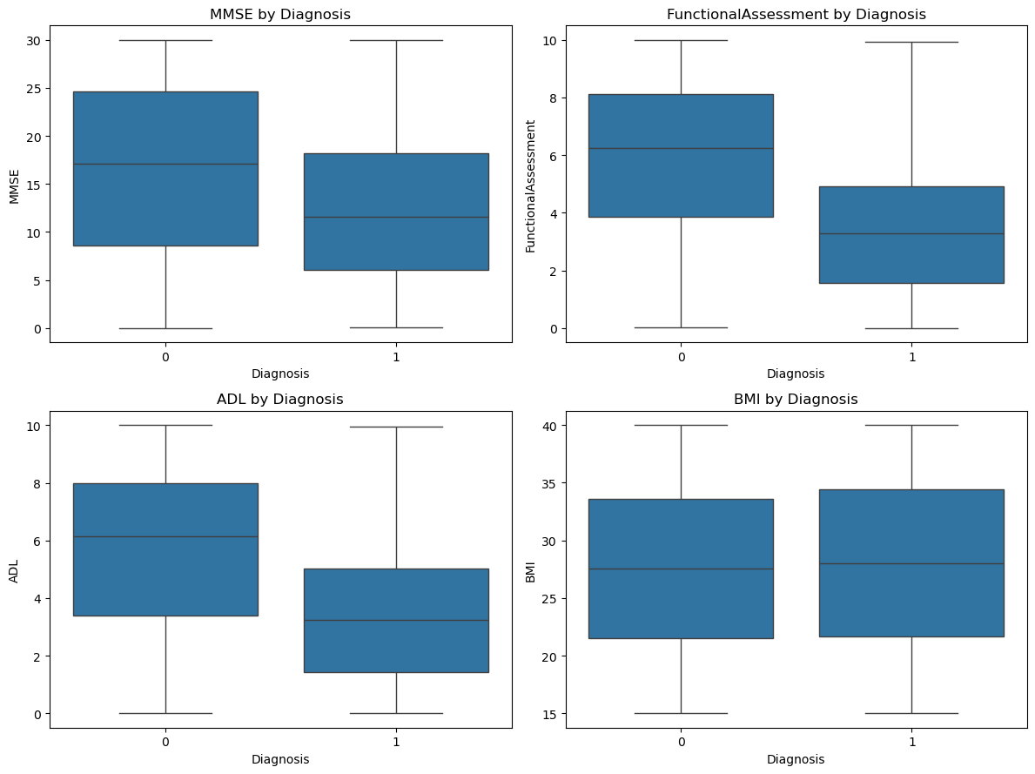
10
Cognitive & Functional Insights
The strongest group-level differences in the EDA
Observed differences
• MMSE is lower on average for the Alzheimer’s group.
• FunctionalAssessment shows a substantial group difference.
• ADL also differs strongly between the two diagnosis groups.
• These variables became important candidates for model development.
Alzheimer’s Disease Classification • Machine Learning Project

Slide 11
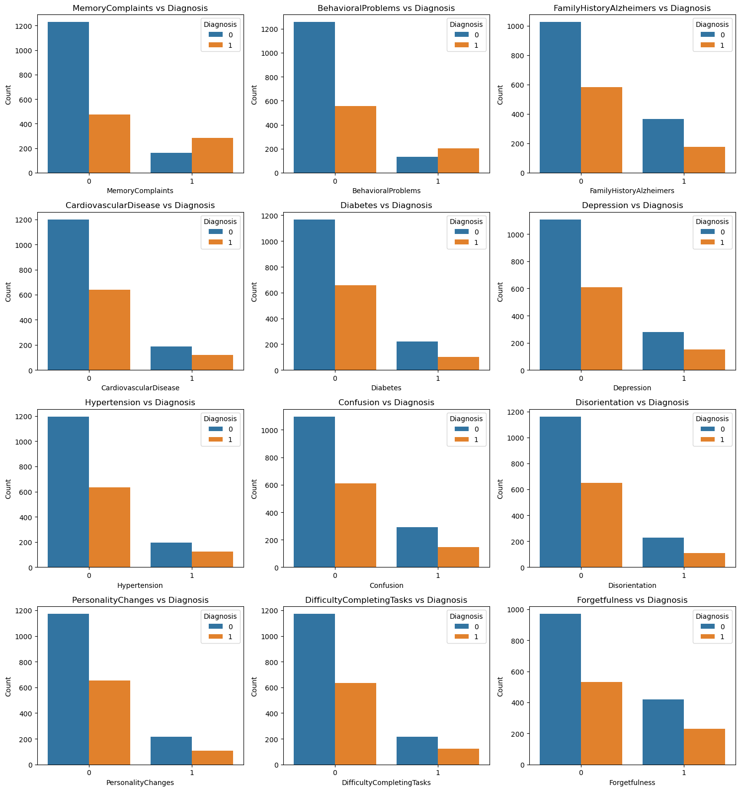
11
Symptom & Behavioral Analysis
Diagnosis rate patterns for binary indicators
Inference
• Memory complaints show a notably higher diagnosis rate when present.
• Behavioral problems also show a meaningful difference.
• Other binary medical indicators have weaker individual separation.
• Combined effects can still be captured by ensemble models.
Alzheimer’s Disease Classification • Machine Learning Project

Slide 12
12
Diagnosis vs Important Categorical Features
Comparing binary patient indicators across diagnosis groups
Key inference
• MemoryComplaints: diagnosis rate rises from 27.8% to 64.0%.
• BehavioralProblems: diagnosis rate rises from 30.7% to 60.2%.
• Family history and several chronic conditions show smaller differences in this dataset.
Alzheimer’s Disease Classification • Machine Learning Project

Slide 13
13
Numerical Features vs Diagnosis
Mean comparison between the two diagnosis groups
16.27
Inference
MMSE
11.99
• MMSE, FunctionalAssessment and ADL show the clearest mean differences.
• Age, BMI and most cardiovascular measures have much smaller mean differences.
• The strongest signals are concentrated in cognitive and functional variables.
FunctionalAssessment
5.86
3.65
ADL
5.71
3.66
SleepQuality
7.12
6.92
Diagnosis 0
Diagnosis 1
Alzheimer’s Disease Classification • Machine Learning Project

Slide 14
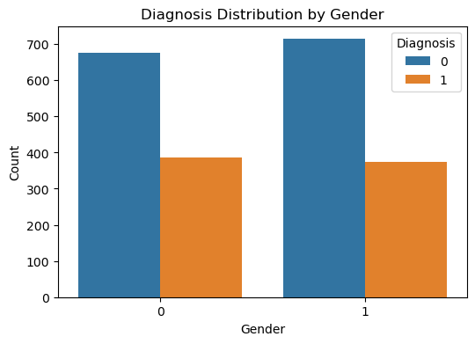
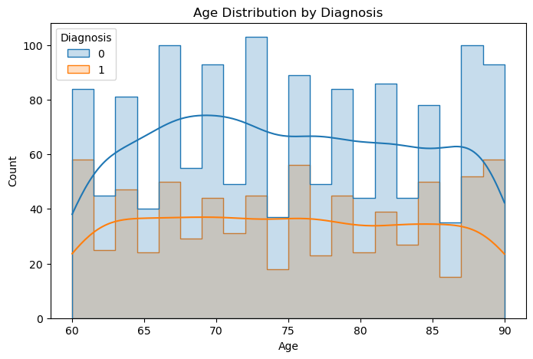
14
Age & Gender Analysis
Assessing whether simple demographic variables separate the classes
Age distributions overlap considerably across the two diagnosis groups.
Gender shows substantial overlap rather than strong individual separation.
Alzheimer’s Disease Classification • Machine Learning Project

Slide 15
15
EDA Summary & Inferences
What the exploratory analysis tells us before modelling
01
Dataset is clean: no missing values, duplicates or significant IQR-based outliers.
02
Diagnosis is moderately imbalanced, with more non-Alzheimer cases.
03
FunctionalAssessment, ADL and MMSE show the clearest numerical differences.
04
MemoryComplaints and BehavioralProblems have strong binary associations with diagnosis.
05
Age and gender overlap substantially across the two groups.
06
Associations are statistical patterns in this dataset and should not be interpreted as causal relationships.
Alzheimer’s Disease Classification • Machine Learning Project

Slide 16
16
Model Building Workflow
From prepared patient data to evaluated classifiers
01
02
03
04
Dataset
→
Feature / Target Split
→
Train-Test Split
→
Scaling where required
05
06
07
08
Model Training
→
Evaluation
→
Hyperparameter Tuning
→
Final Model
The final objective is to select the model with the strongest and most balanced classification performance.
Alzheimer’s Disease Classification • Machine Learning Project

Slide 17
17
Train-Test Split & Scaling
Evaluation design used to reduce leakage
1,719
430
80 / 20
42
training records
testing records
split ratio
random state
Class distribution preserved
Scaling strategy
Training: 1,111 class 0 + 608 class 1
Testing: 278 class 0 + 152 class 1
• StandardScaler was used for Logistic Regression and KNN.
• Scaler was fitted only on training data, then applied to the test set.
• Tree-based models were trained without scaling.
Alzheimer’s Disease Classification • Machine Learning Project

Slide 18
18
Models Evaluated
Four baseline classifiers were compared
Logistic Regression
Decision Tree
Linear decision boundary
Rule-based splits
81.63% accuracy
Baseline probabilistic classifier
90.00% accuracy
Captures non-linear patterns
Random Forest
K-Nearest Neighbors
Ensemble of trees
Distance-based classifier
93.72% accuracy
Strong baseline performance
70.70% accuracy
Weakest overall baseline
Alzheimer’s Disease Classification • Machine Learning Project

Slide 19
19
Initial Model Comparison
Performance before Random Forest tuning
Model
Accuracy
Precision
Recall
F1
Random Forest
93.72%
93.71%
88.16%
90.85%
Decision Tree
90.00%
84.71%
87.50%
86.08%
Logistic Regression
81.63%
74.17%
73.68%
73.93%
KNN
70.70%
63.27%
40.79%
49.60%
Inference: Random Forest was the strongest baseline and provided the best starting point for hyperparameter tuning.
Alzheimer’s Disease Classification • Machine Learning Project

Slide 20
20
Random Forest Hyperparameter Tuning
GridSearchCV was used to improve the strongest baseline
Search space
Best configuration
• n_estimators: 100, 200
• max_depth: None, 10, 20
• min_samples_split: 2, 5
• 5-fold cross-validation
• Scoring objective: F1 score
200 trees
max_depth = 20
min_samples_split = 2
Best cross-validation F1: 0.9074
Inference: tuning produced a measurable improvement over the original Random Forest.
Alzheimer’s Disease Classification • Machine Learning Project

Slide 21
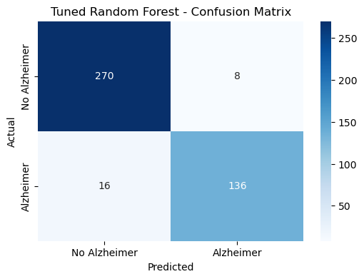
21
Final Model Evaluation
Tuned Random Forest performance on the held-out test set
94.42%
94.44%
89.47%
91.89%
Accuracy
Precision
Recall
F1 Score
Evaluation inference
• The tuned model achieved the highest F1 score among all tested models.
• Recall of 89.47% indicates strong identification of Alzheimer’s cases, while maintaining high precision.
• The tuned model was therefore selected as the final deployment model.
Confusion matrix of the tuned Random Forest on the test set.
Alzheimer’s Disease Classification • Machine Learning Project

Slide 22
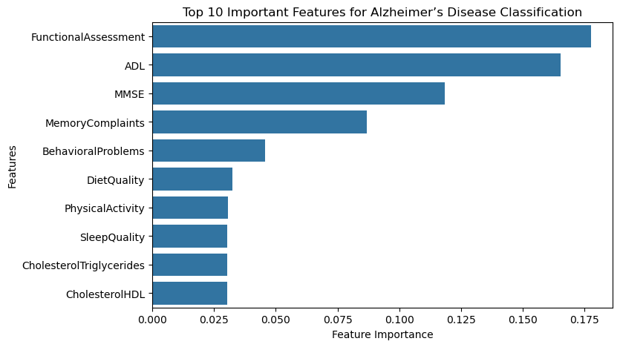
22
Feature Importance
What the final Random Forest relies on most
Top 5 features
FunctionalAssessment
0.1775
ADL
0.1655
MMSE
0.1186
MemoryComplaints
0.0868
BehavioralProblems
0.0456
Inference: cognitive, functional and symptom variables dominate the model’s global feature importance.
Alzheimer’s Disease Classification • Machine Learning Project

Slide 23
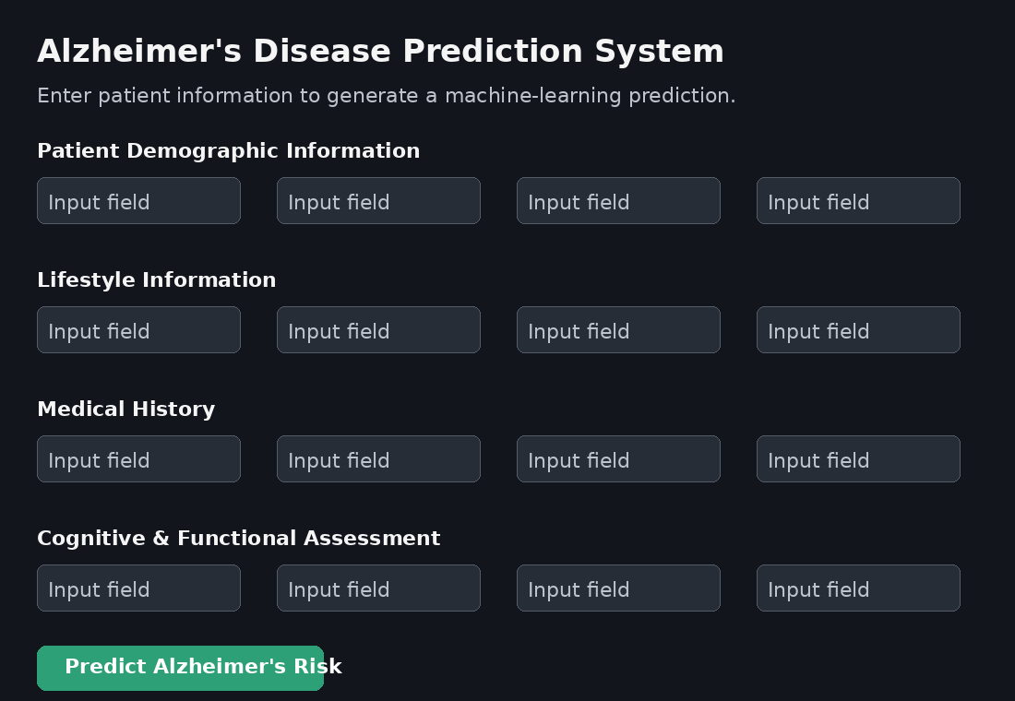
23
Streamlit App Page
Interactive interface for entering patient information and generating a prediction
App capabilities
• Patient demographic inputs
• Lifestyle and medical history
• Blood pressure & cholesterol
• Cognitive and functional scores
• Symptoms and behavioral indicators
• Prediction: lower / higher likelihood
• Prediction probabilities
UI shown as an editable presentation mock-up of the deployed Streamlit workflow.
Alzheimer’s Disease Classification • Machine Learning Project

Slide 24
24
Challenges Faced During the Project
Practical challenges and how they were addressed
Data understanding
Many variables span demographics, clinical measurements, symptoms and assessments.
Grouped features and used target-focused EDA.
Class imbalance
Diagnosis 0 has more observations than Diagnosis 1.
Used stratified train-test splitting and F1-focused tuning.
Model comparison
Different algorithms require different assumptions and preprocessing.
Scaled inputs for Logistic Regression/KNN; tree models used raw features.
Model selection
Strong baseline performance still needed validation after tuning.
Used GridSearchCV and selected the tuned Random Forest.
Deployment consistency
The app must supply features in the exact trained order.
Saved feature_names.pkl alongside the trained model.
Alzheimer’s Disease Classification • Machine Learning Project

Slide 25
Thank You
Alzheimer’s Disease Classification
Final takeaway
The tuned Random Forest provided the strongest overall classification performance and was integrated into an interactive Streamlit application.
Thank you for your time and consideration.

