Slide 1
Multi-Tier Web Application on AWS
PRESENTED BY: Vanapalli Prasanth Kumar
Tools: AWS EC2, RDS, VPC, Flask, Python

Slide 2
Table of content
Introduction
Architecture Diagram
Aws Services Used
Security Best Practices
Step-by Step Workflow
Application Features
Conclusion

Slide 3
introduction
The project demonstrates how to build a multi-tier architecture using AWS services — without spending a single rupee. The main idea is to separate the frontend (Flask app) and backend (MySQL database) across different subnets, just like in enterprise deployments. This architecture is designed to follow real-world cloud and DevOps best practices using only AWS Free Tier resources.

Slide 4
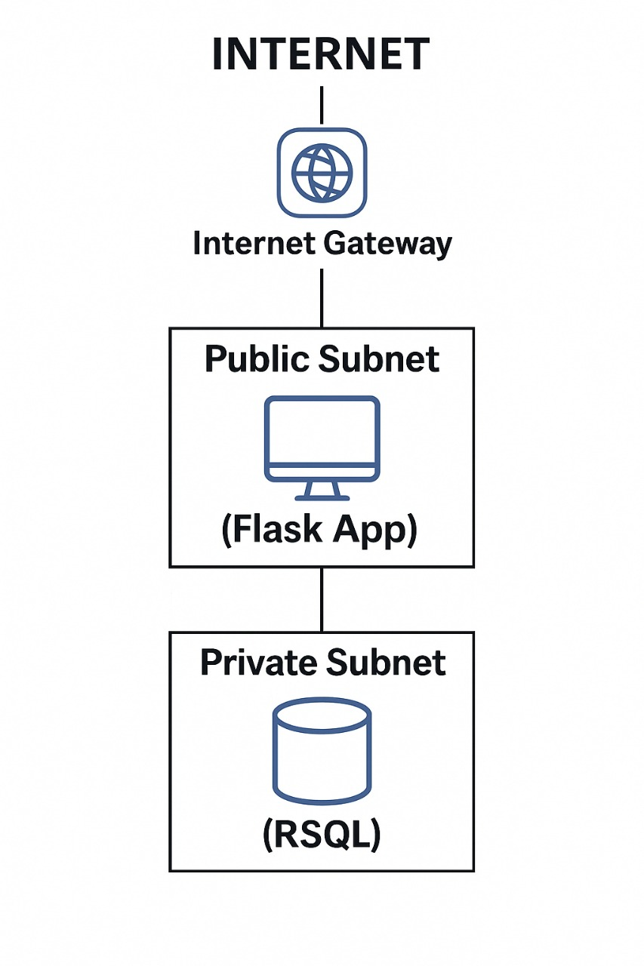
Architecture Diagram
The EC2 instance running the Flask app is deployed in a Public Subnet, while the MySQL RDS database is securely placed in a Private Subnet. Communication between them is strictly managed through security groups, and internet access is controlled via an Internet Gateway and route tables.

Slide 5

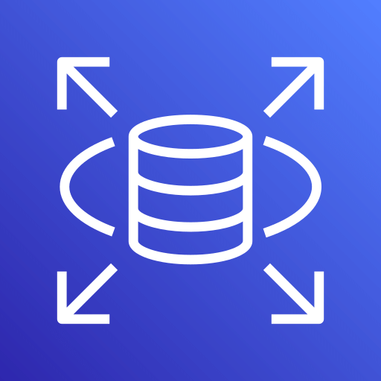
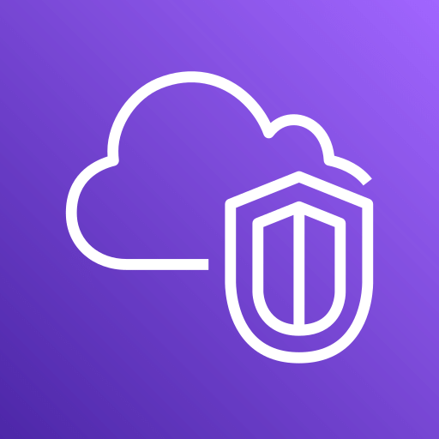
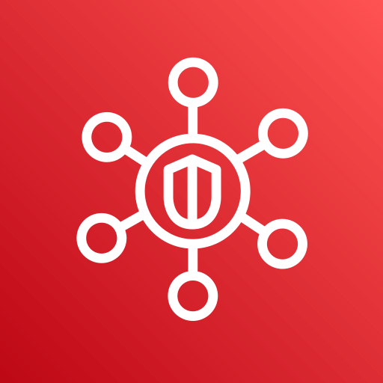
AWS Services Used
EC2: Hosts Flask App
RDS (MySQL): Backend Database
VPC: Private cloud network
Subnets: Isolate components
Security Groups: Secure communication
Internet Gateway: Public access for EC2

Slide 6
Security Best Practices
RDS in Private Subnet – not exposed to internet
EC2 allows HTTP & SSH from specific IP ranges only
RDS allows connections only from EC2's Security Group
No Elastic IP / NAT – 100% Free Tier

Slide 7
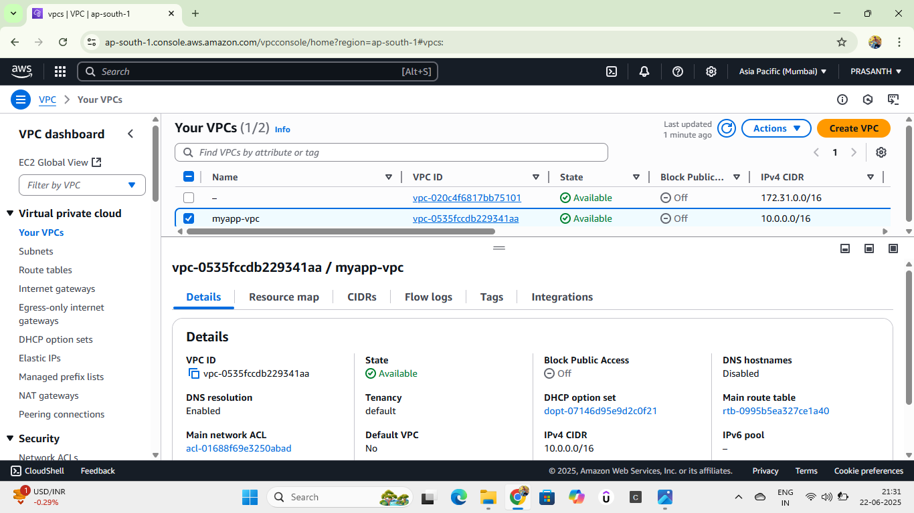
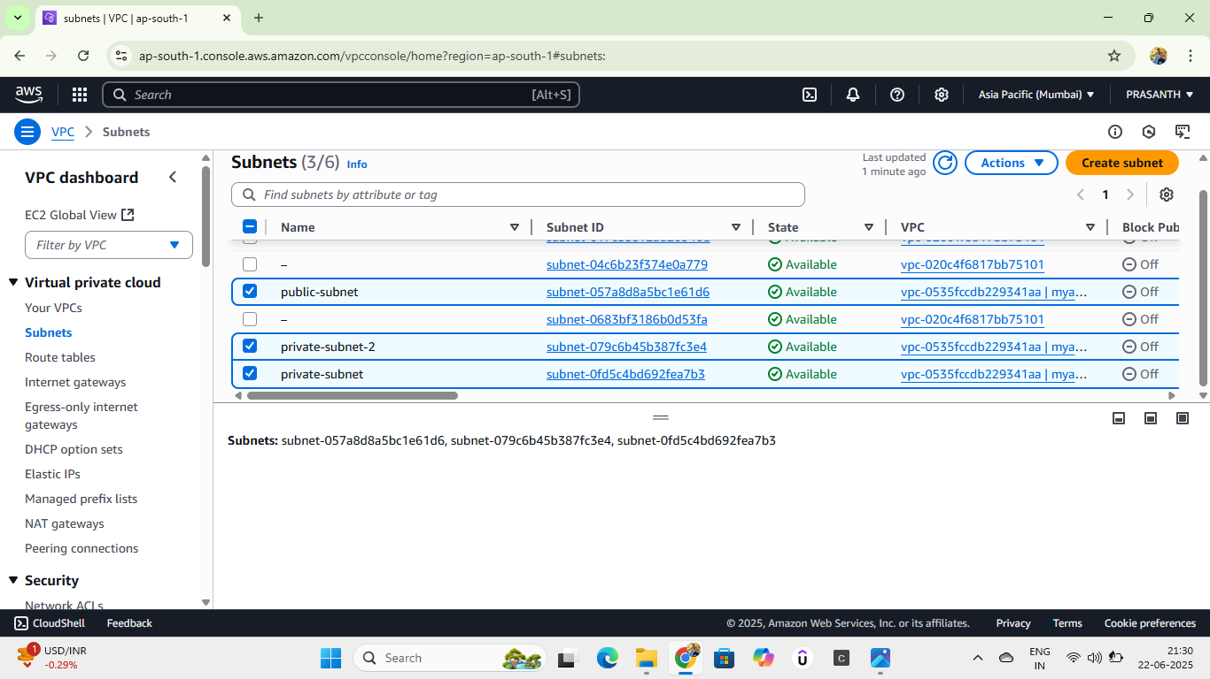
Step-by-Step Workflow
Step-1:
Create VPC, subnets, route tables, and internet gateway
VPC INSTANCE
SUBNETS

Slide 8
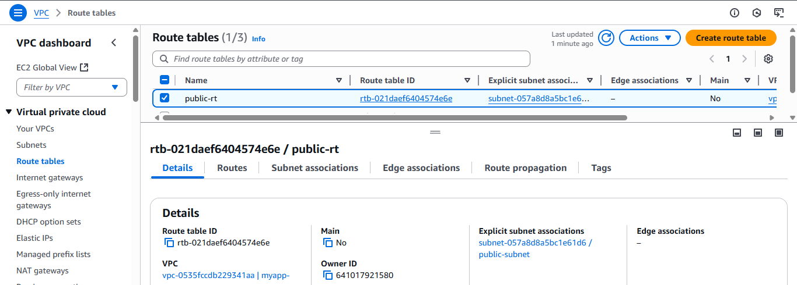
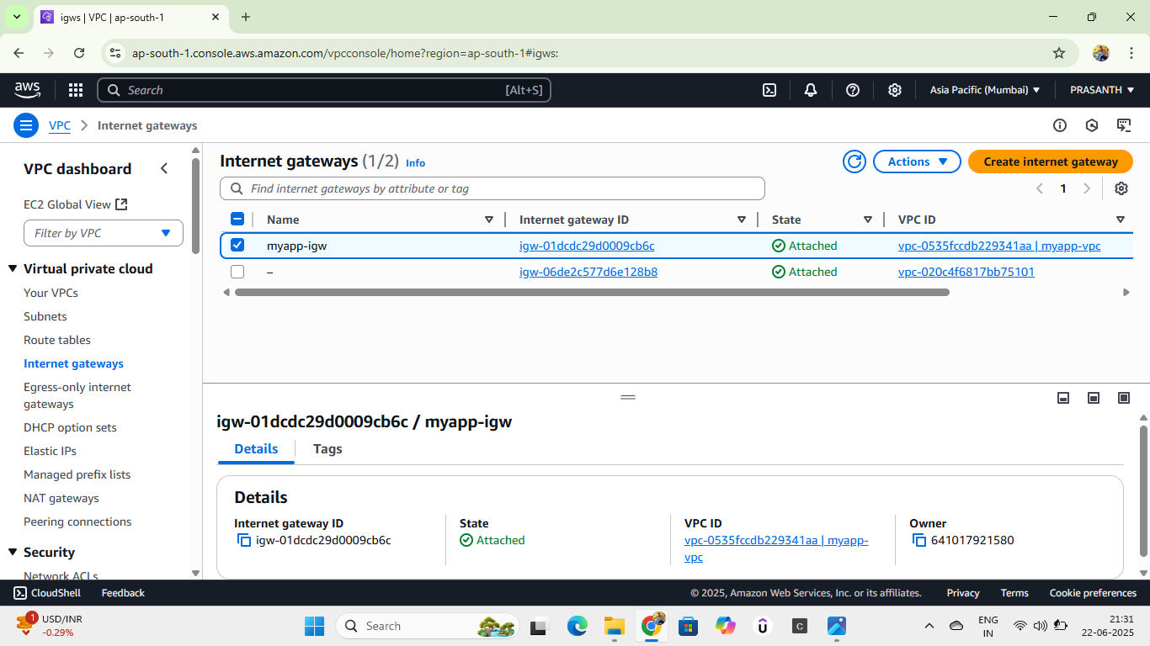
ROUTE TABLES
INTERNET GATEWAY

Slide 9
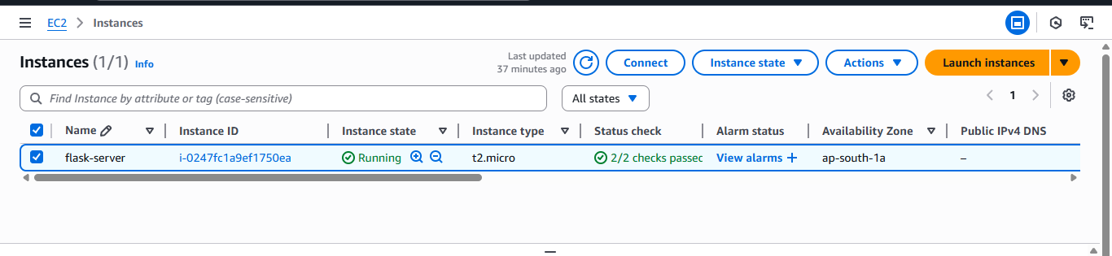
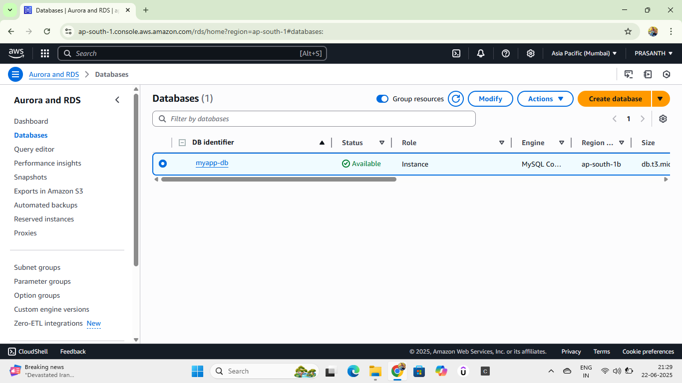
Step-2:
Launch EC2 instance in the public subnet
Install Python , Flask and the MySQL Client
EC2 INSTANCE
Step-3:
Launch RDS MySQL instance in the private subnet
Configure security groups for secure connections
RDS DATABASE

Slide 10
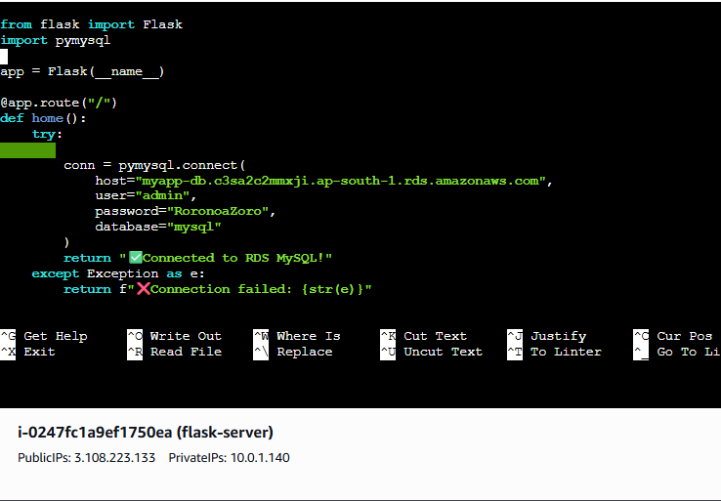
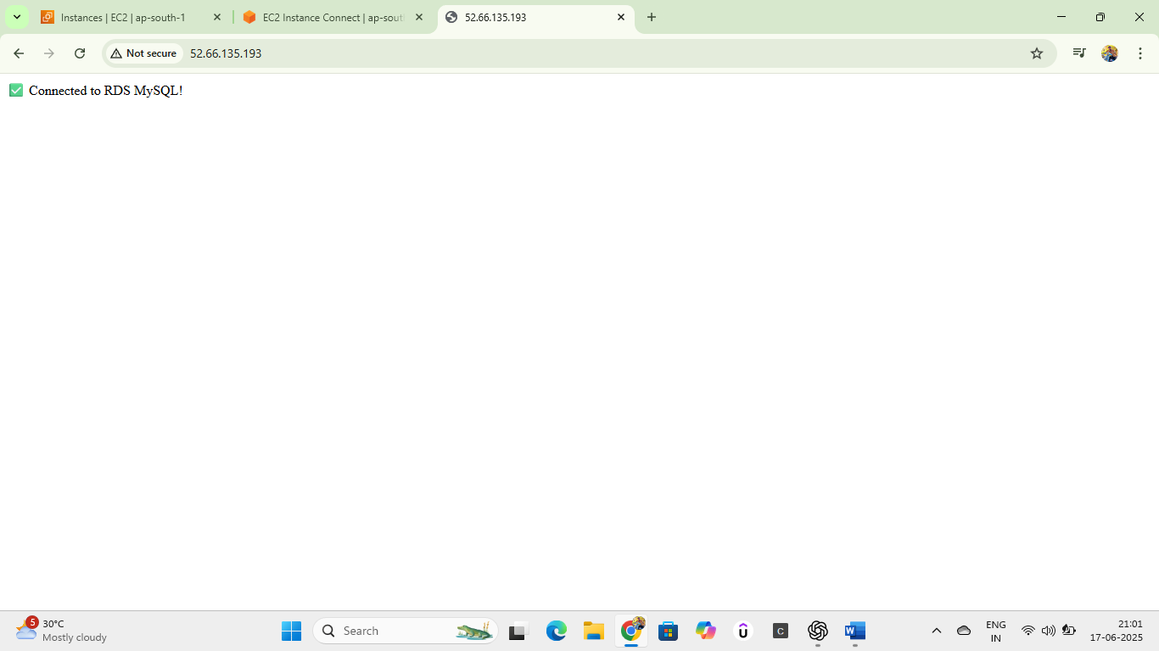
Step-4:
Test and access the Flask app from the browser
Flask App code
OUTPUT

Slide 11
Application Features
Flask app hosted on EC2
Connects securely to MySQL database on RDS
Displays message on successful DB connection
Can be extended with forms, auth, and CRUD features

Slide 12
Conclusion
Successfully deployed a real-world web application architecture on AWS using only Free Tier
Followed best practices for cloud networking, security, and application deployment. resources.
Built a scalable foundation for future cloud-based projects and DevOps automation.

Slide 13
Thank you

