Slide 1


Department of Computer Science and Engineering
DYNAMIC TRAFFIC FLOW REGULATION
Mrs. M. Divya M.E
Asst.Professor,
Dept of CSE,
Rajalakshmi Engineering College
Prasanth D (2116220701199)

Slide 2
Problem Statement and Motivation
Traffic congestion in urban areas is a major issue due to increasing vehicle density and fixed signal timings. Traditional systems do not adapt to real-time traffic conditions, causing inefficiency. This project addresses the problem using a reinforcement learning-based traffic signal control system. The model learns through trial-and-error and adapts signal timings based on vehicle density and congestion patterns. Simulation is conducted using SUMO to replicate real-world traffic scenarios.

Slide 3
Existing System
Conventional systems use fixed-timing traffic lights, which are inefficient during peak and off-peak hours. No adaptation to real-time vehicle flow. Manual signal management or pre-defined schedules often result in long wait times and bottlenecks. Lack of data-driven decision-making results in poor traffic throughput.

Slide 4
Objectives
To develop a reinforcement learning model for adaptive traffic signal control.
To train the model using trial-and-error to minimize vehicle waiting time.
To simulate real-world scenarios using the SUMO traffic simulator.
To reduce congestion and improve throughput at traffic intersections.

Slide 5
Abstract
This project proposes a machine learning-based traffic management system focused on optimizing signal timings at road intersections. It employs reinforcement learning to train an agent that interacts with a simulated traffic environment via SUMO. The system takes real-time traffic density as input and adapts signal phases to minimize congestion and delays. Through continuous interaction and reward-based updates, the model learns to make efficient decisions. The approach is tested under various traffic conditions, showing improvement over static scheduling methods. This system aims to make urban traffic control intelligent, responsive, and scalable.

Slide 6
Proposed System
The proposed system uses reinforcement learning, specifically trial-and-error learning, to dynamically manage traffic light durations.
Facilitates communication between the RL model and the SUMO simulation.
Simulates real-world traffic flow for training and testing. Learns which lane to prioritize based on vehicle congestion.

Slide 7
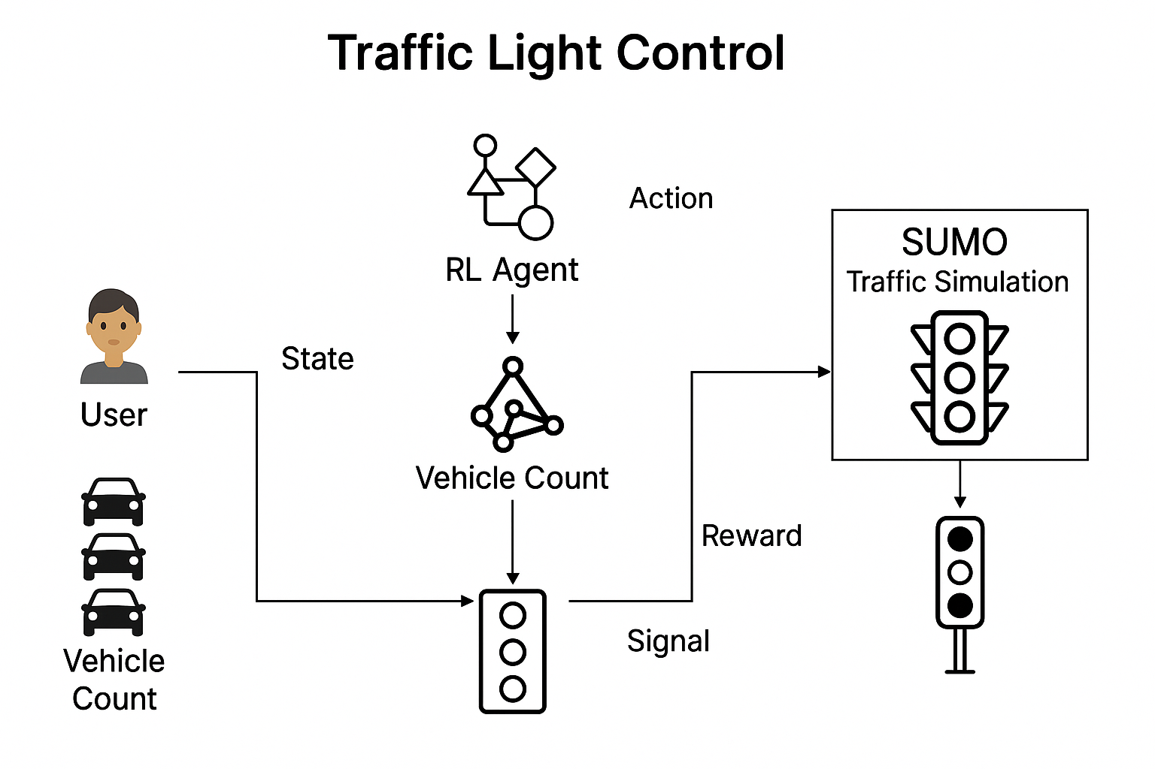
System Architecture

Slide 8
List of Modules
Data Collection & Preprocessing: Collects vehicle count and lane data from SUMO, prepares it for model input.
Reinforcement Learning Agent: Implements Reinforcement-learning to decide optimal actions.
Simulation Interface Module: Connects Python agent with SUMO using SUMO-NETEDIT for environment interaction.
Signal Decision Module: Determines which traffic signal should be green based on learned policy.
Evaluation Module: Tracks metrics like total waiting time per epochs and signal efficiency.

Slide 9
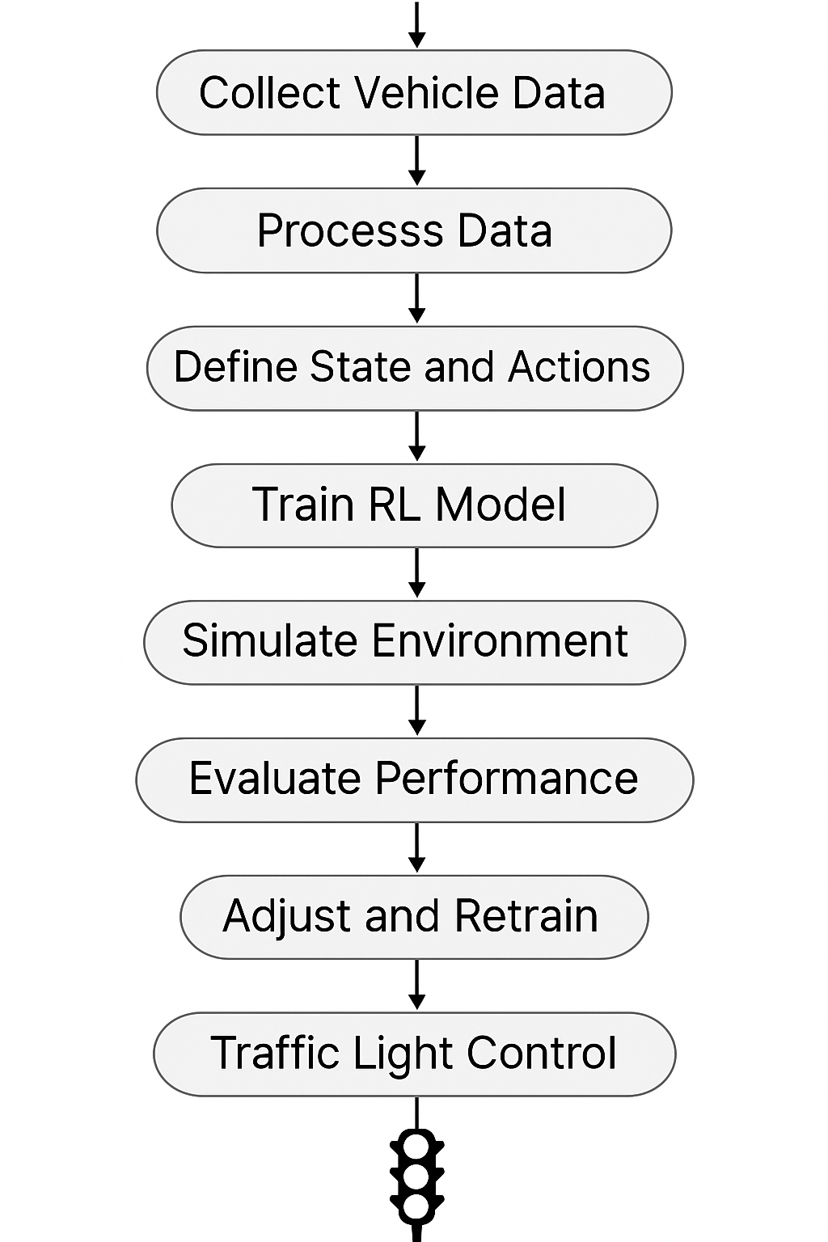
Functional Description for each modules with DFD and Activity Diagram

Slide 10
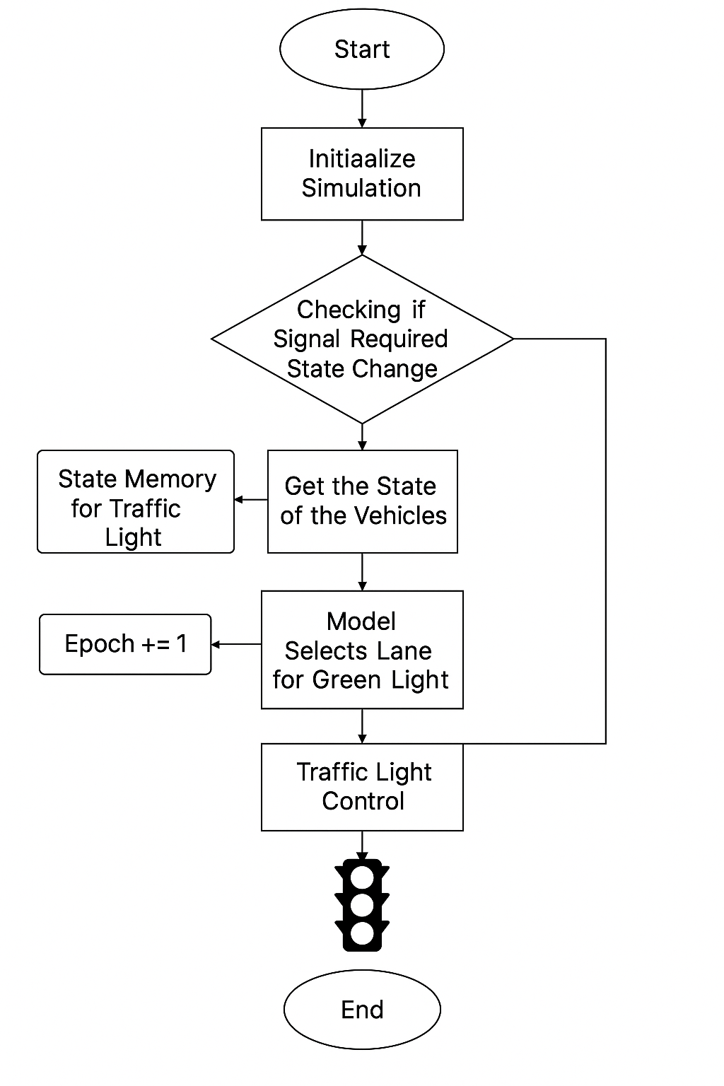
Functional Description for each modules with DFD and Activity Diagram

Slide 11
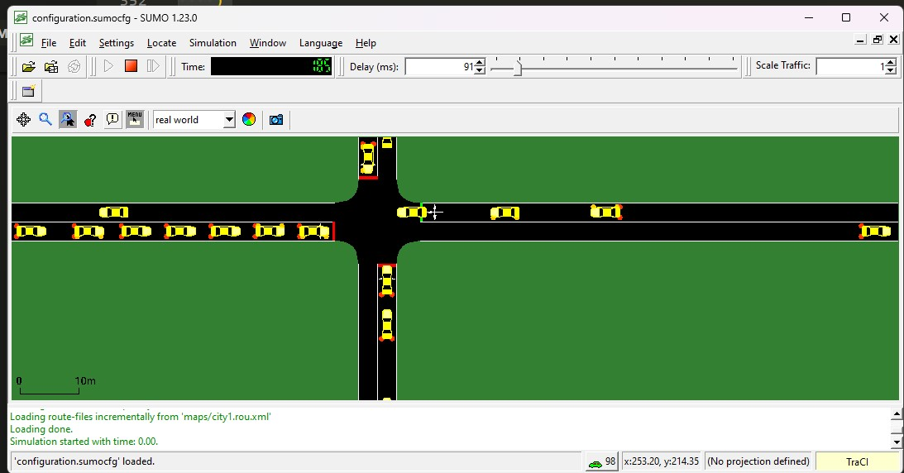
Implementation & Results of Module

Slide 12
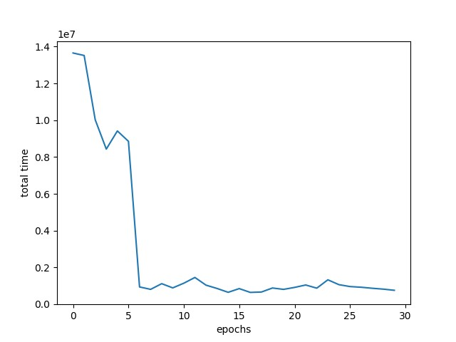
Implementation & Results of Module

Slide 13
Conclusion & Future Work
The dynamic traffic light management system developed in this project successfully applies reinforcement learning to adaptively manage urban traffic signals. By interacting with a simulated environment through SUMO and learning from vehicle congestion patterns, the model efficiently reduces average waiting time and enhances traffic throughput. Unlike traditional fixed-timer systems, the reinforcement learning-based approach demonstrates adaptability, scalability, and improved decision-making through trial-and-error learning. The agent continually updates its strategy based on real-time traffic states, resulting in smoother traffic flow and more efficient signal phase transitions across varying traffic conditions.

Slide 14
References
Wu et al. (2019) - Reinforcement Learning for Traffic Signal Optimization
Wei et al. (2022) - Real-time Traffic Management using RL and Sensor Data
SUMO Official Documentation - https://www.eclipse.org/sumo/
Sutton & Barto - Reinforcement Learning: An Introduction

Slide 15
Thank You

