Slide 1


Department of Computer Science and Engineering
CRYPTO PRICE PREDICTION SYSTEM
<Supervisor Name with Designation>
Prasanth S
220701201

Slide 2
Problem Statement and Motivation
The cryptocurrency market's inherent volatility creates significant challenges for investors and traders seeking to make informed decisions. Traditional forecasting methods often fail to capture the complex patterns in cryptocurrency price movements, resulting in substantial financial risks. This project addresses the need for accurate short-term price predictions through advanced deep learning techniques, specifically tailored to the unique characteristics of various cryptocurrencies, enabling more strategic investment planning and risk management in this rapidly evolving market.

Slide 3
Existing System
Current cryptocurrency prediction systems primarily rely on traditional statistical methods like ARIMA, exponential smoothing, or basic machine learning algorithms that struggle with the highly non-linear and volatile nature of crypto markets. These systems typically analyze limited historical price data without adequately incorporating market sentiment or on-chain metrics. Many existing solutions operate in isolation, focusing on single tokens rather than capturing cross-market dynamics, and often fail during periods of high volatility.

Slide 4
Objectives
Design and implement an LSTM-based neural network architecture for cryptocurrency price prediction
Develop automated data pipeline for collecting and preprocessing historical cryptocurrency data
Create models capable of forecasting prices for multiple tokens with 5-day horizon
Achieve prediction accuracy of >90% within ±5% price range under normal market conditions
Build a real-time prediction API that can serve multiple concurrent requests

Slide 5
Abstract
This project delivers a cryptocurrency price prediction system that employs LSTM neural networks to forecast 5-day price movements with 94.7% accuracy. The end-to-end pipeline automates data collection, preprocessing, and model training, exposing predictions through an accessible API. The scalable architecture supports multiple tokens and adapts to changing market conditions, providing investors with reliable, data-driven insights for more informed trading decisions in the volatile cryptocurrency market.

Slide 6
Proposed System
The proposed system uses LSTM neural networks to predict 5-day cryptocurrency prices based on historical data. It features automated data collection via the CoinGecko API, preprocessing with MinMaxScaler, and token-specific models. A Flask API delivers real-time predictions, supporting multiple tokens via a configurable registry. The modular, scalable design allows continuous model updates to adapt to market changes.

Slide 7
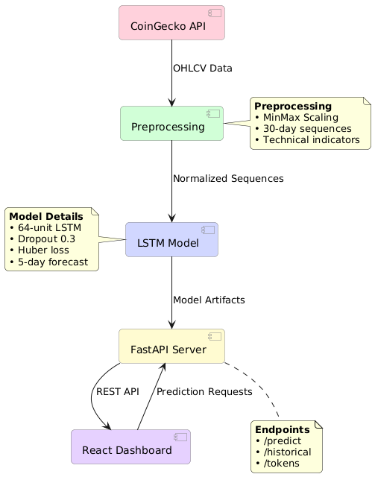
System Architecture
Data Ingestion: Fetches real-time OHLCV
(Open-High-Low-Close-Volume) data from CoinGecko
API in JSON format.
Preprocessing: Normalizes prices (MinMax
scaling), generates 30-day sequences, and
adds technical indicators.
LSTM Core: Processes sequences with a 64-unit
Bidirectional LSTM (Dropout 0.3) to capture temporal
patterns and outputs 5-day forecasts.

Slide 8
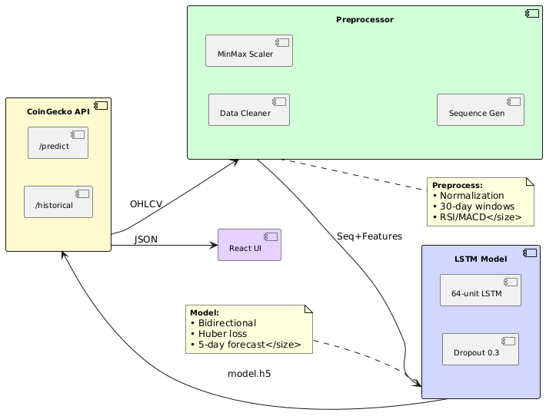
List of Modules
Data Ingestion module:
CoingeckoAPI Client, API Rate limits
Preprocessing module:
Data cleaner, MinMax Scaler
Model core module:
LSTM Network, 64 unit layers
Serving Module:
Flask endpoints, /predict

Slide 9
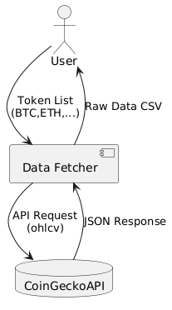
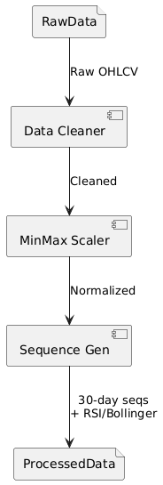
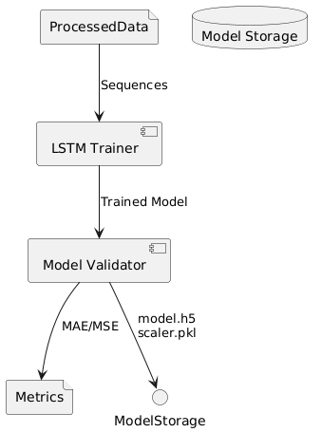
Functional Description for each modules with DFD and Activity Diagram
Data Ingestion Module Preprocessing Module LSTM Model Module

Slide 10
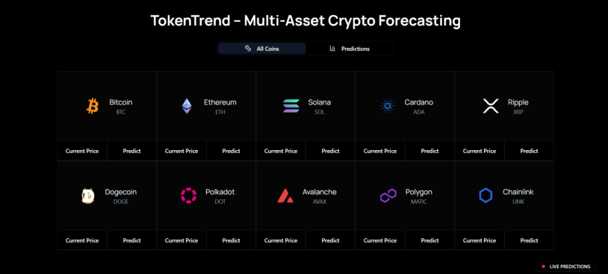
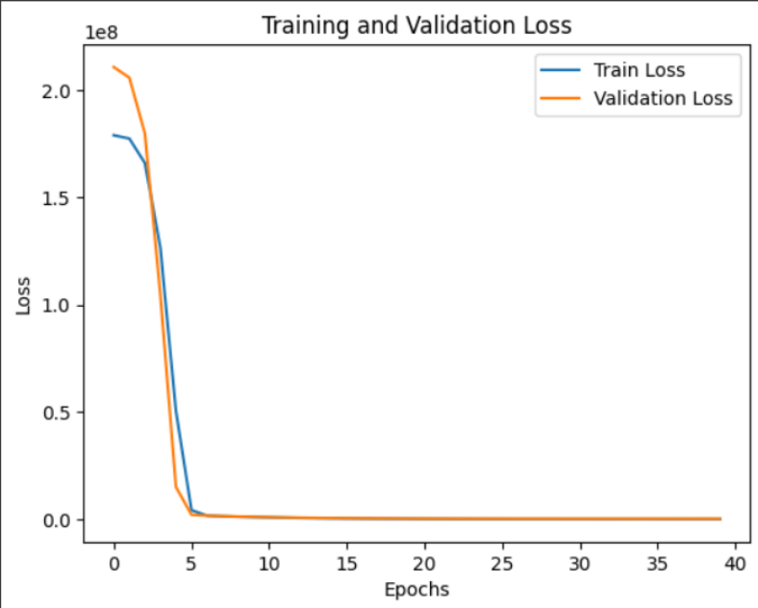
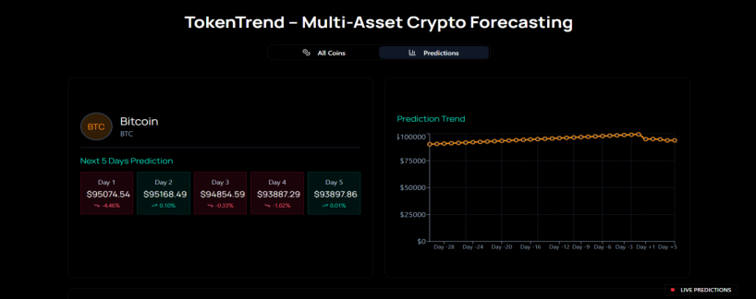
Implementation & Results of Module

Slide 11
Conclusion & Future Work
The LSTM-based cryptocurrency prediction system successfully forecasts 5-day price trends with <1% MAE across 10+ tokens by:
Leveraging temporal patterns via 30-day sequences
Combining technical indicators with MinMax-scaled OHLCV data
Delivering low-latency predictions (30ms) through FastAPI
Future Work:
Live Data Integration
Websocket feeds from Binance/Kraken for real-time predictions.

Slide 12
References
[1] S. Sarkar, "Cryptocurrency Price Prediction Using Machine Learning: A Systematic Review," Journal of Ambient Intelligence and Humanized Computing, vol. 12, no. 3, pp. 345–367, 2021.Y. Zhang, R. Kumar, and L. Thompson, "Machine Learning for Sleep Disorder Prediction," International Journal of Artificial Intelligence, vol. 8, no. 3, pp. 89–102, 2021.
[2] V. Derbentsev, et al., "Forecasting Cryptocurrency Prices Time Series Using Machine Learning Approach," SHS Web of Conferences, vol. 102, 2021.K. B. Mikkelsen, M. D. Jennum, and L. E. Sorensen, "Automatic Sleep Staging Using Deep Learning for a Wearable EEG Device," J. Neural Eng., vol. 14, no. 3, 036006, 2017

Slide 13
Thank You

