Slide 1


EMBEDDABLE LSM-TREE STORAGE ENGINE
DSA 0105-Object Oriented Programming With C++
SIMATS ENGINEERING
SAVEETHA INSTITUTE OF MEDICAL AND TECHNICAL SCIENCES
Presented by (Team No. 8):
Guided by:
Mr. JEGADEESH K
Industrial Professional
Coimbatore
Prasanth R 192421371
Sanjay Kumar D 192421144
Aadhithya V 192511256
Joy Edvin Joshva J 192421219

Slide 2
ABSTRACT
An embeddable key-value storage engine built on the Log-Structured Merge (LSM) tree, written in C++17.
Writes are logged to a checksummed write-ahead log and inserted into an in-memory skip list.
Full MemTables are flushed to sorted, checksummed SSTable files on disk.
A background thread compacts SSTables and swaps an atomic manifest to keep reads fast.
Fault injection, crash tests and a C++ web console verify and expose the engine.
Module 1: MemTable and WAL
Prasanth R
Module 2: SSTable Writer and Reader
Sanjay Kumar D
Module 3: Compaction Engine
Aadhithya V
Module 4: Benchmark and Fault Injection
Joy Edvin Joshva J

Slide 3
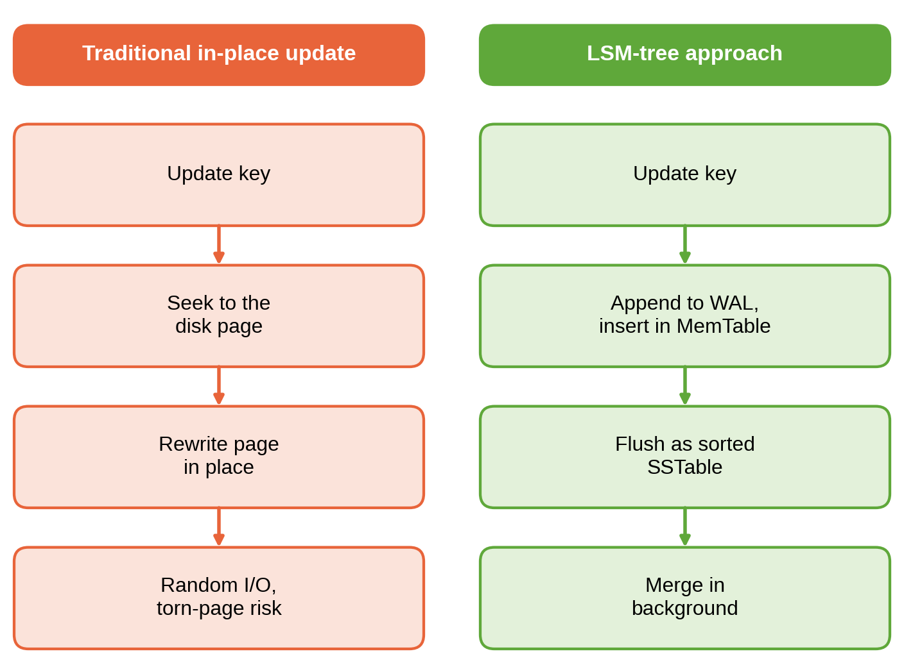
PROBLEM STATEMENT
Write-heavy applications suffer when every update becomes a random, in-place disk write.
A crash in the middle of a write can leave torn data or lose acknowledged writes.
Production storage engines are large and hard to study, test or embed in small programs.
Why it matters: logging, metrics, messaging and edge devices need a small, crash-safe, embeddable store.

Slide 4
OBJECTIVES
1
Build a persistent LSM-tree key-value engine with Put, Get and Delete in C++17
2
Guarantee durability with a CRC32C-protected write-ahead log and crash recovery
3
Store sorted data in checksummed SSTables with a block index and footer
4
Keep reads fast and space bounded using background compaction and an atomic manifest
5
Prove correctness with fault injection, sanitizers, benchmarks and a C++ web console

Slide 5
PROPOSED SYSTEM
Aspect | Existing approach | Proposed LSM engine
Writes | Random in-place page updates | Sequential WAL append plus in-memory MemTable
Durability | Hidden inside large engines, hard to verify | CRC32C-checked WAL, replay and torn-tail truncation
Reads | Single tree lookup | MemTable, then SSTables newest first using index and block CRC
Space | Fragmentation builds up over time | Background compaction drops stale versions and tombstones
Testing | Crash behaviour rarely tested | Fault-injecting file system with seeded crash tests
Result: a small, testable, crash-safe engine with a web console that shows what it is doing

Slide 6
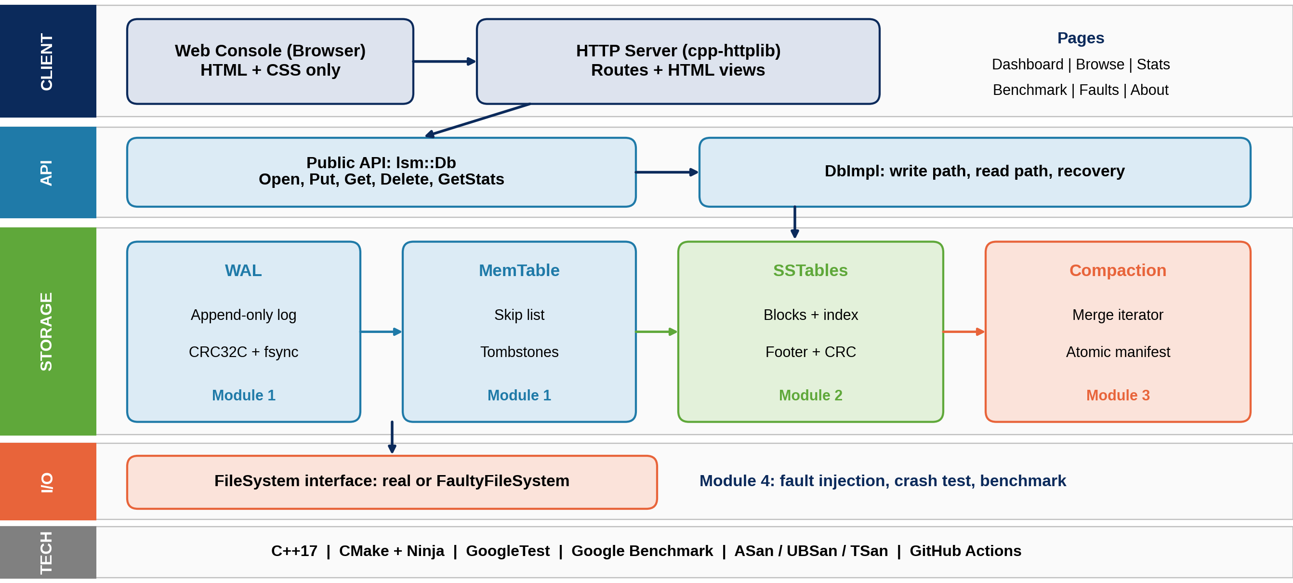
SYSTEM ARCHITECTURE DIAGRAM

Slide 7
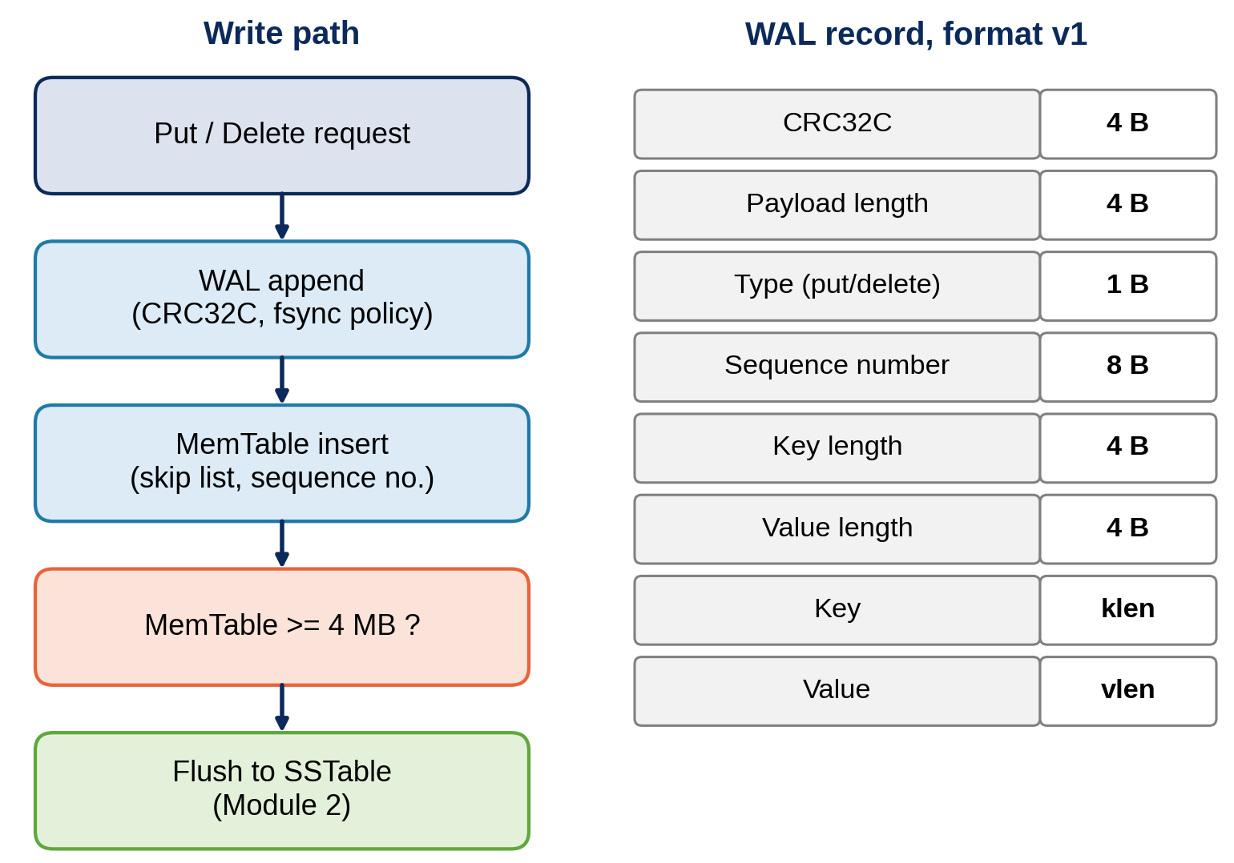
MODULE 1: MEMTABLE AND WAL
Skip list MemTable with ordered iteration and tombstones
Table-driven software CRC32C protects every record
WAL record format v1 with magic header and sequence numbers
Sync policy: every write, every N writes, or never
Recovery replays valid records and truncates a torn tail

Slide 8
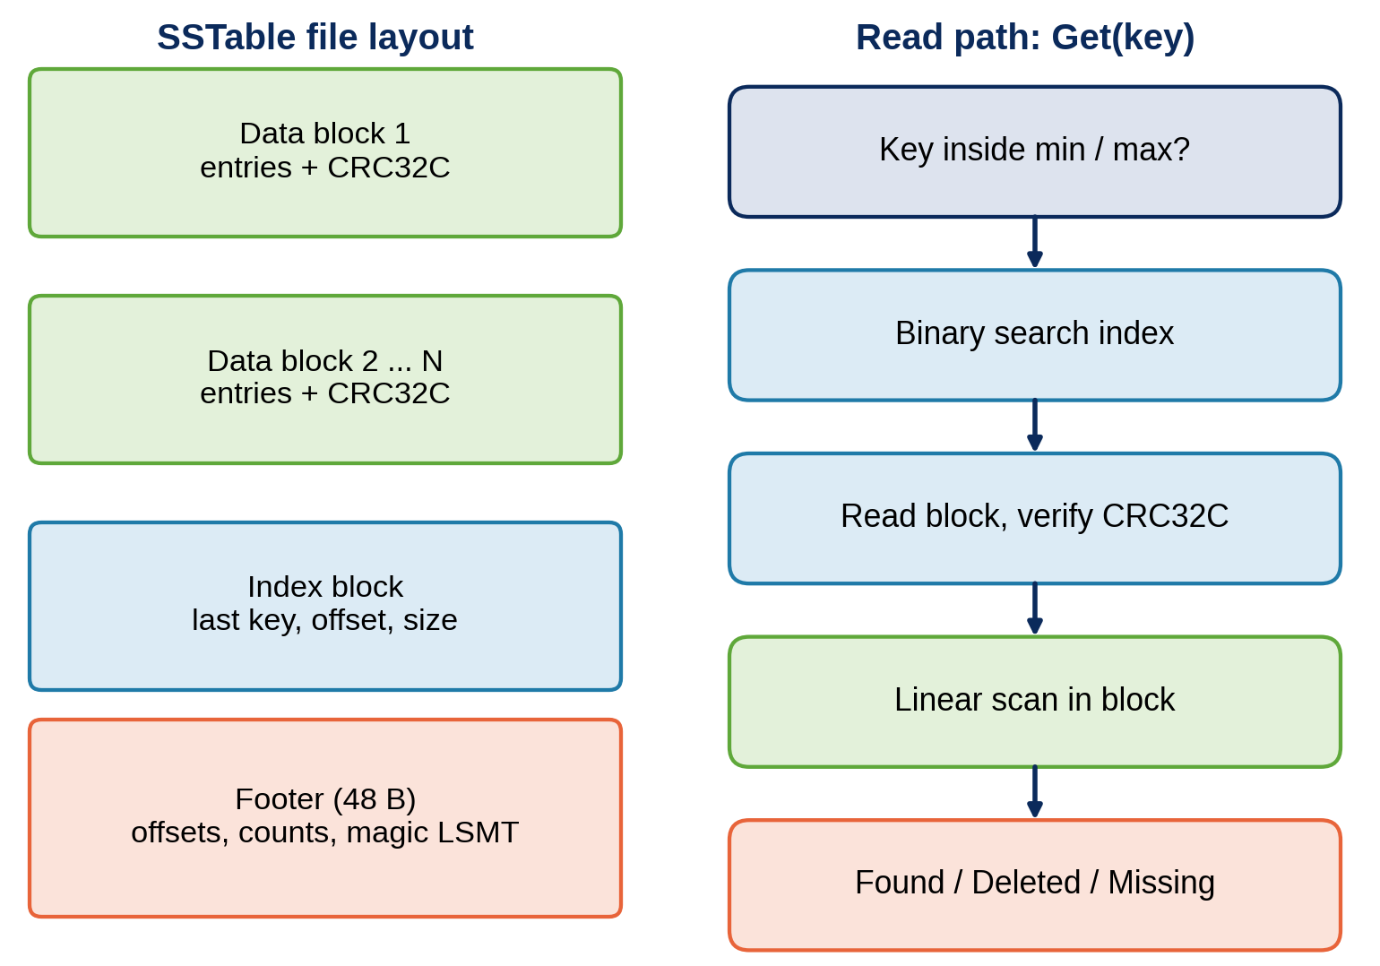
MODULE 2: SSTABLE WRITER AND READER
Writer emits data blocks, an index block and a 48-byte footer
Every block carries a CRC32C; corruption is reported
Reader binary searches the index by last key
Min and max keys skip files without any block read
Iterator for full scans; MemTable flush uses the writer

Slide 9
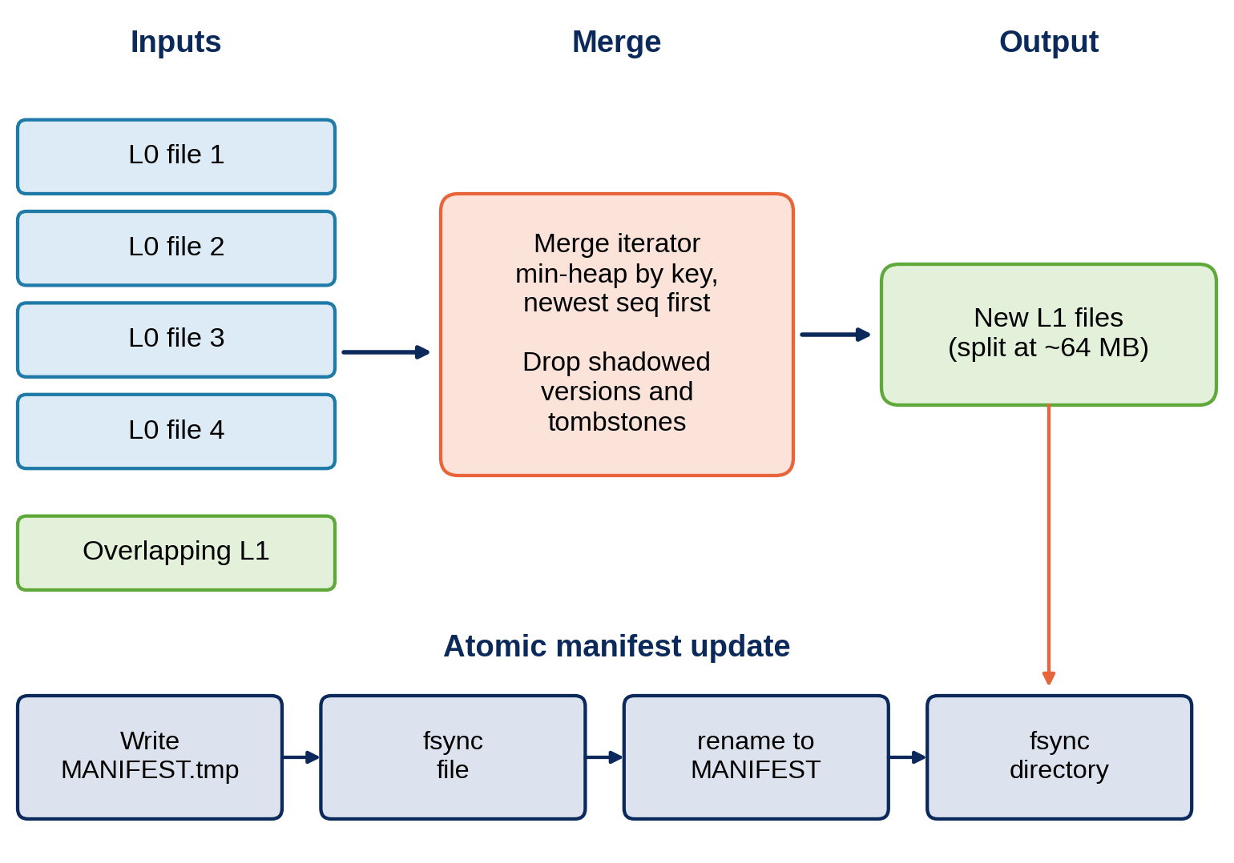
MODULE 3: COMPACTION ENGINE
Manifest lists live SSTables per level and is swapped atomically
Merge iterator uses a min-heap: key order, newest sequence first
Level 0 compacts when it reaches the file limit (default 4)
Tombstones dropped only at the deepest level for the key range
Background thread; readers use shared_ptr snapshots

Slide 10
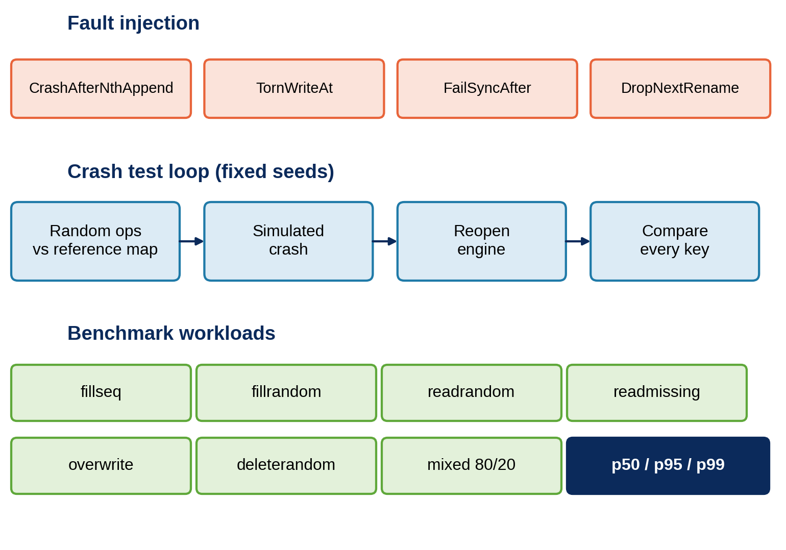
MODULE 4: BENCHMARK AND FAULT INJECTION
FileSystem interface lets faults be injected under the engine
Crash tests compare the reopened engine with a reference map
Every failing run prints its seed so it can be replayed
Google Benchmark micro tests plus end-to-end workloads
Reports p50, p95 and p99 latency as CSV and Markdown

Slide 11
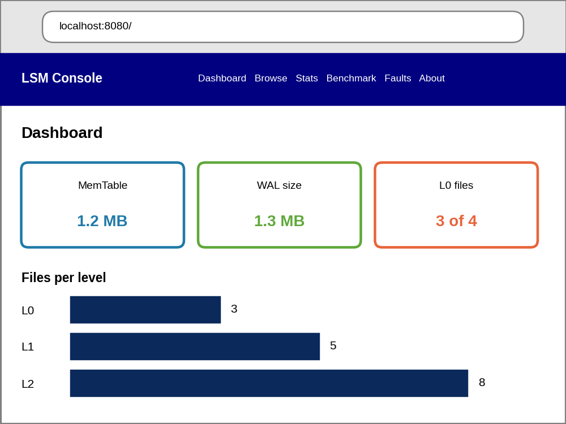
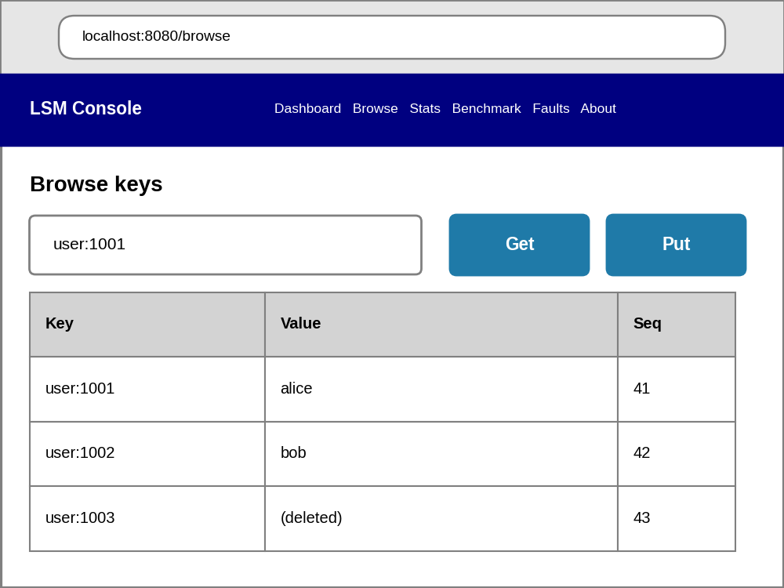
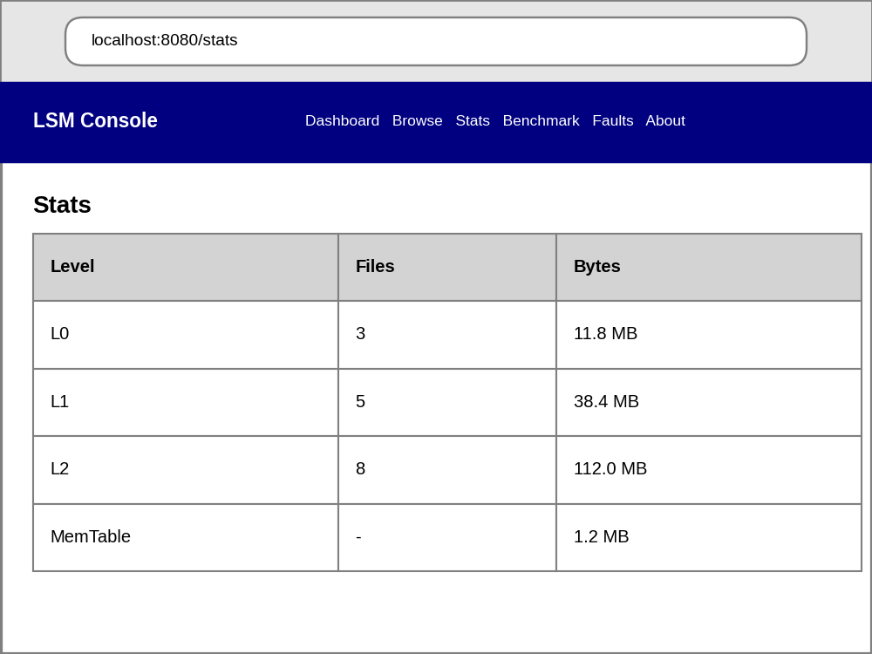
SAMPLE OUTPUT
Dashboard
MemTable, WAL and level summary
Browse
Get and Put by key; deleted keys shown
Stats
Files and bytes per level
Server-rendered C++ console (HTML and CSS only), responsive from phone to desktop. Sample data shown.

Slide 12
ADVANTAGES
1
Crash-safe
2
Fast writes
3
Integrity checks
Checksummed WAL replay restores every acknowledged write
Sequential appends and in-memory inserts avoid random disk I/O
CRC32C on WAL records, blocks, index and manifest detects corruption
4
Bounded space
5
Verifiable
6
Embeddable and open
Background compaction removes stale versions and tombstones
Seeded crash tests, sanitizers and an 80 percent coverage target
Small C++17 library with a clean Db API, built with free open-source tools

Slide 13
CONCLUSION
The C++17 engine combines a checksummed WAL, skip-list MemTable, SSTables and background compaction.
Crash safety is verified with fault injection and seeded crash tests, not assumed.
A C++-only web console and benchmark harness make behaviour visible and measurable.
Outcome: a small, testable, documented storage engine that the team can extend.
4
12
modules, one per team member
week development plan
80%
1000
line coverage target
seeded crash runs planned

Slide 14
THANK YOU

