Slide 1
TITLE:
“Resilient Farming with Climate-Based Crop Guidance”

Slide 2
Submitted by :
Redg no Name
221FA04096 Abhi
221FA04128 Yaswanth
221FA04155 Sai Kiran
221FA04421 Prasanth
221FA04451 Prince Kumar

Slide 3
Abstract :
Agriculture is the main source of income in rural India and has been positively contributing to the nation’s GDP. However, the crop produced per hectare in this country is less than the global average, causing misery to farmers, who even take their own lives the marginal farmers are no exception.This research seeks to tackle these challenges by developing a climatebased crop recommendation system powered by machine learning.The system uses critical field inputs, including temperature, soil moisture, nutrient levels (NPK), pH, and rainfall, the system indicates potential crops to help farmers make databased decisions about using the right crop choice Of the three machine learning algorithms taken- Decision Tree, Random Forest, and Logistic Regression, the highest accuracy was found in Navie Bayes, which reached a peak of 99.54%.Besides this, farm practice also has changed with technological advancement. Mechanization and precision agriculture ensure that crop production yields quality and increases yield. A further development of the model provides a machine learning model that relies upon climatic variability and recorded weather to generate recommendations specific to the location for crops. Intermingling weather patterns with crop performance leads to better yields and sustainable agriculture practices. Future iterations of this could include other variables like soil conditions and market Index Terms—Data pre-processing, Min-Max scaler,Grid search ,Machine Learning, Logistic Regression, Random Forest, XG-Boost Algorithm Algorithm, Accuracy.

Slide 4
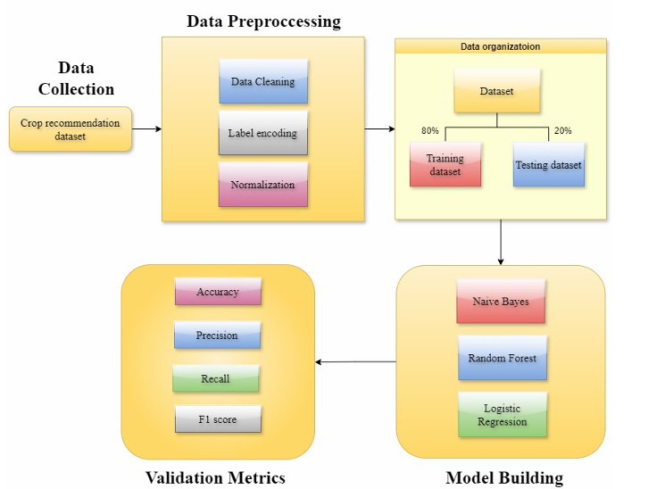
Proposed Architecture:

Slide 5
Introduction :
Motivation :
Agriculture remains the backbone of the rural economy in India and significantly contributes to the nation's GDP. However, the crop yield per hectare in India lags behind the global average, which has led to challenges for farmers, particularly small-scale and marginal farmers. This situation has, at times, led to dire outcomes, including farmers taking their own lives due to financial distress. With advancements in technology, there is an opportunity to address these issues by providing farmers with data-driven insights to make more informed decisions about crop selection. The motivation behind this project is to develop a system that can offer resilient farming solutions by utilizing climate-based crop guidance, thereby improving agricultural productivity and supporting farmers' livelihoods.

Slide 6
Problem Definition/Research Gaps :
Traditional farming practices often rely on experience and general advice, which may not account for specific local environmental conditions and changes. This leads to inefficient use of resources and suboptimal crop yields. While some tools exist for crop recommendation, they may not comprehensively consider critical factors such as soil nutrients, climate variability, and weather patterns. This project aims to bridge this gap by developing a climate-based crop recommendation system that integrates environmental and soil parameters to suggest the most suitable crops. By applying machine learning techniques, the system will predict potential crops, helping farmers to optimize their practices and improve crop yield sustainably.

Slide 7
Literature review :
Pachade, R. S. [1] further claims that these are now finding increased usage in agricultural yield predictions of crops and pest detection. These include methods like decision trees and neural networks that scan large databases with much higher accuracy than traditional methods. Growth of crops is dependent upon the weather conditions; therefore, weather-based models are developed. While earlier systems were general crop recommendation systems, the current ML-based system considers particular weather, soil, and historical information to provide a relevant recommendation, being dynamic and assisting farmers in making an informed decision.
Shams, M.Y., Gamel, S.A. & Talaat [2] Crop recommendation systems can include recent advancements in using machine learning to help farmers with decision making. For example, Shams et al. (2024) proposed the XAI-CROP, where the algorithm is also transparent, primarily based on the use of the principles of eXplainable Artificial Intelligence (XAI). Trained on Indian crop data, XAI-CROP utilizes an integrated decision tree model that employs Local Interpretable Model-agnostic Explanations (LIME) to give understandable recommendations. It achieved a higher accuracy with a low MSE of 0.9412 and an R2 value of 0.94152, thus enhancing the transparency in the way AI-driven agricultural decisions are made. This research underscores the role of interpretation in machine learning models.
Mahale et al. [3] have also designed a crop recommendation and forecasting system for Maharashtra state by using machine learning techniques, such as the combination of LSTM models with a novel expectation-maximization approach. The system increases the accuracy of crop predictions with multifactorial approaches in agriculture, including climatic and soil settings. This research highlights the requirements for advanced machine learning methodology in crop yield advancement and effective farmers’ decision-making. To learn more, you can read the full article

Slide 8
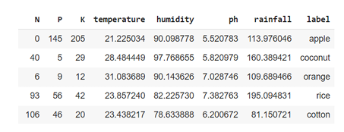
Data Collection :
Input Dataset : The dataset used for building the predictive model consists of a collection of environmental and soil data points. Each data point contains values of various parameters essential in 11 recommending the right crop for the specific conditions.
Detailed Features of the Dataset
The dataset features include:
• N (Nitrogen content in soil): Represents the amount of nitrogen available for the crop.
• P (Phosphorus content in soil): Represents the amount of phosphorus available for the
crop.
• K (Potassium content in soil): Represents the amount of potassium available for the
crop.
• Temperature (°C): The atmospheric temperature at the location.
• Humidity (%): The level of moisture in the air.
• pH: Soil acidity or alkalinity level, which affects nutrient availability.
• Rainfall (mm): The amount of rainfall received.
• Label: The target variable, representing the crop type recommended for the given
conditions.
Each of these features is directly related to the suitability of crops and is key to building an
accurate predictive model.

Slide 9
Data Preprocessing :
Preprocessing was an essential step to make the dataset suitable for machine learning models:
1) Handling Missing Data: Missing values were handled through mean imputation to ensure a complete dataset for training.
2) Feature Scaling: The Min-Max Scaler was applied to normalize the data, scaling all feature values between 0 and 1. This ensures that no feature with larger numerical ranges disproportionately influences the model.
3) Label Encoding: By giving each category a unique number, label encoding transforms categorical data input into a format that machine learning models can understand. The algorithm is able to handle non-numerical data in this fashion. Because categories are handled independently, they do not inherently imply an ordinal relationship between them. In order to enable the model to operate with categorical features while preserving the true meaning of the data for accurate learning and prediction, the labels are converted to numeric values

Slide 10
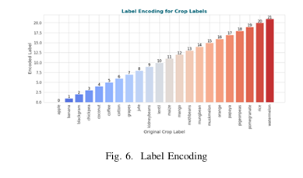
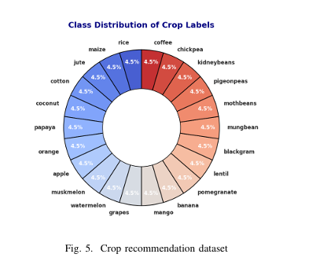

Slide 11
Model selection :
1) Navie bayes: This method emphasizes the overall prob ability of the data for a given class rather than identifying what features are most distinguishing between classes.
2) Random Forest: Random Forest generates many decision trees and predicts the mode of their classifications for detection purposes.
3) Bagging: The method of training many models sep arately using various random subsets of the information is known as ”bagging,” or bootstrap aggregating. The predictions of these models are subsequently combined by voting or averaging. heir classifications for detection purposes.
4) Gradient Boosting: Gradient Boosting was the technique we utilized to learn from misclassified examples to enhance the model’s capacity for prediction.

Slide 12
5) K-Nearest Neighbour’s: KNN, or k-Nearest Neighbor’s, is one of the most intuitive and simple non-parametric, instance-based algorithms used both in classification and re gression in machine learning. The main idea from which KNN sets off is that those data points, which should be similar to each other, lie close to each other in the feature space.
6) Support Vector Machine: It is used in an N-dimensional space. It looks to find the optimal line or hyperplane that maximizes the distance to each class.
7) Logistic Regression : Logistic regression predicts the output of a categorical dependent variable. Therefore the outcome must be a categorical or discrete value. It can be either Yes or No, 0 or 1, true or False, etc. but instead of giving the exact value as 0 and 1, it gives the probabilistic values which lie between 0 and 1.

Slide 13
Model Evaluation :
1) Confusion Matrix: A confusion matrix is essential in machine learning as it evaluates the effectiveness of classification models. It compares the predicted classes with the actual classes, summarizing the model’s effectiveness by presenting counts of true positive(TP), true negative(TN), false positive(FP), and false negatives (FN)
2) Precision: Precision measures how often the correctly predicted positive cases actually are. Precision defines the ratio of true positive cases to the total number of cases that have been classified as such.
3) Recall: Recall is an evaluation of how good the model is in picking out all the actual positives from the total positive count. It represents how well it can classify frauds.
4) F1-Score: These two parameters are measured in a balanced manner by the F1-score. When there are unequal class distributions, it is quite helpful.
5) Accuracy: The effectiveness of a classification model in identifying items is measured by its accuracy. It can be expressed as follows: It is defined as the ratio of successfully predicted instances to all instances in the dataset.

Slide 14
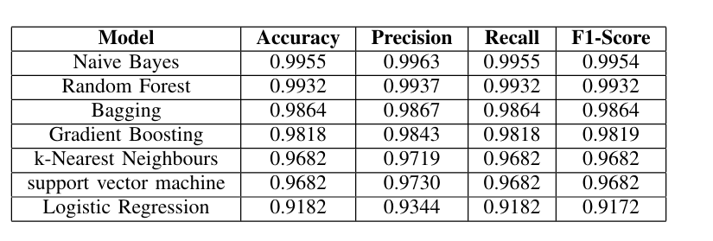
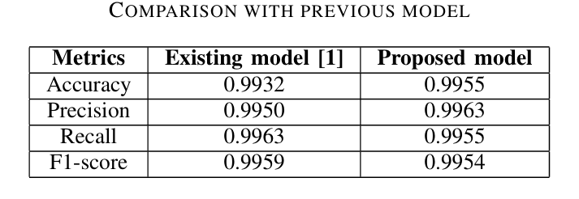
Results :

Slide 15
Conclusion :
The creation of a crop recommendation system based on machine learning has great potential to increase agricultural productivity by enabling farmers to make well-informed se lections depending on particular soil and climate conditions. The usefulness of several machine learning algorithms is demonstrated in this work, with special attention paid to the Random Forest model, which attained an astounding accuracy rate of 99.54%. Such a high degree of accuracy suggests that the model can offer pertinent and trustworthy crop recommendations.
This task provides huge opportunities for increasing agricul tural productivity to the extent that help farmers make their in formed decisions based on specific soil and climate conditions. So, the research explores several machine learning algorithms focusing on the Random Forest model in detail, and the best accuracy rate reached is 99.54%. Such a great accuracy of the model means appropriate crop recommendations.
Looking ahead, there is potential for further development of this system by incorporating additional factors such as real-time soil health metrics, market dynamics, and pest man agement strategies. By continuously adapting to new data and technological advancements, the crop recommendation system can significantly contribute to enhancing farmers’ decision-making processes, promoting sustainable agricultural practices, and fostering resilience in the agricultural sector as a whole.

Slide 16


