Slide 1
“Event Management System” UNDER THE GUIDANCE OF MR.SK. Badar Saheb
Batch : 04
Sec : 3A
221FA04113 – SIKHINAM MERCY
221FA04135 - MADIRA SRILATHA
221FA04178 - V. Mohan Rajasekhara Reddy
221FA04421- TUTA PRASANTH

Slide 2
ABSTRACT :
The Event Management System is a comprehensive digital platform designed to streamline the planning, execution, and analysis of events across various domains such as educational institutions. By automating traditional manual processes, the system enhances efficiency, scalability, and accuracy in event coordination.
Key features include event creation, participant registration, role-based access control, real-time communication through notifications, and user-friendly interfaces.
The platform also emphasizes data management, enabling organizers to analyze event performance through reports and feedback. With robust security protocols and modern technologies, the system ensures data privacy, user satisfaction, and continuous improvement in event management practices.

Slide 3
PROBLEM DEFINITION
In the modern era, individuals seeking to participate in events, particularly hackathons and other competitions, face difficulty finding relevant events tailored to their location and interest. Additionally, event organizers struggle to manage user registrations, event updates, and post-event notifications. This creates inefficiency, missed opportunities for participants, and operational overhead for event organizers.
The need arises for a unified platform where:
Users can find events.
Users can register for events easily.
Admins can manage and update events and users seamlessly.
This problem requires a solution that centralizes event discovery, registration, and management in one accessible platform

Slide 4
Challenges & Need for an Automated Solution
Challenges
Lack of centralized event listings based on user preferences.
Manual event registration processes.
Difficulty for organizers to manage attendees and update event details.
Need for an Automated Solution
A centralized, automated platform solves these problems by:
Displaying events based on location, category, and date.
Allowing users to register effortlessly.
Giving organizers tools to manage events and users.
This increases engagement, improves communication, and reduces operational burden.

Slide 5
OBJECTIVE
The goal of this platform is to address the problems by providing an event management system with the following objectives:
Event Discovery & Registration:
Users should be able to search, filter, and register for events based on parameters like location, event type, and timing.
Event Management for Admins:
Admins should have a dashboard to add, update, and delete events. They should also be able to manage event registrations and send notifications to users.
Personal Dashboard for Users & Admins:
Users should have a dashboard to track their event registration, participation status.
Admins should be able to access analytics on event participation, user registrations.

Slide 6
SCOPE :
1. Functional Scope:
For Users: Discover, search, and register for nearby events (hackathons, workshops, etc.). Access a personalized dashboard .
For Organizers: Create and manage events, view analytics, and promote events.
For Admins: Approve events, manage users, and monitor platform performance.
2.Business Scope:
Revenue from event promotions, sponsorships, ads, and premium subscriptions.
Collaboration with companies and educational platforms for affiliate partnerships.

Slide 7
3. Technical Scope:
Responsive UI for mobile and desktop.
Secure backend with scalable database (MongoDB or SQL).
API integrations for maps, payments, and notifications (e.g., Google Maps, Stripe, SendGrid).
4. Target Audience:
- Students, developers, tech enthusiasts, and event organizers
5. Geographic Scope:
- Start locally, then scale globally with multi-language support.
6. Future Enhancements:
- AI-powered recommendations.
- Virtual participation and live streaming.
- Community networking features like forums.

Slide 8
SOFTWARE REQUIREMENTS SPECIFICATION
Functional Requirements
User Registration and Login:
Users must be able to register and log in with secure credentials (email or social media).
Users should be able to recover/reset passwords.
Event Search and Filtering:
The platform must support an intuitive event search based on parameters like date and event type.
search result should display event descriptions, dates, locations, and other relevant details.
Event Registration:
Users must be able to register for an event by filling out a form with necessary details (e.g., contact info, preferences).

Slide 9
User Dashboard:
A personal dashboard for users to view:
Events they have registered for.
Event participation status (completed, upcoming).
Admin Dashboard:
Admins can create, edit, and delete events.
Admins can view the list of users who have registered for each event.
Notification System:
Notifications should be sent to users about:
Event registration confirmation.
Analytics and Reporting for Admins:
Admins can view reports and analytics on user participation, event registrations, and event outcomes.
Event Completion & Status Updates:
Once an event is completed, users should automatically be notified about their participation results.

Slide 10
Non-Functional Requirements
Performance:
The system should respond to user actions (e.g., search, registration) within 2-3 seconds.
The platform should handle up to 10,000 simultaneous users during peak times.
Scalability:
The platform must be able to scale horizontally (add more servers) to handle increased load as more events and users join.
Security:
User credentials and event data must be securely stored and encrypted using industry-standard protocols (e.g., HTTPS, bcrypt).
The platform should implement role-based access control (RBAC) to restrict access to admin and user functionalities.
Usability:
The platform should have an intuitive, user-friendly interface.
Users should be able to register and search for events easily without requiring training.
Availability:
The platform should maintain 99.9% uptime, ensuring minimal downtime during maintenance.

Slide 11
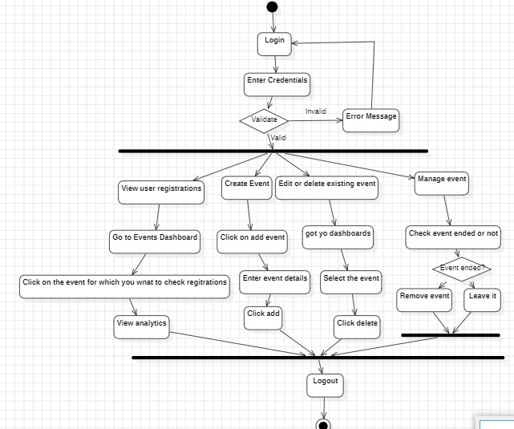
SYSTEM ARCHITECTURE & MODELING
Activity Diagram

Slide 12
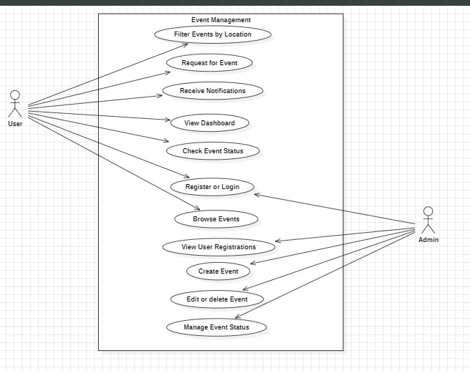
Use Case Diagram

Slide 13
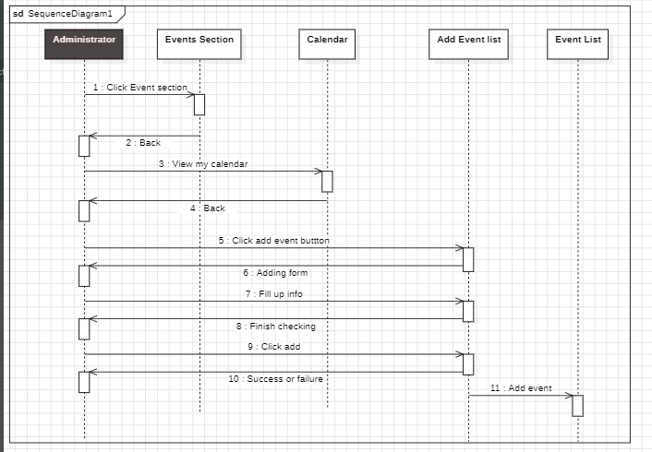
SEQUENTIAL DIAGRAM

Slide 14
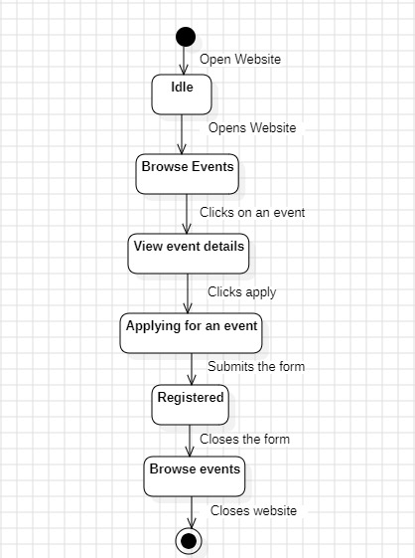
State chart DIAGRAM

Slide 15
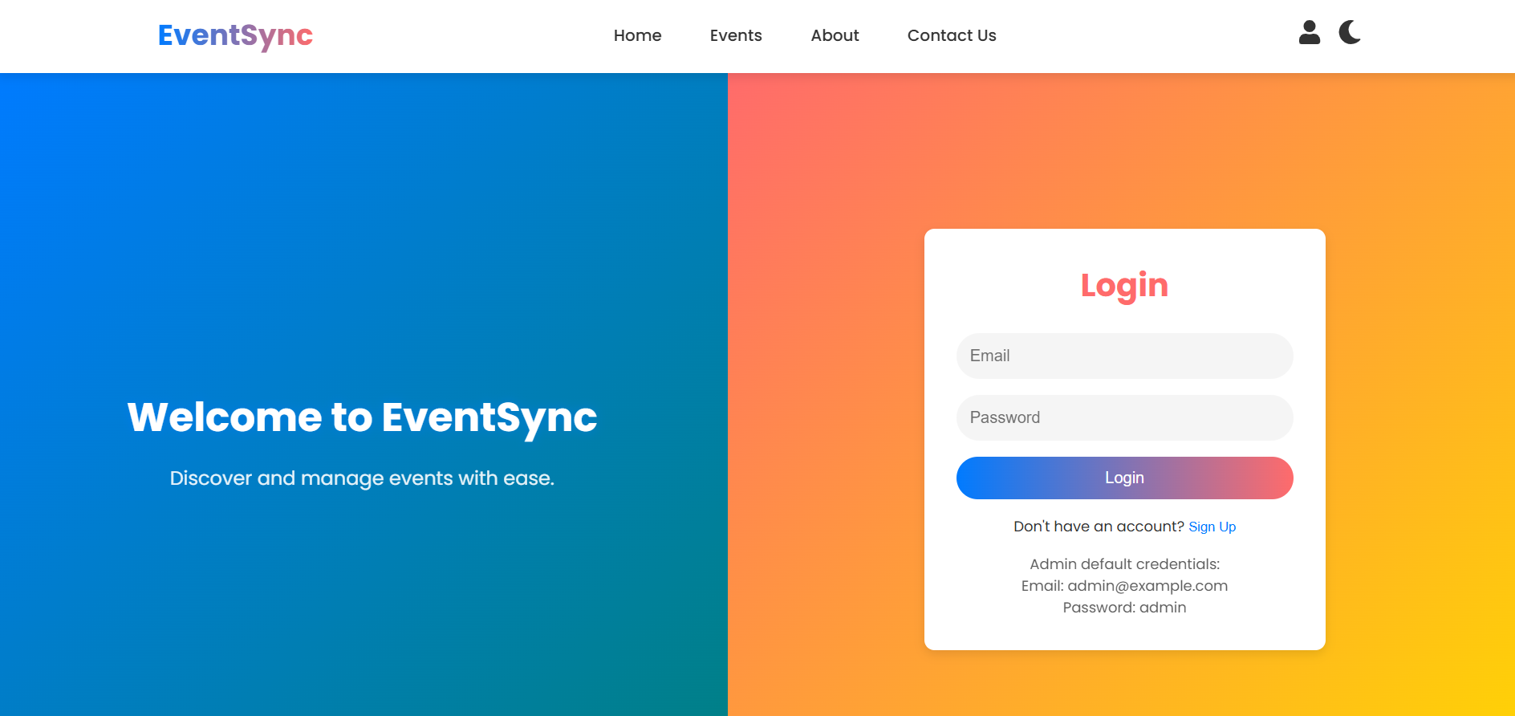
Login/sign up page

Slide 16
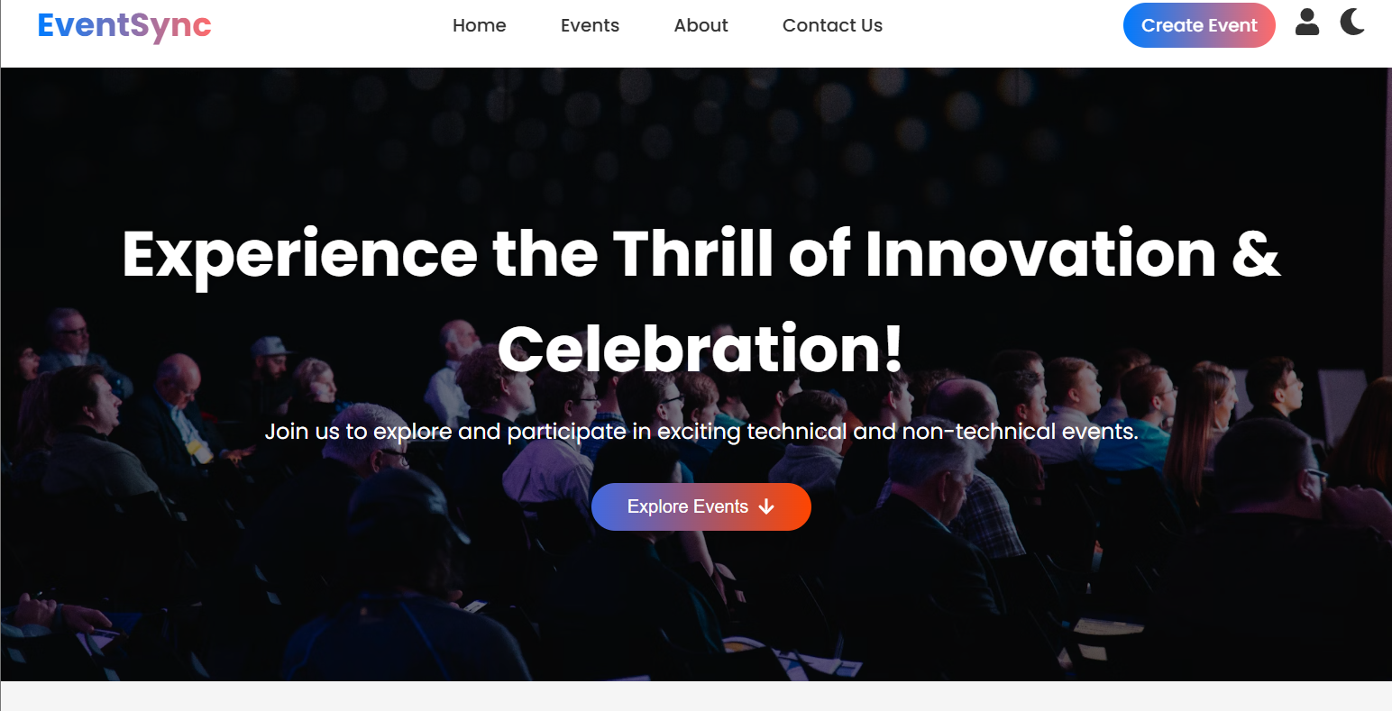
Home Page

Slide 17
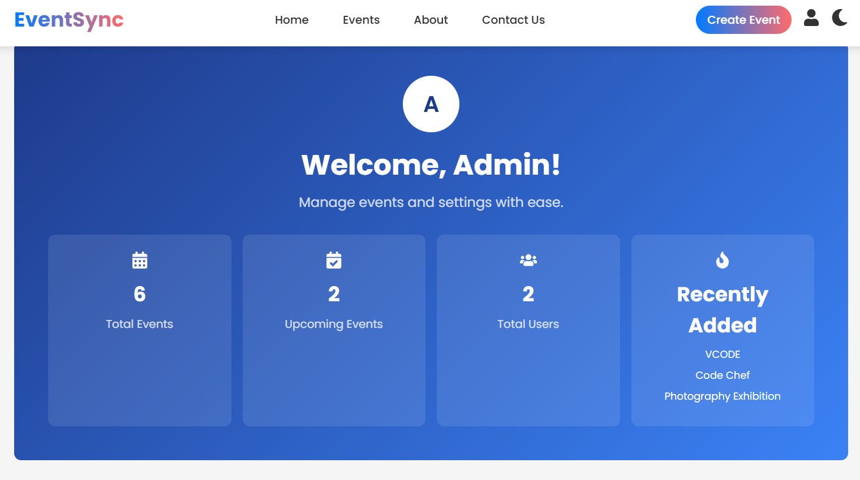
Admin Dashboard

Slide 18
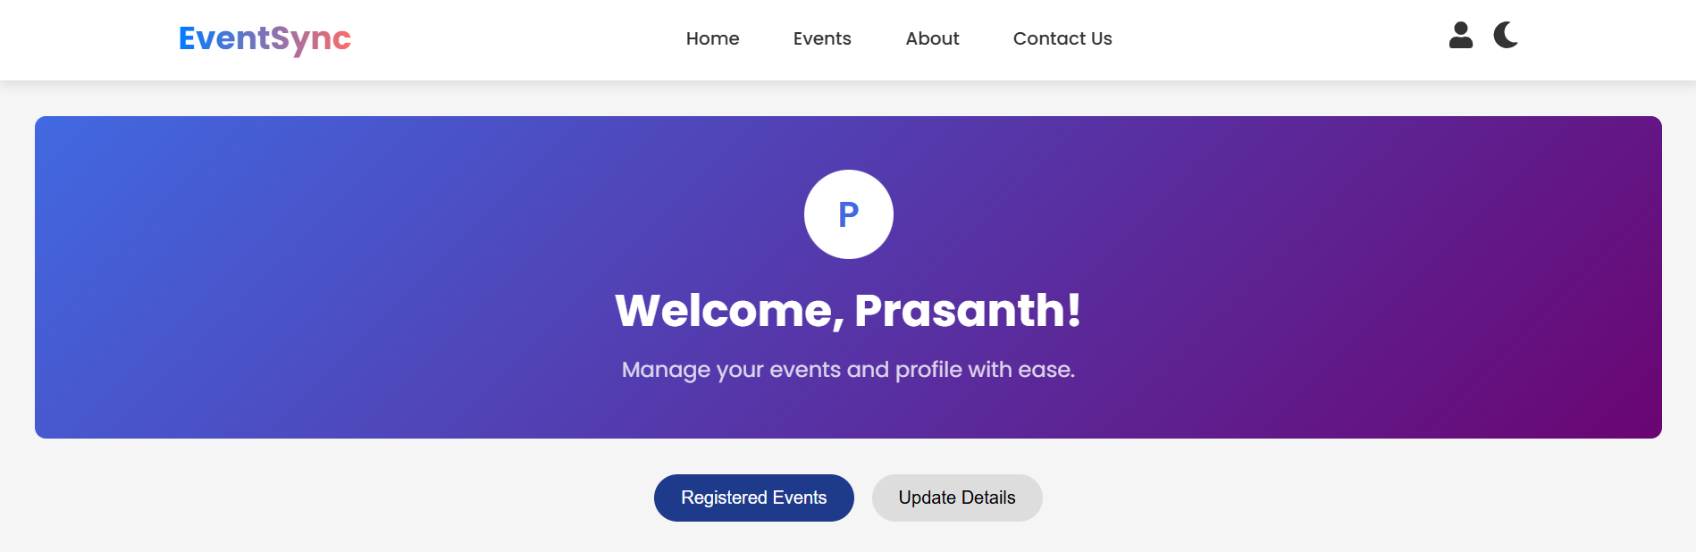
User Dashboard

Slide 19
Conclusion
The event discovery and management platform effectively addresses the major challenges faced by both event participants and organizers. By centralizing event listings, enabling seamless registration, and automating notifications, the system enhances the overall user experience and streamlines event operations. The platform not only reduces manual effort but also increases participation by making relevant events more accessible. With its scalable architecture and user-friendly interface, this solution lays the foundation for future improvements and broader adoption in the event ecosystem.

