Slide 1
TASK-3
ENTERING/SOLVING A GIVEN WEBSITE USING BURPSUITE

Slide 2
REPORT
Load the burp-batch-report-generator-[VERSION].jar file in the Burp Suite "Extender" tab.
When ready to generate reports, navigate to the new "Batch Scan Report Generator" tab.
Select the output format for the reports that will be generated (HTML or XML).
Select whether to generate reports for all hosts or only hosts set in the Target->Scope tab.
Select whether to merge HTTP and HTTPS into one host report, or to have separate reports for both
If the option is selected, one report will be generate

Slide 3
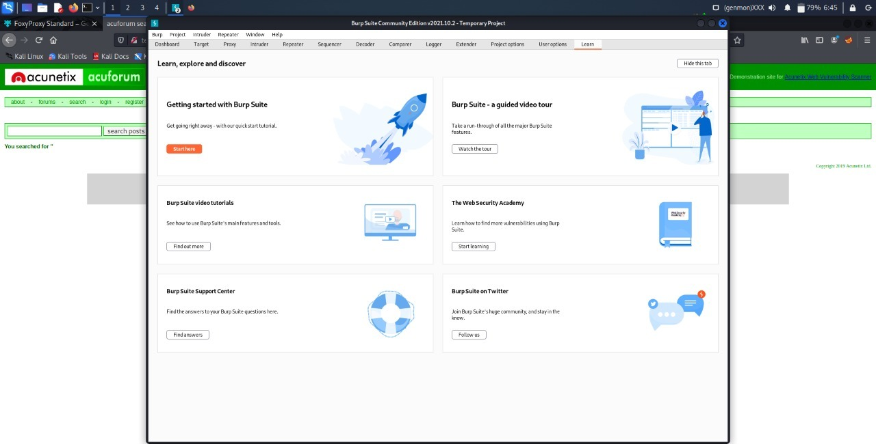

Slide 4
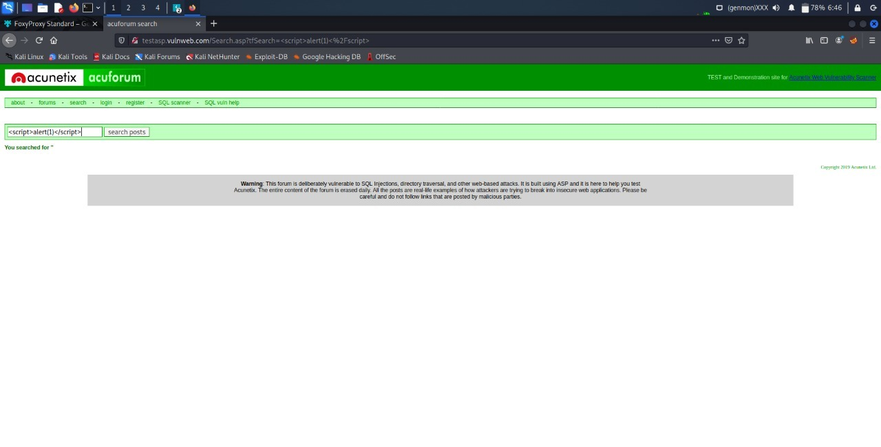

Slide 5
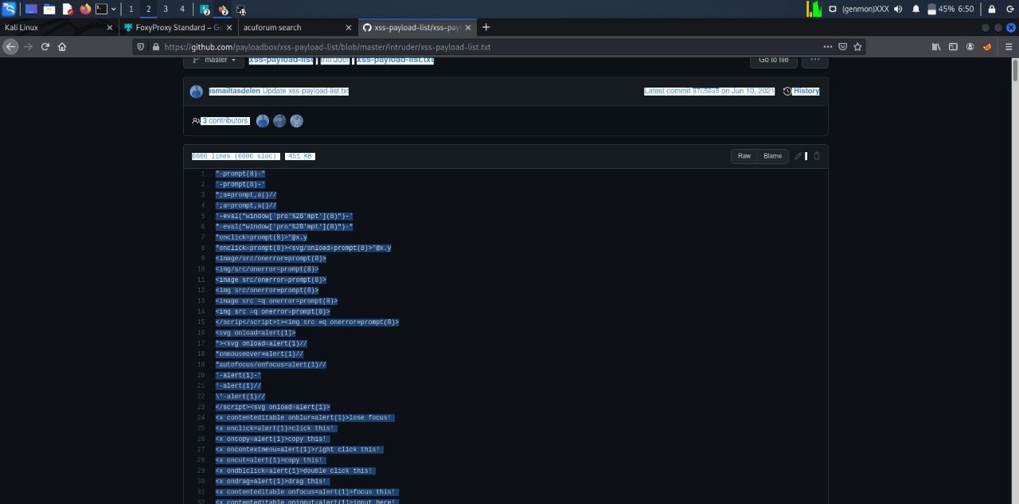

Slide 6
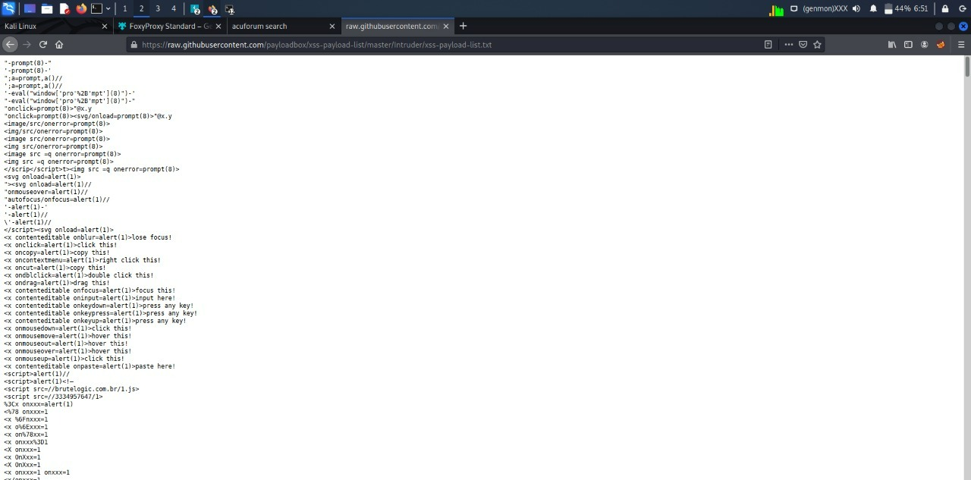

Slide 7
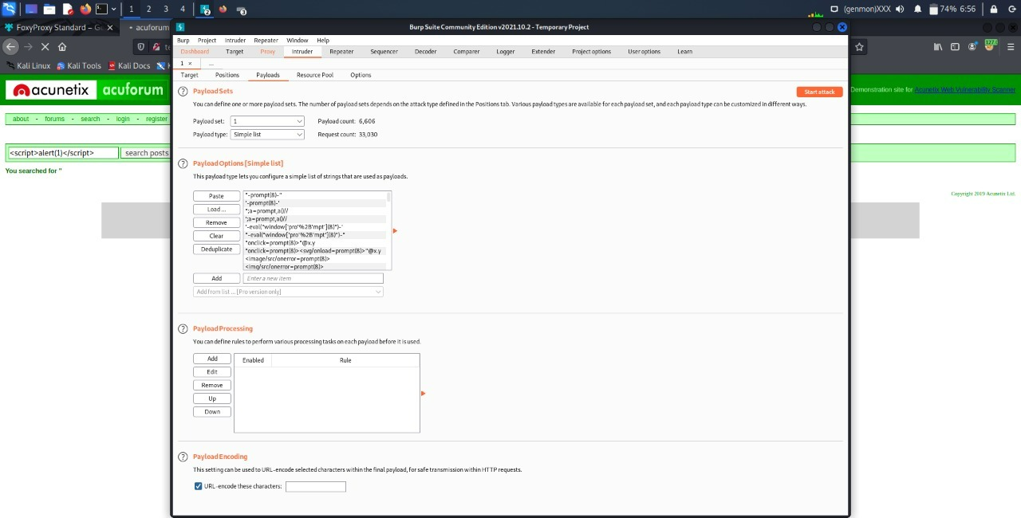

Slide 8
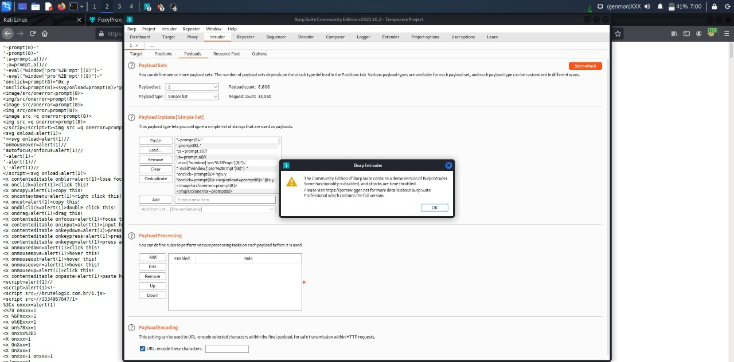

Slide 9
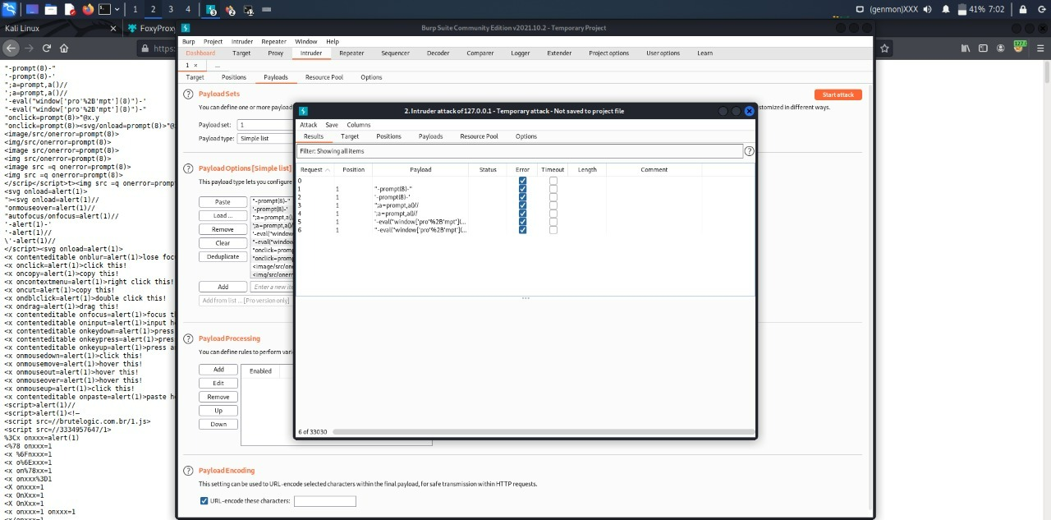

Slide 10
