Slide 1
CyberShield AI
AI-Powered Behavioral Anomaly Detection for Cybersecurity
Live Deployed App: https://cybershield-ai-1-5gyk.onrender.com/
Problem Statement ID —
Honeywell-2026-Q4
Problem Statement Title —
AI-Powered Behavioral Anomaly Detection for Cybersecurity
Theme —
Cybersecurity / AI & Machine Learning
PS Category —
Software
Student Name —
Kota Bhanu Prasanth Reddy
Student ID —
KBPR-2026 (Registered on portal)

Slide 2
CyberShield AI: Proposed Solution
Core Solution: Multi-Tiered AI Behavioral Profiling & Anomaly Engine
• Sequence-Aware ML Framework: Integrates Unsupervised Profiling (Isolation Forest + OCSVM) and Supervised Detection (XGBoost + LSTM Autoencoder).
• Continuous Risk Scoring (0–100): Evaluates every access log event in real-time, providing fine-grained risk assessment.
• 7-Class Attack Classification: Categorizes anomalies into Brute Force, Impossible Travel, Credential Stuffing, Lateral Movement, Device Spoofing, Low & Slow Exfiltration, and Insider Drift.
• Explainable AI (XAI) Engine: Employs SHAP TreeExplainer to produce per-alert feature attribution and natural-language analyst summaries.
Addressing Key Challenges & Innovation:
• Addressing Class Imbalance: Applied SMOTE oversampling & weighted loss (scale_pos_weight=50), achieving 97.70% Recall and 98.78% AUC-ROC.
• Addressing Cold-Start Problem: Implemented population-based statistical baselines for new entities with <20 historical events.
• Addressing Alert Fatigue: Achieved 100% Precision@Top1%, guaranteeing zero false positives in the top 1% alert budget.
• Deployed Web App: https://cybershield-ai-1-5gyk.onrender.com/

Slide 3
TECHNICAL APPROACH & PIPELINE
Technologies Used:
• Languages & ML Core: Python 3.11/3.14, scikit-learn, XGBoost, TensorFlow/Keras, SHAP, imbalanced-learn (SMOTE).
• Backend & Serving: Flask REST API (12 endpoints), Gunicorn, Joblib, NumPy, pandas.
• Frontend & Visualization: Multi-Page SPA (HTML5, Tailwind CSS, Chart.js, Glassmorphism, Light/Dark Theme, Spotlight Search Ctrl+K).
Implementation Methodology:
1. Synthetic Data & Profiling: Generated 59,566 events across 200 entities with 7 distinct attack patterns.
2. Feature Engineering (43 Features): Extracted temporal, geo-velocity (km/h), rolling login counts (1h/6h/24h), device fingerprint shifts, and behavioral z-scores.
3. Multi-Tiered Ensemble Detection Pipeline:
- Tier 1: Isolation Forest + One-Class SVM unsupervised baseline profiler.
- Tier 2: XGBoost + 2-layer LSTM Autoencoder weighted risk scoring (0.6*XGB + 0.4*LSTM).
- Tier 3: SMOTE-balanced multi-class XGBoost classifier for attack attribution.
- Tier 4: SHAP TreeExplainer feature attribution producing human-readable SOC summaries.

Slide 4
FEASIBILITY, VIABILITY & METRICS
Feasibility Analysis & Demonstrated Performance:
• Empirical Validation (59,566 Events Tested): Accuracy = 93.59% | Recall = 97.70% | F1 Score = 84.98% | AUC-ROC = 98.78%.
• Operational Efficiency: 100% Precision@Top1% ensures the top 1% alert budget contains zero false positives.
• Low Latency Inference: Sub-15ms per-event inference suitable for real-time SIEM/SOAR streaming ingestion.
• Live Production Deployment: Deployed on Render PaaS at https://cybershield-ai-1-5gyk.onrender.com/
Potential Challenges & Mitigation:
• Concept Drift & Cold-Start: Handled via population-based fallback baselines and continuous rolling feature updates.
• Analyst Fatigue: Solved via SHAP natural language narratives and risk prioritization.

Slide 5
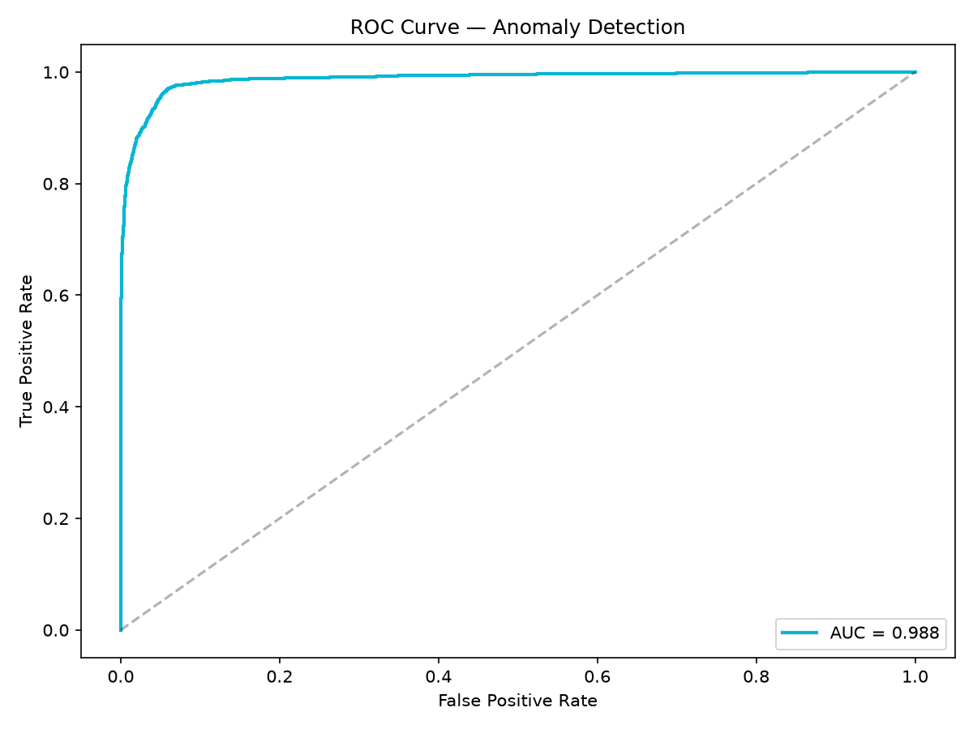
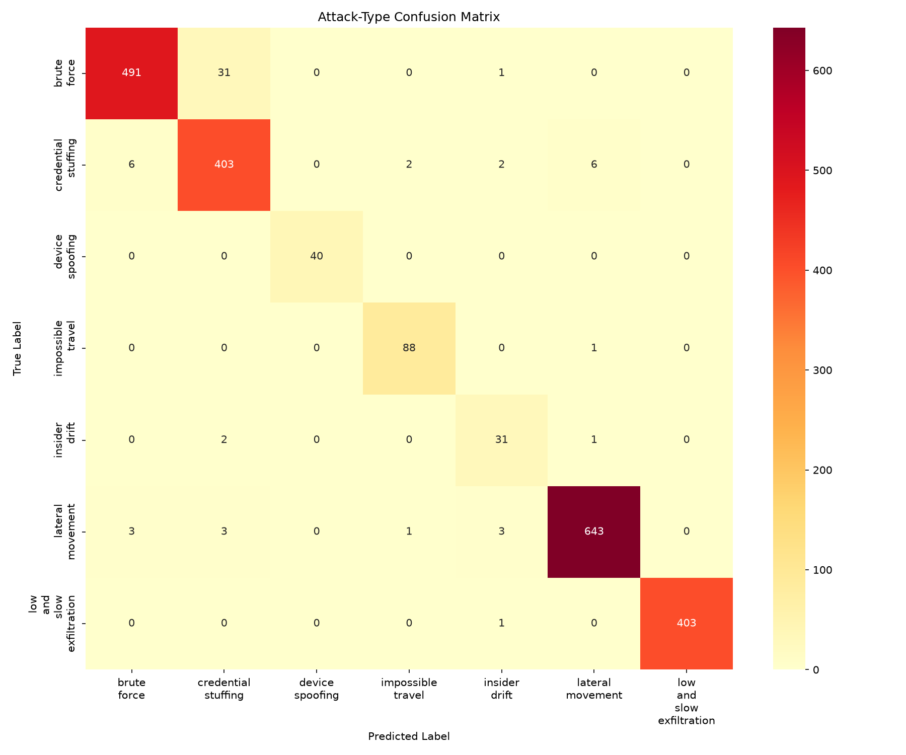
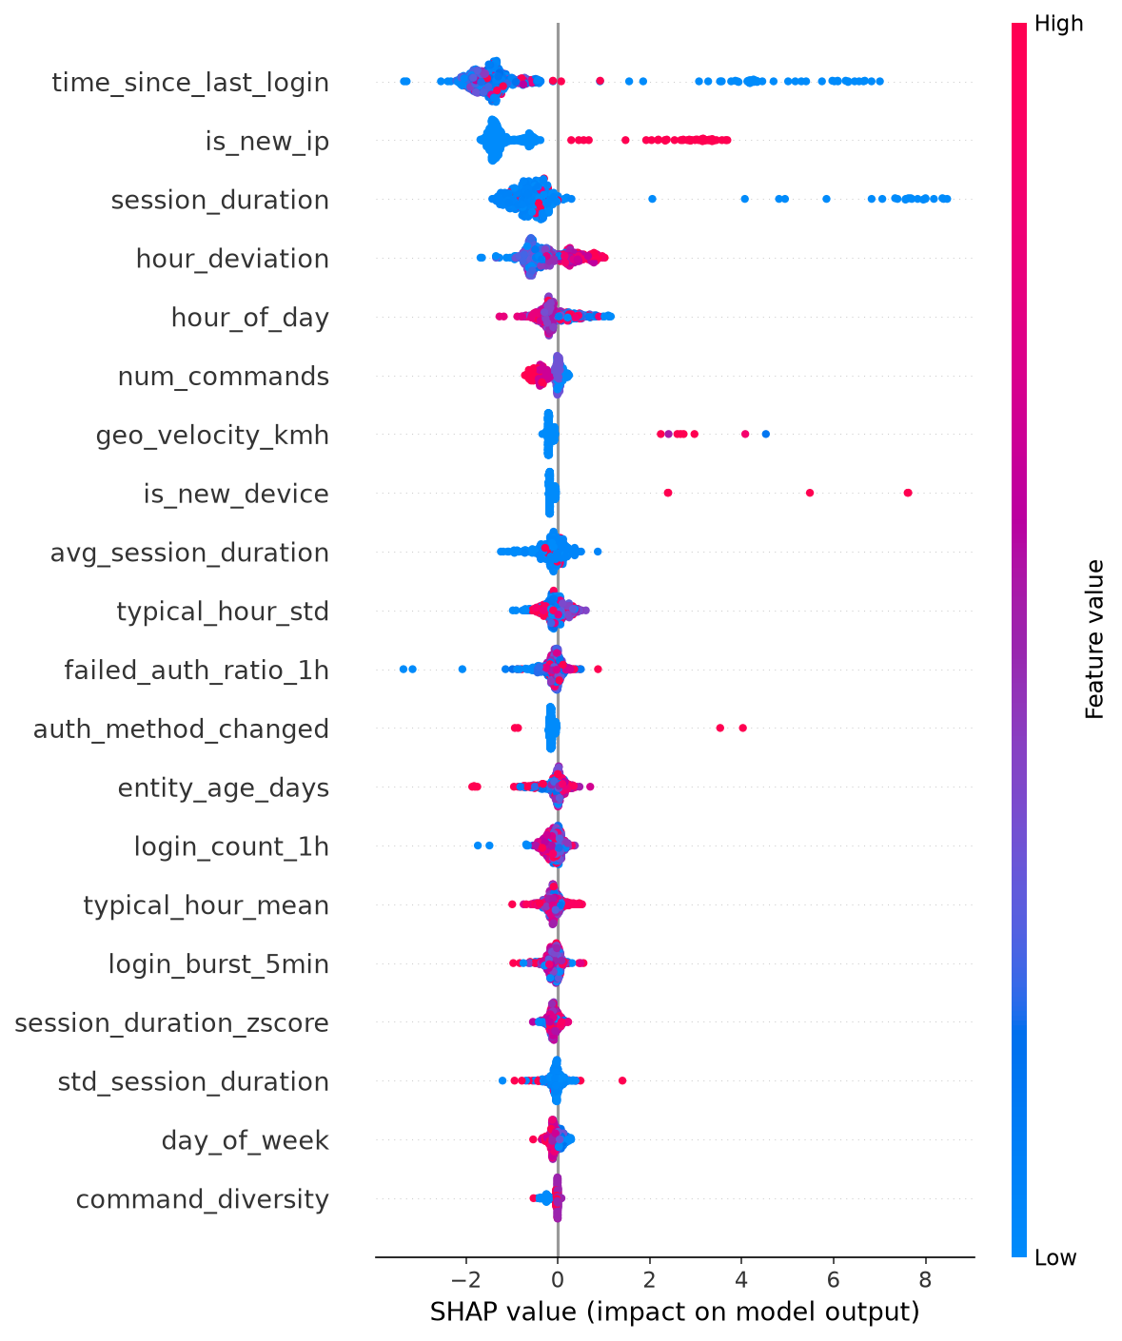
SOLUTION ARTIFACTS & DASHBOARD
Key Project Artifacts & System Deliverables:
• Multi-Page Analyst SOC Dashboard: Deployed live at https://cybershield-ai-1-5gyk.onrender.com/ featuring Overview, Analytics, Alerts, and Model Performance views.
• Advanced UI Features: Spotlight Search (Ctrl+K), Light/Dark Theme toggle, Live Clock, Fullscreen mode, CSV Export, and Toast notifications.
• Modular Python ML Core: 9 production-grade modules (data_generator, feature_engineering, baseline_model, detection_model, classifier, explainer, evaluate, train_pipeline, app).
• Public GitHub Repository: https://github.com/Prasanth4689/CyberShield-AI

Slide 6
RESEARCH & REFERENCES
Academic Research & Industry Standards:
1. Lundberg, S. M., & Lee, S.-I. (2017). 'A Unified Approach to Interpreting Model Predictions.' NIPS 30.
2. Chen, T., & Guestrin, C. (2016). 'XGBoost: A Scalable Tree Boosting System.' ACM SIGKDD.
3. Malhotra, P., et al. (2016). 'LSTM-based Encoder-Decoder for Multi-sensor Anomaly Detection.' ICML Workshop.
4. Liu, F. T., Ting, K. M., & Zhou, Z. H. (2008). 'Isolation Forest.' IEEE ICDM.
5. MITRE ATT&CK Framework: Mapping access patterns to Credential Access, Lateral Movement, and Exfiltration.
Live Deployed Website & Repositories:
• Deployed Website URL: https://cybershield-ai-1-5gyk.onrender.com/
• GitHub Source Code: https://github.com/Prasanth4689/CyberShield-AI

