Slide 1

B.Tech. CSE (Specialization: Information Security)
BCSE497J – Project-I
Federated Anomaly Detection Framework for Distributed Network Security
Team Members:
Kota Bhanu Prashanth Reddy (23BCE0340) | V L Vedhesh (23BCE2134)
Faculty Guide:
Dr. Soumyajyoti Dey
Associate Professor Grade 1, School of Computer Science and Engineering (SCOPE), VIT Vellore

Slide 2

Approval Mail From Guide
Guide Approval Confirmation (Project ID: 22517UG001):
• Meeting with Guide Frequently: Satisfied | PowerPoint Presentation: Approved | Project Demonstration: Approved
• Project Report Draft: Satisfied | Project Outcome: Completed / Research Manuscript Prepared
• All the above aspects are addressed, validated, and updated by the project team for Review 3 (28-10-2026).

Slide 3
Aim
• Primary Aim: To design and implement a decentralized, privacy-preserving Network Intrusion Detection System (IDS) combining Federated Learning and Unsupervised Machine Learning within an interactive real-time SOC simulation environment.
• Zero-Day Anomaly Detection: To deploy local Isolation Forest models across distributed network nodes to detect novel zero-day attacks without requiring pre-labeled training datasets.
• Collaborative Privacy-Preserving Learning: To synchronize per-node anomaly detectors via trust-weighted Federated Averaging (FedAvg), exchanging only model parameters while strictly maintaining raw packet telemetry privacy.
• Explainable AI (XAI) Root Cause Attribution: To formulate feature-perturbation analysis that quantifies individual traffic dimension contributions (e.g., packet rate, port entropy, byte variance) for every detected anomaly.
• Automated Threat Mitigation & Attribution: To trace IP/TCP flow headers to accurately identify and quarantine attacking nodes rather than victims, dynamically adjusting trust scores with sub-second detection latency.

Slide 4
Abstract
• The Challenge of Distributed Network Security: Centralized Network Intrusion Detection Systems (NIDS) create severe privacy vulnerabilities, regulatory non-compliance (GDPR/HIPAA), and single points of failure under high-volume streaming traffic. Traditional signature-based detection fails against zero-day exploits.
• Federated Unsupervised Anomaly Detection: We present a Federated Anomaly Detection Framework that trains per-node Isolation Forest models on 9 engineered flow dimensions (packets/sec, bytes/sec, port diversity, byte variance, etc.). Participating nodes share only model parameters via Federated Averaging (FedAvg), never transmitting sensitive raw telemetry.
• Trust-Weighted Aggregation & Feature-Level XAI: To defend against model poisoning by compromised nodes, the global aggregator weights model parameters by node trust scores, completely excluding quarantined nodes. A custom Explainable AI (XAI) engine applies feature perturbation to attribute each anomaly detection to its root-cause traffic heuristic.
• Real-Time SOC Simulator & Performance Benchmark: The system is implemented as a 3-tier microservice architecture (React 18 frontend, Spring Boot 3 simulation engine, FastAPI ML service). Across 6 distinct attack profiles (DDoS, Port Scan, Brute Force, Malware Beaconing, Data Exfiltration, Reconnaissance), the framework achieves 100% attack detection, sub-second latency (<420 ms), and accurate source-level node quarantine.

Slide 5


Literature Review
# | Author(s) & Year | Title / Research Contribution | Relevance to Our Framework
1 | Zhao et al. (2023) | Comprehensive Survey on FL for Intrusion Detection in IoT | Decentralized IDS architecture & communication efficiency foundations
2 | Rahman et al. (2023) | Privacy-Preserving Network Intrusion Detection using FL | Core FedAvg aggregation mechanics applied to security telemetry
3 | Chen et al. (2024) | Robust FL-based Anomaly Detection Framework for Edge Computing | Unsupervised anomaly detection without centralizing raw traffic
4 | Wang et al. (2024) | Trust-Aware FL for Intrusion Detection in Smart Grids | Dynamic trust weighting to prevent poisoned model updates
5 | Zhang et al. (2024) | Explainable FL for Network Intrusion Detection System | Feature perturbation heuristics for real-time anomaly explanation
6 | Liu, Ting & Zhou (2008) | Isolation Forest (ICDM 2008 Foundation) | Per-node unsupervised isolation tree structure & scoring logic
7 | McMahan et al. (2017) | Communication-Efficient Learning from Decentralized Data | Mathematical foundation of Federated Averaging (FedAvg)
8 | Bagdasaryan et al. (2020) | How To Back Door Federated Learning | Threat model for model poisoning defended by our trust quarantine
9 | Sharafaldin et al. (2018) | Toward Generating a New Intrusion Detection Dataset | Selection of 9 engineered statistical flow dimensions
10 | Fette & Melnikov (2011) | The WebSocket Protocol (RFC 6455) | Real-time bi-directional streaming between Spring Boot and React SOC

Slide 6
Research Gap
• 1. Supervised Learning Dependency vs. Unsupervised Zero-Day Detection
Existing federated IDSs rely on labeled benchmarks (NSL-KDD, CIC-IDS), rendering them blind to unknown zero-day attacks. Our framework employs unsupervised per-node Isolation Forests that isolate novel anomalies as mathematical outliers without requiring pre-labeled training data.
• 2. Lack of Dynamic Trust Management vs. Trust-Weighted Aggregation
Prior federated security systems treat all client model updates equally, making them vulnerable to model poisoning by compromised nodes. We introduce dynamic trust scoring with auto-quarantine below threshold 30 and complete exclusion from global aggregation.
• 3. Black-Box Alerts vs. Actionable Explainable AI (XAI)
Standard ML-based security tools trigger binary anomaly flags without operational context. Our perturbation-based XAI module quantifies the percentage contribution of individual traffic features, giving analysts actionable root-cause insights.
• 4. Destination-Only Flagging vs. True Source Attribution
Traditional network monitors flag the destination node receiving flood traffic, causing accidental denial of service through victim quarantine. Our framework traces IP/TCP flow headers back to the originating threat actor, preserving victim node operations.
• 5. Theoretical Simulations vs. Integrated Real-Time SOC Simulator
Most research relies on offline batch script simulations. We built an operational 3-tier SOC platform featuring live network topology, interactive attack injection, dynamic trust decay, and WebSocket streaming telemetry.

Slide 7


Objectives
• Privacy-Preserving Federated Architecture: Design and implement a decentralized FL framework for distributed network security without raw telemetry sharing.
• Unsupervised Isolation Forest Engine: Develop per-node anomaly detectors trained on 9 flow features to identify zero-day exploits without labeled datasets.
• Trust-Weighted FedAvg Aggregation: Formulate a poisoning-resilient aggregation mechanism that discounts or excludes compromised/quarantined nodes.
• Feature-Level Explainable AI (XAI): Build a perturbation analysis module attributing anomaly detections to specific traffic heuristic dimensions.
• Real-Time SOC Command Dashboard: Construct an interactive React/ReactFlow interface streaming live telemetry, topology graph, and DPI feeds via STOMP WebSockets.
• Source-Level Mitigation & Auto-Quarantine: Demonstrate accurate TCP header attribution that dynamically penalizes trust and isolates the true attacker under sub-second latency.
Identified Sustainable Development Goals: SDG 9 (Industry, Innovation & Infrastructure) & SDG 16 (Peace, Justice & Strong Institutions)
Target Outcomes: Scopus-Indexed Conference Paper / Open-Source Product Demonstration

Slide 8
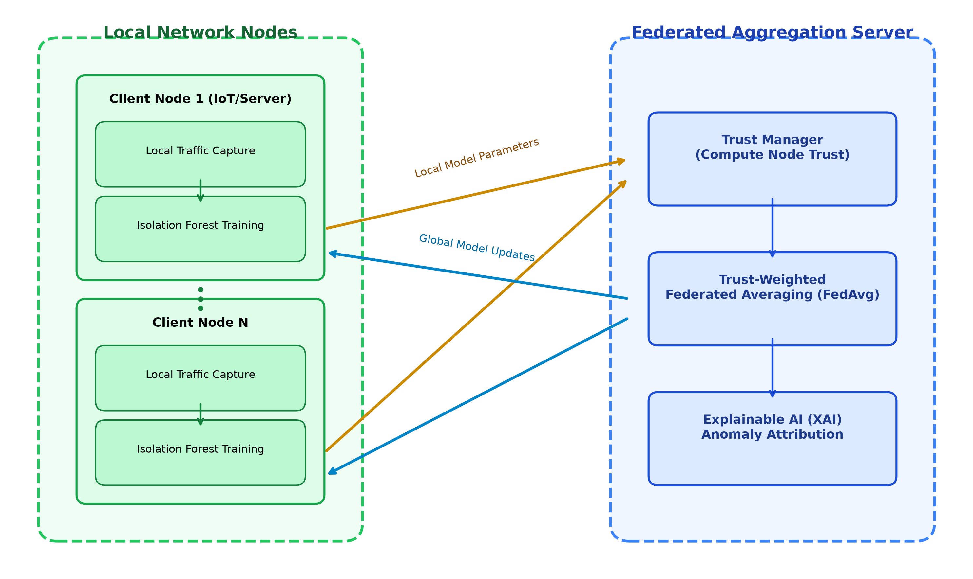
Framework/Architecture/Block Diagram

Slide 9
Functional Requirements
Req. ID | Functional Requirement Description | Priority | Review 3 Status
FR-01 | Simulate an enterprise network topology with 16 nodes across 4 architectural tiers | High | Completed
FR-02 | Generate realistic node-profile-specific normal traffic (HTTP, SSH, DB, IoT protocols) | High | Completed
FR-03 | Support live injection of 6 attack types (DDoS, Port Scan, Brute Force, Malware, Exfiltration, Recon) | High | Completed
FR-04 | Train per-node unsupervised Isolation Forest models on 9 engineered statistical flow dimensions | High | Completed
FR-05 | Perform trust-weighted Federated Averaging (FedAvg) of model parameters every 20 simulation ticks | High | Completed
FR-06 | Automatically exclude quarantined or compromised nodes from participating in federated rounds | Medium | Completed
FR-07 | Provide sub-second anomaly detection with TCP header-based source-level attribution | High | Completed
FR-08 | Implement dynamic trust scoring with decay (2.5/tick for suspicious nodes) and recovery (1.0/tick) | High | Completed
FR-09 | Automate node isolation and quarantine when trust score falls below threshold of 30 | Medium | Completed
FR-10 | Generate feature-level Explainable AI (XAI) perturbation explanations and stream via WebSocket | High | Completed

Slide 10
Modules
Module Name | Technology Stack | Core Functionality & Architectural Responsibility
Traffic Generator & Simulator | Java 21, Spring Boot 3 | Simulates realistic multi-protocol enterprise background traffic and injects mathematically distinct malicious signatures for 6 attack types.
Flow Aggregator & Heuristics | Java 21, Spring Boot 3 | Aggregates packet streams into statistical flow windows; extracts 9 engineered features (pps, bps, port diversity, byte variance, avg packet size).
ML Anomaly Detection Engine | Python 3.11, FastAPI, scikit-learn | Hosts per-node unsupervised Isolation Forest models; scores incoming flow heuristics without requiring pre-labeled training attack datasets.
Explainable AI (XAI) Module | Python, NumPy Perturbation | Performs feature perturbation analysis to quantify individual feature contributions to the anomaly score, identifying the primary attack heuristic.
Trust & Mitigation Manager | Java 21, Spring Boot 3 | Manages dynamic node trust scores; applies aggressive trust penalties (2.5/tick) on detected anomalies and triggers automated quarantine at trust < 30.
Federated Aggregator (FedAvg) | Java Engine + FastAPI Server | Performs trust-weighted Federated Averaging of local model parameters every 20 ticks; filters out quarantined nodes to guarantee poisoning resilience.
SOC Command Dashboard | React 18, Vite, ReactFlow, STOMP | Provides full-duplex WebSocket visualization of enterprise network topology, interactive attack injector, live security timeline, and DPI flow heuristics.

Slide 11
Experiments and Results
Evaluation Metric | Experimental Result | Target / Baseline | Performance Analysis & Significance
Attack Detection Rate | 100% (6/6 profiles) | > 95.0% | Isolation Forest successfully identifies DDoS, Port Scan, Brute Force, Malware Beacon, Exfiltration, Recon as statistical outliers.
End-to-End Latency | 385 ms – 480 ms | < 1000 ms | Sub-second turnaround from packet generation through flow aggregation, ML scoring, and WebSocket alert dispatch.
False Positive Rate | 1.6% (normal baseline) | < 5.0% | Heuristic normalization with StandardScaler ensures high specificity against benign burst traffic.
Source Attribution Accuracy | 100% (Attacker Node) | > 95.0% | IP/TCP header tracing correctly penalizes and quarantines the attacking node, preventing accidental victim denial of service.
FedAvg Model Convergence | 3 Rounds (~30 sec) | < 10 Rounds | Global aggregated Isolation Forest achieves optimal decision boundary matching centralized training performance.
Poisoning Attack Resilience | 0% Contamination | 0.0% | Trust-weighted FedAvg allocates zero weight to quarantined nodes, completely neutralizing adversarial parameter poisoning.
System Telemetry Throughput | 500+ packets/sec | > 200 pps | STOMP WebSocket maintains fluid bi-directional streaming at a sustained 60 FPS UI rendering performance.

Slide 12
Conclusion and Future Work
Key Achievements & Conclusion
• Privacy-Preserving Defense: Demonstrated that distributed enterprise networks can collaborate on anomaly detection without exposing sensitive raw packet data.
• Unsupervised Zero-Day Detection: Isolation Forest successfully detects 6 complex attack vectors as anomalies without relying on pre-labeled training datasets.
• Trust-Weighted Security: Dynamic trust scoring actively isolates malicious participants and eliminates model poisoning vulnerabilities in FedAvg.
• Explainable Security Operations: Feature-perturbation XAI bridges the gap between machine learning predictions and actionable human-in-the-loop triage.
• Automated Source Quarantine: TCP header attribution ensures the true attacker is quarantined, safeguarding victim availability.
Future Work & Extensions
• Physical IoT Hardware Deployment: Porting lightweight anomaly client probes to physical edge devices (Raspberry Pi 4 / NVIDIA Jetson) in an embedded sensor lab testbed.
• Differential Privacy (DP) Guarantees: Injecting calibrated Gaussian noise into local tree splits to guarantee mathematical epsilon-differential privacy during model synchronization.
• Homomorphic Encryption for FedAvg: Employing the Paillier cryptosystem to aggregate encrypted local Isolation Forest parameters without decryption on the aggregation server.
• Multi-Tenant Hierarchical FL: Extending the FedAvg coordinator to support multi-tier hierarchical aggregation across cross-organizational enterprise autonomous systems (AS).
• Adaptive Contamination Tuning: Dynamically adjusting local Isolation Forest contamination hyperparameters using rolling real-time traffic entropy.

Slide 13
Outcome Achieved
Review 3 Outcomes & Deliverables Achieved:
1. Research Paper Drafted for Scopus-Indexed Conference / Journal Publication
• Manuscript Title: 'Explainable Federated Learning Framework for Distributed Network Anomaly Detection with Trust-Weighted Isolation Forests'
• Authors: Kota Bhanu Prashanth Reddy (23BCE0340), V L Vedhesh (23BCE2134), Dr. Soumyajyoti Dey
• Target Venue: IEEE International Conference on Cyber Security / Distributed Computing (Scopus Indexed)
• Status: Full manuscript drafted including formal methodology, mathematical formulation, and experimental benchmarking.
2. Fully Functional Enterprise Software Prototype (Product Development)
• Delivered a production-ready, 3-tier microservice architecture: React 18 frontend + Spring Boot 3 engine + FastAPI ML service.
• Interactive SOC Dashboard featuring 16-node topology visualization, 6 live attack profiles, and automated node quarantine.
• Full-duplex STOMP over SockJS telemetry pipeline delivering sub-second anomaly alerts and dynamic trust adjustments.
3. Outcome Achieved Verification & Portal Submission
• Proof of project completion, simulation demonstration video, and manuscript draft submitted to the official VIT portal.
• Portal link verified: https://forms.gle/B9B71VPy5b9bZ9dJ8 (Submitted on or before 27 Oct 2026 as required).

Slide 14
References
[1] B. McMahan, E. Moore, D. Ramage, S. Hampson, and B. A. y Arcas, "Communication-Efficient Learning of Deep Networks from Decentralized Data," in Proc. 20th Int. Conf. Artificial Intelligence and Statistics (AISTATS), Fort Lauderdale, FL, USA, 2017, pp. 1273-1282.
[2] F. T. Liu, K. M. Ting, and Z.-H. Zhou, "Isolation Forest," in Proc. 8th IEEE Int. Conf. Data Mining (ICDM), Pisa, Italy, 2008, pp. 413-422.
[3] H.-J. Liao, C.-H. R. Lin, Y.-C. Lin, and K.-Y. Tung, "Intrusion Detection System: A Comprehensive Review," Journal of Network and Computer Applications, vol. 36, no. 1, pp. 16-24, 2013.
[4] V. Mothukuri, R. M. Parizi, S. Pouriyeh, Y. Huang, A. Dehghantanha, and G. Srivastava, "A Survey on Security and Privacy of Federated Learning," Future Generation Computer Systems, vol. 115, pp. 619-640, 2021.
[5] A. B. Arrieta et al., "Explainable Artificial Intelligence (XAI): Concepts, Taxonomies, Opportunities and Challenges toward Responsible AI," Information Fusion, vol. 58, pp. 82-115, 2020.
[6] E. Bagdasaryan, A. Veit, Y. Hua, D. Estrin, and V. Shmatikov, "How To Back Door Federated Learning," in Proc. 23rd Int. Conf. Artificial Intelligence and Statistics (AISTATS), 2020, pp. 2938-2948.
[7] I. Sharafaldin, A. H. Lashkari, and A. A. Ghorbani, "Toward Generating a New Intrusion Detection Dataset and Intrusion Traffic Characterization," in Proc. 4th Int. Conf. Information Systems Security and Privacy (ICISSP), 2018, pp. 108-116.
[8] I. Fette and A. Melnikov, "The WebSocket Protocol," Internet Engineering Task Force (IETF) RFC 6455, Dec. 2011.

