Slide 1
HR Analytics Dashboard
Prepared By : R. Prasanth Kumar Reddy.
Tools & Technologies : Power BI | SQL | Excel | Power Query | DAX
Project Objective : Analyzing employee data to uncover workforce trends, demographics, hiring patterns, and actionable HR insights.
Presented For: Data Analytics Portfolio
Date : June 2026

Slide 2
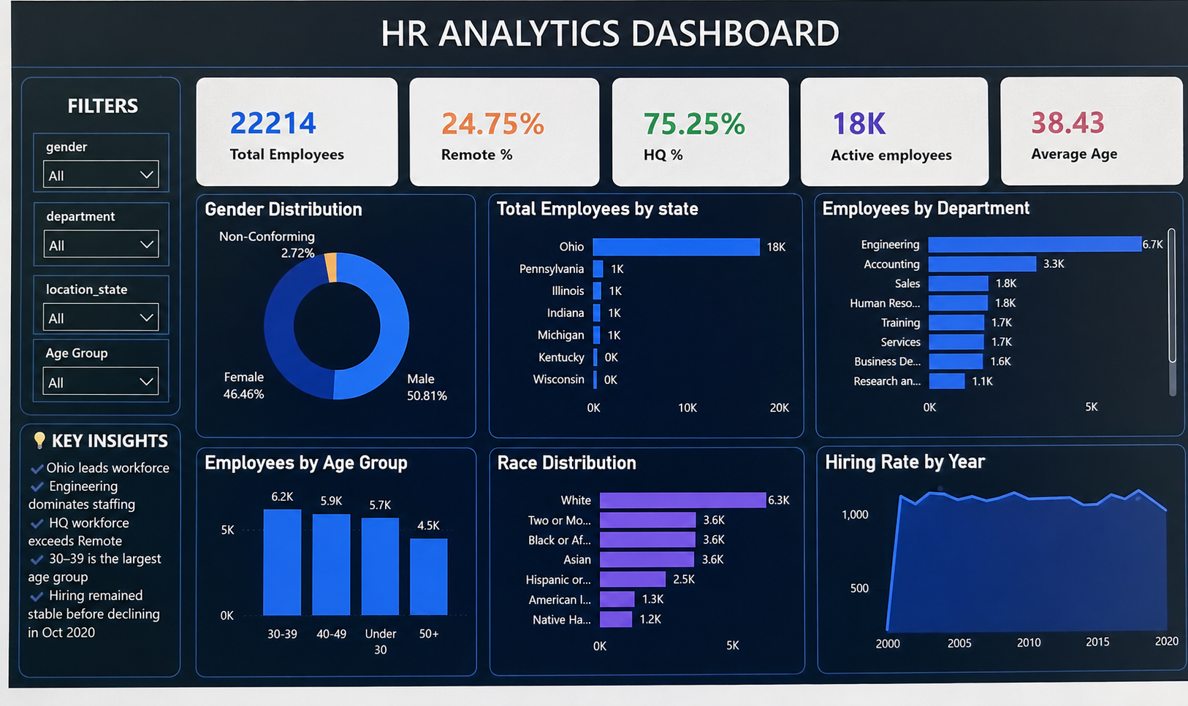
HR Analytics Dashboard: Workforce Insights and Employee Demographics Analysis
Power BI project by R. Prasanth Kumar Reddy — a professional portfolio piece for university submission, viva, and LinkedIn. Modern dark-blue & purple theme designed to match the dashboard visuals. This deck tells a concise, data-driven story: dataset → analysis → insights → actionable recommendations.

Slide 3
Project Objective
Purpose
Business Problem
Dashboard Objectives
Use HR analytics to reveal workforce composition, hiring patterns, and demographic trends to inform strategic HR decisions.
Unseen workforce imbalances, unclear hiring patterns, and suboptimal location allocation that impact productivity and retention.
Provide actionable KPIs, trend analysis, and demographic breakdowns to guide workforce planning, diversity programs, and remote work policy.
Why Data-Driven HR
Quantifies gaps, measures progress, and supports evidence-based policy — reducing bias and aligning HR actions to business goals.

Slide 4
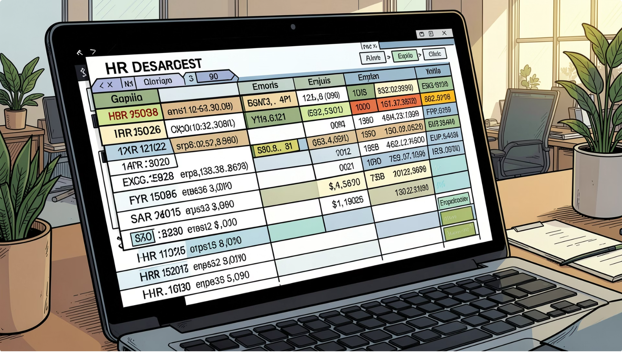

Dataset Overview
Employee demographics: age, gender, race
Department and role information
Location: state and HQ vs Remote
Hiring dates and termination data (tenure calculation)
Data cleaning performed: deduplication, date normalization, null handling
Data sources: HRIS export (MySQL), transformed with Power Query; measures computed with DAX.

Slide 5
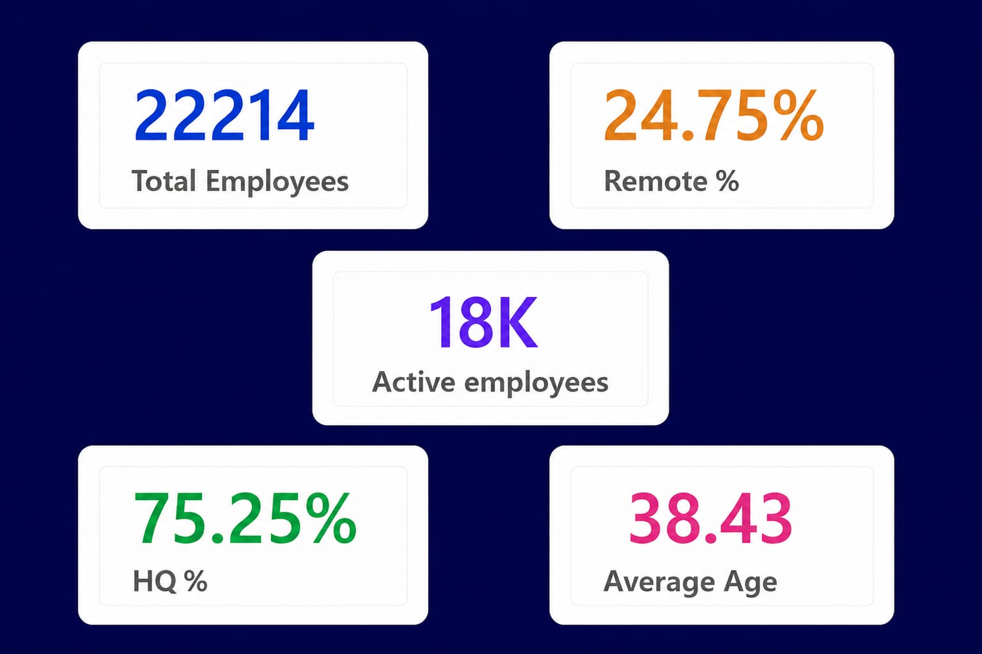

KPI Cards:
Selected KPI values
Total Employees: 22,214 — the authoritative population for all analyses.
Remote %: 24.75% — nearly one quarter of staff operate remotely.
HQ %: 75.25% — three quarters located at headquarters.
Average Age: 38.43 years — mid-career skew.
Active employees:18k — approximately 18,000 employees are currently active, indicating a stable and engaged workforce.
Business significance: KPIs set the context for capacity planning, talent programs, and remote-work policy decisions.

Slide 6
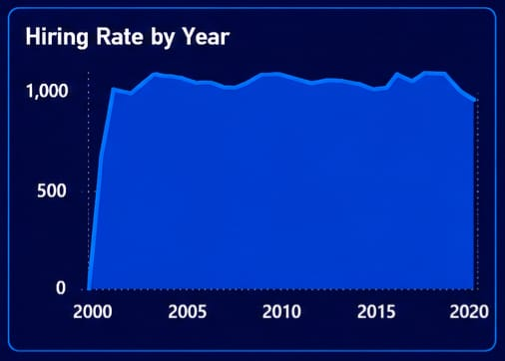

Hiring Trend — Hiring Rate by Year
Trend summary: Hiring activity increased steadily over time, indicating workforce growth.
Highest hiring year: Peak year labelled on chart (annotated in dashboard) — suggests targeted recruitment or growth initiatives that year.
Lowest hiring year: Earliest years in dataset show lower counts (smaller workforce base).
Workforce growth pattern: Overall gradual growth with episodic surges — recommend correlating with business events (product launches, expansions).
Insight: Use hiring trend to forecast hiring needs and budget timing; combine with attrition to get net workforce change.

Slide 7
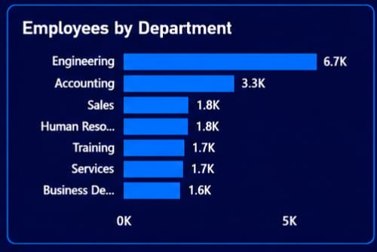

Department Analysis — Employees by Department
Distribution: Engineering is the largest department (dominant bar), followed by Accounting, Sales, and HR.
Largest department: Engineering — major share of workforce, indicating technical focus and resource concentration.
Smallest department: (smallest visible bar) — may be a strategic support function with limited headcount.
Resource allocation insights: High concentration in Engineering suggests prioritization of technical initiatives; consider staffing balance for cross-functional capacity.
Recommendation: Evaluate hiring and training plans to support
Smaller departments that enable core operations (e.g., HR,
Operations).

Slide 8
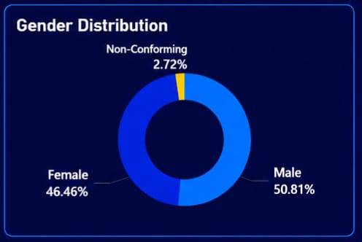

Gender Diversity — Employees by Gender
Distribution (dashboard): Males and females comprise the majority; a smaller non-conforming segment is present.
Male %: ~46.8% (as visualized)
Female %: ~50.8% (as visualized)
Non-Conforming %: ~2.4% (visible but small)
Diversity observations: Gender balance is near parity with a slight female majority; presence of non-conforming category indicates inclusive data capture.
Inclusion insight: Continue supporting inclusive policies and monitor representation in leadership and technical roles.

Slide 9
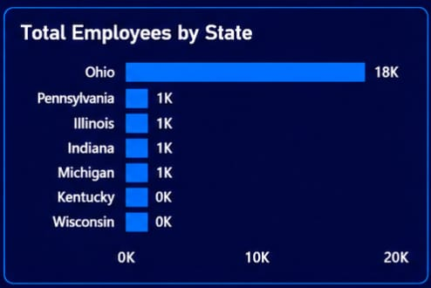
State-wise Workforce — Employees by State
Geographic distribution: Workforce concentrated in select states with one clear leader.
State with highest employees: Ohio — the largest bar on the chart (primary geographic hub).
Concentration insight: High regional concentration can simplify local HR operations but increases exposure to regional labor risks.

Slide 10
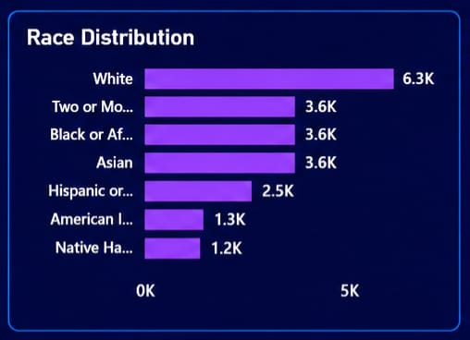
Employees By Race:
Insights – Employees by Race
White employees have the highest representation, making up the largest employee group in the organization.
Two or More Races, Black, and Asian employees show strong presence, contributing significantly to workforce diversity.
Hispanic or Latino employees have moderate representation compared to the top employee groups.
American Indian and Native Hawaiian groups have lower employee counts, showing limited representation.
The workforce shows diversity but is concentrated among few categories, highlighting opportunities for more inclusive hiring.

Slide 11
Conclusion:
This HR Analytics Dashboard project successfully analyzed a workforce of 22,214 employees using Power BI, SQL, Excel, Power Query, and DAX. The analysis provided valuable insights into employee demographics, workforce distribution, hiring trends, gender diversity, and geographic concentration.
Key findings revealed that 24.75% of employees work remotely, while 75.25% are based at headquarters, indicating a predominantly on-site workforce. The workforce has an average age of 38.43 years, reflecting a strong mid-career employee base, and approximately 18,000 employees are currently active, demonstrating workforce stability. Additionally, Engineering emerged as the largest department, gender representation was nearly balanced, and Ohio showed the highest employee concentration.
Overall, the dashboard transforms raw HR data into meaningful business insights, enabling data-driven decision-making for workforce planning, diversity initiatives, recruitment strategies, and organizational growth. This project demonstrates how analytics can support HR leaders in making informed and strategic workforce decisions.
THANK YOU..!

