Slide 1
SUPPLY CHAIN ANALYTICS
A Business Intelligence Project on Revenue, Inventory, Manufacturing & Supplier Performance
Built with Power BI | Interactive Dashboards | Data-Driven Recommendations
Prepared for: Academic Submission
Tool used: Microsoft Power BI

Slide 2
Project Objective & Scope
Why this analysis was undertaken and what it covers
Objective
Scope of Analysis
Analyze end-to-end supply chain performance across product lines, suppliers, and manufacturing operations.
Consolidate revenue, inventory, cost, lead time, and defect-rate metrics into a single decision-support view.
Identify inefficiencies — overproduction, quality gaps, and slow-moving categories — to guide corrective action.
Compare supplier performance on cost, speed, and quality to support sourcing decisions.
3 product categories: Skincare, Haircare, Cosmetics
3 supplier accounts: Supplier A, B, and C
Order, revenue, unit-sales and stock-level data
Manufacturing cost, production volume and lead time
Shipping cost and defect-rate tracking
4 interactive Power BI report pages
Supply Chain Analytics — Executive Project Report
2

Slide 3
Tools & Methodology
How the dashboards were built
01
02
03
04
Data Preparation
Data Modeling
DAX Measures
Dashboard Design
Cleaned and shaped raw supply chain data (orders, cost, defects, shipping) using Power Query — handled data types, removed duplicates, and standardized product/supplier names.
Structured product, supplier, and transaction data into a relational model to enable cross-filtering between slicers (product type, supplier, location, transport mode).
Built calculated measures for Total Revenue, Total Units Sold, Average Lead Time, Average Defect Rate, and Total Supply Chain Cost.
Designed 4 report pages — Executive Overview, Product Comparison, Inventory & Manufacturing, and Supplier Performance — using KPI cards, bar charts, and a filter panel.
Dataset: Product-, order- and supplier-level supply chain records (100 SKUs across 3 categories, 3 suppliers, 5 locations, 3 transport modes).
Supply Chain Analytics — Executive Project Report
3

Slide 4
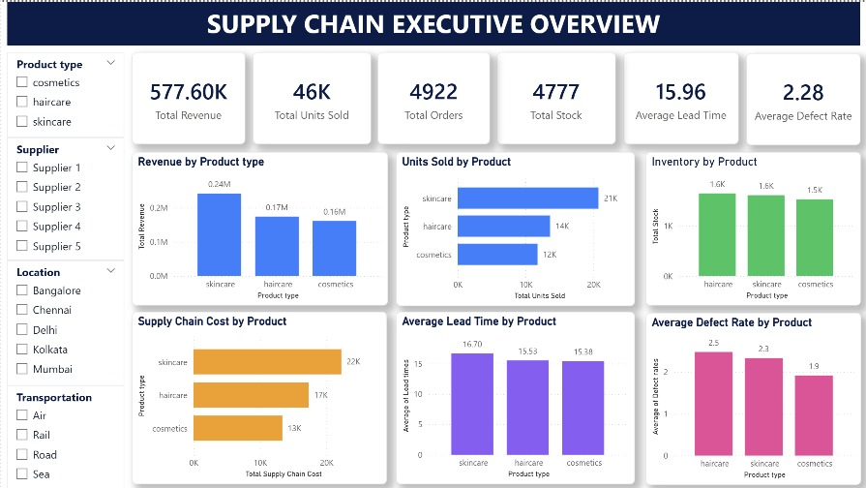
Dashboard 1 — Executive Overview
Company-wide KPIs across revenue, orders, stock, lead time & defects
Key Observations
Total revenue of 577.60K generated from 46K units across 4,922 orders.
Skincare leads on revenue (0.24M) and units sold (21K) — the strongest performer overall.
Skincare also carries the highest supply chain cost (22K) and longest average lead time (16.70 days).
Haircare has the highest average defect rate (2.5%) despite mid-range revenue — a quality flag.
Cosmetics is the most balanced category: lowest cost, shortest lead time, lowest defect rate.
577.60K
15.96
Total Revenue
Avg Lead Time
4,922
2.28%
Supply Chain Analytics — Executive Project Report
Total Orders
Avg Defect Rate
4

Slide 5
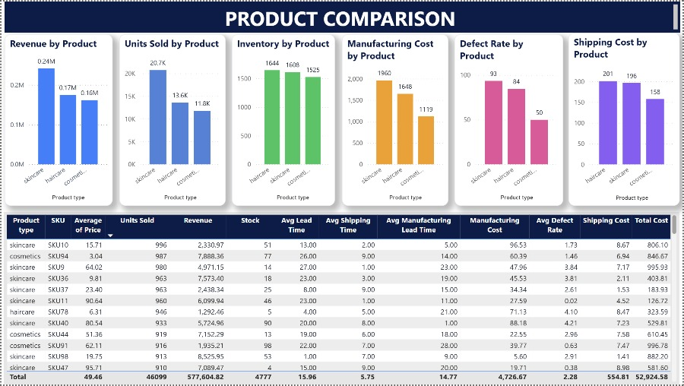
Dashboard 2 — Product Comparison
SKU-level detail behind the category-level KPIs
Key Observations
Skincare tops revenue (0.24M) and units sold (20.7K), but also carries the highest manufacturing cost (1,960) and defect rate (93 per batch).
Cosmetics has the lowest manufacturing cost (1,119) and the lowest defect count (50) — most cost-efficient line.
The SKU table shows skincare SKUs (e.g. SKU10, SKU36) command the highest average selling prices, explaining its revenue lead despite fewer stock units.
Shipping cost by product mirrors revenue rank: skincare (201) > haircare (196) > cosmetics (158).
Supply Chain Analytics — Executive Project Report
5

Slide 6
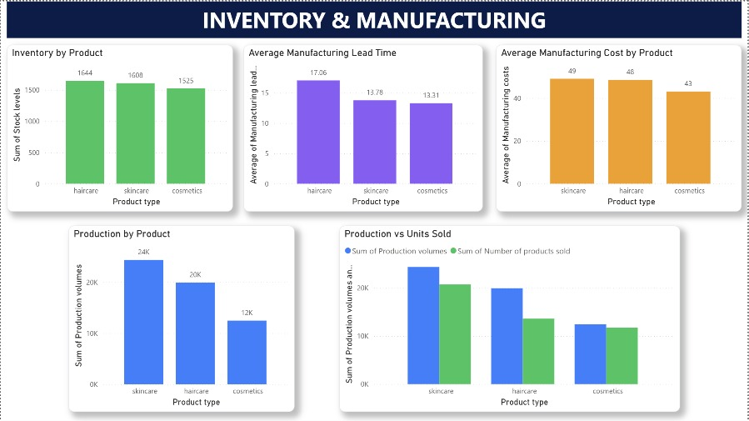
Dashboard 3 — Inventory & Manufacturing
Production efficiency and stock alignment by category
Key Observations
Haircare has the longest manufacturing lead time (17.06) despite not being the top revenue driver.
Skincare is over-produced relative to demand: ~24K units produced vs. ~21K sold — a moderate surplus.
Haircare shows the widest production-to-sales gap: ~20K produced vs. ~14K sold, signalling excess inventory risk.
Cosmetics production (12K) tracks closely with units sold, the tightest demand-supply match of the three categories.
Manufacturing cost is highest for skincare (49) and lowest for cosmetics (43), consistent with its premium pricing.
Supply Chain Analytics — Executive Project Report
6

Slide 7
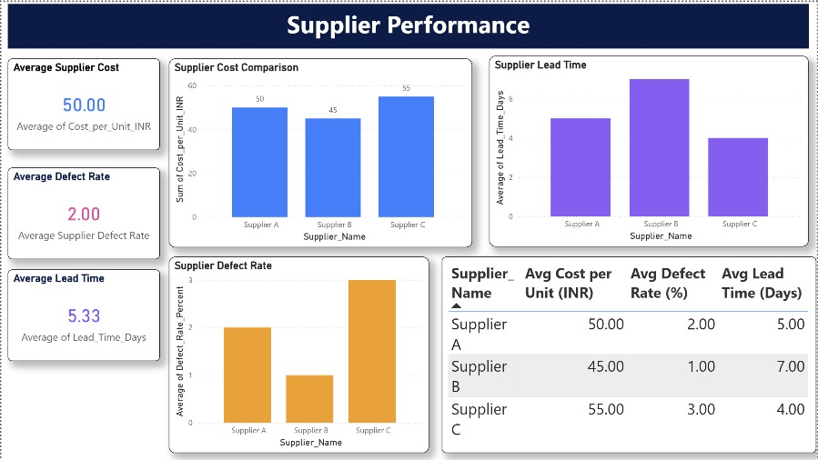
Dashboard 4 — Supplier Performance
Comparing cost, quality and speed across the 3 supplier accounts
Key Observations
Supplier B offers the best cost (45/unit) and lowest defect rate (1.00%), but the slowest lead time (7 days).
Supplier C is fastest (4 days) but most expensive (55/unit) and least reliable (3.00% defects).
Supplier A sits in the middle on every metric — cost 50, defect 2.00%, lead time 5 days — a balanced default option.
Average across suppliers: 50.00/unit cost, 2.00% defect rate, 5.33-day lead time.
Supply Chain Analytics — Executive Project Report
7

Slide 8
Key Insights Summary
What the four dashboards reveal together
Revenue is concentrated
Cosmetics is the efficiency benchmark
Skincare alone generates ~42% of total revenue (0.24M of 577.60K), making it the priority category for supply reliability.
Lowest cost, lowest defect rate, shortest lead time, and the tightest production-to-sales match of all categories.
Haircare needs attention
Supplier trade-offs are clear
Highest defect rate (2.5%) and the largest overproduction gap (~6K excess units) — a combined quality and inventory risk.
No single supplier wins on all fronts: Supplier B = cheapest & most reliable; Supplier C = fastest; Supplier A = balanced.
Supply Chain Analytics — Executive Project Report
8

Slide 9
Recommendations
Actionable next steps based on the analysis
1
Rebalance haircare production toward actual demand to shrink the ~6K unit overproduction gap and reduce holding costs.
4
Investigate the skincare production process to close the gap between its 16.70-day lead time and the cosmetics benchmark of 15.38 days.
2
Audit haircare quality with its supplier(s) to bring the defect rate down from 2.5% toward the cosmetics benchmark of 1.9%.
5
Set monitoring thresholds in the dashboard — e.g. flag any category above 2.5% defect rate or any supplier above 3.0% — for proactive alerts.
3
Shift a larger share of order volume to Supplier B for standard orders, given its lowest cost and defect rate; reserve Supplier C for time-critical, low-volume orders only.
6
Use the Product Comparison SKU table to identify and reduce reliance on high-cost, high-defect SKUs within skincare.
Supply Chain Analytics — Executive Project Report
9

Slide 10
Conclusion
The four Power BI dashboards give a complete, filterable view of supply chain performance — from company-wide KPIs down to individual SKUs and suppliers.
Skincare drives revenue but also cost and delay; cosmetics is the efficiency model the business should benchmark against.
Supplier selection should be need-based: cost/quality for routine orders (Supplier B), speed for urgent orders (Supplier C).
Acting on the haircare quality and overproduction issues offers the clearest near-term improvement opportunity.
Thank You
Prepared using Microsoft Power BI | Dashboards: Executive Overview · Product Comparison · Inventory & Manufacturing · Supplier Performance

