Slide 1

React
https://reactjs.org/

Slide 2
React
A JavaScript library for building user interfaces.
We can create reusable components for View Layer.
It is part of Facebook Open Source.
It is available as an npm package.

Slide 3
Environment Setup
npm install --save react react-dom
npm install --save-dev babel-cli babel-preset-env
npm install --save-dev webpack webpack-dev-server
npm install --save babel-core babel-loader babel-preset-react babel-preset-stage-0
npm install --save react-router-dom

Slide 4
Hello World
import React from 'react';
class App extends React.Component {
constructor(props) {
super(props);
}
render() {
return (
<div>Hello World!</div>
);
}
}
export default App;
Notes:
https://reactjs.org/

Slide 5
React Props
import React from 'react';
class HelloUser extends React.Component {
render() {
return (
<div>
Hello {this.props.name}
</div>
);
}
}
export default HelloUser;

Slide 6
User Input
render() {
return (
<div>
<h3>TODO</h3>
<TodoList items={this.state.items} />
<form onSubmit={this.handleSubmit}>
<input onChange={this.handleChange} value={this.state.text} />
<button> Add #{this.state.items.length + 1} </button>
</form>
</div>
);
}

Slide 7
Inline Styles
render() {
return (
<div>
<h3 ref={(item) => { this.header = item }} style={{ color: this.getStyles().heading.color }}>Inline styles</h3>
<button style={{ color: '#f44336' }} onClick={this.buttonClick}>
Click to change heading color
</button>
</div>
);
}

Slide 8
Component Lifecycle - Mounting
constructor()
componentWillMount()
render()
componentDidMount()

Slide 9
Component Lifecycle - Updating
componentWillReceiveProps()
shouldComponentUpdate()
componentWillUpdate()
render()
componentDidUpdate()

Slide 10
Component Lifecycle - Updating
componentWillUnmount()

Slide 11
React starter kit
npm install -g create-react-app
create-react-app demoapp
cd demoapp
npm start
Use only small letters for in appname. Capital letters not supported.
Notes:
https://reactjs.org/docs/add-react-to-a-new-app.html
https://github.com/facebookincubator/create-react-app

Slide 12
Redux
Redux is an open-source JavaScript library designed for managing application state.
Live code editing and time travel debugging.

Slide 13
Redux Packages
npm install --save-dev redux
npm install --save react-redux

Slide 14
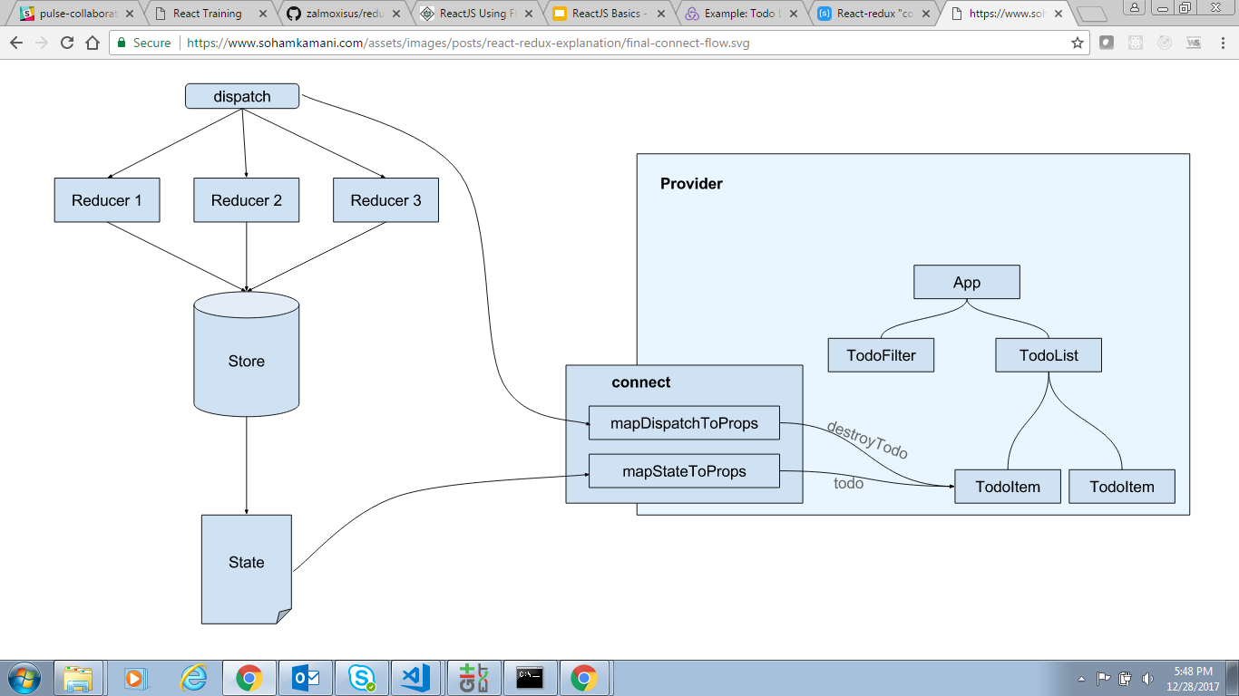
Notes:
https://www.sohamkamani.com/blog/2017/03/31/react-redux-connect-explained/

Slide 15
Unit testing using Jest
npm install --save-dev jest babel-jest

Slide 16
Unit test Actions
import * as actions from '../src/Ex.1.UserInput/actions'
describe('actions', () => {
it('should create an action to add a todo', () => {
const text = 'Finish docs'
const expectedAction = {
type: 'ADD_TODO',
id: 1,
text
}
expect(actions.addTodo(1, text)).toEqual(expectedAction)
})
})

Slide 17
Unit test Reducers
import todos from '../src/Ex.1.UserInput/reducers'
describe('todoReducerItemAddedStage', () => {
it('should return next state of todo', () => {
expect(todos({ "todos": { "todolist": [] } }, { type: 'ADD_TODO', id:"1", text:"test" }))
.toEqual({ "todos": { "todolist": [{ id:"1", text:"test" }] } });
})
})

Slide 18
Unit test Components
npm install --save-dev enzyme
npm install --save-dev enzyme-adapter-react-16 (Admin right needed)
npm install --save-dev react-test-renderer
Notes:
npm install --global --production windows-build-tools

Slide 19
Setup Component Unit test
import React from 'react'
import { mount, configure } from 'enzyme';
import Adapter from 'enzyme-adapter-react-16';
import TodoList from '../src/Ex.1.UserInput/TodoList'
function setup() {
configure({ adapter: new Adapter() })
const props = {
items: []
}
const enzymeWrapper = mount(<TodoList {...props} />);
return {
props,
enzymeWrapper
}
}

Slide 20
Component Unit test
describe('TodoList', () => {
it('should render todoList', () => {
const { enzymeWrapper } = setup();
expect(enzymeWrapper.find('TodoList').find('ul').length > 0).toBe(true);
})
});

