Slide 1
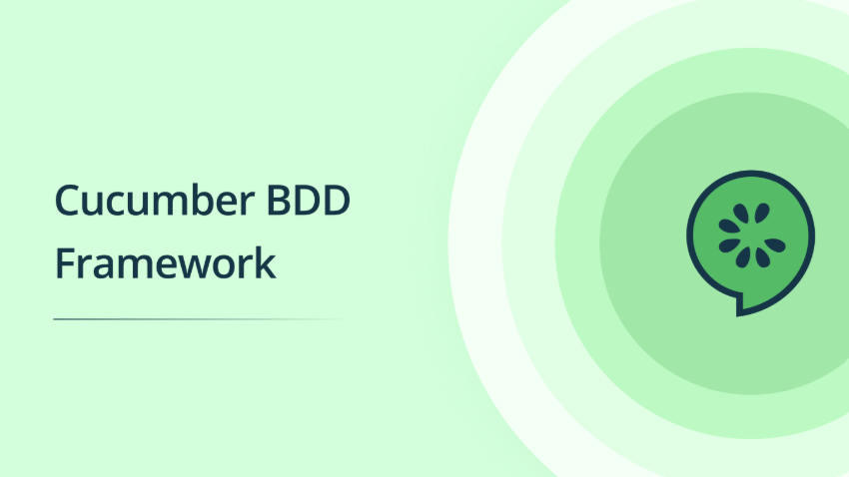

Slide 2
Feature File
Features
Scenarios
Given,
When,
Then,
And
Selenium
+
Java
+
Annotations
Configure
Feature file path,
Step Definition path,
Reports
Step Definition
Test Runner

