Slide 1
AZURE - CLOUD
BIG DATA PIPELINE SERVERLESS ARCHITECTURE

Slide 2
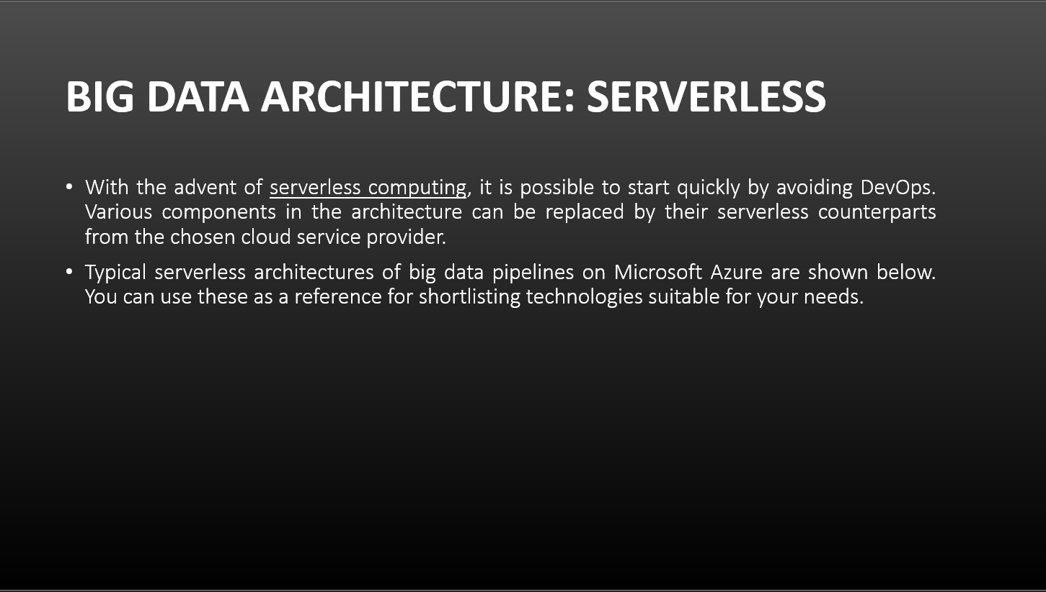

Slide 3
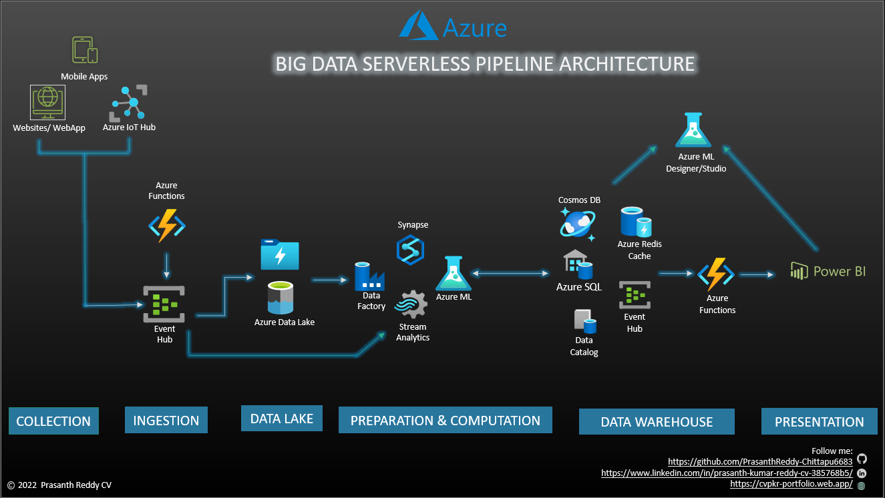

Slide 4
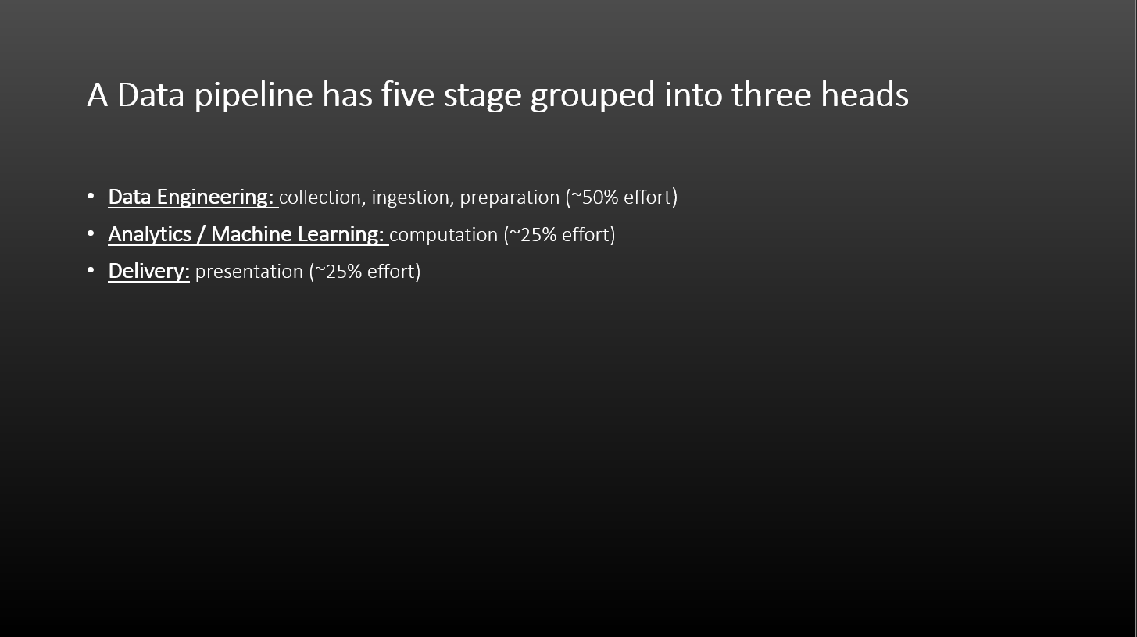

Slide 5
