Slide 1
Welcome to PIVOTAL CLOUD FOUNDRY (PCF)
Developers:
Prasanth CV
Pradeep
Afreen

Slide 2
What is PCF?
Cloud Foundry is an open source, multi-cloud application Platform As A Service (PaaS) governed by the Cloud Foundry Foundation.
The software was originally developed by VMware and then transferred to Pivotal Software, a joint venture by EMC, VMware and General Electric.
Cloud Foundry is promoted for continuous delivery. It supports the
full application development lifecycle,
from initial development through all testing stages to deployment.
Cloud platforms let anyone deploy network apps or services and make them available to the world in a few minutes.

Slide 3
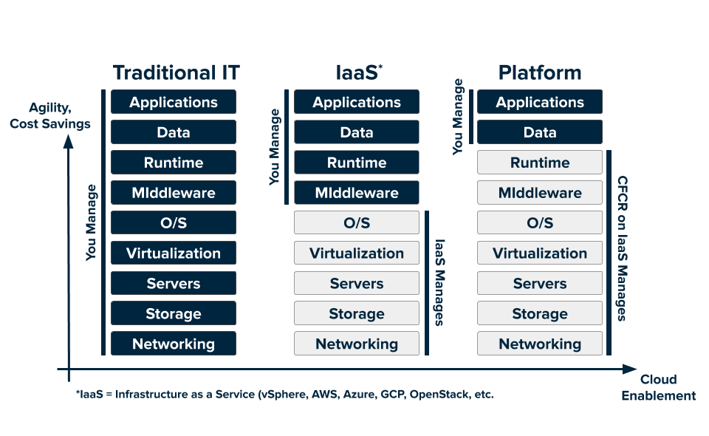
Traditional IT system to current IT systems
Function as a Service
(FaaS)
Serverless functions

Slide 4
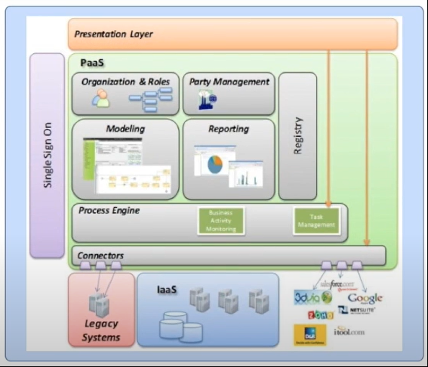

Slide 5
More about PCF…
PCF is similar to Azure, AWS, GCP cloud platforms.
In modern software development many microservices are used to run applications smoothly. All the services should be highly available all the time to run the application smoothly.
PCF makes it easy when comes to deploying the microservices and running the application. After deploying we can monitory the traffic of our application like how the income and outcome requests and any failure requests etc…
Pivotal Cloud Foundry (PCF) is a multi-cloud platform for the deployment, management, and continuous delivery of applications, containers, and functions.
Official Documentation Links:
https://docs.pivotal.io/application-service/2-10/concepts/overview.html
https://tutorials.cloudfoundry.org/what-is-cf/

Slide 6
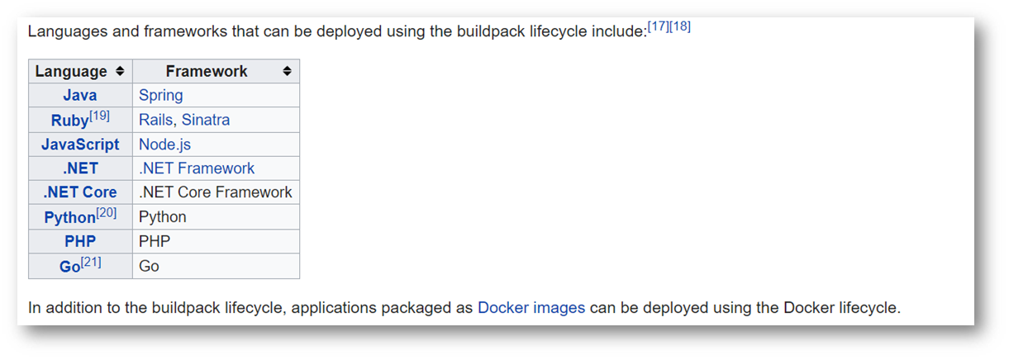
Languages & Frameworks

Slide 7

PCF SETUP

Slide 8
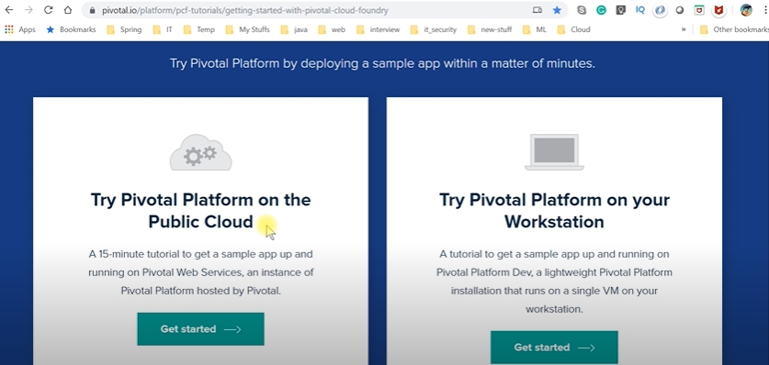
PCF official documentation page(Old website)
Here we can download the setup file to install Cloud foundry in local machine

Slide 9
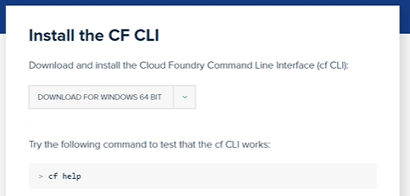
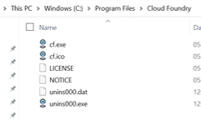
Install CF CLI in Local Machine

Slide 10
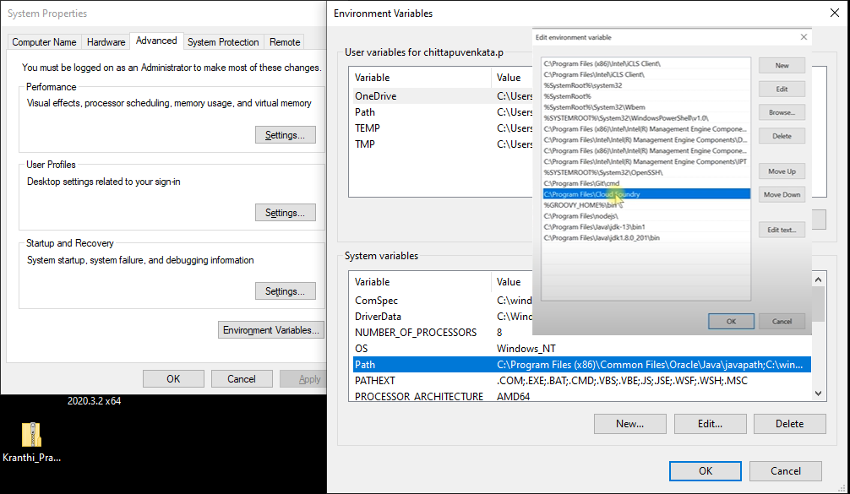
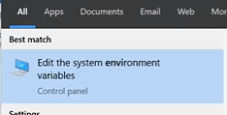
Setup Environment Variables
Path will add automatically if not need to add manually
To check the installation is proper or not -> Go to command prompt and use 'cf help -a' will see all CF commands available.
To check version 'cf version'
Next register an account in CF

Slide 11

ACCOUNT CREATION IN PCF PORTAL

Slide 12
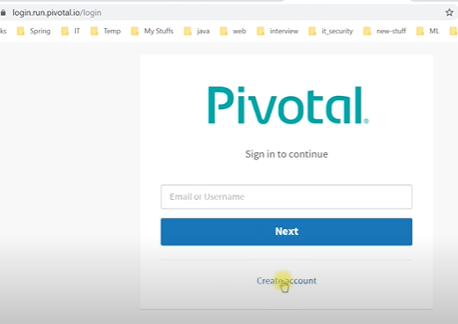
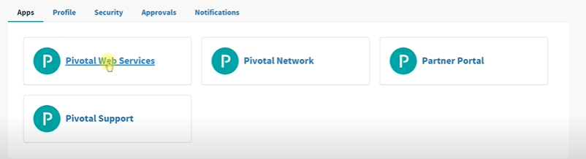
After creating new account and login with the credentials we can see below options in PCF portal
Go to Pivotal Web Services => It will open a page to create a free trail / paid services to use

Slide 13
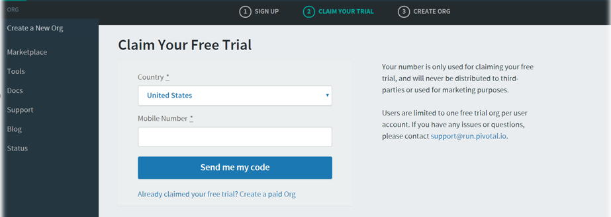
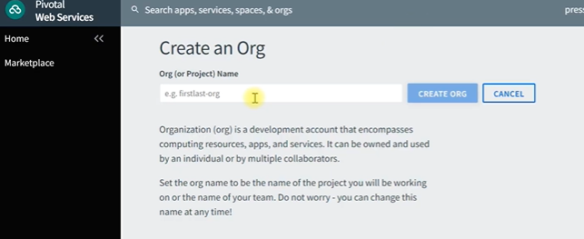
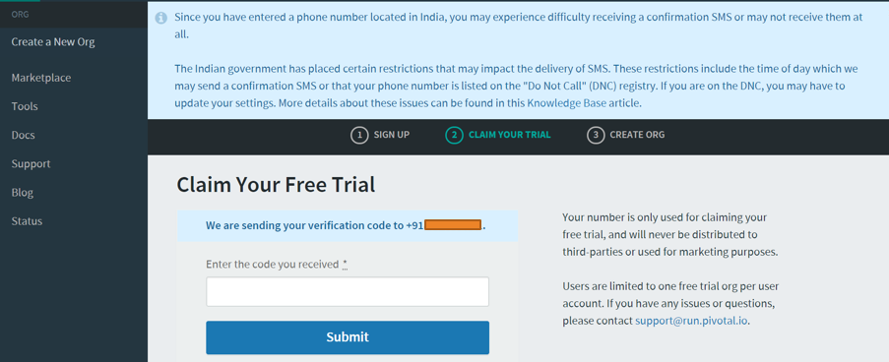

Slide 14
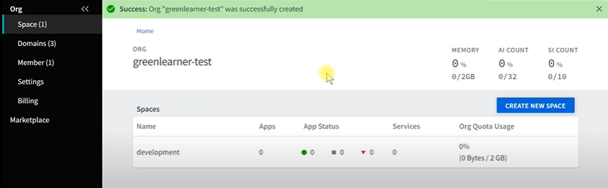
What is an ORG?
An ORG is a development account that an individual or multiple collaborators can own and use.
All collaborators access an org with user accounts, which have roles such as
Org Manager,
Org Auditor, and
Org Billing Manager.
Collaborators in an ORG share a resource quota plan, apps, services availability, and custom domains
By default, an org has the status of active
An admin can set the status of an org to suspended for various reasons such as failure to provide payment or misuse
When an org is suspended, users cannot perform certain activities within the org, such as push apps, modify spaces, or bind services.
Once we create an ORG will see the below screen
By default, 'development' SPACES is created

Slide 15
What is SPACE?
A space provides users with access to a shared location for app development, deployment, and maintenance.
An org can contain multiple spaces
Every app, service, and route is scoped to a space
Org managers can set quotas on the following for a space:
Usage of paid services
Number of app instances
Number of service keys
Number of routes
Number of reserved route ports
Memory used across the space
Memory used by a single app instances
Let’s go and create New SPACE …

Slide 16
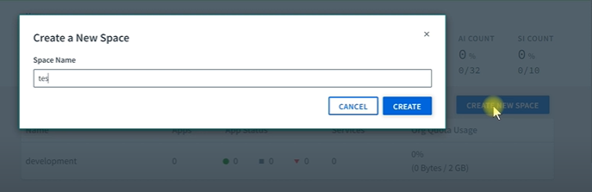
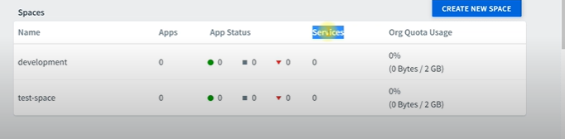
Created Spaces will list out in the below table

Slide 17
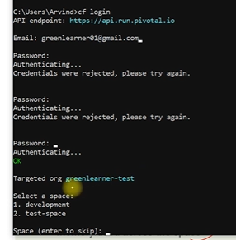

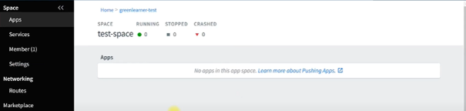
Using CMD prompt
Now login to the PCF account using command prompt with help of below command
> cf login
Enter User ID and Password
After Login Success it will show the ORGS and SPACES available in the account & can choose which space, we need
Using command line, we reached to this SPACE as mentioned below

Slide 18

Check the what APPs are available in the specific SPACE using below command
> cf apps

Slide 19

Deploy the Application using PCF commands
Login to account using 'cf login' and provide email id and password
Select the ORG and SPACE where you want to deploy the app
Once you are ready with .jar file of the project inside build/libs folder
Open the build/libs folder path in command prompt and run the below command
> cf push heloPCF123 -p helloPCF-0.0.1-SNAPSHOT.jar (heloPCF123 is the name of the app which should be unique)

Slide 20
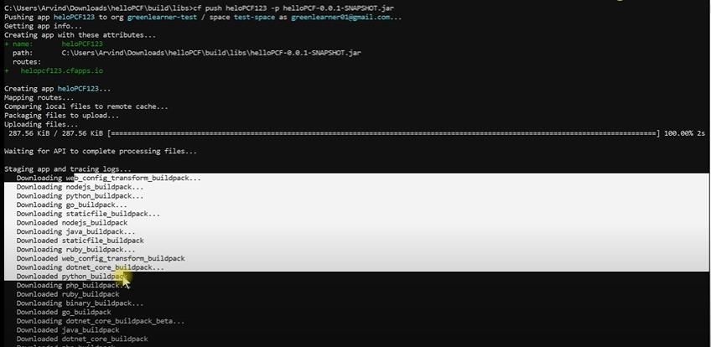
Press enter cfcli will upload this app into the specific space.

Slide 21
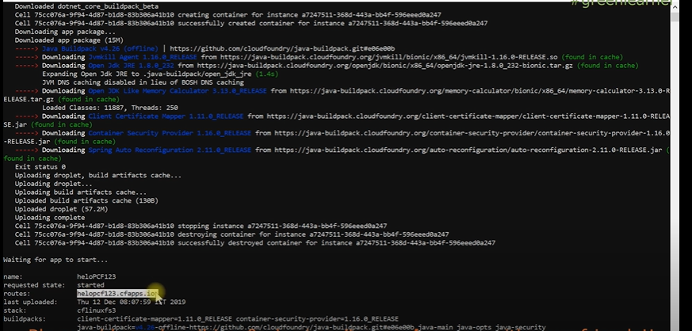
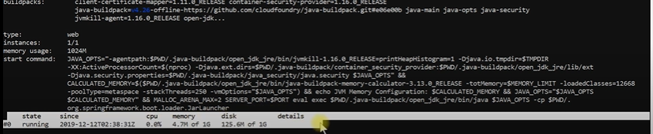

Slide 22

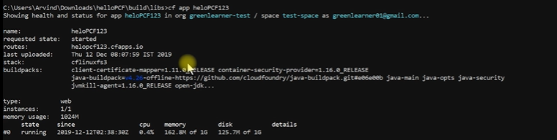
Open the URL in browser
To see the app info in CFCLI – enter the below command
> cf app heloPCF123

Slide 23
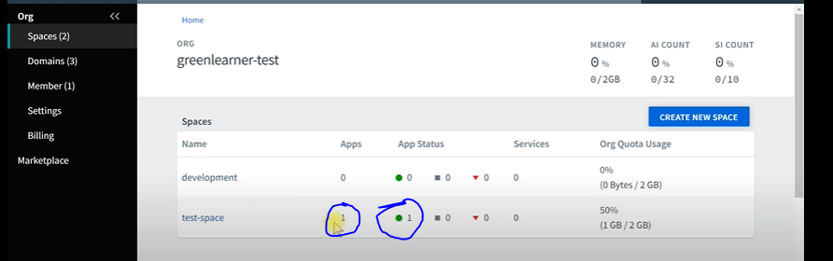
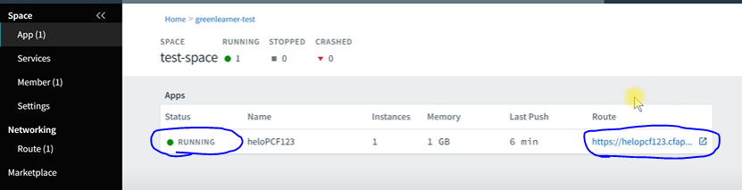
Now the Dashboard page looks as below in PCF portal
WE can see the App details and status info

Slide 24
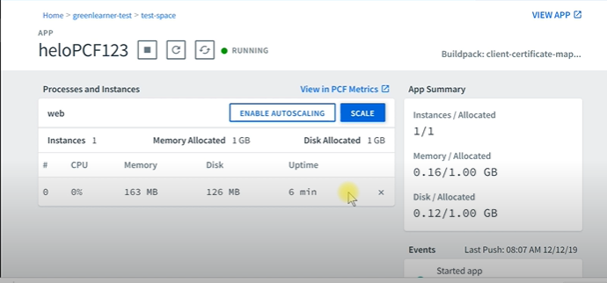
Can see more details about Application

Slide 25
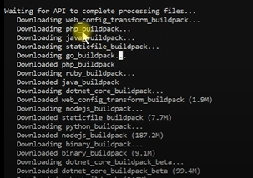
Build Pack in PCF
While pushing the application in to PCF, It will download different types of Build packs like below
Build packs provide framework and runtime support for apps.
Build packs typically examine your apps to determine what dependencies to download and how to configure the apps to communicate with bound services.
When you push an app, Cloud Foundry automatically detects an appropriate build pack for it. This build pack is used to compile or prepare your app for launch.

Slide 26
Types of Build packs
System Buildpacks
Provided by PCF
Sidecar Buildpacks
In App need to install the code we have to provide some proxy which need to additional dependency's that has to run in the same container where main application is running
Community Buildpacks
limited build packs available in PCF. There are some build pack which supported other languages, and which are generated by the community coders which can use in PCF
Cloud Foundry deployments often have limited access to dependencies. In some applications will run through Proxy's or limited firewall/network, Such type of things PCF provides "Build Packager" app setup inhouse build pack setup.

Slide 27
Manifest in PCF
This file has the syntax in YAML format.
Manifests provide consistency and reproducibility and can help you automate deploying apps.
Both manifests and command line options allow you to override the default attribute values of cf push.
These attributes include things like number of instances, disk space limit, and memory limit.
Command line options override manifests.
https://docs.cloudfoundry.org/devguide/deploy-apps/manifest.html

Slide 28
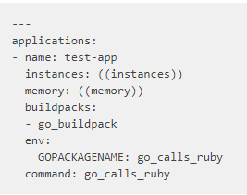

Create our own Manifest file
In existing Helloworld application inside build folder lets create manifest.yml file.
Below is the commands we are using in this file

Slide 42
Thank you…
Any doubts….

