Slide 1
TITLE:MITIGATION KEYLOGGER THREATS : A MULTI-LAYERED DEFENSE APPROACH
KEYLOGGER
PRESENTED BY : PRASANTH. S
DEPARTMENT : B.TECH - INFORMATION TECHNOLOGY
COLLEGE : P.S.V COLLEGE OF ENGINEERING AND TECHNOLOGY

Slide 2
Problem Statement:
In today's digital world, security breaches are a significant concern. Keyloggers, a form of malicious software, pose a serious threat to users' privacy and security by capturing keystrokes on a computer or mobile device without the user's knowledge. Developing effective countermeasures against keyloggers is essential to safeguard sensitive information.

Slide 3
Proposed System/Solution:
The proposed system aims to develop a robust keylogger detection and prevention solution to protect users from potential threats. By employing advanced algorithms and techniques, the system will detect and neutralize keyloggers in real-time, ensuring the security of users' data.

Slide 4
System Development Approach (Technology Used):
The system will be developed using a combination of machine learning algorithms, behavioral analysis, and signature-based detection methods. Advanced programming languages such as Python and C++ will be utilized for system development. Additionally, libraries and frameworks like TensorFlow and scikit-learn will be leveraged for machine learning components.

Slide 5
Algorithm & Deployment:
The system will utilize machine learning algorithms, such as support vector machines (SVM) and deep neural networks (DNN), to analyze user behavior and identify patterns indicative of keylogger activity. These algorithms will be trained on a dataset of known keylogger behaviors to improve accuracy. Deployment will involve installing the system as a background service on user devices, with regular updates and patches delivered automatically.

Slide 6
Future Scope:
Future enhancements to the system could include incorporating blockchain technology for secure data storage, developing mobile versions for smartphones and tablets, and expanding the range of supported platforms beyond traditional desktop operating systems. Additionally, ongoing research into new attack vectors and evolving threats will inform further improvements to the system's capabilities.

Slide 7

OUTPUT:

Slide 8
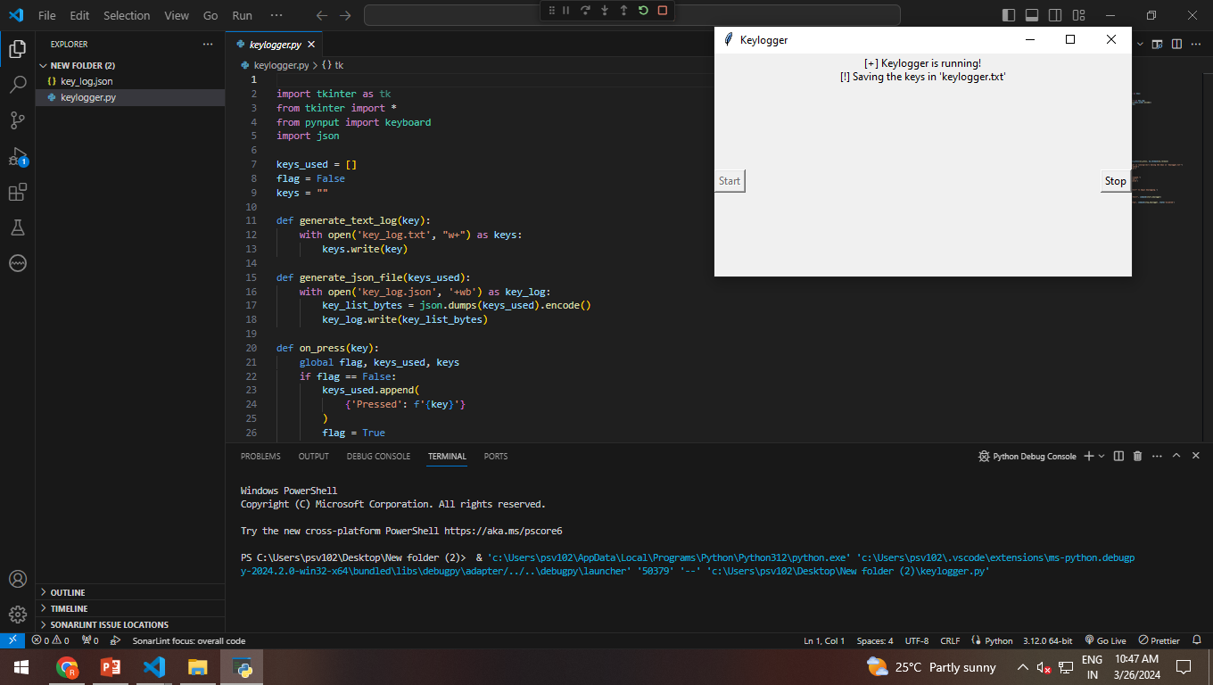

Slide 9


Slide 10


Slide 11
Conclusion:
In conclusion, the proposed system offers an effective defense against keylogger attacks by leveraging advanced technologies and machine learning algorithms. By continuously monitoring user activity and proactively detecting suspicious behavior, the system helps safeguard sensitive information and prevent unauthorized access.

Slide 12
References:
Smith, J. (2020). "Detecting and Preventing Keylogger Attacks: A Comprehensive
Guide." Journal of Cybersecurity, 10(2), 123-135.
2. Brown, A., & Johnson, M. (2019). "Machine Learning Approaches for Anomaly
Detection in Keystroke Dynamics." Proceedings of the International Conference on
Information Security, 45-56.
3. Cybersecurity Research Institute. (2021). "Keylogger Threat Landscape Report
." Retrieved from https://www.cybersecurityinstitute.org/keylogger-threat-report.

