Slide 1
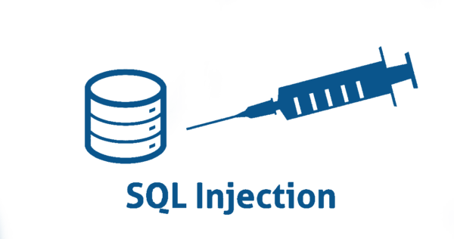
INTRODUCTION TO

Slide 2
An Introduction to SQL Injection
SQL injection (SQLi) is a web security vulnerability that allows an attacker to interfere with the queries that an application makes to its database. This can allow an attacker to view data that they are not normally able to retrieve. This might include data that belongs to other users, or any other data that the application can access. In many cases, an attacker can modify or delete this data, causing persistent changes to the application's content or behavior.

Slide 3
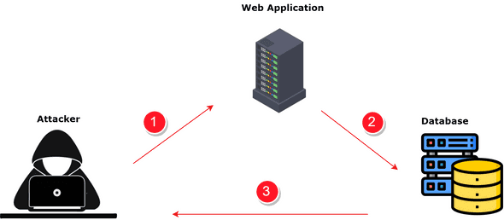
Impact of a successful SQL injection attack
A successful SQL injection attack can result in unauthorized access to sensitive data, such as:
Passwords.
Credit card details.
Personal user information.

Slide 4
SQL injection in different parts of the query
In UPDATE statements, within the updated values or the WHERE clause.
In INSERT statements, within the inserted values.
In SELECT statements, within the table or column name.
In SELECT statements, within the ORDER BY clause.

Slide 5
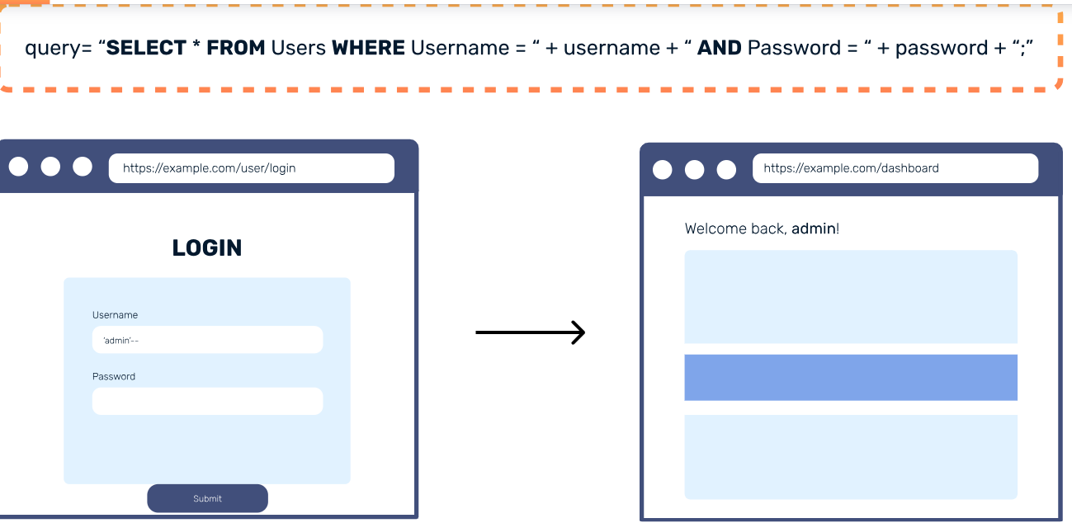
How SQL Injection Works
Consider this login page where a user attempts to log in with a username and password. If the credentials match, the login is successful. Otherwise, an "incorrect username or password" message is displayed, prompting the user to try logging in again.

Slide 6
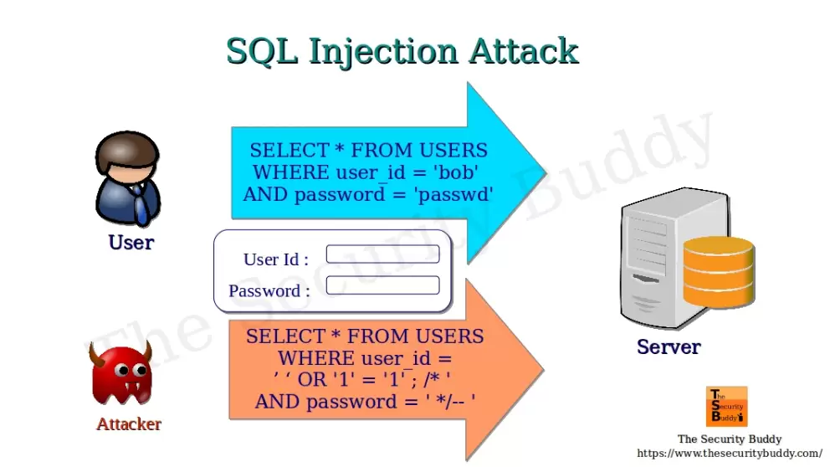
How SQL Injection Works

Slide 7
SQL injection examples
There are lots of SQL injection vulnerabilities, attacks, and techniques, that occur in different situations. Some common SQL injection examples include:
Retrieving hidden data, where you can modify a SQL query to return additional result.
UNION attacks, where you can retrieve data from different database tables.
Blind SQL injection, where the results of a query you control are not returned in the application's responses.

Slide 8
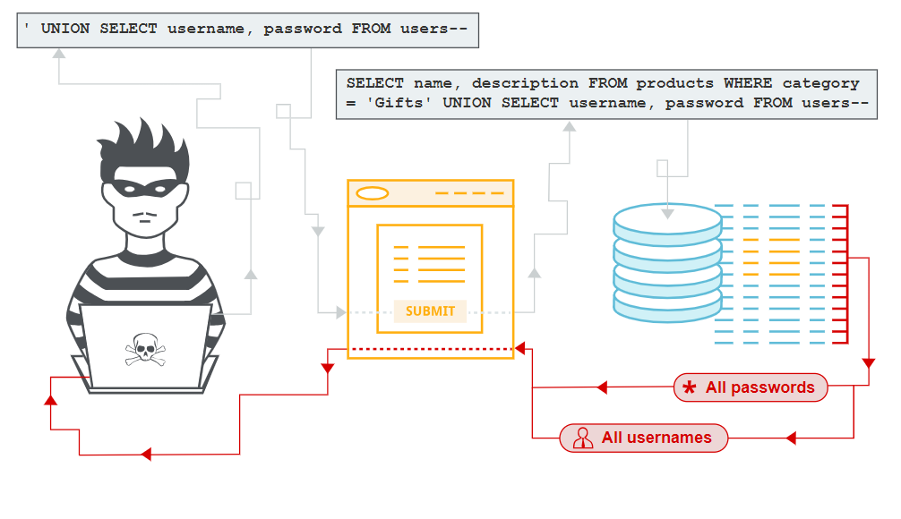
Real time example:

Slide 9
Real time example:
Imagine a shopping application that displays products in different categories. When the user clicks on the Gifts category, their browser requests the URL:
https://secure-website.com/products?category=Gifts
This causes the application to make a SQL query to retrieve details of the relevant products from the database:
SELECT * FROM products WHERE category = 'Gifts' AND released = 1

Slide 10
Real time example:
This SQL query asks the database to return:
all details (*)
from the products table
where the category is Gifts
and released is 1.
The restriction released = 1 is being used to hide products that are not released. We could assume for unreleased products, released = 0.

Slide 11
Real time example:
The application doesn't implement any defenses against SQL injection attacks. This means an attacker can construct the following attack, for example:
https://secure-website.com/products?category=Gifts’--
This results in the SQL query:
SELECT * FROM products WHERE category = 'Gifts'--' AND released = 1

Slide 12
How to prevent SQL injection
You can prevent most instances of SQL injection using parameterized queries instead of string concatenation within the query. These parameterized queries are also know as "prepared statements".
PreparedStatement statement = connection.prepareStatement("SELECT * FROM products WHERE category = ?");
statement.setString(1, input);
ResultSet resultSet = statement.executeQuery();
that prevents the user input from interfering with the query structure.

Slide 13
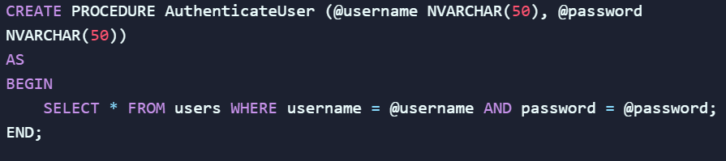
How to prevent SQL injection
Stored Procedures: Use stored procedures to encapsulate SQL queries and separate them from user input.
Example:

Slide 14
Conclusion
SQL Injection is a critical security vulnerability where attackers manipulate SQL queries through unsanitized user input, potentially compromising databases. It remains a top threat in web applications as identified by OWASP. Preventive measures include using parameterized queries, stored procedures, input validation, and adhering to the principle of least privilege

Slide 15

Thank you

