Slide 1


SMART INDIA HACKATHON 2025
Problem Statement Id : SIH25049
Projects Statement Title : Ai-driven public health chatbot for disease awareness.
Theme : HealthTech , Bio Tech , Med Tech
PS Category : Software
Team ID :
Team Name : MedCoders-6

Slide 2
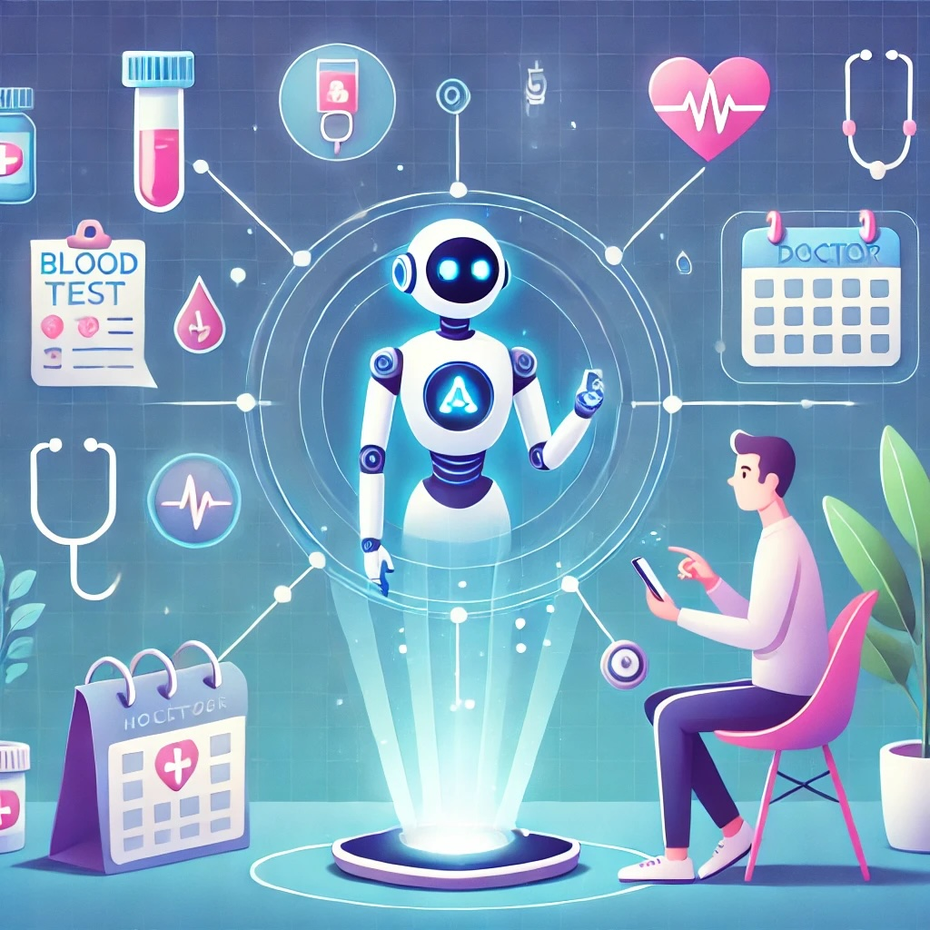
MedCoders-6
Disease Awareness
An AI bot that helps people understand health impacts, recognize early symptoms.
Get guidance for minor health issues using natural remedies and medicines.
Natural and medicinal prescription(referred by WHO), low-cost, effective,eco-friendly.
Innovations:
Multi mode access(WhatsApp , SMS , offline , app).
Emergency alerts (hospital /doctor details in critical cases).
Seasonal health alerts.
3D Diagnosis access(only for exterior parts of body).
Gender specific Responses
Tracking health history of user.
Chat Bot (Arogya Sathi):
Access via smartphone or toll-free dialer.
Search by voice, text and image.
Personalized health tips , remedies / medicines.
Exercises and diet guidance.
Alerts & hospital details for critical cases.
Feedback from user.

Slide 3
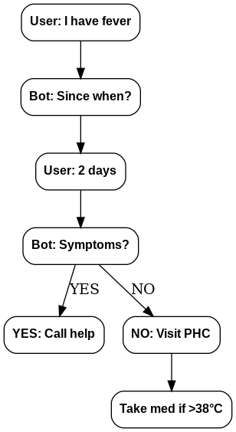
Sample example :
MedCoders-6
AROGYA SATHI
Smart Phone
Normal Phone
Multi Language
Dialer : Toll free no
Search: Typing, Voice, Image Upload
Search: via Voice
Details :Previous health issues and enquire about problem.
TECHNICAL APPROACH
Responses: Text, Voice, Images, 3D Diagnosis
Responses: Voice.
Frontend / UI
Web App: Vue & simple HTML-CSS
Backend
Intent Classification: Dialogflow / Rasa / Lang Chain
Database
Store FAQs & disease info in MongoDB
Info: Remedies and medicines (referred by WHO), Exercise, Diet tips.
Doctor Alert: Suggests consulting a doctor
Feedback From user.

Slide 4
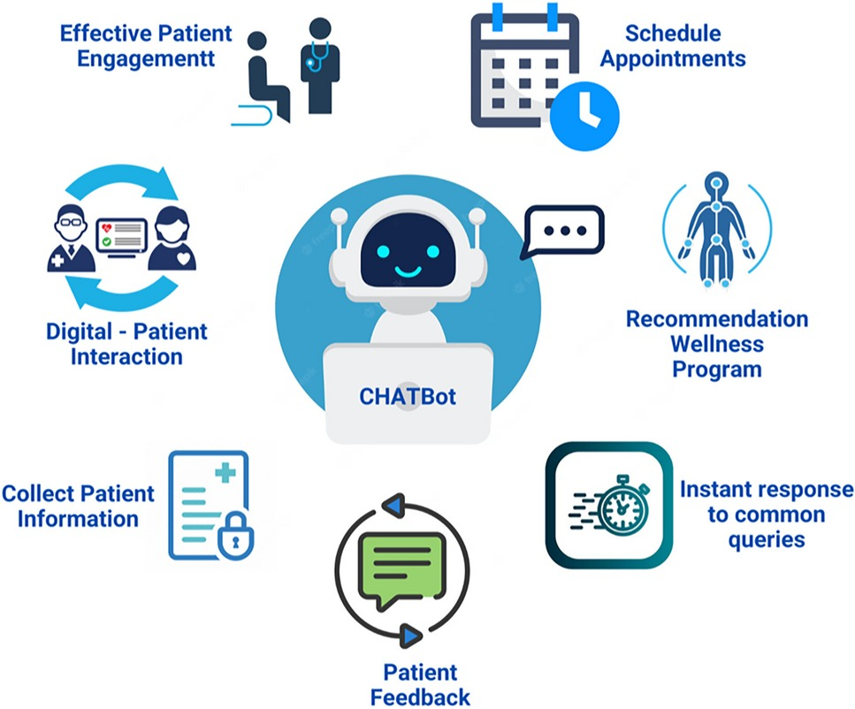
MedCoders-6
FEASIBILITY AND VIABILITY
Feasibility
Works on smartphones & normal phones
Accessible via mobile, web, SMS, IVR
Low-cost, user-friendly, scalable
Challenges
AI accuracy in symptom detection
User trust in chatbot info
Healthcare regulation compliance
Strategies
Verified data & expert checks
Clear sources & simple steps
Secure data & privacy laws

Slide 5
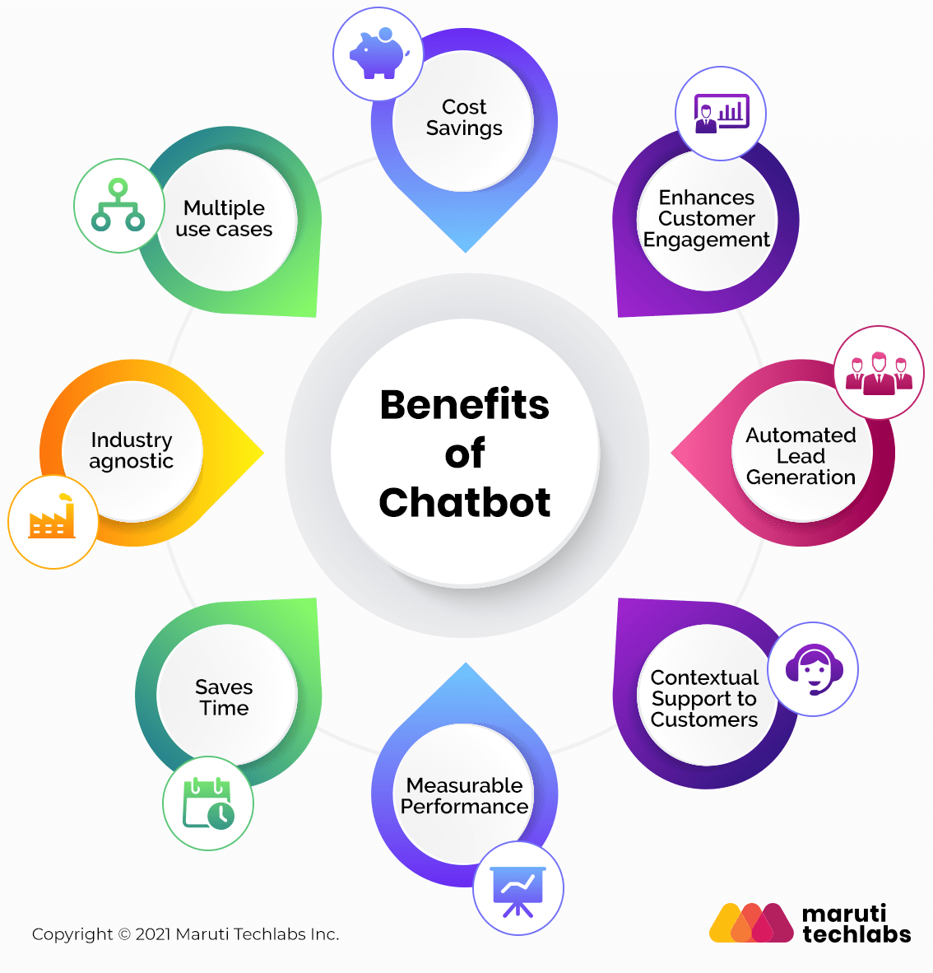
MedCoders-6
IMPACT AND BENEFITS
Target Audience
Rural People : Easy health access, saves time & cost
Students : Builds health knowledge & habits.
Workers : Quick remedies, fewer sick days.
Families/Communities : Preventive care, healthier society.
Benefits
Social : Reduces misinformation, empowers citizens.
Economic : Early awareness lowers hospital costs.
Environmental : Digital-first, less paper use.
Scalability : Expandable to multiple disease & mental health.

Slide 6
RESEARCH AND REFERENCES
MedCoders-6
Medical
WHO Traditional Medicine Strategy 2014-2023
https://iris.who.int/bitstream/handle/10665/92455/9789241506090_eng.pdf?sequence=1
AYUSH for New India: Vision and Strategy
https://aiia.gov.in/wp-content/uploads/2024/03/AyushDecadeGrowthReport-Eng-Final.pdf
Food Diet
Dietary Guidelines for Indians-2024 (ICMR-NIN)
https://www.nin.res.in/dietaryguidelines/pdfjs/locale/DGI07052024P.pdf
FAO Food-based dietary guidelines – India
https://www.who.int/news-room/fact-sheets/detail/healthy-diet
Physical Activities
WHO Physical activity & sedentary behaviour guidelines 2020
https://www.who.int/publications/i/item/9789240015128
Consensus Physical Activity Guidelines for Asian Indians
https://www.who.int/news-room/fact-sheets/detail/physical-activity

