Slide 1

Pizza Sales Analysis

Slide 2

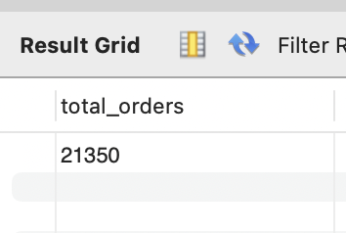
1. Retrieve the total no of orders placed

Slide 3
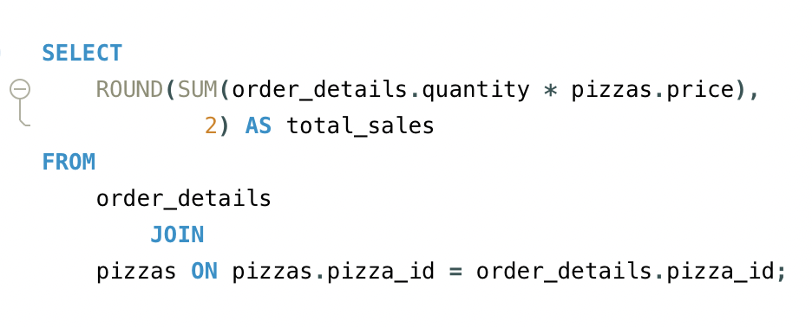
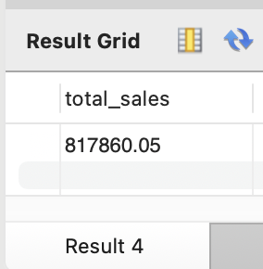
2. Calculate the “total revenue” generated from pizza sales

Slide 4
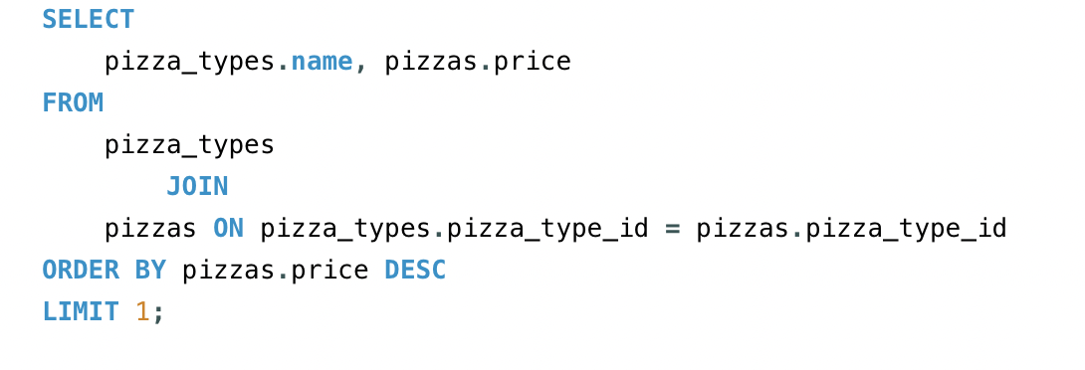
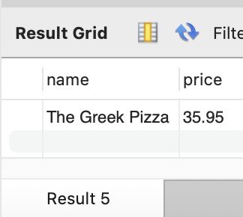
3. Identify the highest priced pizza

Slide 5
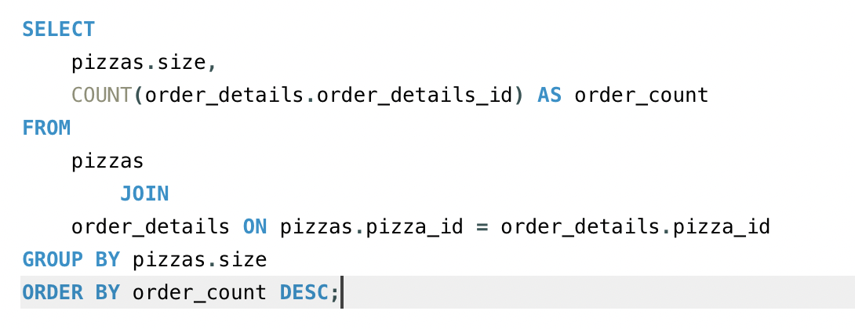
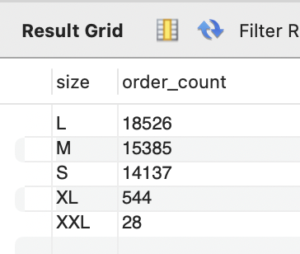
4. Identify the most common pizza size ordered

Slide 6
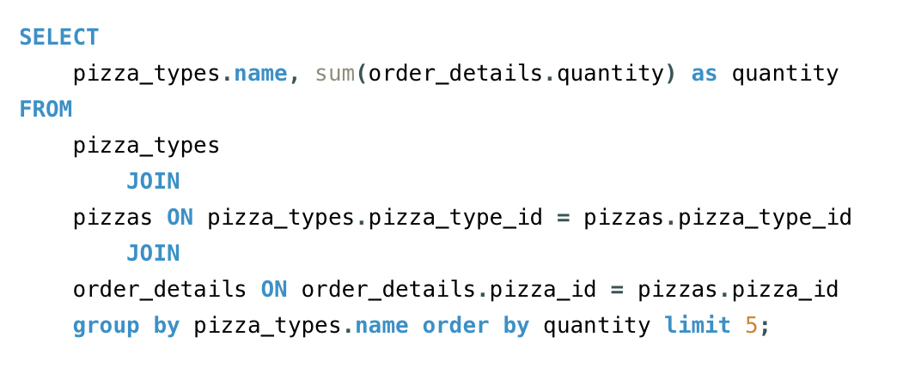
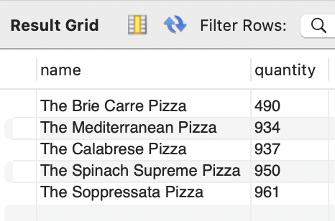
5. List the top 5 most ordered pizza types along with their quantities

Slide 7
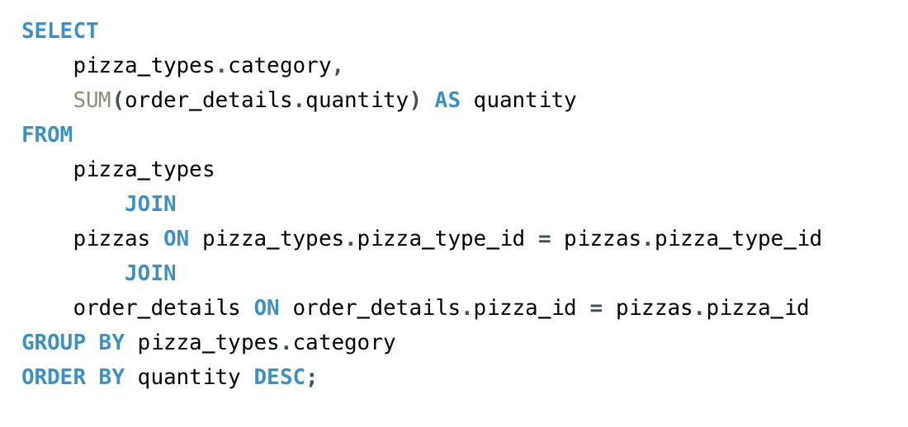
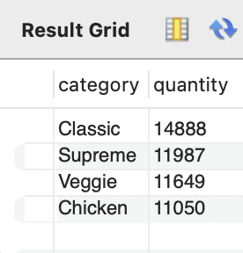
6. Join the necessary tables to find the total quantity of each pizza category ordered

Slide 8
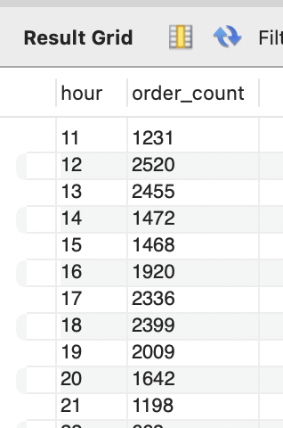
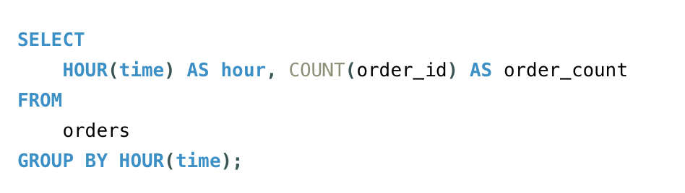
7. Determine the distribution of orders by hour of the day

Slide 9
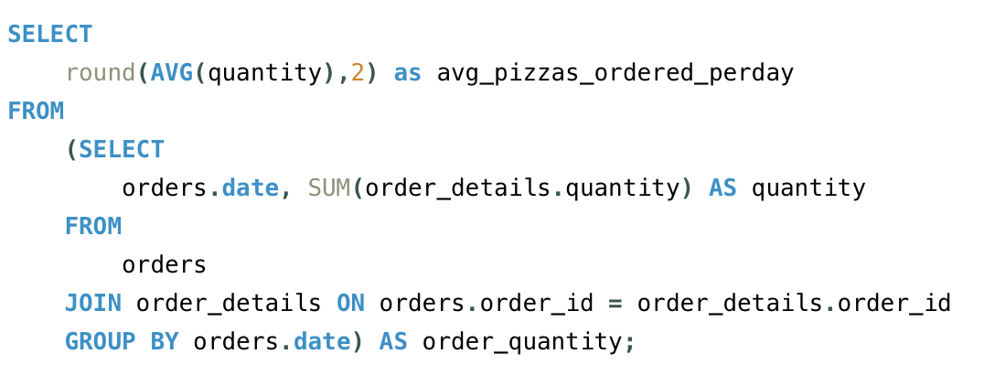
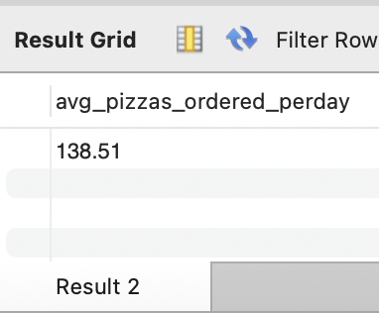
8. Group the orders by date and calculate the average number of pizzas ordered per day

Slide 10
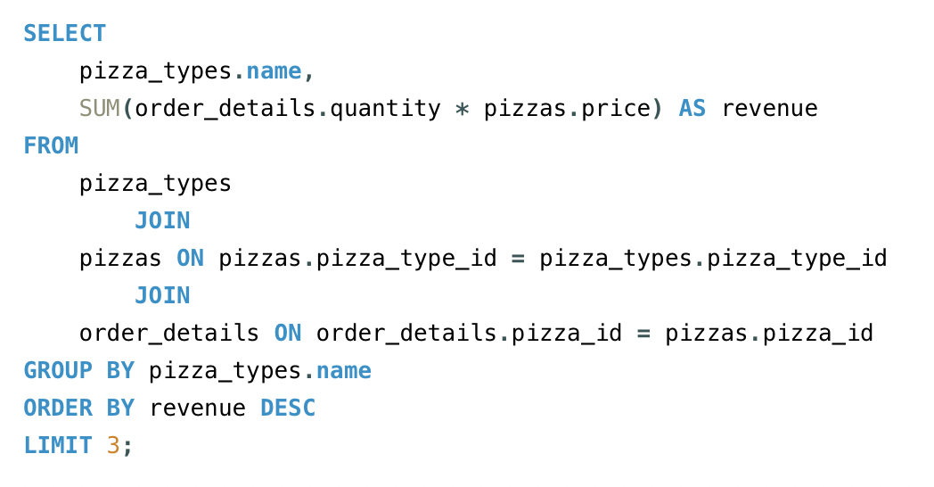
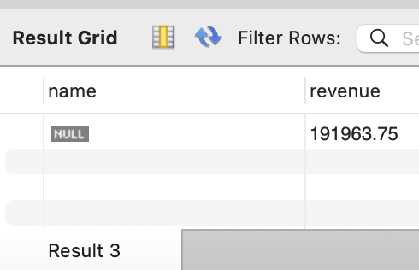
9. Determine the top 3 most ordered pizza types bsaed on revenue

Slide 11
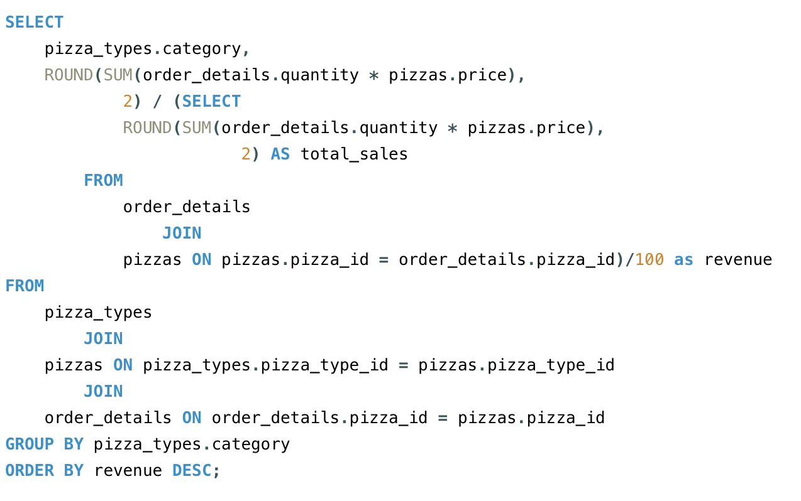
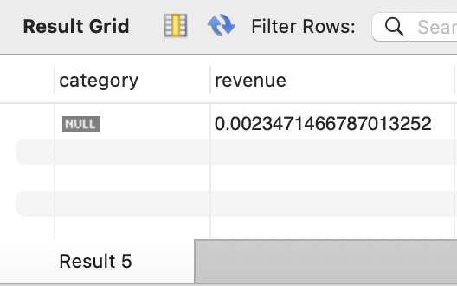
10. Calculate the percentage contribution of each pizza type to total revenue

Slide 12
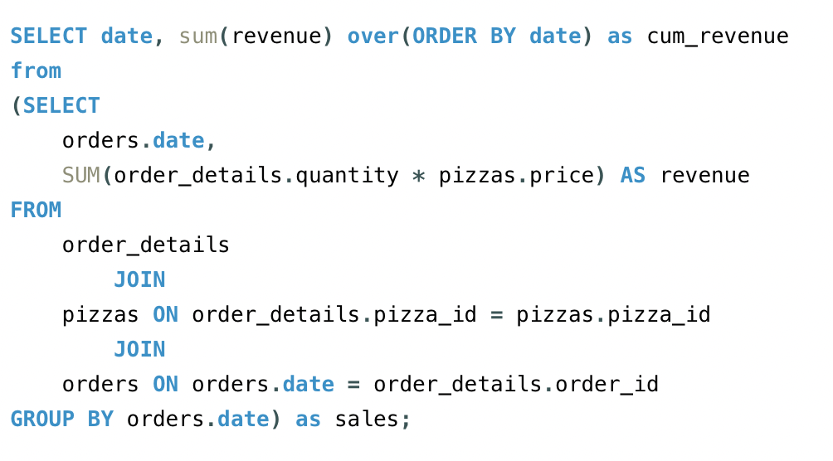
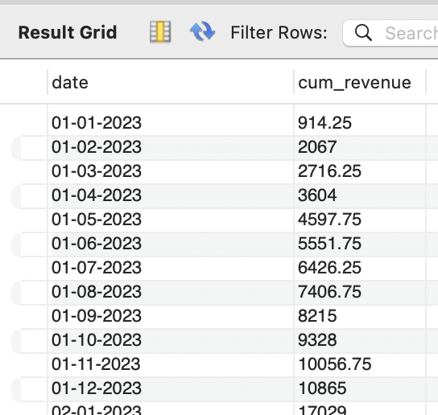
11. Analyze the cumulative revenue generated over time

Slide 13
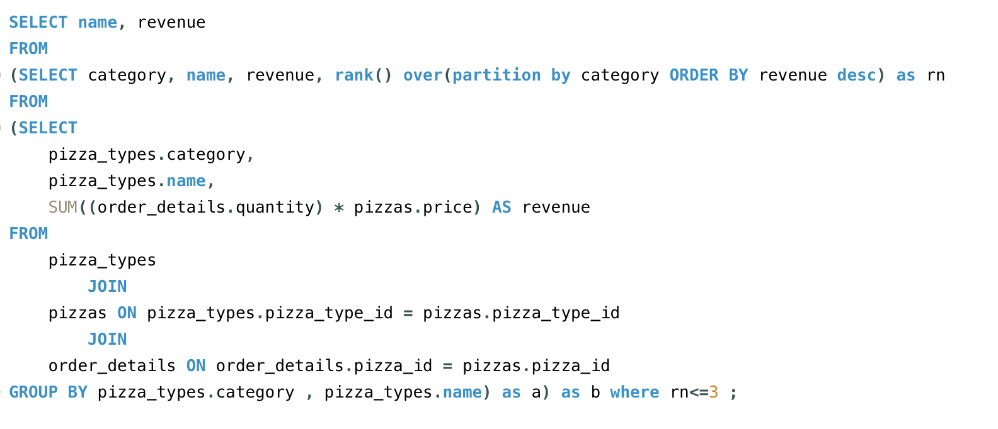
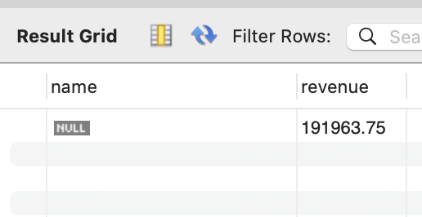
12. Determine the top 3 most ordered pizza types based on revenue for each pizza category

