Slide 1

BUSINESS INTELLIGENCE SYSTEMS
CS591 Course Project
Team 03
Prasanthi Putta

Slide 2
TABLE OF CONTENTS
S. No. | Topic | Slide #
0 | Introduction to BI | 3
1 | Comparison Table | 4
2 | Software Design and Development Model | 5
3 | Scope Statement | 6
4 | Human Resource Management Plan | 9
5 | Project Total Cost estimates | 14
6 | Time Management Plan | 16
7 | Cost Management Plan | 21
8 | Risk Management Plan | 24
9 | Procurement Management Plan | 32
10 | Statement of Work | 35
11 | Conclusion | 39

Slide 3
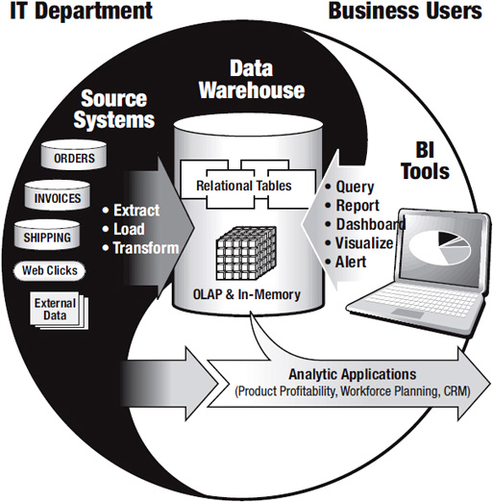
INTRODUCTION TO BI SYSTEMS
Business intelligence (BI) is a set of technologies and processes that allow people at all levels of an organization to access and analyze data.
Business performance is measured by several financial indicators, such as revenue, margin, profitability, cost to serve, and so on.
A key sign of successful business intelligence is the degree to which it impacts business performance, linking insight to action.
https://learning.oreilly.com/library/view/successful-business-intelligence/9780071809184/

Slide 4
1. COMPARISION TABLE
BI Tool | JasperReports | Pentaho | BIRT | Apache Superset | Redash
Scope | JasperReports Server offers web-based reporting, analytic tools and visualization, and a dashboard feature for compiling multiple custom views. | The scope of the Pentaho BI suite is vast supporting all kinds of data and data sources that furnish limitless visualization options. | The BIRT Project will focus on leveraging the Eclipse platform to provide infrastructure and tools for the designing, deploying, generating and viewing of reports in an organization, including ad hoc query and reporting tools. | Superset is a data exploration platform designed to be visual, intuitive and interactive. It’s main goal is to make it easy to slice, dice and visualize data. | Redash helps users connect and query data sources, visualize data, build dashboards, and share insights with the rest of their organization.
Main Functions | Flexible, Modern, and Embeddable Server Architecture Centralized Reporting, Dashboards, and Data Analytics Secured Data Access and Auditing Ad Hoc Report and Dashboard Development OLAP Analysis | High-end data analysis through well-defined ETL capabilities Expertise in products across varied domains Comprehensive report designer taking care of business needs Exceptional data source accommodability with high runtime metadata support | Build reports on XML data sources Used to build reusable component report libraries Allows run time modification of Data Source and Data Set public properties | A lightweight semantic layer, allowing to control how data sources are exposed to the user by defining dimensions and metrics Configurable caching options for loading dashboards Maps and geo support leveraging Mapbox User profile pages which highlight a user’s favorite dashboards/slices. | Quick editor Combine several visualizations Collaboration Alerts Query
Programming languages | JAVA, XML, JavaScript | JAVA, XML, XSL Transformation, JavaScript, HTML | JAVA, XML, HTML, CSS | Python, JavaScript, Typescript, HTML | Python, JavaScript, CSS, HTML
Lines of Code | 529,644 | 793,870‬ | 2,362,446 | 71,751 | 40,364
Technical Platform | OS:Windows, Linux, Mac OS, iOS, Android Application Servers: Apache Tomcat, JBoss, WildFly Database Repositories: MySQL | OS:Windows, Ubuntu Application Servers:Apache Tomcat, JBoss Database Repositories: MySQL, Oracle, PostgreSQL, MS SQL | OS:Windows, Linux Application Servers:Apache Tomcat, IBM WebSphere, JBoss, WildFly Database Repositories: MySQL, Oracle, PostgreSQL, MS SQL, IBM DB2 | OS:Windows, Ubuntu, Mac OS Application Servers: Gunicorn, Nginx, Apache Database Repositories: Amazon Redshift, Apache Hive, Teradata, MySQL, Oracle, PostgreSQL, MS SQL, IBM DB2 | OS:Windows, Linux Database Repositories: PostgreSQL, MySQL, Redshift, MongoDB
Trail Version Website | https://community.jaspersoft.com/download | http://www.pentaho.com/download | https://download.eclipse.org/birt/downloads/ | https://superset.apache.org/installation.html | https://redash.io/help/open-source/setup

Slide 5
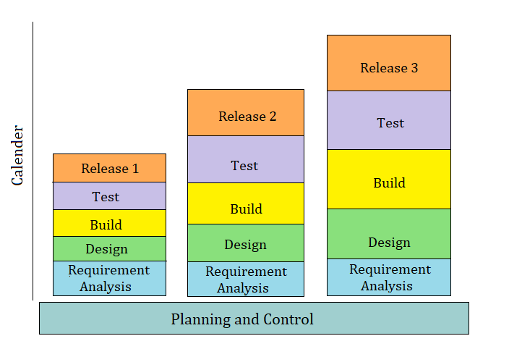
2. SOFTWARE DESIGN & DEVELOPMENT MODEL
Proposing – Incremental Model
Justification:
Most of the requirements are known up-front but are expected to evolve over time.
Each release delivers an operational product and Initial product delivery is faster.
Customer can respond to every build.

Slide 6
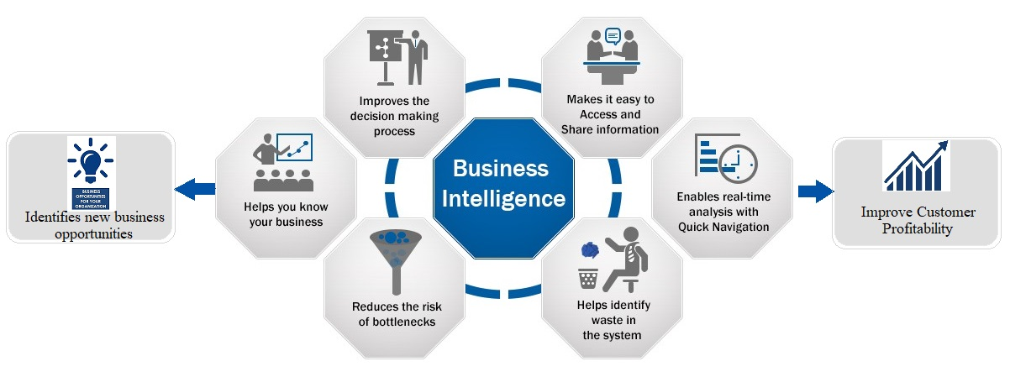
3. SCOPE OF BUSINESS INTELLIGENCE
BI is all about how to capture, access, understand, analyze and turn one of the most valuable assets of an enterprise –raw data– into actionable information in order to improve business performance.

Slide 7
SCOPE OF BUSINESS INTELLIGENCE (cont..)
Functional Requirements:
Platform Functions
Data Visualization
Analytics
Online Analytical Processing (OLAP)
Document Management
Decision Services
Integrations
Big Data Integration
Deployment

Slide 8
SCOPE OF BUSINESS INTELLIGENCE (cont..)
Non-Functional Requirements:
Performance
Security
Availability
Usability
Data Integrity
Scalability
Constraints on Technical Platform:
Operation Systems: Windows, Linux
Application Server: Apache
Database Repositories: Microsoft SQL Server, Oracle
Programming Languages: Python, JavaScript, HTML, CSS

Slide 9
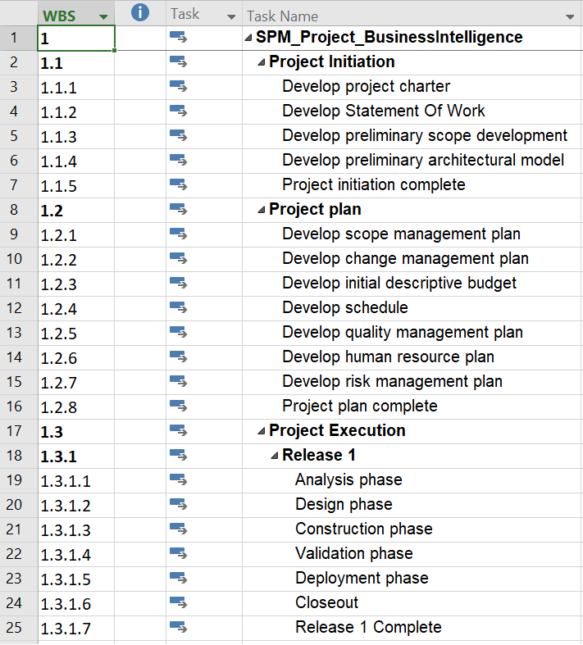
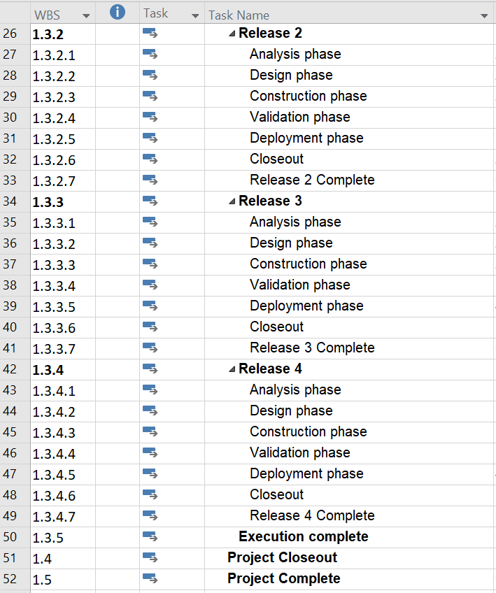
4. HUMAN RESOURCE MANAGEMENT PLAN
Work Breakdown Structure (WBS)

Slide 10

HUMAN RESOURCE MANAGEMENT PLAN (cont..)
Roles and Responsibility Matrix (RRM)
WBS | Project Manager1 | Project Manager2 | Senior Architect | Technical Lead | Quality Assurance Lead | Business Intelligence Analyst | System Analyst1 | System Analyst2 | Developer1 | Developer2 | Developer3 | Developer4 | Developer5 | Developer6 | Developer7 | Developer8 | Tester1 | Tester2
1.1.1 | R | I
1.1.2 | R | I | C
1.1.3 | R | I | C |  |  | C
1.1.4 |  | I | R | C |  |  | C
1.1.5 | R | I
1.2.1 | R | I |  |  |  | C
1.2.2 | A | R | I | C |  | C
1.2.3 | R | I
1.2.4 | A | R | I | C |  | C
1.2.5 |  | A | I | C | R | C | C | C
1.2.6 |  | A | I | R | C |  | C | C
1.2.7 | A | I | R |  |  |  | C | C
1.2.8 | R | I | C
1.3.1.1 |  | A | C | C |  | R | R | I
1.3.1.2 |  | A | R | R | R | C | I | I
1.3.1.3 |  |  | A | C |  |  | I | I | R | R | R | R | R | R | R | R
1.3.1.4 |  |  |  | A | C | I |  |  |  |  |  |  |  |  |  |  | R | R
1.3.1.5 |  | A | I | C |  |  |  |  | R | I
1.3.1.6 |  | A | R | I
1.3.1.7 | R | R | I | I |  | C
1.3.2.1 |  | A | C | C |  | R | R | I
1.3.2.2 |  | A | R | R | R | C | I
1.3.2.3 |  |  | A | C |  |  | I | I | R | R | R | R | R | R | R | R
1.3.2.4 |  |  |  | A | C | I |  |  |  |  |  |  |  |  |  |  | R | R
1.3.2.5 |  | A | I | C |  |  |  |  | I | R
1.3.2.6 |  | A | R | I
1.3.2.7 | R | R | I | I |  | C
R – Responsible A – Approval C – Consult/Review I – Inform or Act as SME

Slide 11
HUMAN RESOURCE MANAGEMENT PLAN (cont..)
Roles and Responsibility Matrix (cont..)
WBS | Project Manager1 | Project Manager2 | Senior Architect | Technical Lead | Quality Assurance Lead | Business Intelligence Analyst | System Analyst1 | System Analyst2 | Developer1 | Developer2 | Developer3 | Developer4 | Developer5 | Developer6 | Developer7 | Developer8 | Tester1 | Tester2
1.3.3.1 |  | A | C | C |  | R | R | I
1.3.3.2 |  | A | R | R | R | C | I | I
1.3.3.3 |  |  | A | C |  |  | I | I | R | R | R | R | R | R | R | R
1.3.3.4 |  |  |  | A | C | I |  |  |  |  |  |  |  |  |  |  | R | R
1.3.3.5 |  | A | I | C |  |  |  |  | R | I
1.3.3.6 |  | A | R | I
1.3.3.7 | R | R | I | I |  | C
1.3.4.1 |  | A | C | C |  | R | R | I
1.3.4.2 |  | A | R | R | R | C | I
1.3.4.3 |  |  | A | C |  |  | I | I | R | R | R | R | R | R | R | R
1.3.4.4 |  |  |  | A | C | I |  |  |  |  |  |  |  |  |  |  | R | R
1.3.4.5 |  | A | I | C |  |  |  |  | I | R
1.3.4.6 |  | A | R | I
1.3.4.7 | R | R | I | I |  | C
1.4 | R | R | I | I | I | C | I | I | I | I | I | I | I | I | I | I | I | I
1.5 | R | R
R – Responsible A – Approval C – Consult/Review I – Inform or Act as SME

Slide 12
HUMAN RESOURCE MANAGEMENT PLAN (cont..)
List of required resources:
Human Resources | Material Resources
Project Manager1 | Laptop1, Cellphone1, PDA1
Project Manager2 | Laptop2, Cellphone2, PDA2
Senior Architect | Laptop3, Cellphone3, PDA3
Technical Lead | Laptop4, Cellphone4
Quality Assurance Lead | Laptop5, Cellphone5
Business Intelligence Analyst | Laptop6, Cellphone6
System Analyst1 | Laptop7, Cellphone7
System Analyst2 | Laptop8, Cellphone 8
Developer1 | Laptop9
Developer2 | Laptop10
Developer3 | Laptop11
Developer4 | Desktop1
Developer5 | Desktop2
Developer6 | Desktop3
Developer7 | Desktop4
Developer8 | Desktop6
Tester1 | Laptop12
Tester2 | Desktop5

Slide 13
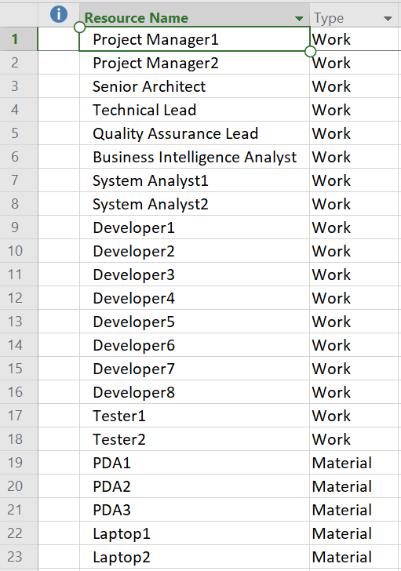
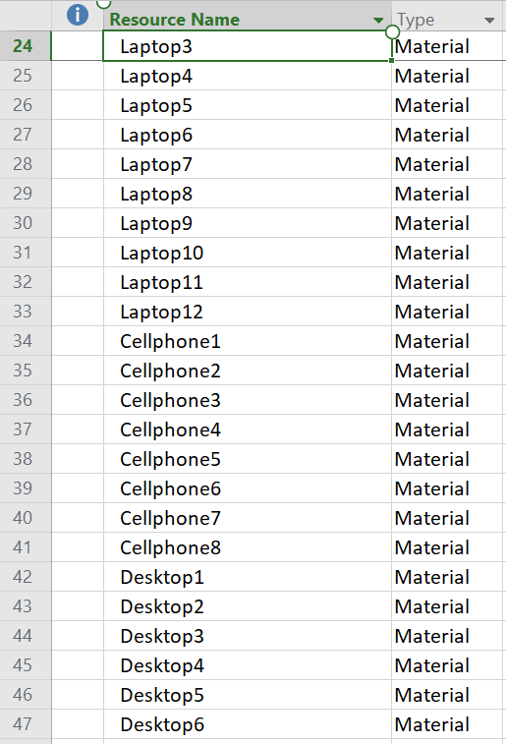
HUMAN RESOURCE MANAGEMENT PLAN (cont..)
List of required resources (cont..):

Slide 14
5. PROJECT TOTAL COST
Lines of Code Based Estimate:
Function | Pages(P) | Lines of code per Page (LOCP) | Total Lines Of Code (TLOCF)
User Interface for Static Pages | 62 | 81 | 5022
User Interface for Dynamic Pages | 89 | 154 | 13706
Code behind for Static Pages | 67 | 95 | 6365
Code behind Dynamic Pages | 98 | 162 | 15876
Data Base –SQL Stored Procedures | 64 | 144 | 9216
Business layer- Logical Pages | 86 | 125 | 10750
Other Layer-Logical Pages | 75 | 120 | 9000
Total(TLOC): |  |  | 69,935
Total Project Cost(TPC) in $: |  |  | 1,118,960
Estimating $16 per line of code
Total Project Cost = 69,935 * 16 = $1,118,960

Slide 15
PROJECT TOTAL COST (cont..)
Function Point Based Estimate:
Complexity Calculation
Category | Low | Weight_L | Average | Weight_A | High | Weight_H | Total (T)
User inputs | 27 | 4 | 14 | 6 | 7 | 3 | 250
User outputs | 25 | 4 | 12 | 5 | 6 | 4 | 210
User inquires | 23 | 2 | 11 | 6 | 5 | 5 | 219
File/Structures | 26 | 8 | 12 | 9 | 5 | 7 | 396
External Interface | 18 | 7 | 9 | 9 | 4 | 7 | 242
 |  |  |  |  |  |  | 1120
Unadjusted Total (UT):
Total Functional points = 1120
Average Cost per functional point is 1000
Estimated Project Cost = 1120* 1000 = ‭$1,120,000

Slide 16
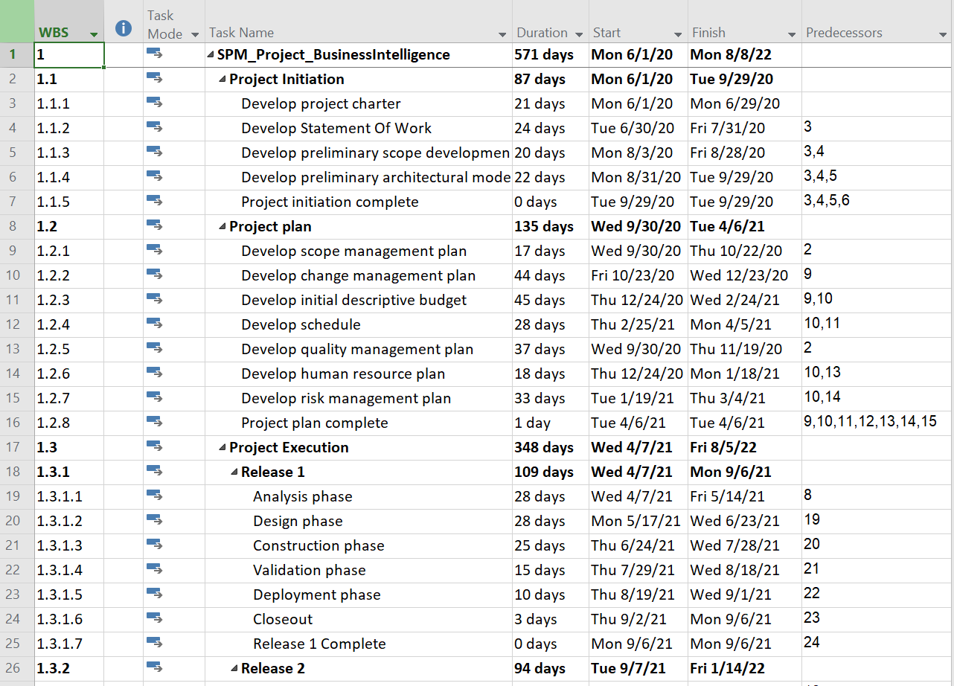
6. TIME MANAGEMENT PLAN
List of all project tasks with predecessors and durations:

Slide 17
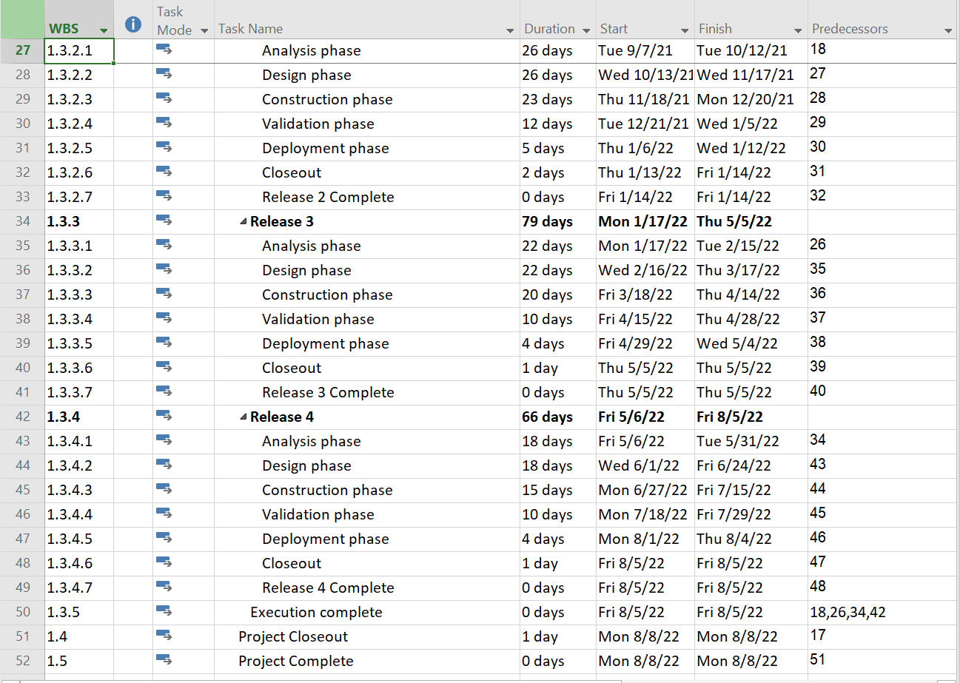
TIME MANAGEMENT PLAN (cont..)
List of all project tasks with predecessors and durations (cont..):

Slide 18
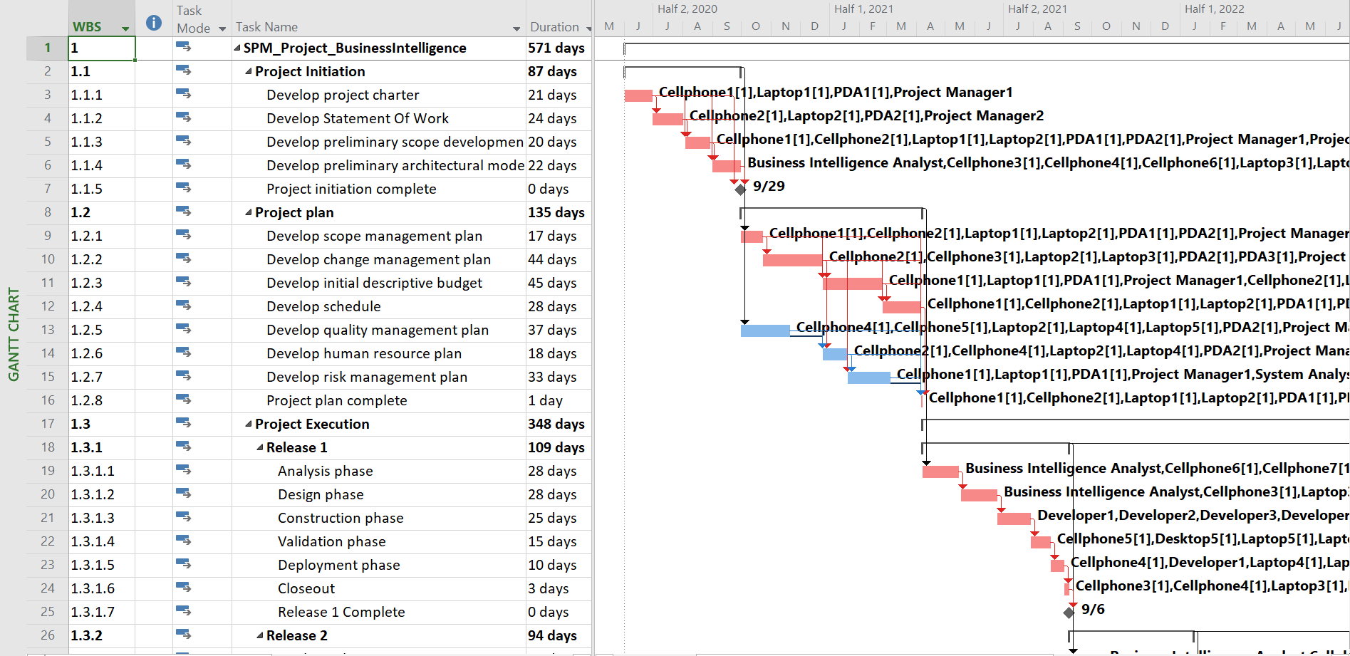
TIME MANAGEMENT PLAN (cont..)
Gantt Chart View with Critical Path:

Slide 19
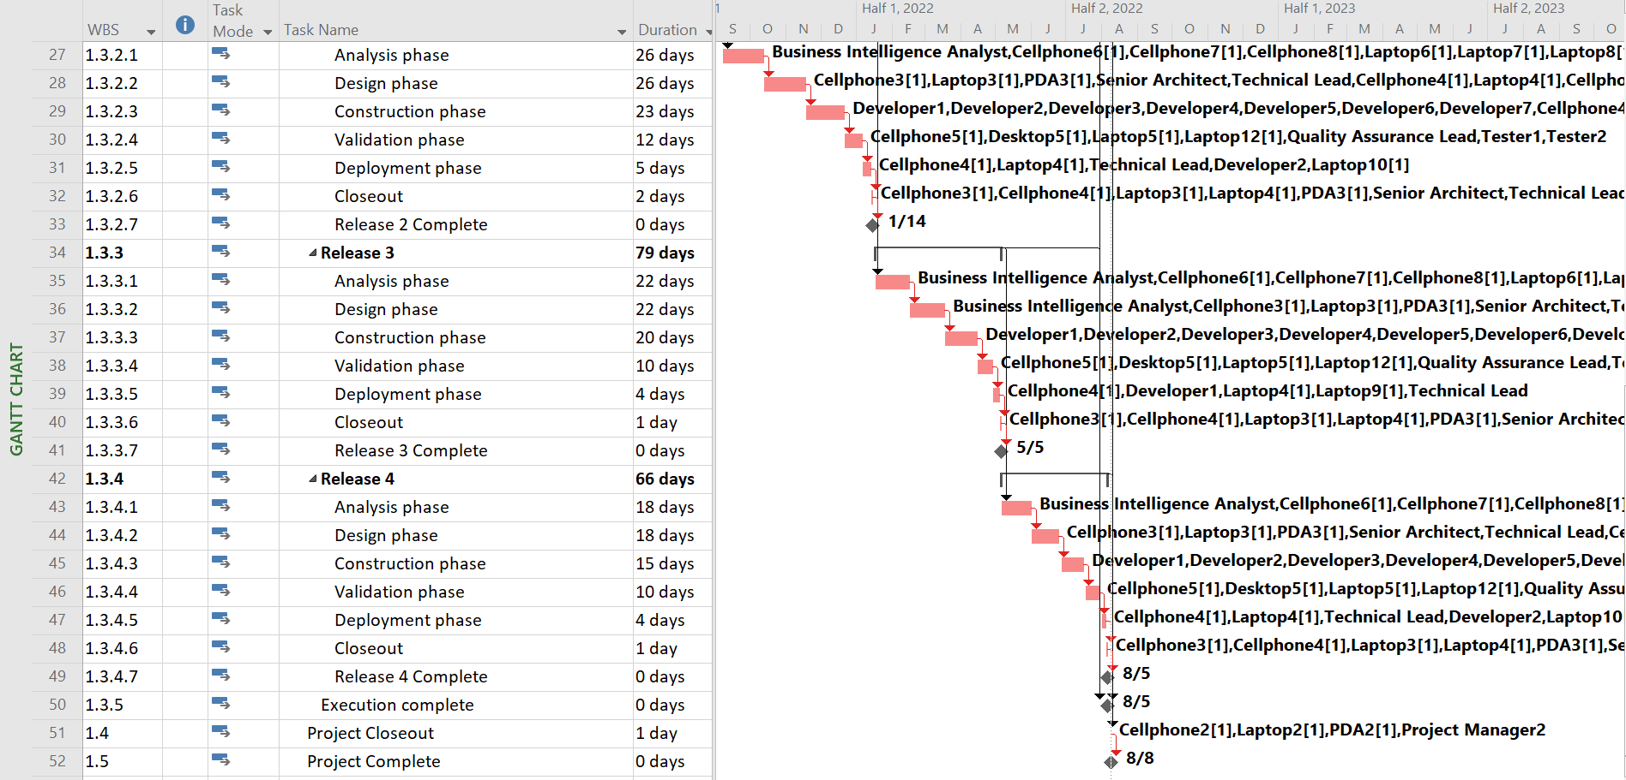
TIME MANAGEMENT PLAN (cont..)
Gantt Chart View with Critical Path (cont..):

Slide 20
TIME MANAGEMENT PLAN (cont..)
Total Project Time:
Phases | Start Date | Final Date | Duration(Days)
1.1 Project Initiation | 06/01/2020 | 09/29/2020 | 87
1.2 Project Plan | 09/30/2020 | 04/06/2021 | 135
1.3.1 Release 1 | 04/07/2021 | 09/06/2021 | 109
1.3.2 Release 2 | 09/07/2021 | 01/14/2022 | 94
1.3.3 Release 3 | 01/17/2022 | 05/05/2022 | 79
1.3.4 Release 4 | 05/06/2022 | 08/05/2022 | 66
Overall Project | 06/01/2020 | 08/08/2022 | 571
Total Project time = 571 days

Slide 21
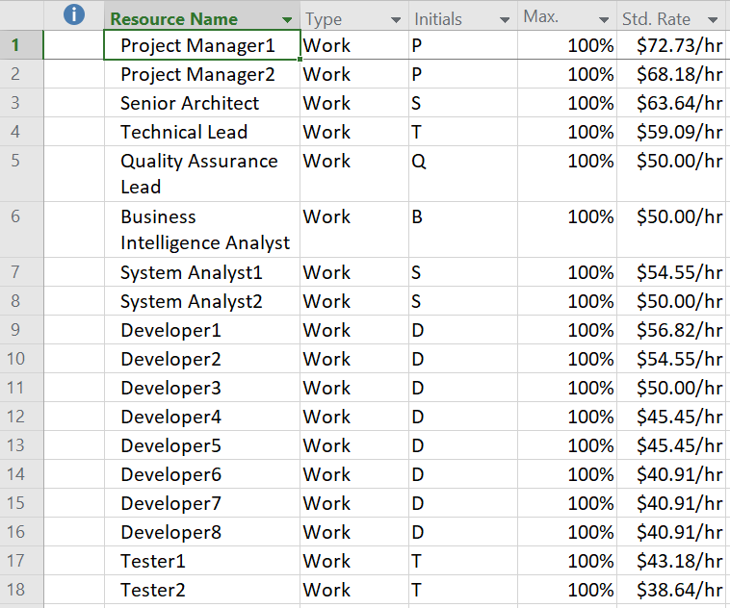
7. COST MANAGEMENT PLAN
List of human resources with salaries:

Slide 22
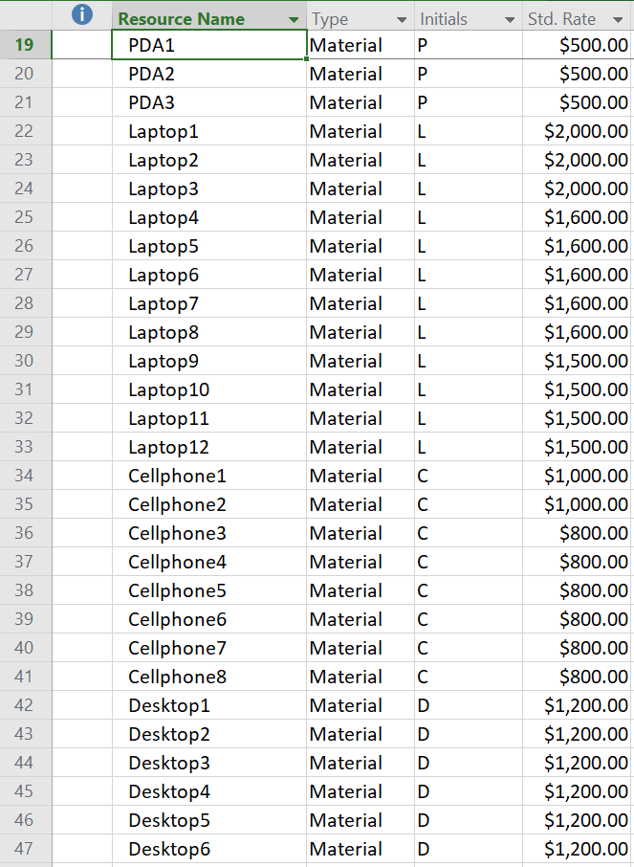
COST MANAGEMENT PLAN (cont..)
List of material resources with costs:

Slide 23
COST MANAGEMENT PLAN (cont..)
Project Budget:
Phases | Total Project Cost($) | Actual Cost($) | Remaining Cost($)
1.1 Project Initiation | $100,355.28 | $100,355.28 | $0.00
1.2 Project Plan | $225,865.04 | $225,865.04 | $0.00
1.3.1 Release 1 | $232,265.44 | $29124.09 | $203,141.35
1.3.2 Release 2 | $212,157.20 | $0.00 | $212,157.20
1.3.3 Release 3 | $186,392.24 | $0.00 | $186,392.24
1.3.4 Release 4 | $159,138.24 | $0.00 | $159,138.24
Overall Project | $1,120,218.88 | $355,344.41 | $764,874.47
Total Project cost = $1,120,218.88

Slide 24
8. RISK MANAGEMENT PLAN
Decision Tree Analysis with Expected Monetary Value:
Initial
Question
Outcome
Probabilities
Outcome +/-
Expected Value
Options
-1,000,000
-1,000,000*0.1= -100,000
CF=0.1
PS=0.2
560,150
560,150*0.2=112,030
In house development
CS=0.7
1,120,300
1,120,300*0.7=784,210
Business Intelligence System
Total = $796,240
Outsource
CS=0.6
1,000,000
1,000,000*0.6=600,000
CF=0.4
-1,120,300
-1,120,300*0.4=-448,120
Total =$151,880

Slide 25
RISK MANAGEMENT PLAN (cont..)
Risk List:
Risk No. | Risk | Risk Description
1 | Scope Creep | One of the greatest threats to a successful Business Intelligence project is scope creep. “Scope creep” simply as having a project scope that increases in size due to initially unintended or unanticipated changes to requirements and expectations.
2 | Polluted Data | In most cases, polluted data is a result of errors or problems in the production system that registers and stores the data: the data entered is not sufficiently monitored and validated. Because of polluted data, the ETL process becomes much more complex and more difficult to maintain.
3 | Data without context | If we have large amounts of data at our disposal but we do not know the meaning (or context), then we have a major problem. If the data and its structure and meaning is not clearly described – metadata -, we cannot determine what we want to measure and modeling the data in the data warehouse coherently is even more problematical. The better the data is described, the faster we can implement BI projects.
4 | Large Volumes of data | Large amounts of data can form a barrier when we start using Business Intelligence. The production systems of larger organizations often deal with very large volumes of data (hundreds of millions) on a daily basis. Additionally, large volumes of data may cause delays during the development and testing of the BI system.
5 | Absence of data | If an organization does not register the signals that are important for effective business operations, then the senses of that organization malfunction. If this is the case, the organization must return to previous steps in the major Business Intelligence cycle in order to record the required signals in their source system.
6 | The complexity of ETL | Extracting and integrating data from different source systems is difficult. According to a renowned research institute, ETL takes up 70 to 80 percent of the total (technical) costs involved with building a BI system.
7 | The technology push | The IT department forces a data warehouse and BI technology onto the organization without taking into account the wishes and requirements of users and without properly aligning technology and information needs.
https://www.passionned.com/top-10-bi-risks-and-obstacles-to-success/

Slide 26
RISK MANAGEMENT PLAN (cont..)
Risk Exposure table:
Risk No. | Risk Probability (RP) | Risk Impact (RI) | Risk Exposure (RP * RI)
1 | Medium (0.5) | High (0.9) | 0.45
2 | Medium Low (0.3) | Medium (0.5) | 0.15
3 | Medium Low (0.3) | Medium Low (0.3) | 0.09
4 | Medium (0.5) | Medium High (0.7) | 0.35
5 | Low (0.1) | Medium (0.5) | 0.05
6 | Medium high(0.7) | High (0.8) | 0.5
7 | Low (0.1) | Medium Low (0.3) | 0.03
 |  |  | 1.68
Total Risk Adjustment Factor

Slide 27
RISK MANAGEMENT PLAN (cont..)
Probability and Impact Matrix
Impact Probability | Low | Low Medium | Medium | Medium High | High
Low |  | 7 | 5
Low Medium |  | 3 | 2
Medium |  |  |  | 4 | 1
Medium High |  |  |  |  | 6
High

Slide 28
RISK MANAGEMENT PLAN (cont..)
Risk Register:
Risk No. | Risk | Trigger Event | Responsible | Consequence | Probability | Mitigation
1 | Scope Creep | Client may be under pressure with a competitor and hence would like to introduce additional features/functionalities | Project Manger1 and Project Manager2 | Scope creep has negative impact on a project as the project may be derailed in terms of timelines and may overshoot budget. Leads to financial loss in case a project gets cancelled. Leads to lot of rework as the scope keeps changing. | Medium | Understand Project Scope Document requirements exhaustively Educate the client about the change control procedures Trace the Requirements
4 | Large Volumes of data | The production systems of larger organizations often deal with very large volumes of data (hundreds of millions) on a daily basis. | Team | Low Performance Pushes the limit of BI Capacity | Medium | Incremental loading Leaving out metadata that is already known Compressing data Widening the frame within which the processing can take place
6 | The Complexity of ETL | Due to aspects such as (poor) quality of source data, large amounts of data or so-called ‘back-dated transactions’ | Team | ETL takes up 70 to 80 percent of the total (technical) costs involved with building a BI system. | Medium High | Deploying an ETL tool Balanced architecture Collaborate with administrators of source systems

Slide 29
RISK MANAGEMENT PLAN (cont..)
Comparison Table
Case # | Project Total Cost | Risk Factor | Duration (Days) | Probability | Expected Value
 | (Data will be obtained during Lab 3) | (Data must be calculated before the Lab 3) | (Data will be obtained during Lab 3) | (Data will be given by Instructor before Lab 3) | (Data will be calculated during Lab 3)
0 | $1,120,218.88 | 1.62 | 571
1 (Remove 1 expert (8-9 yrs exp) - 1SA) | $1,091,922.56 | 1.90 | 640 | Partial Failure (35%) | ($9,903.71)
2 (Remove 2 experts(8-9 yrs exp) 1SA, 1 Devloper) | $1,084,602.03 | 2.20 | 650.38 | Complete Failure (30%) | ($10,685.06)
3 (add experts - 1developer) | $1,129,994.38 | 0.94 | 562.7 | Complete Success (15%) | $1,466.33
4(add 1 expert and 1 beginner - 2 developers) | $1,130,473.19 | 1.28 | 555.91 | Partial Success (20%) | $2,050.86
 |  |  |  | EMV | ($17,071.58)
 |  |  |  | Total EMV | $1,103,147.30
 |  |  |  | Conclusion | So, from a risk perspective, this project is worth doing.

Slide 30
RISK MANAGEMENT PLAN (cont..)
Comparison using Graphs:

Slide 31
9. PROCUREMENT MANAGEMENT PLAN
Make or Buy Diagram and Calculations:
1,120,000
336,000
Simple(0.3)
1,127,000
1,130,000
791,000
Difficult (0.7)
build
1,085,000
434,000
Minor changes (0.4)
Simple
(0.2)
1,105,000
132,600
1,121,400
BI Project
reuse
Major
changes
(0.6)
Complex
(0.8)
1,135,000
554,800
buy
Minor changes (0.7)
1,075,000
752,000
1,089,000
contract
Major changes
(0.3)
1,125,000
337,000
Without changes (0.6)
1,115,000
669,000
1,125,000
With changes
(0.4)
1,140,000
456,000

Slide 32
PROCUREMENT MANAGEMENT PLAN (cont..)
Type of Contract to be used:
Fixed Price Contract
Fee: $1,080,000
Cost plus Fixed Fee Contract
Estimated price of project: $ 1,080,000
Fixed Fee: $30,000
If the project is completed by the seller at
$1,100,000,
then the seller would receive
$ 1,100,000 +$30,000+
($ 1,080,000 - $1,100,000)=$ 1,110,000
Profit = $10,000
If the project is completed by the seller at
$1,060,000, then
the seller would receive
$ 1,060,000 +$30,000=$1,090,000
Profit = 30,000
Cost plus Incentive Fee Contract
Sharing Formula is 75/25
Allowable Cost: $ 1,080,000
Target Fee: $40,000
Maximum Fee: $60,000
Minimum Fee: $25,000
If the project is completed by the seller at
$1,050,000,
then the seller would receive
$1,050,000 +(1,080,000- 1,050,000)*0.25
+40,000 =$1,097,500
Profit = $47,500
If the project is completed by the seller at
$1,100,000,
then the seller would receive
$1,100,000 +$25,000 =$1,125,000
Profit = $25,000

Slide 33
PROCUREMENT MANAGEMENT PLAN (cont..)
Selected Contract:
Cost plus Incentive Fee Contract
Justification:
A cost-plus incentive fee contract provides a way to apply any savings, whether financial or by completing work ahead of schedule, that the contractor is able to secure to the pay that he or she will receive for the contracted work.

Slide 34
10. STATEMENT OF WORK
Title:
Business Intelligence Systems
Introduction:
Business intelligence (BI) is a technology-driven process for analyzing data and presenting actionable information which helps executives, managers and other corporate end users make informed business decisions.
Objectives:
The goal of this project is to design and develop Business Intelligence tool with great data visualizations and ETL Integration. More information than ever lies within our reach today as intelligence is infused into the systems and processes that make our world work. The aim of business intelligence (BI) and performance dashboards is to make sense of the mountains of data available to us and to turn it into usable knowledge.
Project Scope:
BI is evolving in every industry. The scope has expanded to more than just a set of standard, SQL-based reports. Following are the main functionality planned to implement:
Data visualization is the core of business intelligence. Both business analytics and business intelligence offers a variety of data visualization capabilities to convert the muddled sets of unstructured data into energetic images that convey meaning.
An analytical dashboard is used to analyze massive amounts of data to allow users to inspect trends, envisage outcomes and discover insights.
Predictive modeling involves creating, testing and validating a model to best predict the probability of an outcome.

Slide 35
STATEMENT OF WORK (cont..)
Milestones:
Project Schedule:
Project Start Date: 06/01/2020
Project End Date: 08/08/2022
Work Requirements:
Set the Key Performance Indicators
Find out the best software.
Define the tasks & Delegate the Resources
Critical Success Factors:
System Quality and Information Quality
Performance
Business-Executive involvement
Milestone | StartDate | EndDate
Release 1 | 4/7/2021 | 9/6/2021
Release 2 | 9/7/2021 | 1/14/2022
Release 3 | 1/17/2022 | 5/5/2022
Release 4 | 5/6/2022 | 8/5/2022

Slide 36
REQUEST FOR PROPOSAL
Background:
CS591_CP_Team_03 is developing Business Intelligence Systems. The purpose of the document is request to perform execution of testing the business key performance indicators in accordance with competitive intelligence.
Project Goals:
The purpose of business intelligence in a business is to help corporate executives, business managers, and other operational workers make better and more informed business decisions.
Schedule:
Bids shall be firm offers and shall remain valid for acceptance 60 days following the RFQ closing date.
Statement of Work:
Details enclosed in Statement of Work.
Technology constraints:
Details enclosed in Statement of Work.

Slide 37
REQUEST FOR PROPOSAL (cont..)
Elements of Proposal:
Experience of minimum 5 years in Business Intelligence Systems
Detailed document of KPI test plan.
Knowledge on business and metrics evaluation
Knowledge in mostly used Business Intelligence
Additional Options:
Although the entity has specific requirements, it is also interested in your ideas for integrating new KPI’s into the development of BI System. We encourage respondents to consider and propose alternative solutions for implemented metrics.
Evaluation Criteria:
Proposals will be evaluated based on previous experience in Business intelligence Systems, quality of previous work, time to completion and price.
Vendor Reference:
Vendors should provide their contact for further processes.

Slide 38
REQUEST FOR QUOTE
10. Required Bid Content:
Scope of Work
Bid Amount – as hourly rate/total bid
Please fill the below table
11. Contact Information:
Send your bids/proposals to:
Prasanthi Putta
Bradley University
Peoria - 61615
Item | Description | Unit Cost | Extended Cost
1 | Unit Test case design, test script, results, supporting document and traceability of software development
2 | Software integration test design, test case, results, supporting documentations and traceability to software development
3 | System integration test design, test case, results and supporting documentations traceability to system requirements

Slide 39
CONCLUSION
Business intelligence tools are essential for companies to stay competitive and maximize revenue streams. Below are the key benefits of using BI System:
Fast and accurate reporting
Valuable business insights
Competitive analysis
Better data quality
Increased customer satisfaction
Identifying market trends
Increased operational efficiency
Improved, accurate decisions
Increased revenue

Slide 40
REFERENCES
https://community.jaspersoft.com/wiki/jasperreports-server-features
https://mindmajix.com/pentaho-tutorial
https://www.predictiveanalyticstoday.com/birt-business-intelligence/
https://www.predictiveanalyticstoday.com/apache-superset/
https://www.predictiveanalyticstoday.com/redash/
http://worldcomp-proceedings.com/proc/p2012/SER2400.pdf
https://www.javatpoint.com/software-engineering-functional-point-fp-analysis

Slide 41
Thank You

