Slide 1
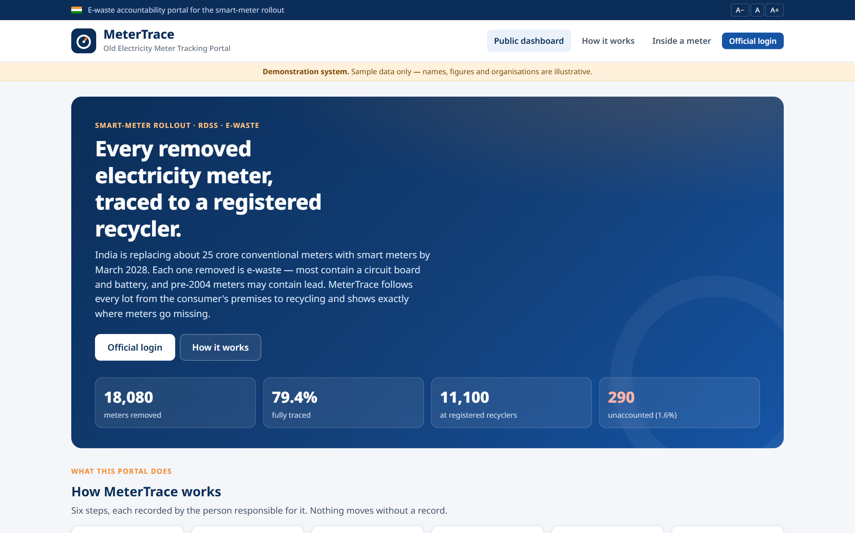
MeterTrace
SMART-METER ROLLOUT · E-WASTE ACCOUNTABILITY
Tracking every old electricity meter from removal to a registered recycler
Full-stack web portal · live at metertrace.vercel.app
Presented by Ram Prasath N
Notes:
Introduce yourself and the project. MeterTrace is a working, hosted web portal (not a mock-up) that tracks the old electricity meters removed during India's smart-meter rollout, all the way to a registered recycler. One-line pitch: 25 crore meters are coming off walls and nobody tracks where they go; this portal does.

Slide 2
20 crore old meters are coming off walls, and no one tracks them
20.33 crore
7.24 crore
31 Mar 2028
~10%
smart meters sanctioned under RDSS; each one replaces an old meter
already installed across India (as on 30 June 2026)
RDSS sunset date: about 13 crore more meters to go
of India's e-waste is formally recycled today
What happens to a removed meter today
Removed by installer
Returned to utility, or kept by contractor
Sold as scrap by weight in online auctions
Buyer and fate unknown
Each power company decides whether the installer returns old meters or disposes of them, and no public system records where they go. Meters made before 2004 can contain lead.
Sources: Ministry of Power, Rajya Sabha Unstarred Q.943 (27 Jul 2026); NITI Aayog & TERI, Circular Economy of E-waste report (Jan 2026).
Notes:
Official figures from the Ministry of Power (Rajya Sabha reply, 27 July 2026): 20.33 crore smart meters are sanctioned under RDSS — 19.79 crore for consumers, plus 52.53 lakh transformer and 2.05 lakh feeder meters. 7.24 crore smart meters were installed nationwide by 30 June 2026, 5.73 crore of them under RDSS, and the scheme ends on 31 March 2028. Every consumer smart meter replaces an old one. Meanwhile NITI Aayog reports only about 10% of India's e-waste is formally recycled. Disposal of old meters is left to each power company, many sell them as scrap by weight, and nothing public tracks where they go. That is the gap MeterTrace fills.

Slide 3




What is an electricity meter?
Electromechanical
Spinning aluminium disc and number dials
≈ 1.8 kg · mostly metal
It measures energy used
A meter records the electrical energy a home or shop uses, in kilowatt-hours (kWh) — the "units" on your bill.
It sits between the supply line and the building wiring, so all current passes through it.
Electronic, before 2004
Circuit board and LCD; solder usually contains lead
≈ 1.2 kg · lead risk
Electronic, 2004 or later
Lead-free board, lithium battery; smart meters add a modem
≈ 0.9 kg · battery fire risk
Notes:
A meter measures energy in kilowatt-hours, the units on the bill. Three kinds are being removed: old electromechanical meters with a spinning disc, early electronic meters from before 2004 whose solder usually contains lead, and newer electronic meters with lead-free boards and lithium batteries. Each needs different handling, which is why the portal records meter type for every lot.

Slide 4
Inside an electromechanical meter
6
1
Register & gear train
1
number dials turned by brass and steel gears
0 4 2 7 8
2
Voltage (shunt) coil
many turns of thin copper wire
2
V
I
3
3
Current (series) coil
a few turns of thick copper wire
4
Aluminium disc
5
spins in proportion to the power drawn
4
5
Braking magnet
permanent magnet that steadies the disc speed
6
Frame, base and cover
cast metal frame, Bakelite base, glass cover
7
7
Terminal block
brass terminals and screws for the wires
Mostly metal — copper, brass and steel are valuable and easy to recycle.
Notes:
How it works: the voltage and current coils create magnetic fields that drive an aluminium disc; the braking magnet keeps its speed proportional to power; the gear train turns the dials. Materials are mostly copper, brass, steel and some Bakelite and glass, so these meters are valuable scrap with few hazards.

Slide 5
Inside an electronic (and smart) meter
1
LCD display
00427.8 kWh
1
shows the kWh reading
2
Printed circuit board (PCB)
fibreglass board with copper tracks and solder
2
3
Metering IC & microcontroller
4
3
measures current/voltage, calculates and stores kWh
4
Lithium backup battery
modem
keeps the clock and memory alive in power cuts
5
6
5
Current sensor (shunt / CT)
copper-alloy shunt or small current transformer
6
Communication module
7
RF / GPRS / NB-IoT modem (smart meters only)
7
Relay & terminal block
remote on/off switch (smart) and brass terminals
Pre-2004 boards: lead solder. All: lithium battery must be removed first.
Notes:
Electronic meters have no moving parts. A shunt or current transformer senses current, a metering chip calculates energy and the LCD shows it. A small lithium battery keeps the clock running. Smart meters add a modem and a relay for remote disconnection. The circuit board is where both the value (copper, traces of gold and silver) and the hazards (lead solder before 2004) are.

Slide 6

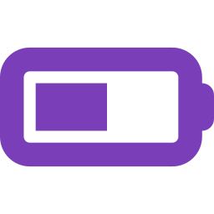

What a meter is made of
Lead
Solder on pre-2004 boards. Toxic if burned or acid-stripped in informal yards.
Lithium battery
Can short and catch fire if crushed in a scrap truck. Remove before shredding.
Recoverable value
Copper, brass, and gold/silver traces in circuit boards.
Material shares are illustrative values for this demonstration — verify before use. They are editable in the portal's Settings.
Notes:
This chart uses the portal's default settings. Electromechanical meters are metal-heavy; electronic ones are mostly plastic with a circuit board. The three things that matter for recycling: lead in old solder, lithium batteries that can start fires, and the valuable copper, brass and precious metals that make informal recycling attractive. Point out that these numbers are illustrative and editable.

Slide 7




Why every removed meter must be tracked
Health & environment
Fire risk
Unsound e-waste recycling can release up to 1,000 chemicals, including lead (WHO, 2024).
Lithium cells left inside meters can ignite when crushed during transport or shredding.
Lost value
Accountability
India's e-waste holds ₹51,000 crore of materials, yet only ~10% is formally recycled (NITI Aayog, 2026).
About 62% of India's e-waste is handled by the informal sector, outside any record (NITI Aayog, 2026).
Notes:
Four reasons, with sources. Health: WHO's 2024 fact sheet says unsound e-waste recycling can release up to 1,000 different chemicals, lead among them, and UNICEF estimates over 27 crore Indian children have elevated blood lead. Fire: lithium cells crushed in scrap trucks can ignite. Value: NITI Aayog puts the materials in India's e-waste at Rs 51,000 crore, with only about 10% formally recycled. Accountability: about 62% of e-waste goes through the informal sector, where nothing is recorded.

Slide 8
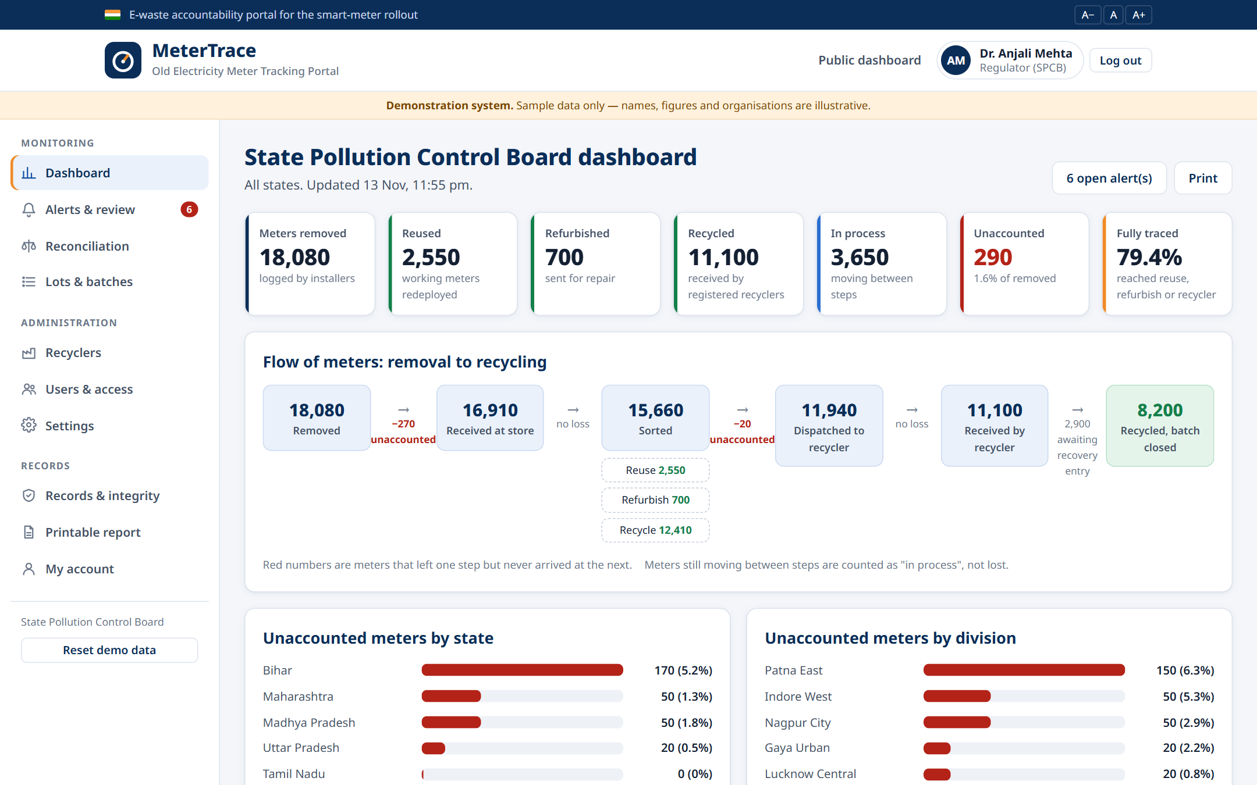



MeterTrace: one record for every step, from wall to recycler
Trace
Every lot of meters is recorded at removal, store, sorting, sale, recycler receipt and recovery.
Detect
Counts and weights are reconciled automatically; 8 rules flag anything irregular to the Regulator.
Prove
Records are append-only and hash-chained, so a silent edit is caught instantly.
Notes:
The solution in three words: Trace, Detect, Prove. On the right is the live Regulator dashboard: totals, the flow from removal to recycling, and the unaccounted meters highlighted in red.

Slide 9







How it works: six steps, each recorded by the person responsible
1
2
3
4
5
6
Removal
Store receipt
Sorting
Disposal batch
Recycler receipt
Recovery
Date, place, meter type, count, condition
Count that actually arrived
Reuse, refurbish or recycle
Weighed, sold to approved recycler only
Count and weight received
Copper, brass, plastic, PCB, battery, hazardous
Installer
Store officer
Store officer
Store officer
Recycler
Recycler
Only the correct role can create each record. Sales are blocked unless the buyer is a Regulator-approved recycler.
Notes:
Walk through the six steps left to right. Stress that each step is entered by a different organisation, which is what makes cross-checking possible, and that the server enforces roles — an installer cannot create a batch, and a store officer cannot sell to an unapproved buyer.

Slide 10





Who uses the portal
Installer
Store officer
Recycler
Regulator
Public
Meter installation contractor
Power company (DISCOM) store
Registered recycling unit
State Pollution Control Board
No login needed
Logs meters removed
Corrects own records
Receives and sorts lots
Creates disposal batches
Sees reconciliation
Confirms receipt
Records materials recovered
Approves recyclers
Reviews alerts
Manages users and settings
State-wise summary
How it works
Inside a meter
Every user signs in with an email ID and password issued by the Regulator, and sees only their own part of the process.
Notes:
Four logged-in roles plus the public. Accounts are created by the Regulator under Users & access; each role gets its own dashboard and the server only returns data that role is allowed to see.

Slide 11
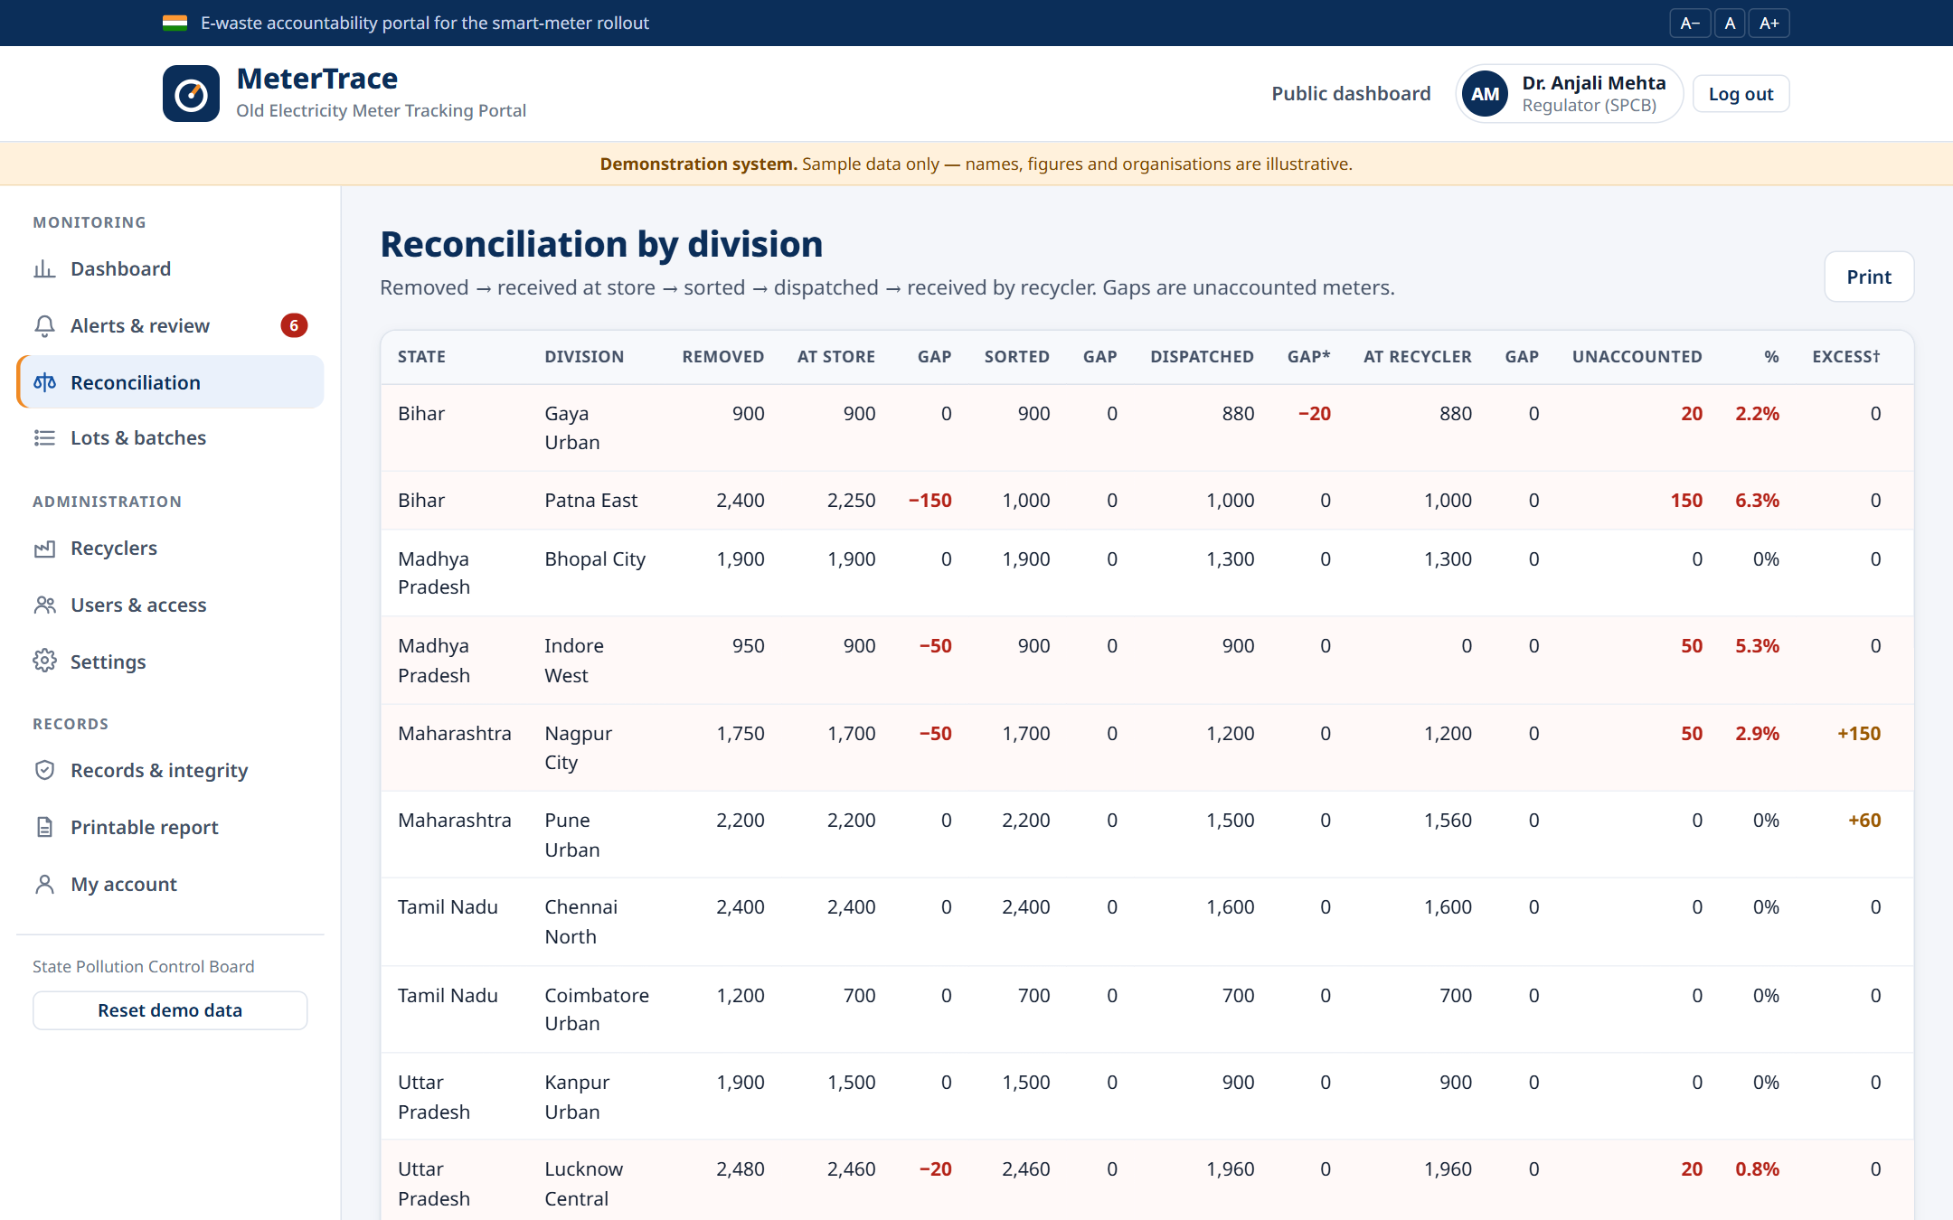
Reconciliation shows exactly where meters go missing
290
unaccounted meters (1.6% of 18,080)
150
lost between removal and store in Patna East, Bihar (6.3%)
+2.5%
weighed vs expected weight across all batches
Notes:
For every division the portal compares removed, received at store, sorted, dispatched and received by the recycler. Each gap is shown as unaccounted meters in number and percent. Expected weight (count times average weight per meter type) is compared with weighed weight to catch padding or swapping.

Slide 12
Eight automatic checks flag irregular records
1
2
3
4
Received more than sent
Dispatch larger than stock
Date before previous step
Weight outside tolerance
Recycler got 1,560 of 1,500 meters (B-MH-01)
1,200 dispatched, only 1,050 sorted (B-MH-02)
Store receipt dated before removal (lot BR-003)
1,150 kg vs 810 kg expected, +42% (B-UP-02)
5
6
7
8
Held in store too long
Pre-2004 meters to Reuse
No battery removal entry
Recovered more than batch
Held 96 days, limit is 30 (lot BR-002)
600 lead-risk meters sent to reuse (lot UP-004)
Electronic batch closed without it (B-MH-01)
1,115 kg recovered from 1,045 kg (B-BR-02)
Plus: a sale to a buyer not approved by the Regulator is blocked outright and reported. Every rule fires at least once in the sample data.
Notes:
These checks run on the server every time a record is saved. Each finding goes to the Regulator's review queue with status open, under review or closed. The sample data was built so that every rule is triggered at least once — use the examples on the slide.

Slide 13
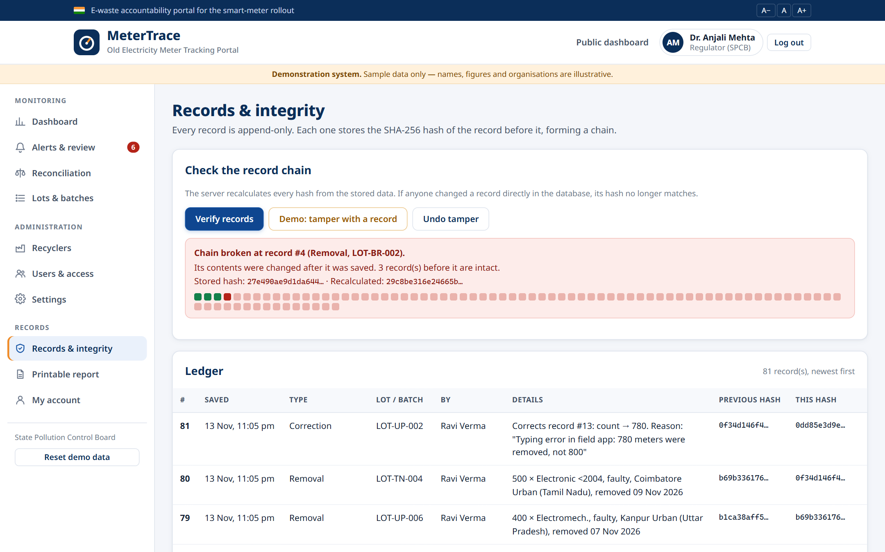
Tamper-evident records: a hash chain catches silent edits
Each record stores the previous record's SHA-256 hash
Record #3
prev: 9f1c… hash: a41e…
Record #4 — edited!
prev: a41e… hash: 27e4… ≠ 29c8…
Record #5
prev: 27e4… hash: c0d2…
The database itself refuses UPDATE and DELETE. Mistakes are fixed by a new correction record linked to the original.
Notes:
Live demo moment: press 'Demo: tamper with a record'. It edits LOT-BR-002 directly in the database, changing 1,400 removed meters to 1,250 — exactly hiding 150 missing meters. 'Verify records' recalculates every hash and reports the chain broken at record 4. Undo tamper, verify again, and it is green.

Slide 14
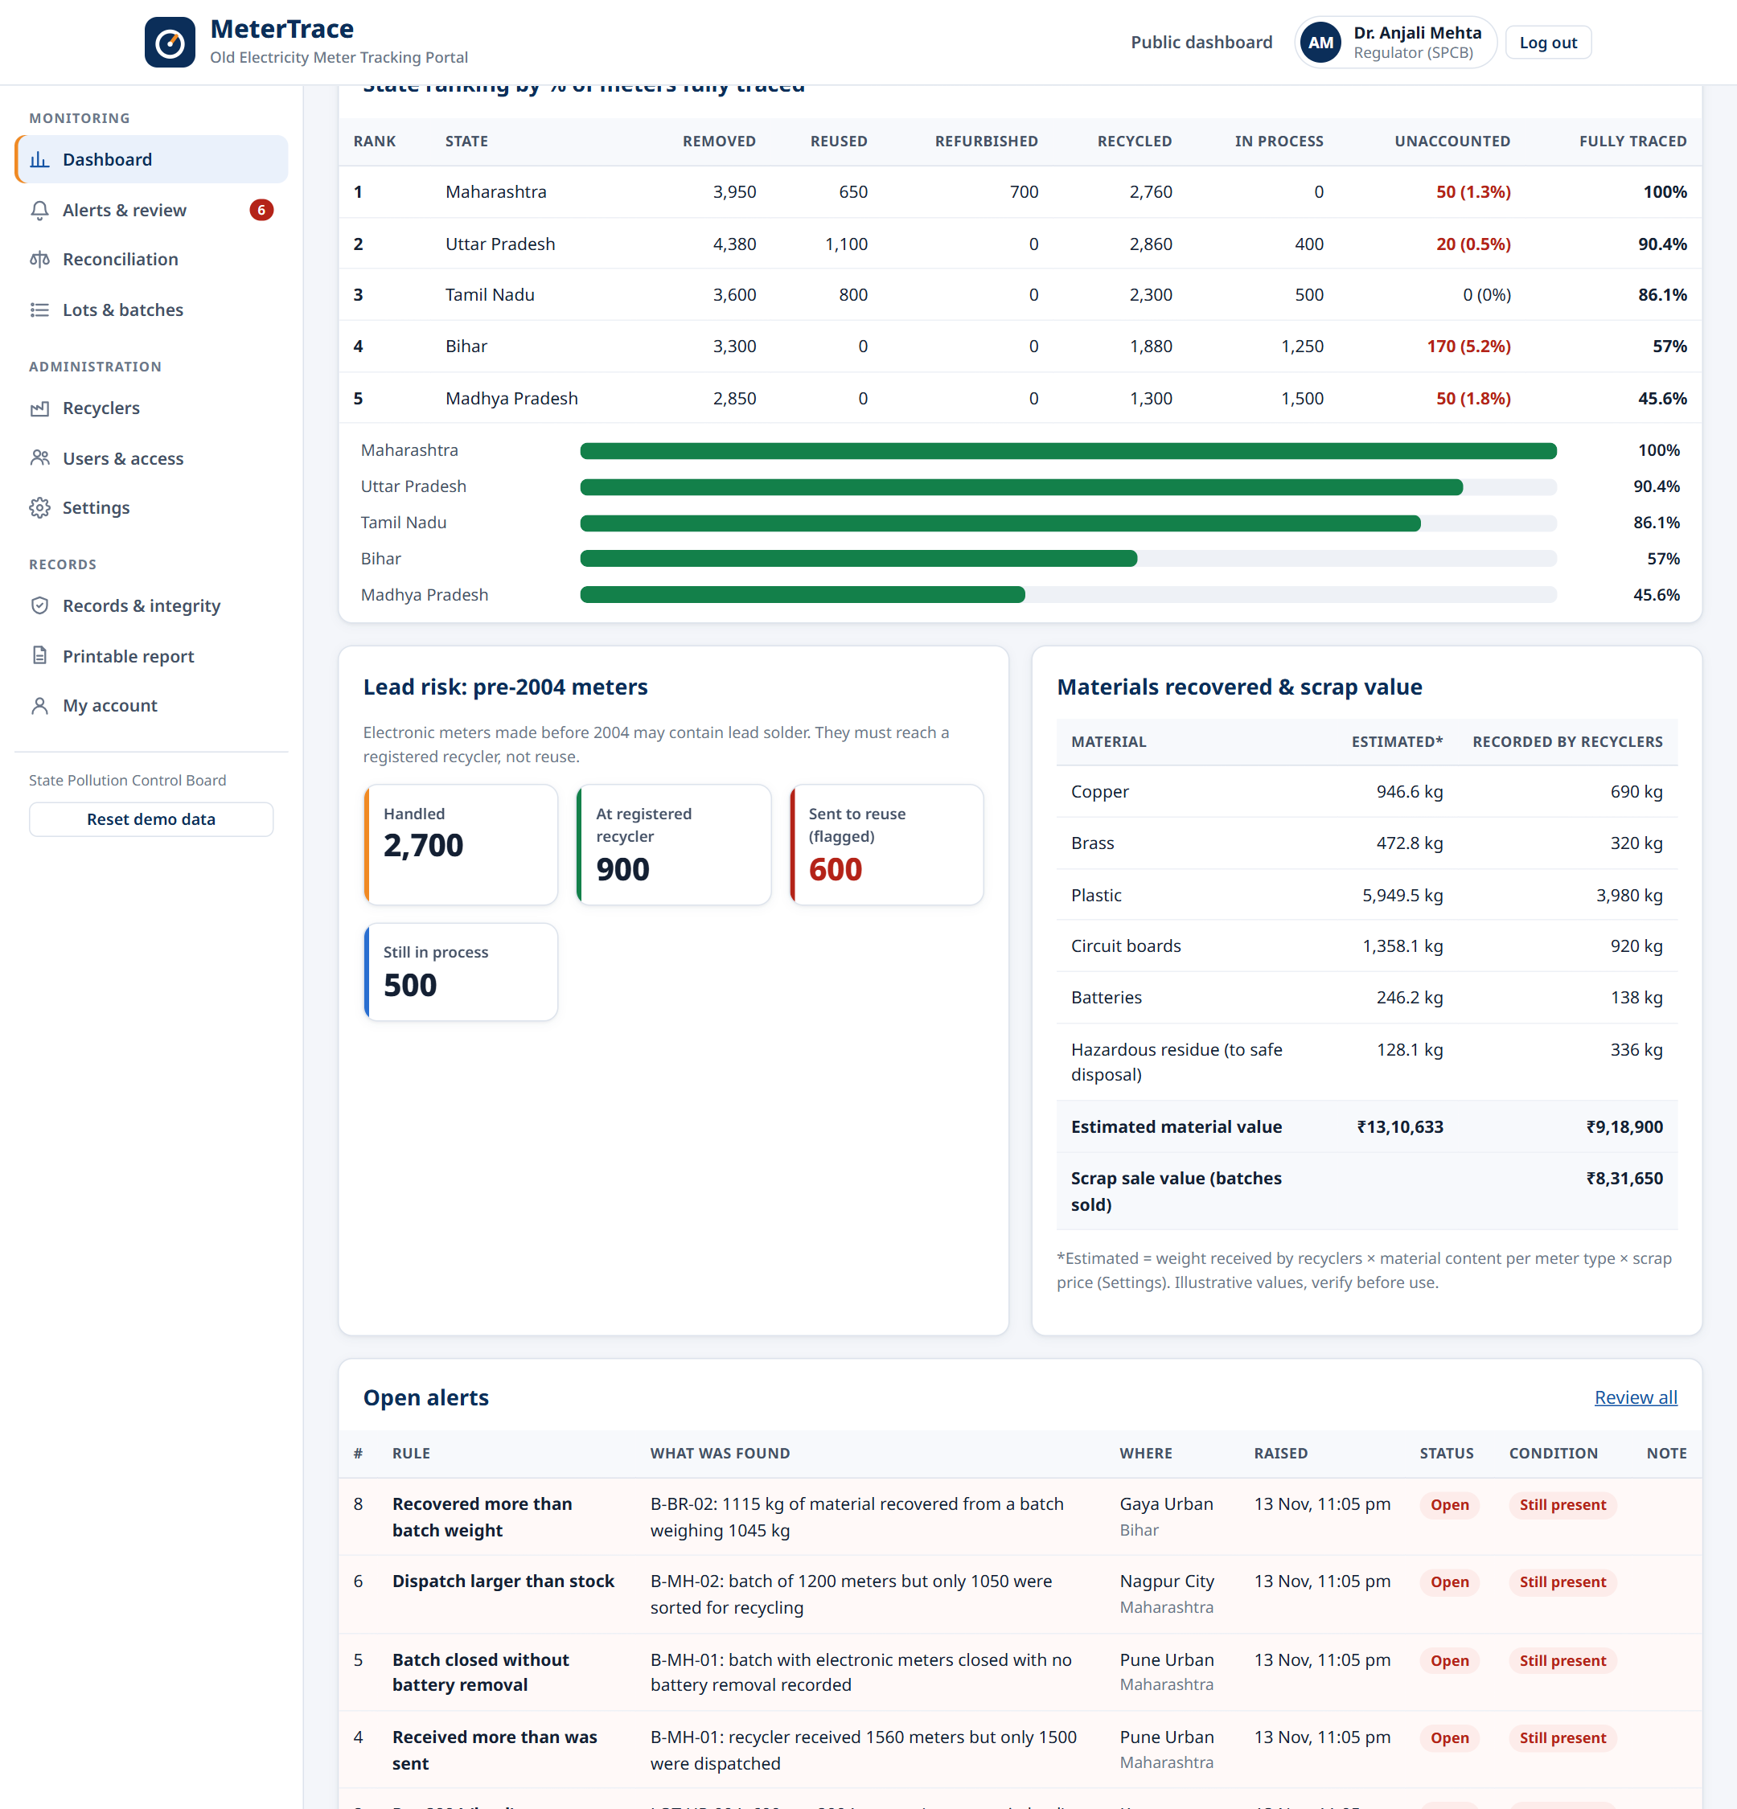

Dashboards and reports for every role
Totals: removed, reused, refurbished, recycled, unaccounted
Unaccounted meters by state and by division
Lead-risk count of pre-2004 meters
Materials recovered and ₹ scrap value
State ranking by % of meters fully traced
Print-friendly report for each role
Notes:
The Regulator sees all states; the store sees reconciliation; recyclers see only their batches. Each role has a Printable report that prints cleanly or saves as PDF.

Slide 15
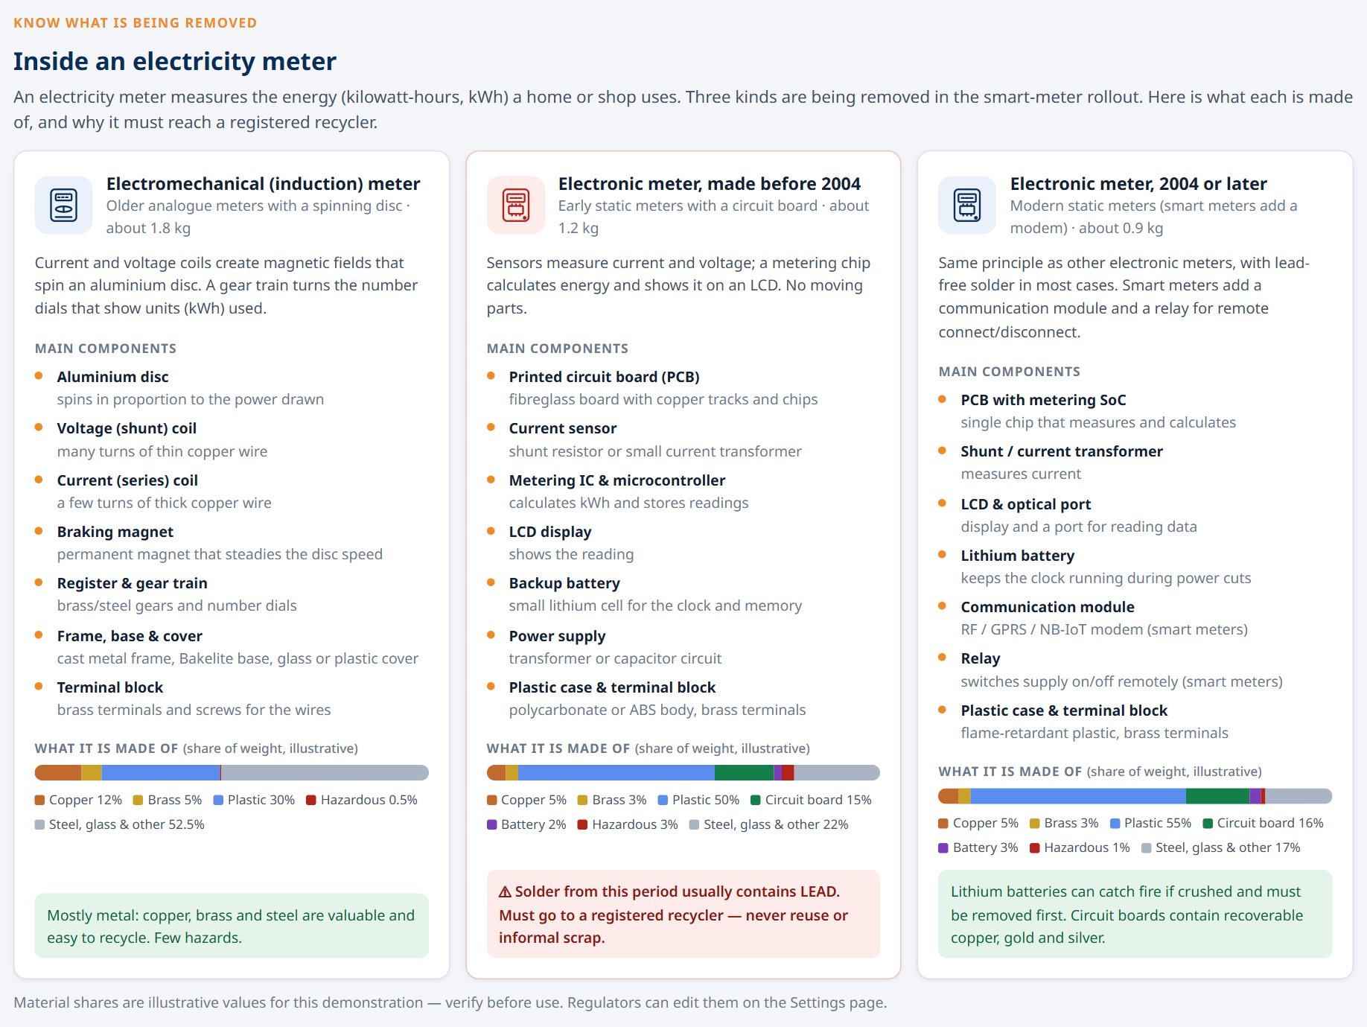
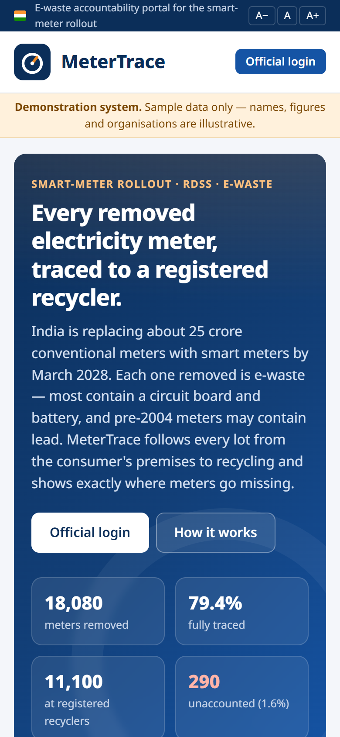
The public page explains what is inside a meter
Notes:
Anyone can open the site without logging in: a state-wise summary, how the process works, and this 'Inside an electricity meter' section listing the components and materials of each meter type. It works on phones too.

Slide 16




Architecture: a real full-stack app on free tiers
Browser
Vercel
Edge Function
PostgreSQL
HTML · CSS · JavaScript
Hosts the site; forwards /api/*
TypeScript (Deno): login, roles, 8 rules, reconciliation
Append-only hash-chained records, triggers, row-level security
Supabase (Mumbai)
Frontend
Vanilla HTML/CSS/JS, no build step, responsive, print styles
Backend
Supabase Edge Function (TypeScript / Deno)
Database
PostgreSQL 17 · SHA-256 hash chain · append-only triggers
Hosting
Vercel + Supabase free tiers · code on GitHub
Notes:
The browser only displays pages. Every action is an API call through Vercel to a Supabase Edge Function, which checks the session and role, validates, runs the rules, and writes to PostgreSQL. Browsers have no direct database access. Everything runs on free tiers; the code is public on GitHub.

Slide 17
What the sample data shows
18,080
79.4%
meters removed across 5 states, 10 divisions
fully traced to reuse, refurbishment or a recycler
290
8 / 8
unaccounted (1.6%) — pinpointed by division
irregularity rules triggered and sent for review
Notes:
Sample results: about 18 thousand meters across five states. 79 percent fully traced, 290 unaccounted and located down to the division. Bihar ranks last because one Patna lot is stuck in the store and 150 meters never arrived. Madhya Pradesh is low mainly because batches are still in transit.

Slide 18






Future scope
QR tags on every lot
Field mobile app
Weighbridge integration
Scan at each step instead of typing
Offline entry with GPS and photo proof
Weights sent directly from the scale
EPR portal link
Regional languages
SMS / email alerts
Connect to the national e-waste EPR system
Hindi and state languages for field staff
Notify the Regulator the moment a rule fires
Notes:
Next steps that would make this production-ready: physical QR tags, a field app, direct weighbridge data, integration with the national EPR portal, regional languages and instant alerts.

Slide 19


Thank you
Live portal
metertrace.vercel.app
Questions and live demo
Source code
github.com/Prasathn01/metertrace
Try it
Sample accounts for every role on the login page
Ram Prasath N
Notes:
Close with the links and offer a live demo: log in with the Use buttons on the login page, show a blocked sale, a flagged record, and the tamper check.

