Slide 1

Explicit Sets and Renaming of Attributes in SQL
Can use explicit set of values in WHERE clause
Use qualifier AS followed by desired new name
Rename any attribute that appears in the result of a query

Slide 2
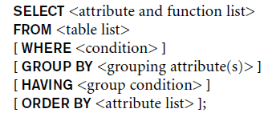
Discussion and Summary of SQL Queries

Slide 3
The ALTER Command
Alter table actions include:
Adding or dropping a column (attribute)
Changing a column definition
Adding or dropping table constraints
Example:
ALTER TABLE EMPLOYEE ADD COLUMN Job VARCHAR(12);
To drop a column
Choose either CASCADE or RESTRICT

Slide 4
The ALTER Command (cont’d.)
Change constraints specified on a table
Add or drop a named constraint
ALTER TABLE EMPLOYEE DROP CONSTRAINT CK CASCADE

Slide 5
ALTER TABLE Person ADD PRIMARY KEY (ID);
ALTER TABLE Person ADD CONSTRAINT PK_Person PRIMARY KEY (ID,LastName);

Slide 6
ALTER TABLE Persons DROP PRIMARY KEY;
ALTER TABLE Persons DROP CONSTRAINT PK_Person;

