Slide 1
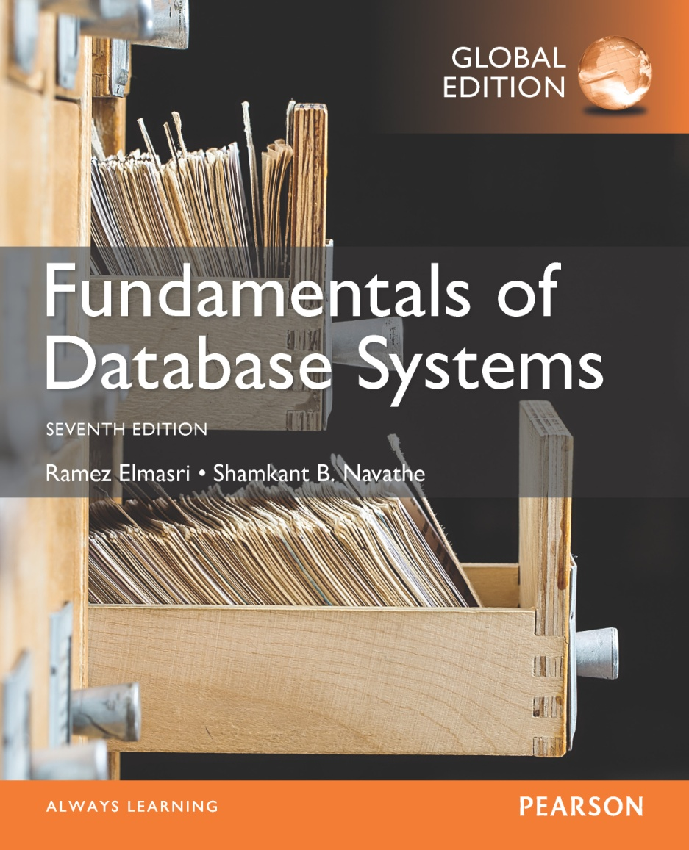

Slide 2
CHAPTER 6
Basic SQL
Slide 6- <number>

Slide 3
Chapter 6 Outline
SQL Data Definition and Data Types
Specifying Constraints in SQL
Basic Retrieval Queries in SQL
INSERT, DELETE, and UPDATE Statements in SQL
Additional Features of SQL
Slide 6- 3

Slide 4
The CREATE TABLE Command in SQL (cont’d.)
Base tables (base relations)
  Relation and its tuples are actually created and stored as a file by the DBMS
Virtual relations (views)
  Created through the CREATE VIEW statement. Do not correspond to any physical file.
Slide 6- 10

Slide 5
CREATE TABLE DEPARTMENT
CREATE TABLE DEPARTMENT (
dname varchar(25) not null,
dnumber int not null,
mgrssn char(9) not null,
mgrstartdate date,
primary key (dnumber), UNIQUE (dname) );
Slide 6- <number>

Slide 6
CREATE TABLE EMPLOYEE
CREATE TABLE EMPLOYEE ( fname varchar(15) not null, minit varchar(1), lname varchar(15) not null,
ssn char(9),
bdate date,
address varchar(50),
sex char,
salary decimal(10,2),
superssn char(9), dno int,
primary key (ssn), foreign key (superssn) references EMPLOYEE(ssn), foreign key (dno) references DEPARTMENT(dnumber));
Slide 6- <number>

Slide 7

Slide 6- <number>

Slide 8
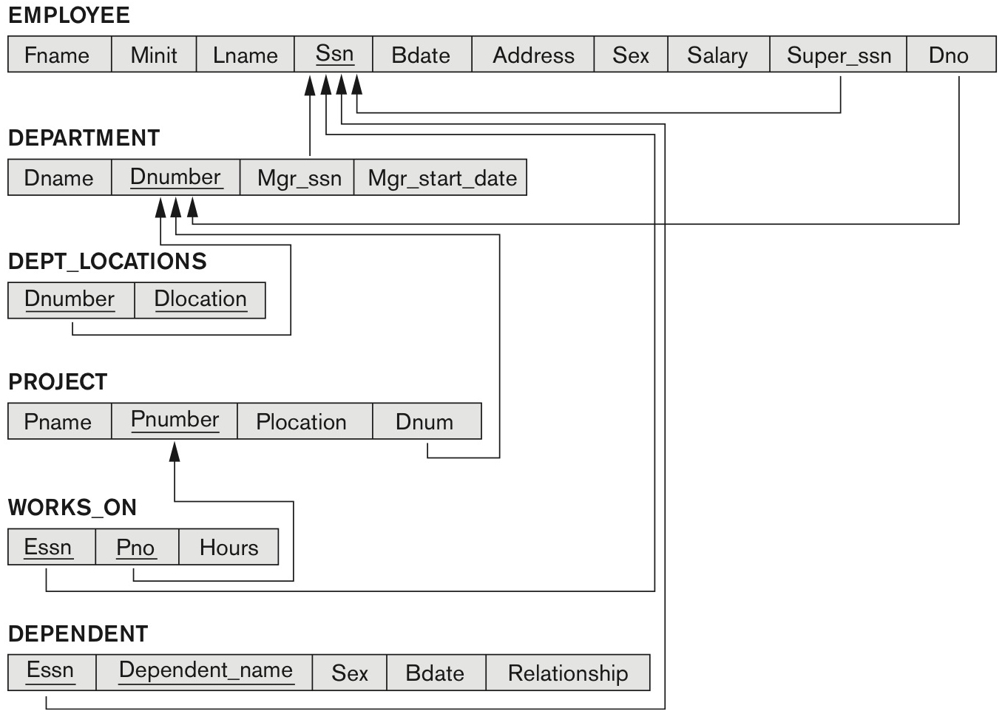
COMPANY relational database schema (Fig. 5.7)
Slide 6- 11

Slide 9
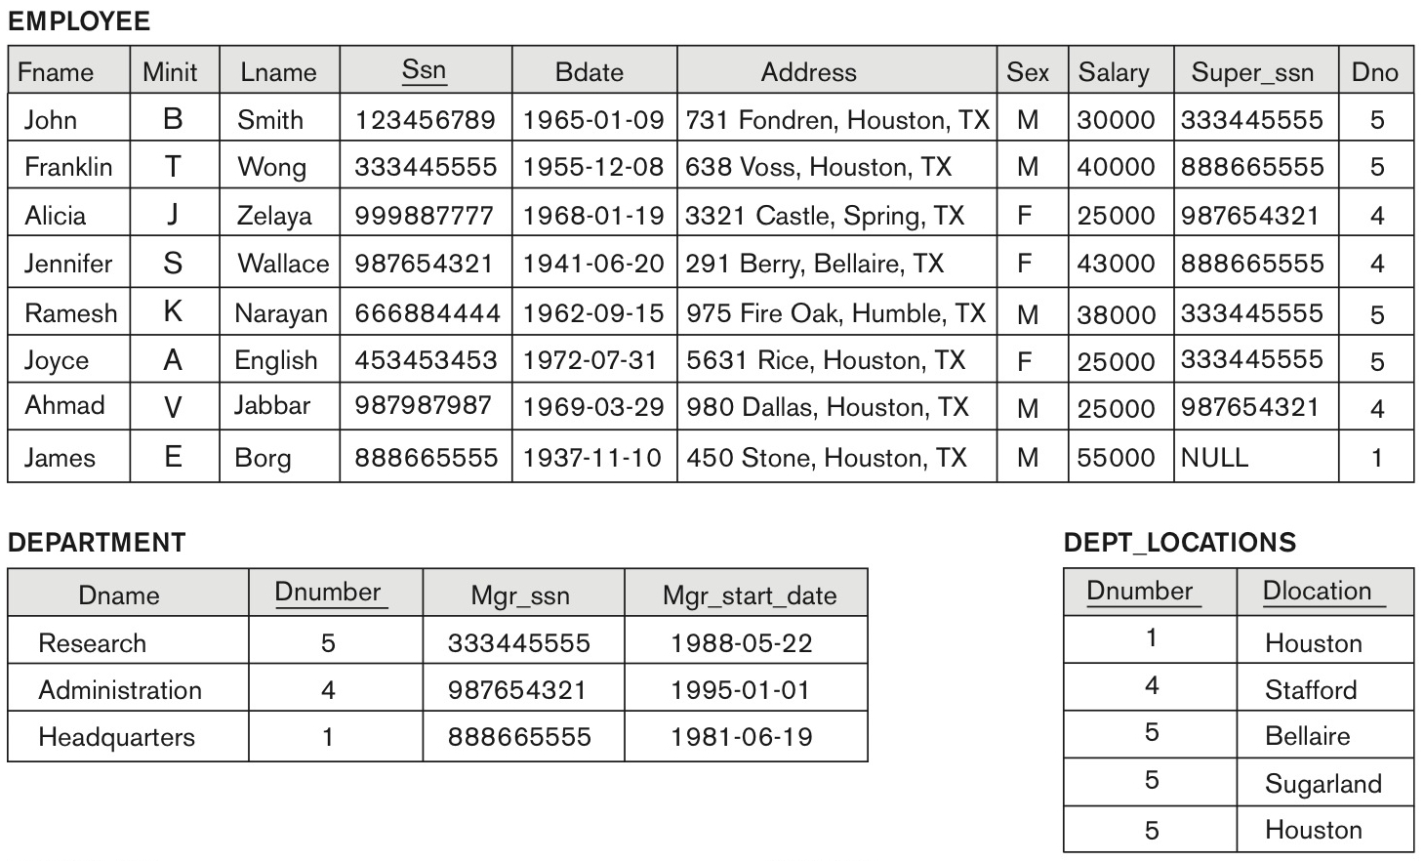
One possible database state for the COMPANY relational database schema (Fig. 5.6)
Slide 6- 12

Slide 10
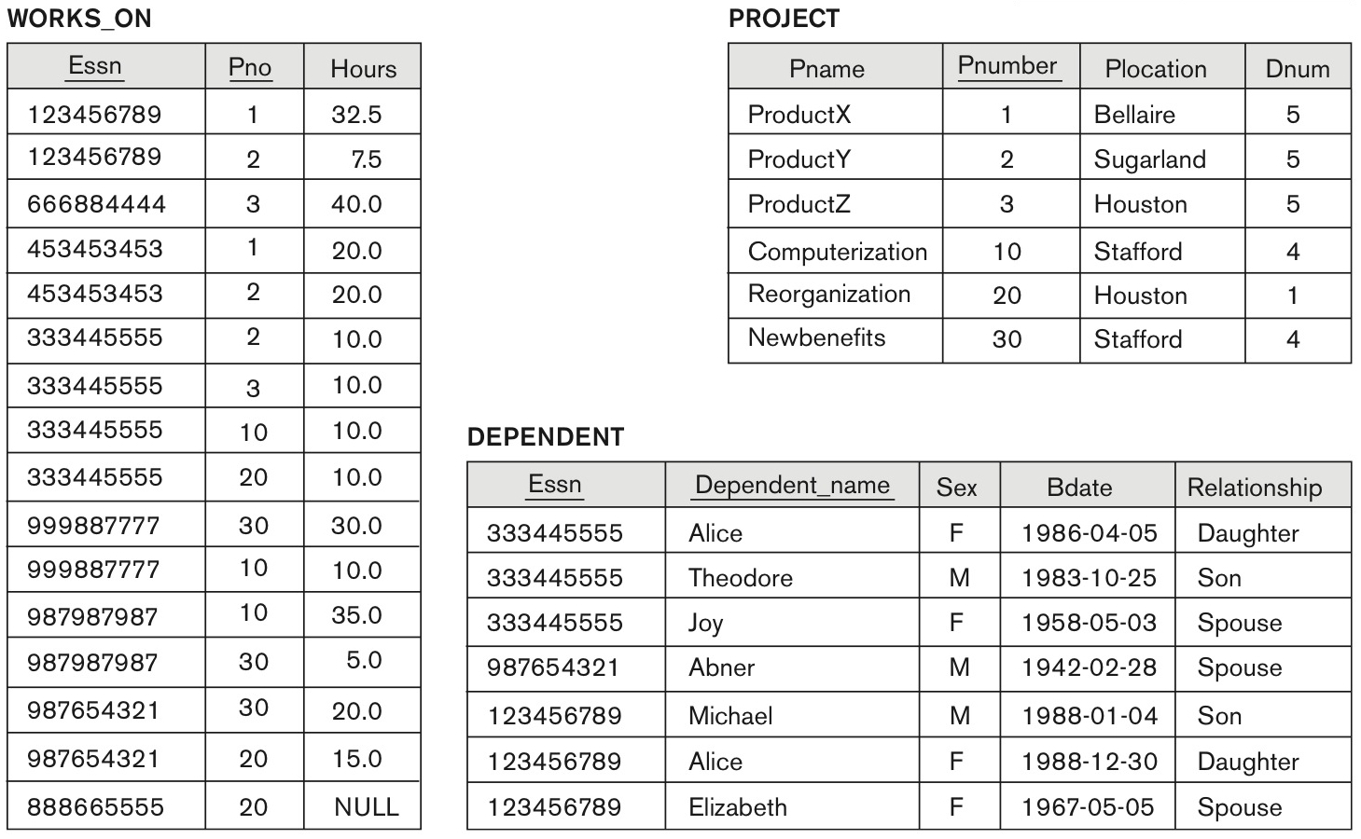
One possible database state for the COMPANY relational database schema – continued
Slide 6- 13

Slide 11
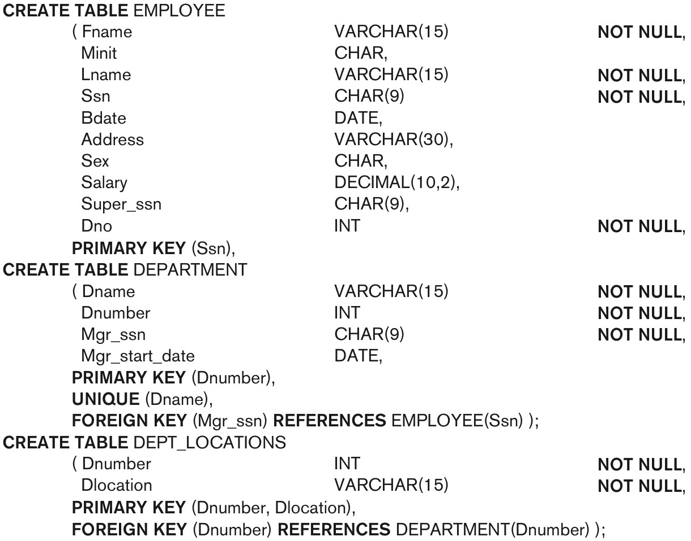
SQL CREATE TABLE data definition statements for defining the COMPANY schema from Figure 5.7 (Fig. 6.1)
continued on next slide
Slide 6- 14

Slide 12
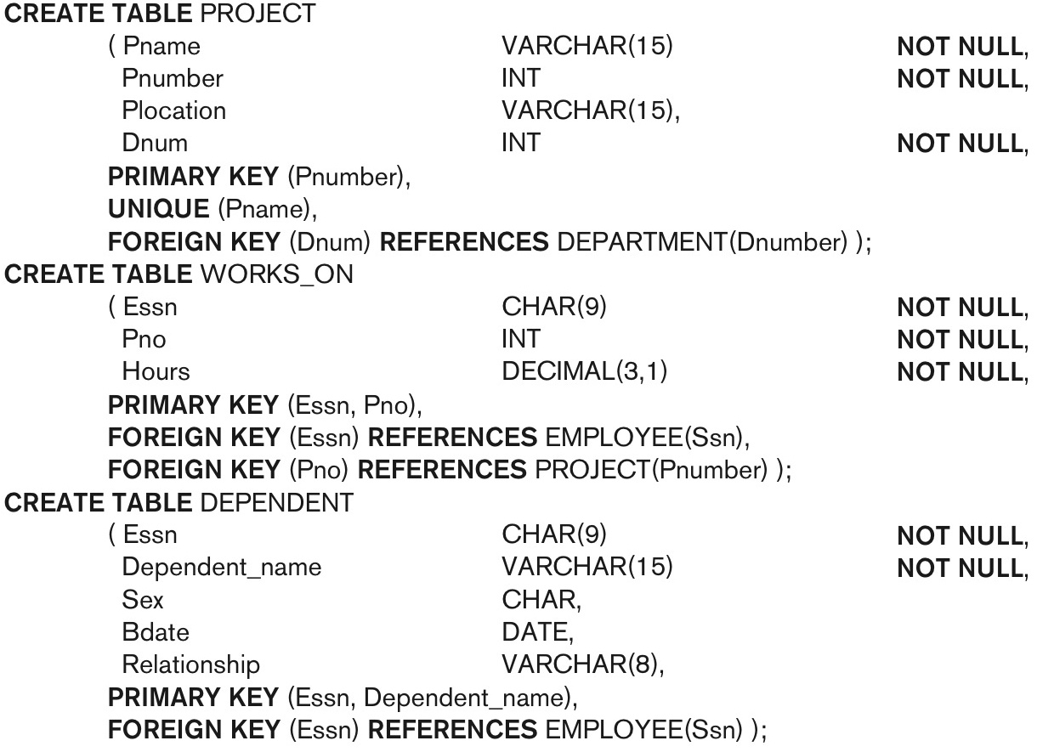
SQL CREATE TABLE data definition statements for defining the COMPANY schema from Figure 5.7 (Fig. 6.1)-continued
Slide 6- 15

Slide 13
The CREATE TABLE Command in SQL (cont’d.)
Some foreign keys may cause errors
  Specified either via:
    Circular references
    Or because they refer to a table that has not yet been created
  DBA’s have ways to stop referential integrity enforcement to get around this problem.
Slide 6- 16

Slide 14
Attribute Data Types and Domains in SQL
Basic data types
  Numeric data types
    Integer numbers: INTEGER, INT, and SMALLINT
    Floating-point (real) numbers: FLOAT or REAL, and DOUBLE PRECISION
  Character-string data types
    Fixed length: CHAR(n), CHARACTER(n)
    Varying length: VARCHAR(n), CHAR VARYING(n), CHARACTER VARYING(n)
Slide 6- 17

Slide 15
Attribute Data Types and Domains in SQL (cont’d.)
  Bit-string data types
    Fixed length: BIT(n)
    Varying length: BIT VARYING(n)
  Boolean data type
    Values of TRUE or FALSE or NULL
  DATE data type
    Ten positions
    Components are YEAR, MONTH, and DAY in the form YYYY-MM-DD
    Multiple mapping functions available in RDBMSs to change date formats
Slide 6- 18

Slide 16
Attribute Data Types and Domains in SQL (cont’d.)
Additional data types
  Timestamp data type
  Includes the DATE and TIME fields
    Plus a minimum of six positions for decimal fractions of seconds
    Optional WITH TIME ZONE qualifier
  INTERVAL data type
    Specifies a relative value that can be used to increment or decrement an absolute value of a date, time, or timestamp
  DATE, TIME, Timestamp, INTERVAL data types can be cast or converted to string formats for comparison.
Slide 6- 19

Slide 17
Attribute Data Types and Domains in SQL (cont’d.)
Domain
  Name used with the attribute specification
  Makes it easier to change the data type for a domain that is used by numerous attributes
  Improves schema readability
  Example:
    CREATE DOMAIN SSN_TYPE AS CHAR(9);
TYPE
  User Defined Types (UDTs) are supported for object-oriented applications. (See Ch.12) Uses the command: CREATE TYPE
Slide 6- <number>

Slide 18
Specifying Constraints in SQL
Basic constraints:
Relational Model has 3 basic constraint types that are supported in SQL:
  Key constraint: A primary key value cannot be duplicated
  Entity Integrity Constraint: A primary key value cannot be null
  Referential integrity constraints : The “foreign key “ must have a value that is already present as a primary key, or may be null.
Slide 6- <number>

Slide 19
Specifying Attribute Constraints
  Other Restrictions on attribute domains:
Default value of an attribute
  DEFAULT <value>
  NULL is not permitted for a particular attribute (NOT NULL)
CHECK clause
  Dnumber INT NOT NULL CHECK (Dnumber > 0 AND Dnumber < 21);
Slide 6- 22

Slide 20
Specifying Key and Referential Integrity Constraints
PRIMARY KEY clause
  Specifies one or more attributes that make up the primary key of a relation
  Dnumber INT PRIMARY KEY;
UNIQUE clause
  Specifies alternate (secondary) keys (called CANDIDATE keys in the relational model).
  Dname VARCHAR(15) UNIQUE;
Slide 6- <number>

Slide 21
Specifying Key and Referential Integrity Constraints (cont’d.)
FOREIGN KEY clause
  Default operation: reject update on violation
  Attach referential triggered action clause
    Options include SET NULL, CASCADE, and SET DEFAULT
    Action taken by the DBMS for SET NULL or SET DEFAULT is the same for both ON DELETE and ON UPDATE
    CASCADE option suitable for “relationship” relations
Slide 6- <number>

Slide 22
Giving Names to Constraints
Using the Keyword CONSTRAINT
  Name a constraint
  Useful for later altering
Slide 6- <number>

Slide 23
INSERT
In its simplest form, it is used to add one or more tuples to a relation
Attribute values should be listed in the same order as the attributes were specified in the CREATE TABLE command
Constraints on data types are observed automatically
Any integrity constraints as a part of the DDL specification are enforced
Slide 6- 45

Slide 24


The INSERT Command
Specify the relation name and a list of values for the tuple. All values including nulls are supplied.
The variation below inserts multiple tuples where a new table is loaded values from the result of a query.
Slide 6- 46

Slide 25
DELETE
Removes tuples from a relation
  Includes a WHERE-clause to select the tuples to be deleted
  Referential integrity should be enforced
  Tuples are deleted from only one table at a time (unless CASCADE is specified on a referential integrity constraint)
  A missing WHERE-clause specifies that all tuples in the relation are to be deleted; the table then becomes an empty table
  The number of tuples deleted depends on the number of tuples in the relation that satisfy the WHERE-clause
Slide 6- 48

Slide 26
SQL DELETE Statement
DELETE FROM table_name WHERE condition;
Slide 6- <number>

Slide 27

The DELETE Command
Removes tuples from a relation
  Includes a WHERE clause to select the tuples to be deleted. The number of tuples deleted will vary.
Slide 6- 49

Slide 28
UPDATE
Used to modify attribute values of one or more selected tuples
A WHERE-clause selects the tuples to be modified
An additional SET-clause specifies the attributes to be modified and their new values
Each command modifies tuples in the same relation
Referential integrity specified as part of DDL specification is enforced
Slide 6- 50

Slide 29
UPDATE (contd.)
Example: Change the location and controlling department number of project number 10 to 'Bellaire' and 5, respectively
  U5: UPDATE PROJECT
  SET PLOCATION = 'Bellaire', DNUM = 5
  WHERE PNUMBER=10
Slide 6- 51

Slide 30
UPDATE (contd.)
Example: Give all employees in the 'Research' department a 10% raise in salary.
  U6: UPDATE EMPLOYEE
  SET SALARY = SALARY *1.1
  WHERE DNO IN (SELECT DNUMBER
  FROM DEPARTMENT
  WHERE DNAME='Research')
In this request, the modified SALARY value depends on the original SALARY value in each tuple
  The reference to the SALARY attribute on the right of = refers to the old SALARY value before modification
  The reference to the SALARY attribute on the left of = refers to the new SALARY value after modification
Slide 6- <number>

Slide 31
DROP TABLE Statement
The DROP TABLE statement is used to drop an existing table in a database.
DROP TABLE table_name;
TRUNCATE TABLE
The TRUNCATE TABLE statement is used to delete the data inside a table, but not the table itself.
TRUNCATE TABLE table_name;
Slide 6- <number>

Slide 32
Summary
SQL
  A Comprehensive language for relational database management
  Data definition, queries, updates, constraint specification, and view definition
Covered :
  Data definition commands for creating tables
  Commands for constraint specification
  Simple retrieval queries
  Database update commands
Slide 6- 55

