Slide 1
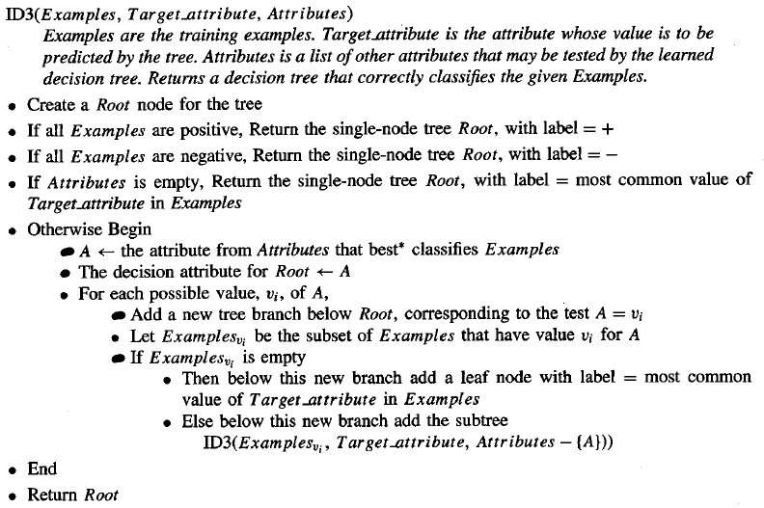
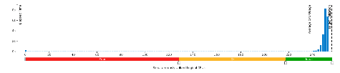
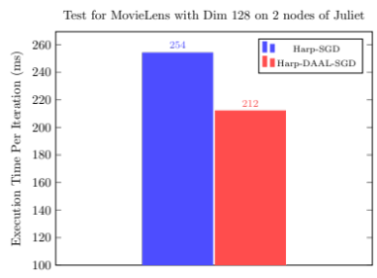

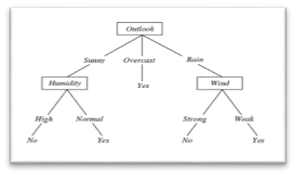
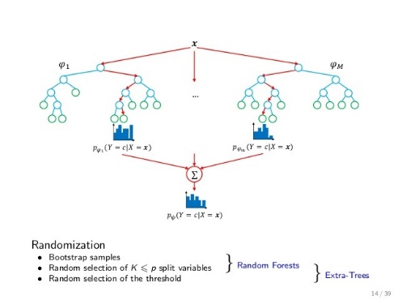
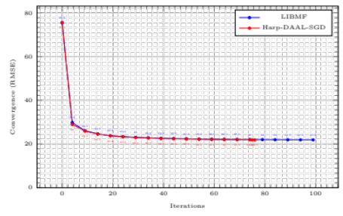
Evaluation of Random Forest Performance on Distributed Environment Using Harp
Prashanth Balasubramani, Shree Harsha Sridharamurthy
ABSTRACT
The ID3 Algorithm
Performance Comparison between Single decision tree and Random Forest
It uses 93.5% of KNL’s all 256 threads.
Random Forests are collection of decision trees in the form of an ensemble. By coupling multiple decision trees built over chosen features from the training dataset and running them in parallel, we will be able to see a significant increase in the performance and accuracy of the system. In this project we show the decision trees written in Java and executed on the distributed Harp framework will be able to classify the on-time airline dataset faster than its sequential version of a single decision tree.
Random Forest has an increased performance of 70% with two trees
It benefits from KNL’s High Bandwidth Memory
Decision Tree
CONCLUSIONS
Harp-DAAL aims to provide fast machine learning solutions for Big Data applications. We have shown a better performance than the original Harp framework on both Haswell CPU and emerging many-core KNL Xeon Phi processors. Through extensive tests on KNL, highly optimized DAAL kernels can exploit the threads and memory resources of the new Xeon and Xeon Phi architectures. It shows 4x speedup over Haswell, an over 90% threads utilization, as well as a stat-of-art convergence speed.
Random Forest Model
Fast Convergence
Harp-DAAL-SGD has a better convergence than the
state-of-art LIBMF library, using 25% less iterations
MATERIALS AND METHODS
REFERENCE
Harp[4] is a Hadoop plug-in made to abstract communication by transforming map-reduce programming models into map-collective models.
1.Harp has MPI-like collective communication operations that are highly optimized for big data problems.
2. Harp has efficient and innovative computation models for different machine learning problems.
[1] B. Zhang, Y. Ruan, J. Qiu, Harp: Collective Communication on Hadoop, in the proceedings of IEEE International Conference on Cloud Engineering (IC2E2015), March 9-13, 2015.
[2] B. Zhang, B. Peng and J. Qiu, “Parallelizing Big Data Machine Learning Applications with Model Rotation”. Submitted to Book Chapter in "Advances in Parallel Computing", 2016.
[3] B. Zhang, B. Peng and J. Qiu. “Model-Centric Computation Abstractions in Machine Learning Applications”. BeyondMR, 2016.
[4] Harp project https://github.iu.edu/IU-Big-Data-Lab/Harp
[5] DAAL project https://github.com/01org/daal
Random Forest is an ensemble of the decision trees which are implemented using ID3 machine learning algorithm used in classification and regression of data.

