Slide 1
Why not Magist?
Presented by:
Prashadhini Annur Mahendran
Francesco Arioli
Konstantinos Bouzianis,
Prema Raman
22.11.2024

Slide 2
Who is Magist?
Eniac is planning to expand its business to Brazil for selling its Apple products.
Magist is under consideration as a potential partner.
MAGIST :
Revenue : € 3.4 M
ENIAC:
Revenue : € 14 M

Slide 3
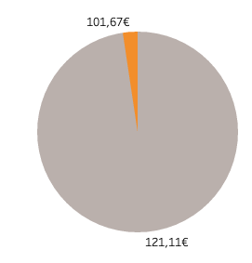

Focus on tech products such as:
Does Magist have the experience necessary to deal with our expensive (540 €) tech products?
Tech products make up only 2.4% of the total orders managed by Magist
Telephony
Computers
Computers_accessories

Slide 4
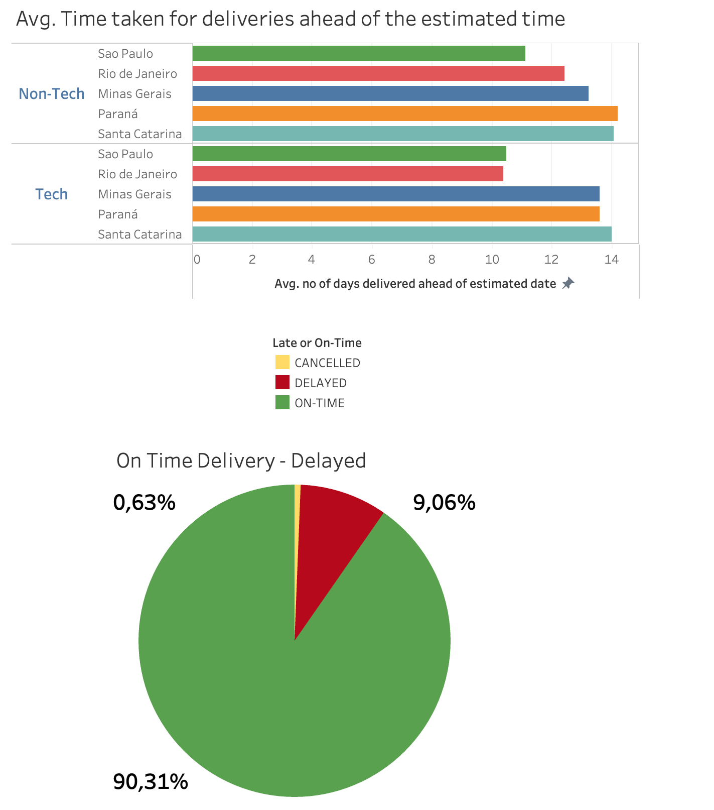
Delivery Status
On an average of 12 days, most of the Tech and Non-Tech are delivered ahead of estimated date.
90 percent of orders are delivered on time.
No significant delay pattern found.

Slide 5
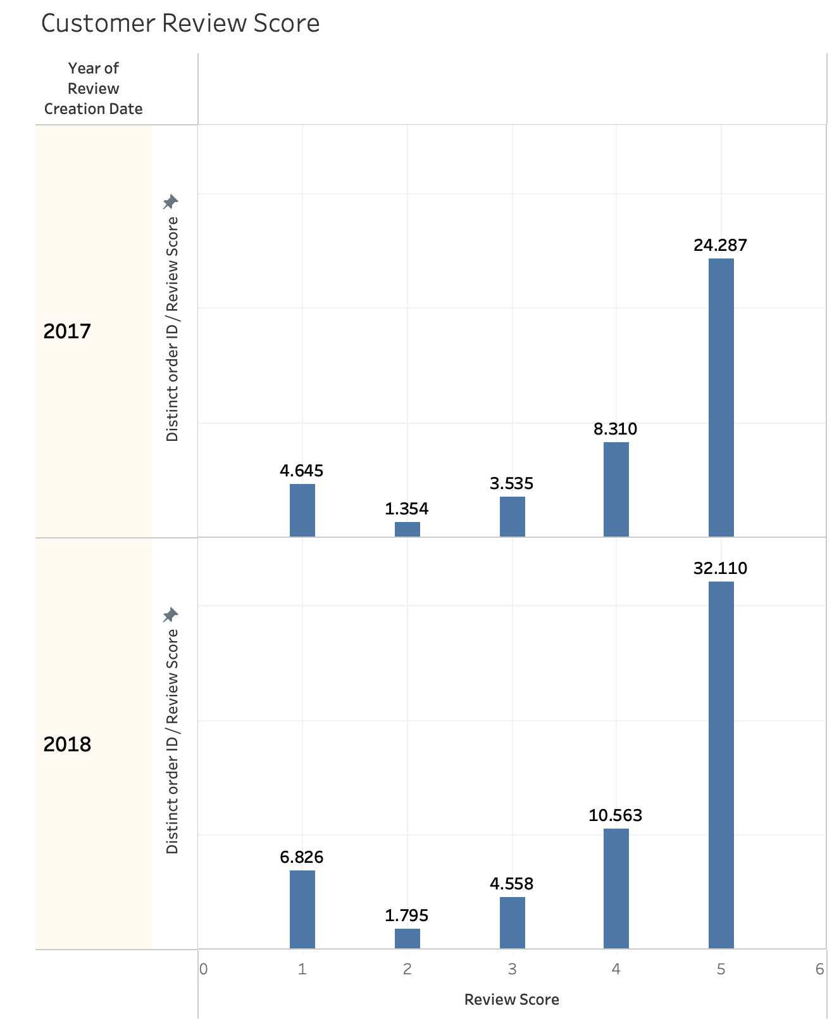
Are customers happy with Magist?
Almost 70 percent of customer shared a positive review in 2017.
Number of order inflows increased in 2018 but the trend continued the same

Slide 6
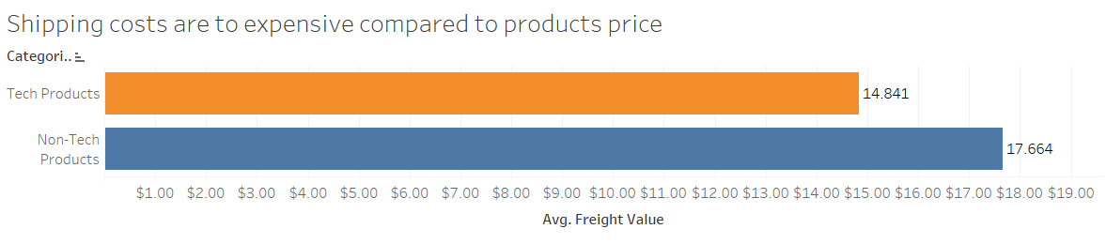
Shipping costs
Average Magist order price in tech products is 171$ and shipping costs are almost 15$.
Shipping costs are too expensive for our products price range.

Slide 7
Conclusions
Magist lacks experience with expensive high tech products such as Apple’s
Delivery is slow
Magist struggles with delivering premium products efficiency
Estimated delivery times too long, however maximum orders are delivered within the timeframe and expensive compared to competitors
Eniac should consider other Brazilian platforms or other markets before deciding on Magist

