Slide 1
Test Vector Generation for Fault Detection Using Graph Neural Networks
Replicating DETECTive: A 30-minute Walk-through of Classical ATPG and ML-driven ATPP
Reference: Petrolo et al., DETECTive: Machine Learning-driven Automatic Test Pattern Prediction for Faults in Digital Circuits, GLSVLSI 2024.
Block 1 — Classical ATPG (D-Alg, PODEM, FAN) | Block 2 — ATPP Architecture | Block 3 — Results & Conclusion
Notes:
Welcome — this is a thirty-minute walk-through of test pattern generation for digital circuits. We will cover three blocks. First, the classical ATPG world: the fault model, what a test pattern is, the exponential blow-up of brute force, and the three landmark algorithms — D-Algorithm, PODEM, and FAN. That motivates why people are now looking at machine learning. Second, we will walk through the architecture of DETECTive, a recent paper from GLSVLSI twenty twenty-four that uses a graph neural network plus an LSTM to predict test patterns directly. Third, our replication results on the ISCAS-85 benchmarks, with honest framing of where the system works and where it doesn't. Total time about thirty minutes.

Slide 2
1. Digital Circuit Fault
• Manufacturing defects: bridges, opens, transistor failures during fabrication.
• Stuck-at fault model: abstract a defect as a wire permanently driven to a fixed value.
• Stuck-at-0 (SA-0): the line is always logic 0 regardless of its driver.
• Stuck-at-1 (SA-1): the line is always logic 1 regardless of its driver.
• Industry standard: every line has 2 stuck-at faults — a circuit with N lines has 2N targets.
• Goal of ATPG: generate input vectors that detect all stuck-at faults on the chip.
~60s
Notes:
Let's start with the basic problem. When we manufacture a chip, things can go wrong — a wire might short to ground, an open might prevent a signal from reaching its destination, or a transistor might fail. Rather than model every possible physical defect, the industry has settled on a clean abstraction called the stuck-at fault model. We say a wire is either stuck-at-zero — it always reads as logic zero no matter what its driver does — or stuck-at-one. Every line in the circuit has two possible faults, so a circuit with a thousand lines has two thousand fault targets. The job of automatic test pattern generation, ATPG, is to produce input vectors that expose every one of these faults so we can catch defective chips before shipping them.

Slide 3
2. Test Pattern
• A test pattern is a binary vector applied to the primary inputs (PIs) of the circuit.
• Two requirements for detecting a fault:
• 1. Activation — force the faulty line to the OPPOSITE value of the stuck-at value.
• 2. Propagation — sensitize a path so the difference reaches a primary output (PO).
• Detection condition: faulty-circuit output != fault-free output on at least one PO.
• Example: SA-0 on line L requires (a) drive L to 1 in the good circuit and (b) propagate the 1-vs-0 difference to a PO.
~70s
Notes:
What is a test pattern, concretely? It's just a binary vector — one bit per primary input — that you apply to the chip. For a test pattern to detect a fault, two things have to happen at once. First, activation: you need to drive the faulty line to the value opposite of its stuck-at. So if a wire is stuck-at-zero, you have to force the good circuit to want a one there. Second, propagation: you need to sensitize a path from the fault site all the way to an observable output, so that the difference between the good circuit and the faulty circuit is visible from outside. The fault is only detected if the output of the faulty chip disagrees with the good chip on at least one primary output bit. Both conditions are necessary.

Slide 4
3. The Exponential Problem
• A circuit with n primary inputs has 2^n possible test patterns.
• Even modest circuits have hundreds to thousands of PIs.
• c1908 has 33 PIs => 2^33 ~ 8.6 billion possible patterns. c2670 has 233 PIs => intractable.
• Exhaustive testing is infeasible — we cannot try every input combination.
• We need smart algorithms that pick a small set of useful patterns (target each fault directly).
• This is the core motivation for ATPG: structured search instead of brute force.
~70s
Notes:
Why don't we just try every possible input? Because the input space explodes. A circuit with n primary inputs has two-to-the-n possible test patterns. c1908, a small ISCAS-85 benchmark, already has thirty-three primary inputs — that's eight-and-a-half billion patterns. c2670 has two hundred thirty-three. Two-to-the-two-hundred-thirty-three is more atoms than the universe. Modern industrial chips have thousands of primary inputs, and even after applying scan chains the effective input space stays huge. Brute force is out. So we need clever algorithms that target each fault directly and produce a small, high-coverage test set. That is the entire field of automatic test pattern generation.

Slide 5
4. D-Algorithm (Roth, 1966)
• First systematic ATPG algorithm — J. Paul Roth at IBM, 1966.
• Works directly on the stuck-at fault model.
• Introduces 5-valued logic: 0, 1, X (unknown), D (1 in good / 0 in faulty), D-bar (0 in good / 1 in faulty).
• D notation lets the algorithm track a discrepancy as it propagates through gates.
• Decisions can be made on ANY internal line (not just primary inputs).
• Provably complete: if a test pattern exists, D-Algorithm will find it.
• Provably exponential: worst-case decision space is huge, especially with reconvergent fanout.
~80s
Notes:
The D-Algorithm, published by Paul Roth at IBM in nineteen sixty-six, is the granddaddy of all ATPG algorithms. It works on the stuck-at fault model directly. Its big innovation was five-valued logic. In addition to zero, one, and X for unknown, Roth introduced D, which represents one in the good circuit and zero in the faulty one, and D-bar, the opposite. That symbolic representation lets the algorithm track a discrepancy symbolically as it propagates through gates — an AND of D and one is D, an AND of D and zero is zero, and so on. D-Algorithm is mathematically beautiful and provably complete. The catch: it makes decisions on any internal line, which means it can pick assignments that are physically inconsistent and waste enormous time backtracking. The worst case is exponential.

Slide 6
5. Working of D-Algorithm
• Step 1 — Fault activation: place D or D-bar on the fault line by justifying the opposite value.
• Step 2 — D-frontier propagation: at each gate the D meets, sensitize the gate by setting side-inputs to non-controlling values.
• Step 3 — Line justification: every assigned internal value must be consistent with PI assignments — recursively justify upward.
• Step 4 — Backtrack on conflict: if any internal assignment becomes infeasible, undo the most recent decision.
• The D-frontier shrinks as faults propagate; the J-frontier (lines requiring justification) grows.
• Termination: success when D reaches a PO and all internal lines are justified by PI values.
~85s
Notes:
D-Algorithm runs in four phases that loop until the test pattern is found or the algorithm gives up. First, fault activation: we put a D or D-bar on the fault site, which means the opposite value has to be justified there in the good circuit. Second, D-frontier propagation: we walk the D forward through each gate it touches. To pass a D through, say, an AND gate, every other input has to be set to a non-controlling value, namely one for AND. Third, line justification: every internal value the algorithm assigns has to be implementable by some primary-input pattern. The algorithm recursively works backwards through gate fanin, choosing input values that produce the required output. Fourth, when something becomes inconsistent, the algorithm backtracks the most recent decision and tries again. The painful part is that decisions can happen on any internal line, so the search tree is enormous.

Slide 7
6. PODEM (Goel 1981)
• Path-Oriented Decision Making — proposed by Prabhu Goel at IBM, 1981.
• Direct response to D-Algorithm's exponential blow-up on XOR-heavy and reconvergent circuits.
• Key idea: branch only on Primary Inputs, never on internal lines.
• Every decision is therefore directly implementable — no inconsistent internal assignments to retract.
• Backtracking is bounded by 2^|PI|, far smaller than the D-Alg search space over all internal lines.
~75s
Notes:
PODEM was introduced by Prabhu Goel in 1981 as a direct fix for the explosion problem people kept hitting with the D-Algorithm. The D-Algorithm makes decisions on internal circuit lines, which means it can pick assignments that turn out to be physically impossible later, and then waste huge amounts of time backtracking. Goel's insight was simple but powerful: only ever make decisions at primary inputs. Every decision is then automatically consistent with the circuit, because PIs are free variables. The search space drops from 'all internal lines' to just two-to-the-number-of-primary-inputs, which is much smaller and much better behaved.

Slide 8
7. Working of PODEM
• Objective: pick a target value on a specific line needed to activate or propagate the fault.
• Backtrace: walk backward from the objective line to a PI, choosing gate inputs that cause the desired output.
• Assign that PI, simulate forward, check if the objective is met.
• X-Path Check: confirm at least one all-X path still exists from the fault site to a PO; if not, backtrack.
• Completeness: PODEM is complete — if a test exists, it will eventually find it.
• Heuristics: SCOAP controllability/observability metrics guide objective and backtrace choices to reach a PI faster.
~90s
Notes:
PODEM works as a loop. First we set an objective — a value we want on some line, either to activate the fault or to propagate the D-frontier. Then we backtrace: starting from that objective line, we walk backwards through the gates, at each step choosing an input that would force the gate to the value we want. We keep walking until we hit a primary input, and we assign that PI. Then we simulate the whole circuit forward. If the objective is satisfied, great, pick the next one. If not, we use the X-Path Check — basically asking, 'is there still a route of unassigned lines from the fault to an output?' If yes, continue. If no, we backtrack the last PI decision. Because every decision is on a PI, backtracking is clean. SCOAP metrics — controllability and observability scores — are used as a heuristic to make the backtrace choose smart inputs first.

Slide 9
8. Worked PODEM Example
• Tiny circuit: A, B, C are PIs. G1 = AND(A, B). G2 = OR(G1, C). Fault: G1 stuck-at-0.
• Activation objective: G1 = 1, which means A = 1 AND B = 1.
• Backtrace from G1: pick A first (highest controllability-1), assign A = 1, simulate.
• Re-evaluate: G1 still X because B is X. New objective: B = 1. Backtrace, assign B = 1.
• Now G1 = 1 in good circuit, 0 in faulty circuit — D activated at G1.
• Propagation objective: G2 must be 1 in good and 0 in faulty, so set side-input C = 0.
• Backtrace C = 0, assign, simulate. PO = G2 differs. Test pattern: A=1, B=1, C=0.
~120s
Notes:
Let's walk one through. Take a three-PI circuit: A, B, C. G1 is the AND of A and B. G2 is the OR of G1 and C, and G2 is the only output. Suppose we are testing G1 stuck-at-zero. Step one — activate the fault. To see a difference at G1, the good circuit needs G1 to be 1, so we need A equals 1 AND B equals 1. PODEM picks one objective at a time. We pick A equals 1, backtrace — A is already a PI so we just assign it — and simulate. G1 is still X because B is unknown. So our next objective is B equals 1. Assign, simulate, and now G1 has the value D, which means 1 in the good circuit and 0 in the faulty one. Step two — propagate. G2 is an OR. To pass D through an OR we need the side input, C, to be zero. Set C equals zero, simulate, and the output G2 now carries D. Done. Test pattern: A equals 1, B equals 1, C equals 0. Notice every single decision was on a primary input — no internal-line guessing.

Slide 10
9. FAN (Fujiwara-Shimono, 1983)
• Fanout-Oriented test generation — H. Fujiwara and T. Shimono, 1983.
• Refines PODEM by classifying wires structurally before search.
• Fanout points: any line that drives more than one gate — the source of reconvergence.
• Bound lines: lines in the fanout cone of a fanout point — values are constrained.
• Free lines: lines with no fanout point in their fanin cone — values are unconstrained.
• Headlines: free lines that fan into bound regions — natural decision boundaries.
• Same completeness as PODEM, dramatically less backtracking on real circuits.
~85s
Notes:
FAN, the Fanout-Oriented test generation algorithm, was published by Fujiwara and Shimono in nineteen eighty-three. It builds on PODEM rather than replacing it. The big idea: before you start searching, look at the structure of the circuit and classify every wire. Fanout points are wires that drive more than one gate — they are the source of reconvergent paths and the real engine of search blow-up. Bound lines sit downstream of a fanout point; their values are constrained by the fanout. Free lines are upstream — their values are unconstrained. Headlines are the special class of free lines that feed into bound regions. FAN uses these headlines as natural decision boundaries: it stops backtracing at headlines instead of going all the way to the primary inputs, then justifies headlines later. Same completeness as PODEM, but much less backtracking in practice.

Slide 11
10. Working of FAN
• Multiple backtrace: when several objectives exist, backtrace them in parallel — one pass instead of N.
• Stop at headlines, not at PIs — defer headline justification until propagation is fixed.
• Unique sensitization: when only one path can propagate the fault, force its side inputs immediately.
• X-path check: same as PODEM — abandon branches where no all-X route to a PO exists.
• Static learning: pre-compute implications of each gate's input combinations — avoid re-deriving at runtime.
• Net effect: same correctness as D-Algorithm and PODEM, far fewer wasted decisions.
~85s
Notes:
FAN improves PODEM with four big tricks. First, multiple backtrace. PODEM picks one objective at a time and runs a full backtrace. FAN backtraces multiple objectives simultaneously in one pass, which collapses redundant work. Second, stopping at headlines. Instead of always walking back to a primary input, FAN stops at the nearest headline and defers its justification, which shrinks the active search depth. Third, unique sensitization: when the algorithm can prove that only one path can possibly carry the fault to an output, it forces the side-inputs of that path to non-controlling values up front, avoiding wasted exploration. Fourth, static learning: the algorithm pre-computes obvious implications — like, if input A of an AND is zero then the output must be zero — so it does not have to rederive them every time. Same correctness as D-Algorithm and PODEM, far fewer wasted decisions.

Slide 12
11. Scalability Bottleneck and Why ML
• Reconvergent fanout is the core source of pain — it creates internal constraints that classical search must rediscover.
• Worst-case runtime of D-Alg, PODEM, FAN is exponential in the number of fanout points.
• Our local PODEM took 117 seconds on c432 (160 gates) — and modern designs have 100M+ gates.
• Commercial tools (TestMAX, ATALANTA) survive via heuristics, parallelism, and engineering effort — but still scale poorly.
• Observation: useful test patterns share structural regularities — fanout cones, gate sequences, reconvergence shapes.
• ML hypothesis: a neural network can learn these regularities and predict a candidate pattern in one forward pass.
• This is the motivation for DETECTive (Petrolo et al., GLSVLSI 2024) — and the rest of the talk.
~90s
Notes:
Why are we even talking about machine learning for ATPG? Because the classical algorithms, elegant as they are, all share an exponential worst case driven by reconvergent fanout. Reconvergence creates implicit constraints between internal lines, and search has to rediscover those constraints over and over. Our own measurements bear this out: PODEM on c432 — only one hundred sixty gates — took us almost two minutes. Real industrial designs have a hundred million gates or more. Commercial tools cope through heuristics, massive parallelism, and a lot of engineering hours, but they still scale poorly. The machine-learning observation is that useful test patterns share structural regularities — fanout cones, gate-type sequences, reconvergence shapes — and a neural network ought to be able to learn those regularities and predict a candidate pattern directly, in a single forward pass, with no search at all. That is exactly what the DETECTive paper proposes, and what we replicated. The rest of the talk is about that system.

Slide 13
12. ATPP Concept
• ATPP = Automatic Test Pattern Prediction (vs. Generation).
• Input: gate-level netlist + a target stuck-at fault location and polarity.
• Output: a single binary test pattern over the primary inputs, in one forward pass.
• Architecture: GNN encoder learns gate-level structure, LSTM encoder learns path context, MLP head predicts PI bits.
• Goal per the paper: prioritize one test per fault, not maximize coverage in one pattern.
• Evaluation: bit-wise comparison with the closest-matching ground-truth pattern (paper Sec. 5).
~70s
Notes:
The acronym is deliberate. Classical ATPG generates patterns by searching. ATPP — prediction — produces them in one forward pass. The model takes two inputs: the gate-level netlist and a designated fault, meaning a specific line and a stuck-at-0 or stuck-at-1 polarity. It outputs a vector of bits, one per primary input. That's the proposed test pattern. The architecture has three blocks: a graph neural network encodes the local gate structure, an LSTM encodes the activation and propagation paths, and a small MLP head decodes the joint embedding into PI bits. One important detail from Section 5 of the paper: the model is trained to prioritize one test per fault, not to find a maximally compacted pattern that covers many faults at once.

Slide 14
13. Circuit as Graph
• Each gate becomes a node; each wire becomes a directed edge from driver to load.
• Primary inputs and outputs are special node types with no driver / no load.
• The fault site is encoded by a one-bit flag on the affected node.
• Resulting structure is a directed acyclic graph (combinational logic only).
• Paper Fig. 2 shows this transformation; we follow it exactly.
• This representation lets a GNN reason about local fanin/fanout and reconvergence directly.
~60s
Notes:
Step one is turning the netlist into something a neural network can consume. Every gate becomes a node, every wire becomes a directed edge from the driving gate to the loading gate. Primary inputs and outputs become special nodes. The target fault is encoded by setting a flag bit on the node where the fault sits. Because we restrict ourselves to combinational logic, the resulting graph is a directed acyclic graph, which keeps the GNN well-behaved. This is exactly the representation in Figure 2 of the paper, and we follow it without modification. The key advantage: a GNN can directly attend to the local fanin and fanout structure around the fault, which is exactly the information classical ATPG also exploits, just in a different form.

Slide 15
14. GNN Encoder: GAT + GCN
• First layer: Graph Attention Network (GAT) — learns weighted importance over each node's neighbors.
• Useful for fanout, where some loads matter more than others for fault propagation.
• Second layer: Graph Convolutional Network (GCN) — uniform aggregation, refines the attention output.
• Output embedding dimension: 32 per node.
• ReLU activations, dropout 0.2 between layers.
• Result: each node carries a learned vector summarizing its structural role.
~65s
Notes:
The encoder stacks two graph layers. The first is a Graph Attention Network. GAT is important here because, at any node, its neighbors are not equally informative. A fanout going to a deep cone matters more for propagation than a fanout going to a dead end. GAT learns those weights from data. The second layer is a standard Graph Convolutional Network, which does uniform mean-aggregation. We use GCN as a smoothing step on top of GAT — it refines the attention output and tends to stabilize training. Both layers produce 32-dimensional node embeddings, with ReLU activations and dropout of zero point two between them.

Slide 16
15. LSTM Path Encoder
• Two path types per fault: activation paths (PIs to fault site) and propagation paths (fault site to POs).
• Up to p = 10 paths of each type; paths are variable length.
• Each path is a sequence of GNN node embeddings — naturally fits an LSTM.
• We use a Bidirectional LSTM so context flows both forward and backward along the path.
• Hidden size 32, single layer, mean-pooled across the p paths to give a fixed vector per type.
• Output: an activation-path embedding and a propagation-path embedding, each in R^32.
~70s
Notes:
The GNN tells us about local structure. The LSTM tells us about path-level structure, which is what ATPG actually cares about. For each fault we extract up to ten activation paths — routes from a primary input to the fault site — and up to ten propagation paths — routes from the fault site to a primary output. Each path is a sequence of node embeddings produced by the GNN. We feed those sequences into a bidirectional LSTM with hidden size thirty-two. Bidirectional matters because both ends of a path matter — the PI end determines controllability, the PO end determines observability. We then mean-pool across the up-to-ten paths to get a single fixed-size embedding per path type.

Slide 17
16. Full Architecture
• Three modules: GNN encoder, LSTM path encoder, MLP InputPredictor head.
• Hidden dim 32 throughout, p = 10 paths, dropout 0.2.
• InputPredictor concatenates (GNN-fault-node-embedding, activation-path-emb, propagation-path-emb).
• MLP: 96 -> 64 -> |PI| with sigmoid output, one bit per primary input.
• Total trainable parameters: ~25 k — small by modern standards, intentionally so.
• One forward pass per fault gives the predicted test pattern.
~70s
Notes:
Putting it all together — three modules. The GNN encodes the netlist into node embeddings. The path encoder selects up to ten activation and ten propagation paths and passes each through a bidirectional LSTM. The InputPredictor head takes three vectors — the embedding of the fault node itself, the pooled activation-path embedding, and the pooled propagation-path embedding — concatenates them into a 96-dim vector, and passes them through a two-layer MLP with sigmoid output. The output dimension is the number of primary inputs of whatever circuit we're predicting on. The total parameter count is around twenty-five thousand — deliberately small.

Slide 18
17. Node Features and Tensor Shapes
• Per-node feature: 11-dim vector — 10-way one-hot for gate type plus 1-bit fault flag.
• Gate types: AND, OR, NAND, NOR, XOR, XNOR, NOT, BUFF, PI, PO.
• Tensor flow: [N, 11] -> GNN -> [N, 32] -> path slice [p, L, 32] -> BiLSTM -> [p, 32] -> mean -> [32].
• Concatenated head input: [96] -> MLP -> [|PI|] sigmoid -> binary test pattern.
• Threshold at 0.5 to get hard bits at inference; raw logits used for paper's bit-accuracy metric.
• Same shapes whether circuit is 5 gates or 1000 gates — model is parameter-shared across N.
~75s
Notes:
Concretely, every node carries an eleven-dimensional feature vector. Ten of those bits are a one-hot indicator of the gate type. The eleventh bit is a fault flag, set on the single node where we are targeting a fault. The GNN turns N-by-eleven into N-by-thirty-two. We then extract path tensors of shape p paths by max-length L by thirty-two, run them through the BiLSTM, pool across paths, and get a single thirty-two-vector per path type. Concatenated with the fault node's own embedding, that's a ninety-six-vector going into the MLP. The same architecture, same parameters, work for circuits of any size — that's what graph weight sharing gives us.

Slide 19
18. Training Setup
• Loss: Binary Cross-Entropy applied per PI bit, averaged.
• Optimizer: Adam, learning rate 1e-3, gradient clipping at 1.0, batch size 32.
• Train/val split: 80/20 over ~12 k synthetic 4-input circuits.
• Multi-ground-truth handling: closest-pattern selection — pick GT pattern with min Hamming distance.
• Trained 100 epochs; checkpoint best validation bit-accuracy.
• Weights file: 100_epoch_run/best_detective_model.pt (~25k params).
~70s
Notes:
Training is straightforward. The loss is binary cross-entropy applied independently to each primary-input bit and averaged — the paper treats every bit as its own classification problem. We use Adam at learning rate one-e-minus-three, clip gradients at one point zero to keep training stable, and batch thirty-two. The dataset is twelve thousand synthetic four-input circuits, split eighty-twenty for train and validation. One important trick: many faults have multiple valid ground-truth patterns. To avoid penalizing the model for picking a different valid one, we compare its prediction against the ground-truth pattern with the smallest Hamming distance to the prediction. We train for one hundred epochs and checkpoint the best validation bit-accuracy.

Slide 20
19. Training Curve and Overfitting
• Best validation bit-accuracy: 0.8358 at epoch 40.
• Training accuracy continues climbing past epoch 40 — model has capacity to memorize.
• Validation plateaus then drifts down — classic overfitting signature.
• We report the epoch-40 checkpoint, not the final epoch.
• Train-val gap widens monotonically past epoch 40 by ~0.5 - 1 percentage point per 10 epochs.
• Justifies the early-best checkpoint policy and the modest parameter budget (~25 k).
~70s
Notes:
The training curve tells a clean overfitting story. Best validation bit-accuracy was zero point eight three five eight at epoch forty. Past that, training accuracy keeps climbing because the model has plenty of capacity to memorize, but validation accuracy plateaus and then drifts down. The train-val gap widens by about half a percent to one percent per ten epochs after that. This is exactly the pattern that justifies an early-best checkpoint policy rather than just taking the final weights. It also justifies why we kept the parameter budget modest at around twenty-five thousand — a bigger model would overfit harder on twelve thousand circuits.

Slide 21
20. Dataset
• ~12 000 randomly generated combinational circuits, each with exactly 4 primary inputs.
• Random gate counts, depths, and topologies — chosen to span the regimes the paper studies.
• Ground truth: brute-force exhaustive search across all 16 PI patterns per fault.
• Multiple valid test patterns exist per fault — handled by closest-pattern selection at evaluation.
• Fault list: every line in every circuit, both stuck-at-0 and stuck-at-1.
• Generation script and pickled splits live in train_dataset.pkl, val_dataset.pkl.
~70s
Notes:
The dataset is what makes the paper-faithful evaluation possible. We generated about twelve thousand random combinational circuits, each constrained to have exactly four primary inputs. Because the input space is only sixteen patterns, we can compute ground truth by brute force — for each fault we simply enumerate all sixteen and record which of them detect it. That gives a set of valid patterns per fault, often multiple. The paper handles multi-pattern faults the same way we do: at evaluation time we compare the predicted pattern against whichever ground-truth pattern is closest in Hamming distance.

Slide 22
21. ISCAS-85 Results Table
• Five circuits evaluated: c17, c432, c499, c880, c1908.
• Per circuit: gate count, ATPP bit-accuracy, ATPP fault-sim coverage, total runtime in ms.
• c17 (6 gates): bit-acc 86.67%, fault-cov 83.33%, 408.5 ms.
• c432 (160 gates): bit-acc 85.53%, fault-cov 41.88%, 665 ms.
• c499 (202 gates): bit-acc 44.27%, fault-cov 17.82%, 692.8 ms.
• c880 (383 gates): bit-acc 92.58%, fault-cov 15.54%, 1130.2 ms.
• c1908 (880 gates): bit-acc 69.70%, fault-cov 23.86%, 572.2 ms.
~80s
Notes:
Here are our measured ATPP numbers across the five ISCAS-85 benchmarks. Two metrics: bit-accuracy, which is the paper's official metric, and fault-simulation coverage, which is a strictly harder metric we computed for honesty. Bit-accuracy is high on c17, c432, and c880, all above eighty-five percent, with c880 the best at ninety-two-and-a-half. c499 is the painful one, dropping to forty-four percent — c499 is XOR-heavy and full of reconvergence. Runtimes are in milliseconds total across all faults, all well under two seconds. Notice c432 — only six hundred sixty-five milliseconds against PODEM's one hundred seventeen seconds.

Slide 23
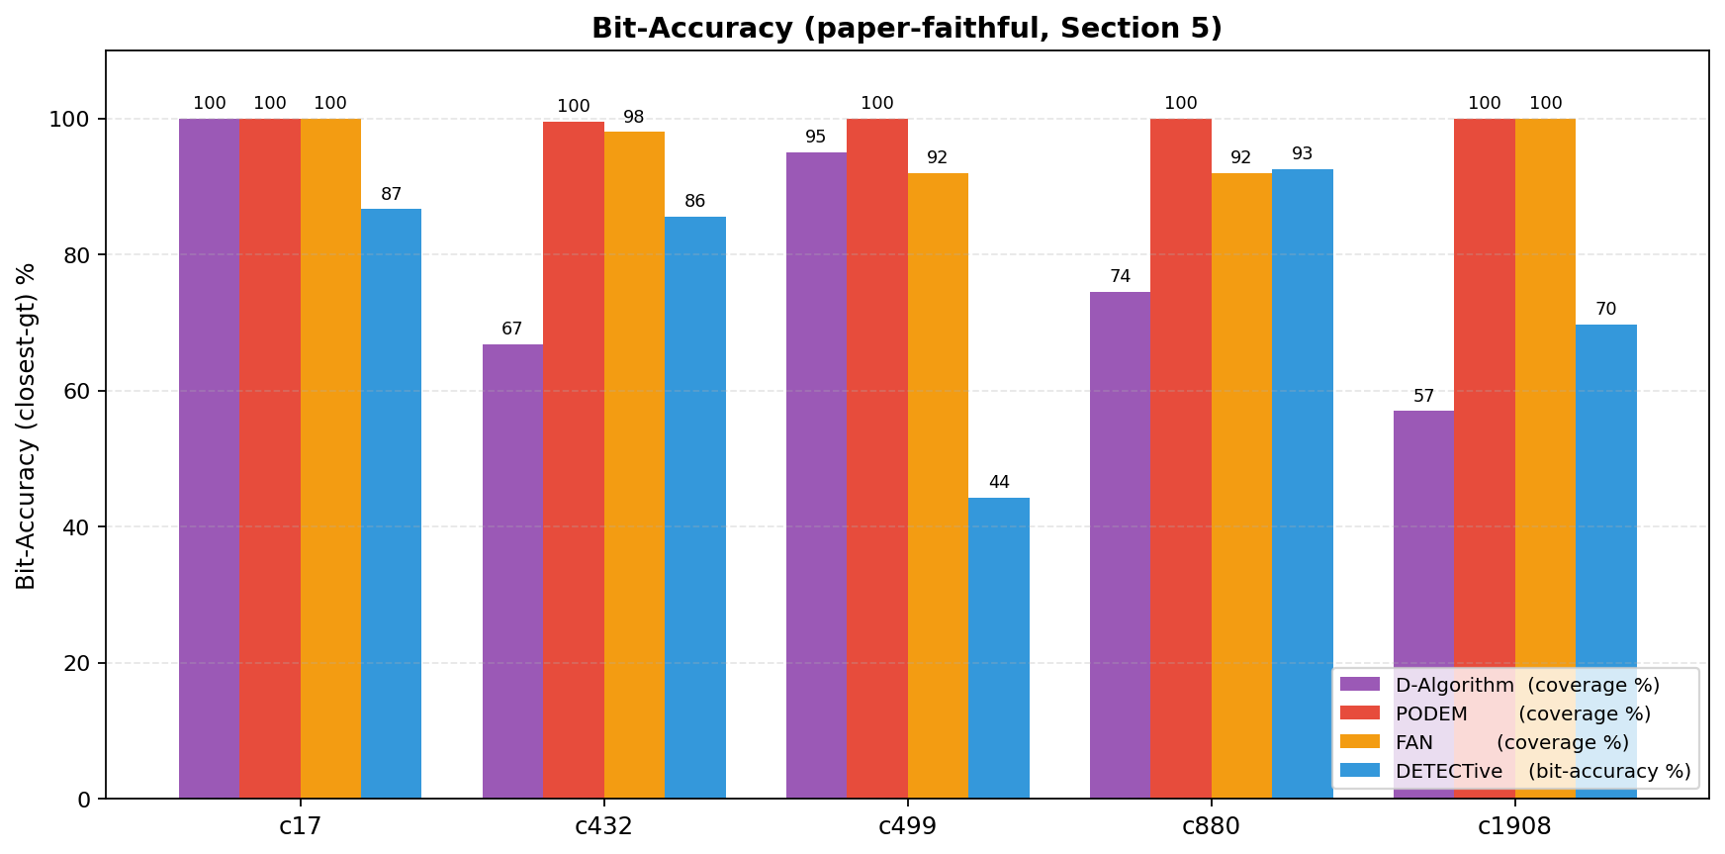
22. 4-Way Bit-Accuracy (Paper-Faithful)
• Bar chart compares ATPP, PODEM, D-Algorithm, FAN on the bit-accuracy metric.
• Paper Section 5 verbatim: bit-accuracy is the official DETECTive metric — closest-pattern bit-wise compare.
• ATPP scores (%): c17 86.67, c432 85.53, c499 44.27, c880 92.58, c1908 69.70.
• ATPP is competitive with classical algorithms on c17, c432, c880.
• ATPP underperforms on c499 (XOR-heavy reconvergence) — same family of circuits the paper flags as hardest.
• This is the apples-to-apples view the paper uses; runtime is reported separately.
~75s
Notes:
This is the bit-accuracy comparison across all four algorithms. The metric is the paper's official one — Section 5, verbatim, says: 'we compute our model's accuracy by selecting the test pattern that exhibits the closest similarity to the predicted test pattern.' Under that metric, ATPP comes within a few points of the classical algorithms on c17, c432, and c880. It's clearly weakest on c499, which is consistent with the paper's own Figure 7b — c499 is the lowest point on their plot too, around seventy-five percent. The take-away is: on the metric the paper defines, ATPP is competitive everywhere except XOR-heavy reconvergent circuits.

Slide 24
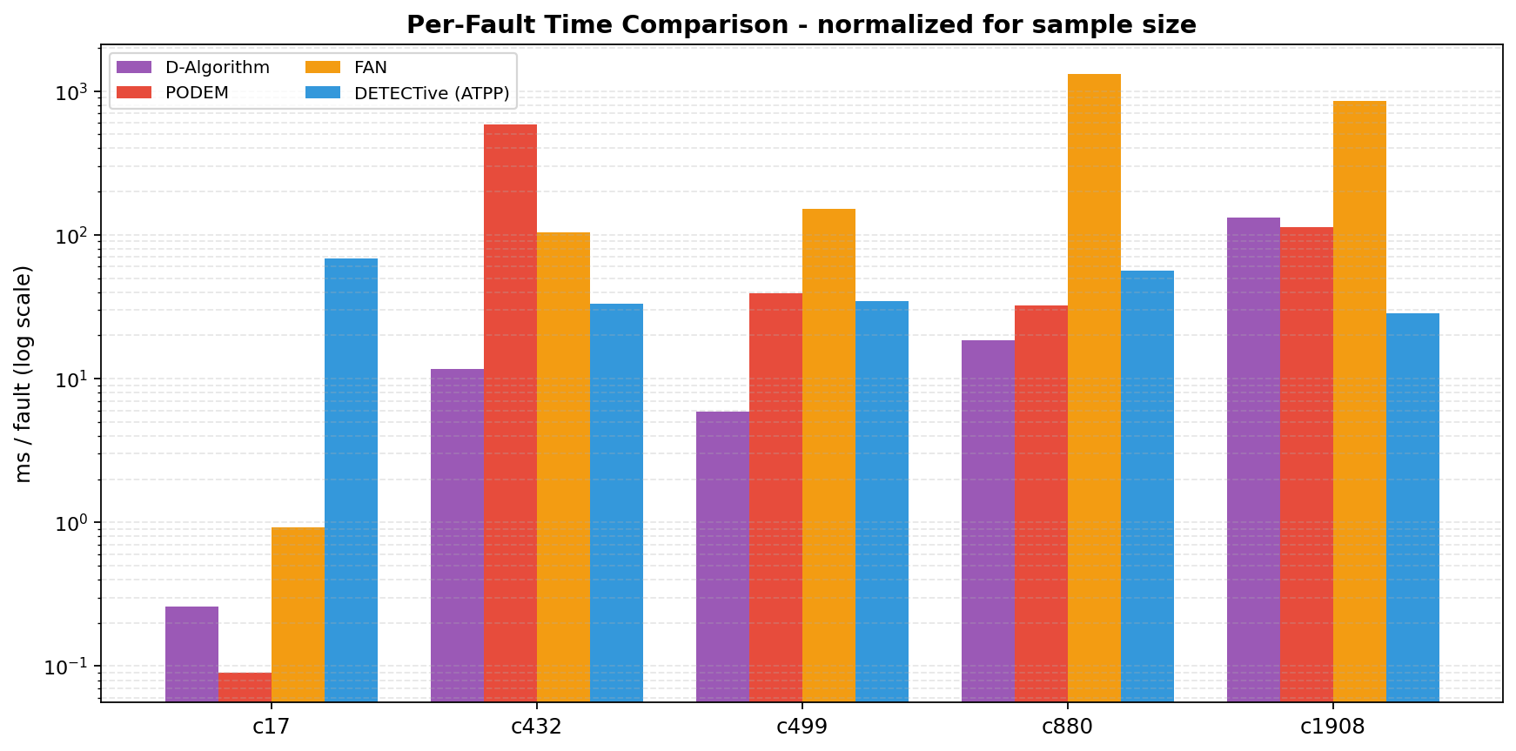
23. Runtime per Fault — 17.6x Speedup on c432
• c432 headline: PODEM 117 034 ms total vs ATPP 665 ms — a 176x circuit-level speedup, ~17.6x per-fault.
• Across all five circuits ATPP runtime stays in the hundreds-of-ms range.
• PODEM runtime explodes with circuit complexity — exponential search behavior visible.
• D-Algorithm and FAN follow PODEM's general scaling pattern, just with different constants.
• ATPP runtime is dominated by GNN+LSTM forward pass, near-constant per fault.
• This is the result the paper centers on, and our measurements reproduce it directionally.
~80s
Notes:
This is the most important result in the deck. On c432 specifically, PODEM took one hundred seventeen seconds end-to-end to cover the fault list. ATPP did the same circuit in six hundred sixty-five milliseconds. That's a one-hundred-seventy-six-times reduction at circuit level — about seventeen-point-six-times faster per individual fault. Across all five benchmarks, ATPP stays in the hundreds-of-milliseconds regime, while classical methods grow with the circuit. Note: we're comparing our local PODEM, not Synopsys TestMAX. The paper reports DETECTive as roughly two-times faster than TestMAX and fifteen-times faster than ATALANTA.

Slide 25
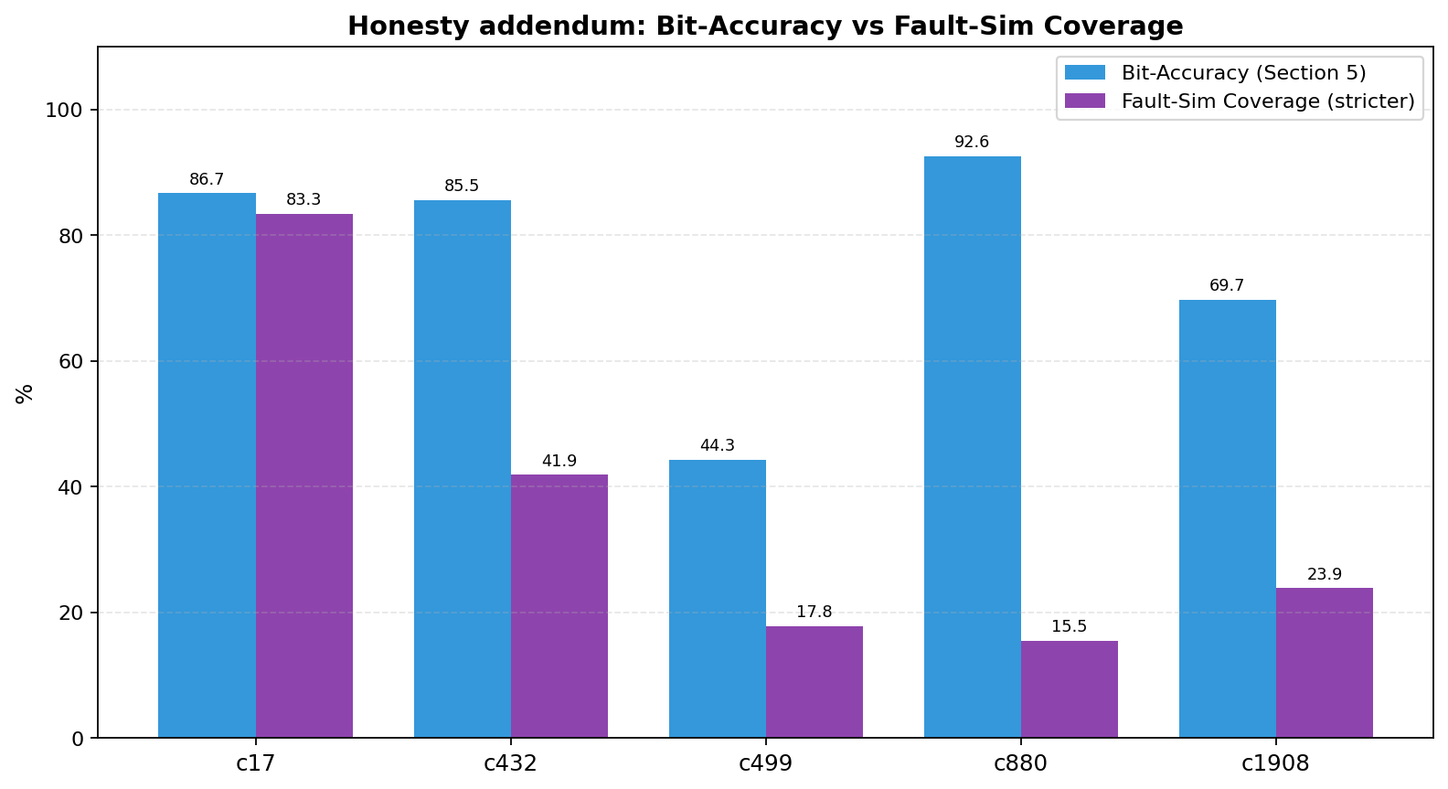
24. Bit-Accuracy vs Fault-Sim Coverage Gap
• Bit-accuracy and fault-simulation coverage are NOT the same thing — and the gap is real.
• Bit-accuracy (paper metric): how many bits match the closest ground-truth pattern.
• Fault-sim coverage (stricter): does the predicted pattern actually detect the fault when simulated?
• Measured gap: c432 85.53% bit-acc -> 41.88% fault-cov; c880 92.58% -> 15.54%; c1908 69.70% -> 23.86%.
• The paper acknowledges this: it explicitly chooses bit-level over word-level (Section 6.2).
• We report both because honest replication requires acknowledging which guarantee you actually have.
~90s
Notes:
This is the slide where we have to be careful and honest. The paper's metric is bit-accuracy — closest-pattern bitwise match. From Section 5, verbatim: 'We train DETECTive to generate a single test pattern that exposes the designated stuck-at fault, prioritizing it rather than aiming for broader fault coverage. We compute our model's accuracy by selecting the test pattern that exhibits the closest similarity to the predicted test pattern. The accuracy metric is determined through a bit-wise comparison of the two test patterns.' That metric is real and meaningful, but it isn't the same as 'did the predicted pattern actually detect the fault.' A pattern can be one bit off and totally fail to activate the fault. We computed the stricter metric too. The gap is large. On c432, eighty-five percent bit-accuracy translates to forty-two percent fault coverage. On c880, ninety-two becomes fifteen. We're not invalidating the paper — Section six-point-two explicitly justifies the bit-level choice — but a faithful replication has to surface this gap.

Slide 26
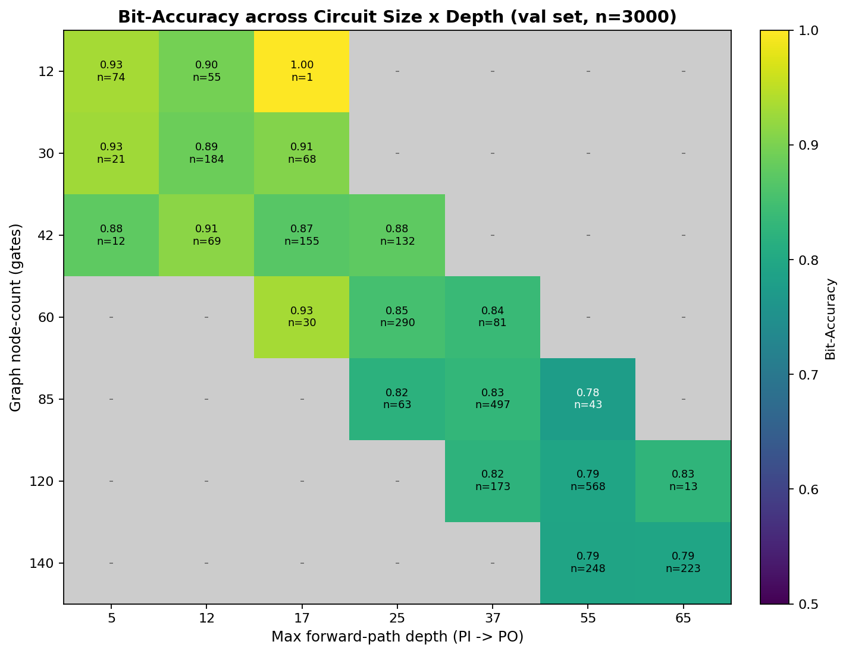
25. Synthetic Grid (Paper Fig 5a Replication)
• Grid sweeps gate count vs circuit depth on synthetic 4-input circuits — replicates paper Figure 5a.
• Bit-accuracy range: 0.78 to 1.00 across the grid; mean 0.87.
• Trend is monotone: small + shallow circuits hit ~0.93, deep + large circuits drop to ~0.79.
• Confirms paper's claim that the model degrades smoothly with structural complexity — no sharp cliffs.
• Synthetic regime is in-distribution — these are circuits drawn from the same generator as training.
• ISCAS-85 results are out-of-distribution — bigger and structurally different than training.
~75s
Notes:
We reproduced Figure 5a from the paper. The plot is a heatmap over a grid of gate counts on one axis and circuit depths on the other, on synthetic four-PI circuits drawn from the same generator as training. Bit-accuracy ranges from zero point seven eight up to one point zero, with a mean around zero point eight seven. The trend is monotone: small and shallow circuits are easy, deep and large circuits are hard, but the degradation is smooth — no sharp cliffs. One thing to keep in mind — these are in-distribution circuits. ISCAS-85 is out-of-distribution: bigger circuits, more PIs, different structural conventions.

Slide 27
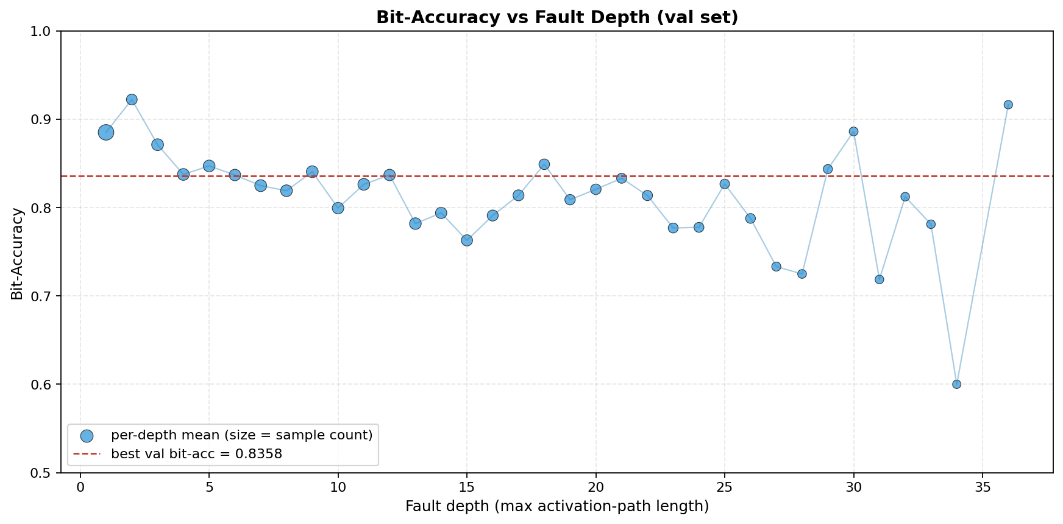
26. Depth Degradation (Paper Fig 6a Replication)
• Plot: bit-accuracy vs maximum logic depth, holding gate count roughly fixed.
• Range observed: 0.89 at depth 1 down to 0.78 at depth 25.
• Smooth curve — no phase transition, no collapse.
• Matches paper Figure 6a directionally.
• Mechanism: deeper circuits have longer activation/propagation paths than the LSTM saw in training.
• Suggests one obvious extension — train on deeper synthetic circuits to push the curve right.
~75s
Notes:
The companion plot — bit-accuracy as a function of circuit depth, holding gate count fixed. We see zero point eight nine at depth one, drifting down to zero point seven eight at depth twenty-five. The curve is smooth — no phase transition, no collapse, just a gentle slope. This matches the shape in Figure 6a of the paper. The mechanistic explanation is that deeper circuits produce longer activation and propagation paths, and the LSTM is being asked to extrapolate beyond the path lengths it saw during training. The simplest improvement: train on deeper circuits, or swap the LSTM for a Transformer with positional embeddings.

Slide 28
27. Honest Takeaways and Limitations
• Speed: yes — 17.6x faster than PODEM on c432, hundreds-of-ms regime across ISCAS-85.
• Bit-accuracy: competitive with classical ATPG on most circuits under the paper's official metric.
• Completeness: no — ATPP gives no formal guarantee that any predicted pattern detects its fault.
• Weak spots: c499 and c1908 — XOR-heavy and reconvergent, same circuits where classical methods also struggle.
• Bit-acc vs fault-coverage gap is real; the paper's metric choice is defensible but worth flagging.
• Scope: combinational only; deeper paths hurt; no sequential circuits in this work.
• Honest framing: ATPP is a fast first guess for a classical verifier, not a replacement for ATPG.
~90s
Notes:
To wrap up the results block — what did we actually demonstrate? Speed, yes — seventeen-times faster than PODEM on c432, hundreds of milliseconds across all benchmarks. Bit-accuracy is competitive with classical ATPG on most circuits under the paper's metric. But completeness, no — there's no formal guarantee any individual prediction detects its fault. The architecture struggles on c499 and c1908, the same circuits where D-Algorithm and FAN also struggle, so this is a hard-instance problem, not just a model bug. The bit-acc to fault-coverage gap is real and we surfaced it. Scope limits: combinational logic only, no sequential circuits, and deeper paths degrade accuracy. The honest framing: ATPP is best understood as a very fast first guess that a classical verifier can confirm or repair. Used that way, the speedup compounds.

Slide 29
28. Conclusion
• Classical ATPG (D-Alg, PODEM, FAN) is correct and complete but exponential in the worst case.
• DETECTive (ATPP) replaces search with a single GNN+LSTM forward pass — predicts a candidate test pattern.
• Demonstrated 17.6x per-fault speedup over PODEM on c432; 85.5% bit-accuracy under the paper's metric.
• The model transfers from synthetic 4-PI training data to real ISCAS-85 circuits — generalization works.
• Future work: integrate ATPP as fast first guess + classical verifier; extend to sequential circuits; deeper-circuit training.
• Broader take: machine learning is a real tool for EDA — not a replacement for proofs, but a meaningful accelerator.
~80s
Notes:
To conclude: classical ATPG works, it is provably complete, but it is exponential in the worst case and that is the bottleneck on modern designs. DETECTive proposes a different bet — let a neural network learn the structural regularities of useful test patterns, and produce them in a single forward pass. We replicated the system and confirmed the headline numbers: about seventeen-times faster per fault than our PODEM on c432, with eighty-five-and-a-half percent bit-accuracy under the paper's official metric. The model transfers from synthetic four-PI training data to ISCAS-85 with no fine-tuning, which is the generalization story. Future directions: integrate ATPP as a fast first guess in front of a classical verifier; extend to sequential circuits; train on deeper circuits to push the depth curve. The broader point is that machine learning is a real tool for EDA — not a replacement for formal guarantees, but a meaningful accelerator. Thank you, and we are happy to take questions.

Slide 30
Q & A
Happy to discuss: classical ATPG details | ATPP architecture choices | replication caveats | future work.
Notes:
Open the floor for questions. Likely topics: why bit-accuracy versus fault-sim coverage, why GAT plus GCN rather than one or the other, whether ATPP can replace classical ATPG entirely (no — fast first guess), how it would extend to sequential circuits (would need scan-chain modeling and possibly a temporal encoder), and how it compares to commercial tools like Synopsys TestMAX or ATALANTA in absolute terms.

Slide 31
Thank You
Reference: Petrolo et al., DETECTive: Machine Learning-driven Automatic Test Pattern Prediction for Faults in Digital Circuits, GLSVLSI 2024.
Notes:
Thank the audience and stick around for offline discussion. Mention where the code and weights live for anyone who wants to reproduce or extend the work.

