Slide 1



CLOUD INFRASTRUCTURE · SEMINAR PRESENTATION
Amazon Lightsail
30 Nov 2016
Launched at AWS re:Invent
Platform-as-a-Service, Lite
How AWS packaged its own building blocks into a fixed-price virtual private server — and what you trade away to get that simplicity.
$5 / month
Entry bundle — compute, SSD and 1 TB of transfer in one price
Presented by
Hridiyansh Shukla
8 resource types
Instances, containers, databases, storage, CDN, DNS and more
Registration No. 2427030591
Amazon Web Services · August 2026
Notes:
[1/20 · target 16s] Stand still. Let the title slide settle for two seconds before speaking. Good morning. My name is Hridiyansh Shukla, registration number 2427030591. Today I am presenting on Amazon Lightsail — Amazon Web Services' fixed-price virtual private server, and the reason so many people describe it as Platform-as-a-Service, lite.

Slide 2






ROADMAP
What this talk covers
The problem worth solving
Where Lightsail sits
Why AWS built a simpler front door
IaaS, PaaS-Lite, PaaS and SaaS compared
Anatomy of the service
The pricing model in full
Blueprints, bundles and the resource catalogue
Instances, databases, storage, networking
Lightsail versus the field
Hands-on and use cases
Amazon EC2, DigitalOcean, Heroku, Azure
A production site in under ten minutes
Limits and the exit
Verdict
What you give up, and how you leave
When this is the right tool
Amazon Lightsail (PaaS-Lite) · Hridiyansh Shukla · 2427030591
2
Notes:
[2/20 · target 18s] Move briskly. Do not read all eight items aloud — gesture across them. I have structured this in eight parts. We begin with the problem Lightsail was built to solve. We then open the service up — its anatomy, its pricing, and its competitors — and we close with its limitations and my verdict.

Slide 3

MOTIVATION
The problem: power arrived with complexity
Amazon EC2 gives you every knob a data centre has. For a team that only wants a website, a blog or a small application online, most of those knobs are a tax rather than a feature.
750+
Too many decisions
Amazon EC2 instance types to choose between
Before a raw EC2 instance serves traffic you must design a VPC, a subnet, a route table, an internet gateway, a security group, an EBS volume, a key pair and an Elastic IP.
8
Unpredictable bills
Lightsail general-purpose bundles — the whole menu
Compute, storage, egress and the IP address are four separate meters. A small site cannot forecast next month's invoice.
1
Skills mismatch
Students, freelancers and small businesses need a running server, not a cloud architecture certification.
Line on your bill, fixed before you deploy
Fewer choices, stated cost, identical AWS hardware.
Amazon Lightsail (PaaS-Lite) · Hridiyansh Shukla · 2427030591
3
Notes:
[3/20 · target 47s] Point to the three statistics on the right when you reach the last sentence. Amazon EC2 is extraordinarily capable, and that is precisely the problem. Before a raw EC2 instance serves a single request, you must design a virtual private cloud, a subnet, a route table, an internet gateway, a security group, a storage volume, a key pair and an elastic IP address. Second, the bill arrives on four separate meters — compute, storage, outbound data and the address itself — so a small site simply cannot forecast next month's invoice. And third, there is a skills mismatch: most people who want a website need a running server, not a cloud architecture qualification. The numbers on the right make the point.

Slide 4
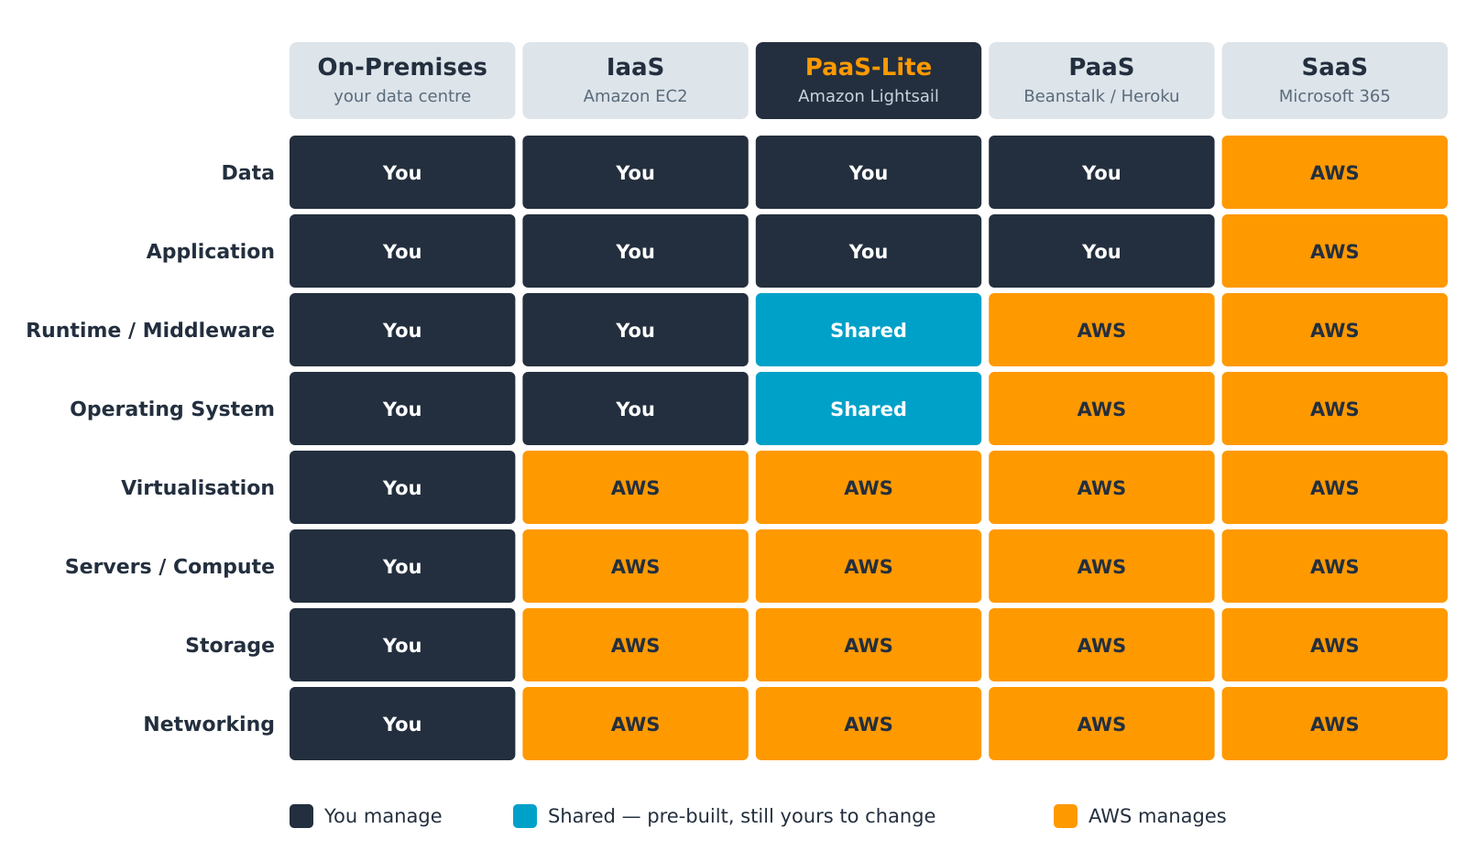
POSITIONING
Where Lightsail sits in the cloud stack
Why “PaaS-Lite”?
A true PaaS hides the operating system entirely — you push code and never meet a server.
Lightsail pre-builds the OS and the runtime for you, then hands you the root password anyway.
You get PaaS convenience on day one and IaaS control on day two. That hybrid position is the whole product.
Figure 1 — Division of management responsibility across cloud service models.
Amazon Lightsail (PaaS-Lite) · Hridiyansh Shukla · 2427030591
4
Notes:
[4/20 · target 46s] Trace the Lightsail column downward with your hand as you describe the three colours. Reading left to right: on-premises, you manage every layer. With Infrastructure-as-a-Service — EC2 — Amazon takes the four hardware layers and hands you the operating system upward. With true Platform-as-a-Service — Heroku, or Elastic Beanstalk — Amazon takes the operating system and the runtime too, and you never meet a server. Lightsail sits in between, and the teal band is why. Amazon pre-builds your operating system and your runtime, exactly like a PaaS — and then hands you the root password anyway. You get PaaS convenience on day one and IaaS control on day two. That hybrid position is the entire product.

Slide 5

DEFINITION
What Amazon Lightsail actually is
Amazon Lightsail is AWS's virtual private server offering: pre-configured compute, storage, networking and managed services, sold as fixed-price monthly bundles through a deliberately simplified console.
Announced 30 November 2016
One price, four things
Launched at AWS re:Invent in US East (N. Virginia); expanded to Hong Kong, São Paulo and Spain in June 2026.
Every bundle folds vCPU, memory, SSD storage and a monthly data-transfer allowance into a single figure.
Blueprint, not blank box
Real AWS underneath
Choose WordPress, LAMP, Node.js or a plain OS; the instance boots with the software already installed.
Instances are EC2, disks are EBS, DNS is Route 53. Nothing is a proprietary dead end.
Amazon Lightsail (PaaS-Lite) · Hridiyansh Shukla · 2427030591
5
Notes:
[5/20 · target 36s] Emphasise 'nothing is a proprietary dead end' — it sets up slide 18. Formally, then: Lightsail is AWS's virtual private server offering — pre-configured compute, storage, networking and managed services, sold as fixed-price monthly bundles through a deliberately simplified console. It was announced at re:Invent on the thirtieth of November 2016, and it is still expanding — Hong Kong, São Paulo and Spain were added as recently as June this year. The fourth card matters most: instances are EC2, disks are EBS, DNS is Route 53. Nothing here is a proprietary dead end.

Slide 6
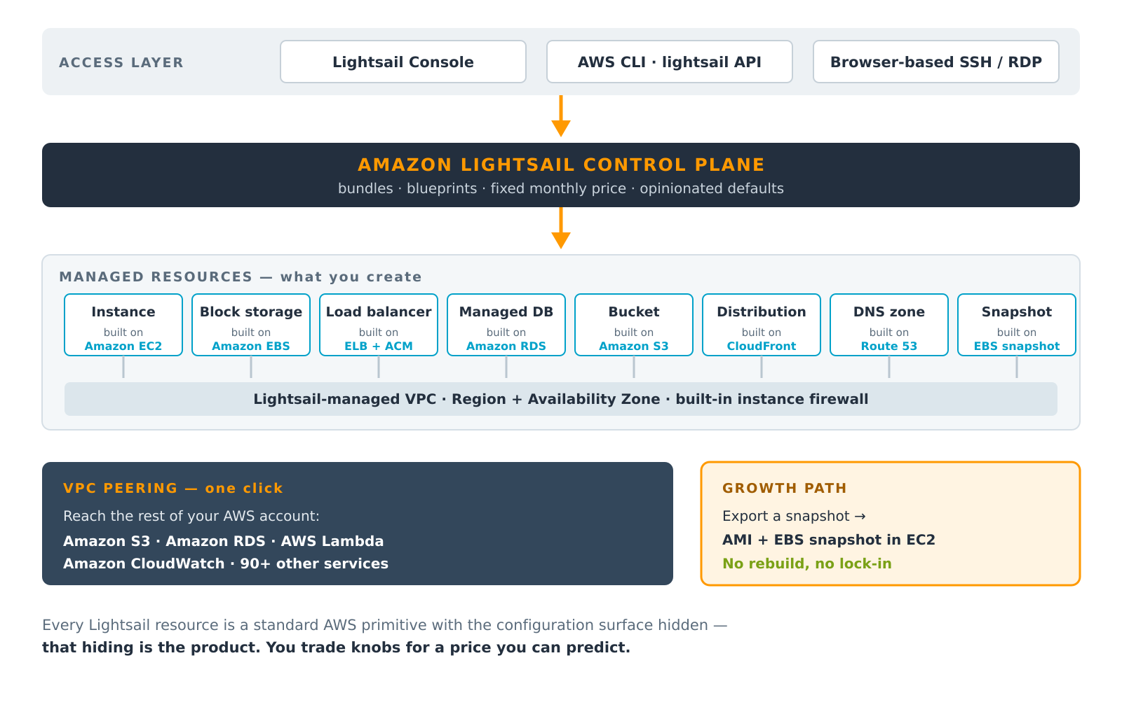
ARCHITECTURE
How the abstraction is built
The one idea
Lightsail is not a new infrastructure platform. It is a curated control plane over services AWS already sells.
An instance is an EC2 instance
A disk is an EBS volume
A load balancer is ELB plus a free ACM certificate
A distribution is CloudFront
A DNS zone is Route 53
Simplicity is the feature; the hardware is unchanged.
Figure 2 — The Lightsail control plane and the AWS primitives beneath it.
Amazon Lightsail (PaaS-Lite) · Hridiyansh Shukla · 2427030591
6
Notes:
[6/20 · target 39s] Follow the two orange arrows down the diagram as you speak. So how is it built? Lightsail is not a new infrastructure platform. It is a curated control plane over services Amazon already sells. The control plane holds the bundles, the blueprints and the opinionated defaults. Underneath, every resource you create is an ordinary AWS primitive with most of its configuration surface hidden — an instance is EC2, a load balancer is Elastic Load Balancing with a free certificate, a distribution is CloudFront. That hiding is the product. You are trading knobs for a price you can predict.

Slide 7
ANATOMY
The resource catalogue
Ten resource types cover the whole surface of the service.
Resource | What it gives you | Built on
Instance | Virtual server with a fixed bundle of vCPU, RAM, SSD and transfer | Amazon EC2
Container service | Runs Docker images behind a managed HTTPS endpoint — no cluster to operate | ECS / Fargate
Managed database | MySQL or PostgreSQL with automated backups and an optional standby | Amazon RDS
Block storage disk | Additional SSD volumes attached to a running instance | Amazon EBS
Object storage bucket | Static assets, media and backups served over HTTPS | Amazon S3
Load balancer | Spreads traffic across instances; includes a free, auto-renewed certificate | ELB + ACM
CDN distribution | Edge caching in front of an instance, bucket or load balancer | Amazon CloudFront
DNS zone | Authoritative DNS with three million queries a month included | Amazon Route 53
Static IP | A fixed public IPv4 address that survives stop, start and restore | Elastic IP
Snapshot | Point-in-time backup of an instance or disk; exportable to EC2 | EBS snapshot
Every row is an AWS service with its configuration surface deliberately reduced — which is exactly why a Lightsail workload can later be lifted onto the full service without a rewrite.
Amazon Lightsail (PaaS-Lite) · Hridiyansh Shukla · 2427030591
7
Notes:
[7/20 · target 26s] Do not read the table. Name three rows and move on. Ten resource types cover the entire service. I will not read the table, but notice the shape of it: instances and containers for compute; managed databases, block storage and buckets for state; load balancers, distributions, DNS zones and static addresses for delivery. The right-hand column is the honest one — every single row is an existing AWS service, simplified.

Slide 8
ANATOMY
Two choices: the blueprint and the bundle
Blueprint — the software
Bundle — the hardware
What the machine boots into.
What it runs on, and what it costs.
Operating systems
One bundle fixes vCPU, RAM, SSD size and the monthly transfer allowance together
Three families: general purpose, memory optimised (to 512 GB RAM, Feb 2026) and compute optimised (to 72 vCPU, Apr 2026)
Entry tiers use burstable CPU; $24/month and above give dedicated vCPU
Bundles can be resized upward by taking a snapshot and restoring onto a larger plan
Amazon Linux 2 and 2023 · Ubuntu · Debian · AlmaLinux 9 · CentOS · FreeBSD · openSUSE · Windows Server 2016 / 2019 / 2022
Application stacks
WordPress · WordPress Multisite · LAMP · Nginx (LEMP) · Node.js · Ruby on Rails · Django · Drupal · Joomla · Magento · PrestaShop · Ghost · Redmine · GitLab · cPanel & WHM · Plesk
Currently in transition — worth knowing for any new build
AWS stopped shipping newer Bitnami-packaged blueprints on 19 May 2026. WordPress, LAMP, Nginx and Node.js images packaged by Bitnami retire on 19 November 2026; Joomla, Magento, Drupal, Ghost, Django, GitLab, Redmine, MEAN and PrestaShop follow on 19 May 2027. AWS-maintained replacements for Node.js, LAMP and Ruby on Rails shipped in January 2026.
Amazon Lightsail (PaaS-Lite) · Hridiyansh Shukla · 2427030591
8
Notes:
[8/20 · target 40s] The orange box is the most current fact in the deck. Slow down for it. Creating a server is therefore only two decisions. The blueprint is the software — a plain operating system, or a ready-built stack such as WordPress, LAMP, Node.js or Magento, already installed. The bundle is the hardware and the price, fixed together. One point of currency, in the orange box: Amazon is retiring the Bitnami-packaged blueprints. WordPress, LAMP, Nginx and Node.js images from Bitnami retire this November; the remainder follow in May 2027. AWS-maintained replacements began shipping in January. If you are starting a project today, choose the AWS-maintained image.

Slide 9
ECONOMICS
Instance bundles — the published price list
Linux/Unix general-purpose bundles with a public IPv4 address. Windows bundles carry a licence premium.
Bundle | Memory | vCPU | SSD storage | Transfer / month | Linux $/month | Windows $/month
Nano | 512 MB | 2 | 20 GB | 1 TB | $5 | $9.50
Micro | 1 GB | 2 | 40 GB | 2 TB | $7 | $14
Small | 2 GB | 2 | 60 GB | 3 TB | $12 | $22
Medium | 4 GB | 2 | 80 GB | 4 TB | $24 | —
Large | 8 GB | 2 | 160 GB | 5 TB | $44 | —
XLarge | 16 GB | 4 | 320 GB | 6 TB | $84 | —
2XLarge | 32 GB | 8 | 640 GB | 7 TB | $164 | —
4XLarge | 64 GB | 16 | 1,280 GB | 8 TB | $384 | —
IPv6-only bundles cost about 30% less
Transfer overage is metered
Three months free
A public IPv4 address is now the premium — the Linux nano tier drops from $5 to $3.50 without one.
Exceed the allowance and you pay per GB. Inbound traffic and traffic to other AWS services in-Region are free.
Selected Linux/Unix IPv6 bundles at $3.50, $5 and $10 carry a three-month introductory credit for new accounts.
Amazon Lightsail (PaaS-Lite) · Hridiyansh Shukla · 2427030591
9
Notes:
[9/20 · target 40s] Read only the first and last rows aloud. Then the three notes underneath. Here is the published price list for Linux general-purpose bundles. Five dollars a month buys half a gigabyte of memory, two virtual CPUs, twenty gigabytes of solid-state storage and a terabyte of outbound transfer. At the top, three hundred and eighty-four dollars buys sixty-four gigabytes and eight terabytes of transfer. Three things worth noting underneath. A public IPv4 address is now the premium — go IPv6-only and the entry tier falls to three dollars fifty. Transfer beyond the allowance is metered. And selected entry bundles carry three months free.

Slide 10
ECONOMICS
What everything else costs
The rest of the catalogue is priced the same way — a flat monthly figure with an allowance attached.
Resource | Representative configuration | Price | What is included
Container service | Nano node — 0.25 vCPU, 512 MB | $7 / month per node | 500 GB transfer per service
Container service | XLarge node — 4 vCPU, 8 GB | $160 / month per node | Scale = price × node count
Managed database | 1 GB RAM, 40 GB SSD (standard) | $15 / month | High-availability plans cost double
Object storage | 5 GB storage, 25 GB transfer | $1 / month | Free for the first 12 months
Object storage | 250 GB storage, 500 GB transfer | $5 / month | 100 GB tier sits at $3
Load balancer | Includes managed TLS certificate | $18 / month | Certificate issue and renewal are free
CDN distribution | CloudFront edge caching | $2.50 / month | 50 GB/month free for 12 months
Block storage | Additional SSD disk | $0.10 / GB / month | Attach up to 16 TB per instance
Snapshots | Instance or disk backup | $0.05 / GB / month | Manual and automatic both charged
Static IP · DNS zone | IPv4 address · authoritative DNS | Free | IP billed only when left unattached
Read the pattern: AWS sells you an allowance, not a meter. That is the entire commercial difference between Lightsail and the rest of AWS.
Amazon Lightsail (PaaS-Lite) · Hridiyansh Shukla · 2427030591
10
Notes:
[10/20 · target 23s] Point at the navy bar and deliver that line as the takeaway. Everything else follows the same pattern. Containers from seven dollars a node. A managed database from fifteen. A load balancer at eighteen, certificate included. Object storage from one dollar, free for a year. The line at the bottom is the one to remember: Amazon is selling you an allowance, not a meter.

Slide 11
ECONOMICS
Where the fixed price actually pays off
The assumption behind the bars
A Lightsail Small bundle is $12/month for 2 GB RAM, 2 vCPU, 60 GB SSD and 3 TB of outbound transfer.
The comparison builds the same thing on EC2 at us-east-1 list prices: a t3.small on demand, a 60 GB gp3 volume, one Elastic IP, and egress at $0.09/GB after the first 100 GB.
Read it honestly
Data transfer, not compute, drives the gap. At low traffic the two are close and EC2 wins back ground with Savings Plans. Lightsail's advantage is bandwidth included in the price — and a number you knew in advance.
Figure 3 — Same workload, two billing models.
Amazon Lightsail (PaaS-Lite) · Hridiyansh Shukla · 2427030591
11
Notes:
[11/20 · target 47s] Give the audience three seconds to read the chart before you explain it. This is where that matters. I priced a Lightsail Small bundle — twelve dollars, three terabytes of transfer included — against the same thing built on EC2 at list price. At a hundred gigabytes of traffic, EC2 costs about twenty-four dollars. At three terabytes — the allowance you already paid for — two hundred and ninety-one dollars. But let me be honest about that chart. Compute is not what drives the gap; data transfer is. At low traffic the two are close, and EC2 wins ground back through Savings Plans. Lightsail's real advantage is bandwidth included in the price, and a number you knew in advance.

Slide 12

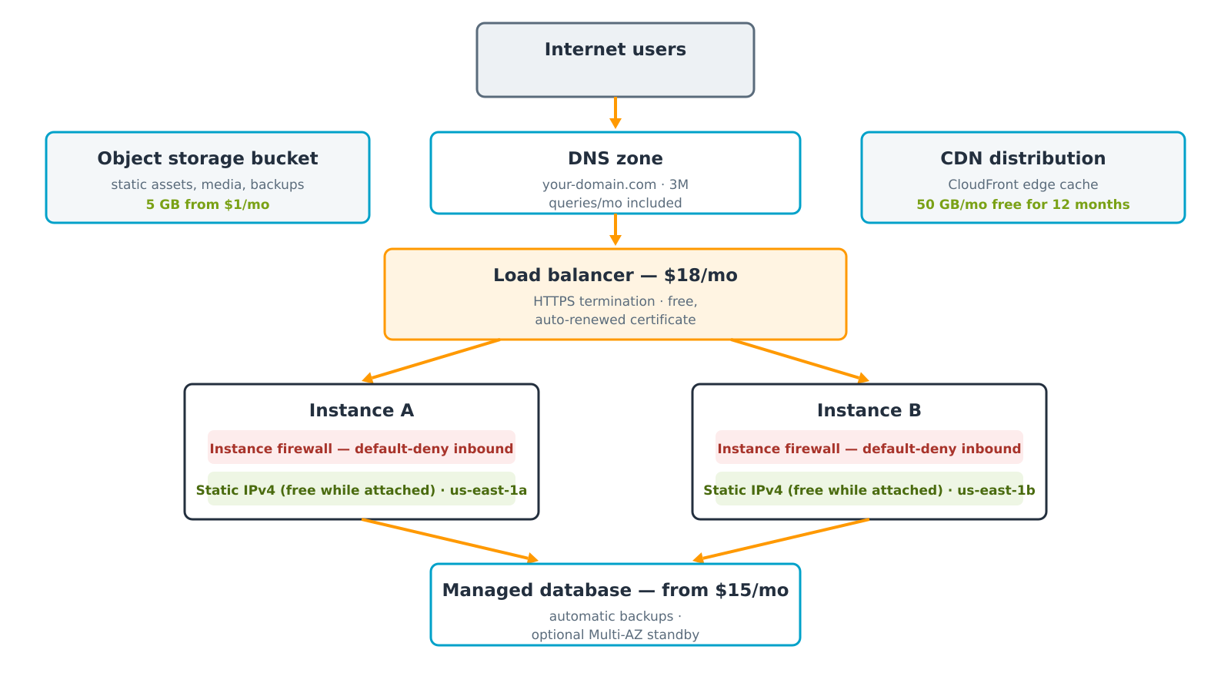

OPERATIONS
Networking and security by default
Default-deny firewall
Every instance ships with its own firewall; only the ports the blueprint needs are open.
Free managed certificates
A load balancer issues and renews TLS certificates at no charge; instances can use Let's Encrypt.
Static IPv4, free in use
Attached addresses cost nothing. An unattached one is billed at $0.005/hour to discourage hoarding.
Isolation and peering
Resources live in a Lightsail-managed VPC. One click peers it with your default VPC.
Figure 4 — A conventional highly available Lightsail deployment.
A simpler console does not shrink your security responsibility — patching the OS inside a blueprint is still your job.
Amazon Lightsail (PaaS-Lite) · Hridiyansh Shukla · 2427030591
12
Notes:
[12/20 · target 37s] End on the red line at the bottom. Pause after it. Every instance carries its own default-deny firewall. A load balancer issues and renews TLS certificates free of charge. A static IPv4 address costs nothing while attached. And resources sit in a Lightsail-managed private cloud that peers with your main one in a single click. But note the line at the bottom, because it is the most commonly misunderstood point about this service: a simpler console does not shrink your security responsibility. Patching the operating system inside that blueprint is still your job.

Slide 13
COMPARISON
Amazon Lightsail versus Amazon EC2
Dimension | Amazon Lightsail | Amazon EC2
Pricing model | Fixed monthly bundle, allowance included | Per-second metering across four separate meters
Choice of hardware | Eight general-purpose bundles plus two specialised families | More than 750 instance types
Maximum single instance | 64 GB / 16 vCPU general purpose; 512 GB memory optimised | Up to 448 vCPU and 12,288 GB of memory
Networking | Lightsail-managed VPC; peering to the default VPC | Full VPC design: subnets, route tables, NAT, gateways
Automatic scaling | Not available for instances; containers scale by node count | EC2 Auto Scaling groups with policies and schedules
Discount instruments | None — the list price is the price | Reserved Instances, Savings Plans, Spot
Access control | Coarse; Lightsail-level permissions | Full IAM, resource policies, service control policies
Time to first server | Minutes, from a menu | Longer; several dependent resources must exist first
Best fit | Predictable small workloads, fast delivery, cost certainty | Elastic, large or compliance-heavy architectures
The two are not rivals: Lightsail is the on-ramp, EC2 the motorway, and the snapshot export makes the journey cheap.
Amazon Lightsail (PaaS-Lite) · Hridiyansh Shukla · 2427030591
13
Notes:
[13/20 · target 37s] Four rows only: pricing, scaling, discounts, best fit. Four rows tell the story. Pricing: a fixed bundle against per-second metering. Scaling: Lightsail has no auto scaling for instances at all — capacity is a manual decision. Discounts: Lightsail has no Reserved Instances, no Savings Plans, no Spot. The list price is the price. And best fit: predictable small workloads against elastic or compliance-heavy architectures. But these two are not rivals. Lightsail is the on-ramp; EC2 is the motorway. The snapshot export exists precisely so that the journey between them is cheap.

Slide 14
COMPARISON
Lightsail against the wider market
Indicative entry pricing, August 2026. Figures are list prices and vary by region.
Platform | Entry price | You still manage | Distinguishing strength
Amazon Lightsail | $5 / month (nano, dual-stack) | OS and application | Generous transfer allowance; a documented path onto full AWS
DigitalOcean Droplet | $4 / month (512 MB); $6 is the practical floor | OS and application | Clean developer experience and documentation
Linode / Akamai Nanode | $5 / month (1 GB, 25 GB SSD, 1 TB) | OS and application | Strong price-to-memory ratio at the entry tier
Heroku dyno | $5 Eco (sleeps) · $7 Basic | Application only | True PaaS — no server to patch, but add-ons are billed separately
Azure App Service | Basic B1 around $55 / month | Application only | Deep integration with the Microsoft estate
What actually separates them
On raw price per gigabyte of RAM, Lightsail is competitive rather than cheapest. It wins on two things a price list does not show: the included data-transfer allowance, which is where independent VPS bills usually break, and the fact that the resource underneath is ordinary AWS — so growing out of Lightsail is a migration inside one account rather than a change of vendor.
Amazon Lightsail (PaaS-Lite) · Hridiyansh Shukla · 2427030591
14
Notes:
[14/20 · target 35s] Concede the price point honestly — it strengthens the next sentence. Against the wider market, on raw price per gigabyte of memory, Lightsail is competitive rather than cheapest. DigitalOcean starts lower; Linode gives more memory for the same five dollars. Lightsail wins on two things a price list does not show. First, the included transfer allowance — which is exactly where independent VPS bills tend to break. Second, the resource underneath is ordinary AWS, so outgrowing Lightsail is a migration inside one account rather than a change of vendor.

Slide 15
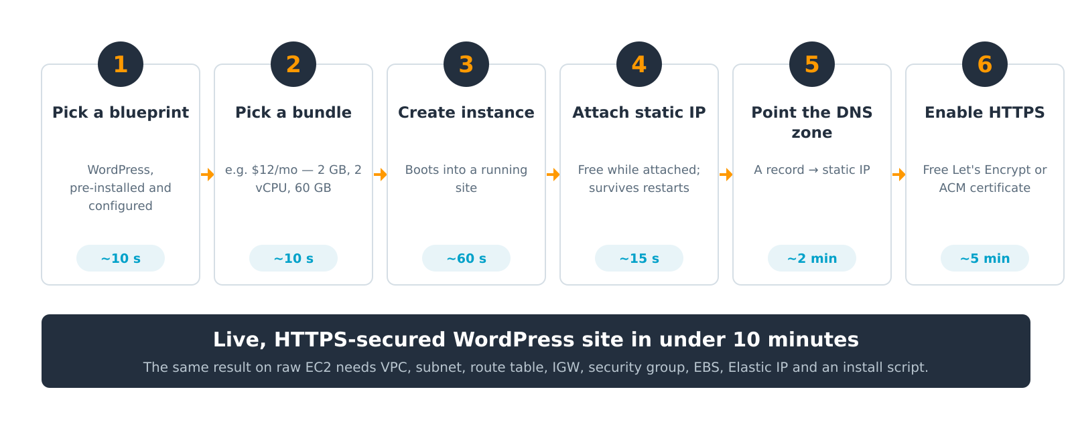
DEMONSTRATION
From nothing to a live HTTPS site
Figure 5 — The complete deployment path for a production WordPress site.
Everything above is also a single API call:
aws lightsail create-instances --blueprint-id wordpress --bundle-id small_3_0
Amazon Lightsail (PaaS-Lite) · Hridiyansh Shukla · 2427030591
15
Notes:
[15/20 · target 37s] Count the six steps on your fingers. Land firmly on 'ten minutes'. In practice it looks like this. Pick the WordPress blueprint. Pick a bundle. Create the instance — it boots into a running site in about a minute. Attach a static address. Point a DNS record at it. Enable HTTPS. That is a live, secured, production WordPress site in under ten minutes. The same result on raw EC2 needs all eight of those resources built and wired together first. And none of this is console-only — every step is a single command-line call.

Slide 16


APPLICATION
Where Lightsail earns its place
Websites and blogs
Development and test
Small business applications
WordPress, Ghost and Drupal on a bundle whose bandwidth allowance covers ordinary traffic.
Disposable environments that mirror production and are deleted when the sprint ends.
Line-of-business tools, booking systems and intranets for teams with no operations staff.
E-commerce storefronts
Learning and coursework
Research computing
Magento and PrestaShop blueprints with a managed database and a CDN in front.
A genuine cloud server for the price of a coffee — the fastest route into AWS for a student.
Lightsail for Research packages CPU and GPU workstations with the same fixed-price model.
The common thread is a workload whose ceiling is known in advance. Lightsail is a poor fit the moment demand becomes genuinely unpredictable.
Amazon Lightsail (PaaS-Lite) · Hridiyansh Shukla · 2427030591
16
Notes:
[16/20 · target 29s] Two examples aloud, then the closing line. Websites and blogs, where the bandwidth allowance comfortably covers ordinary traffic. Development and test environments that are created for a sprint and deleted afterwards. Small business applications for teams with no operations staff. Storefronts, coursework, and research computing through Lightsail for Research. The common thread is a workload whose ceiling is known in advance. Lightsail is a poor fit the moment demand becomes genuinely unpredictable.

Slide 17
CRITIQUE
What you give up for the simplicity
Architectural limits
Operational and commercial limits
No auto scaling for instances — capacity is a manual decision
No Reserved Instances, Savings Plans or Spot pricing
Coarse IAM; unsuitable where least-privilege access is audited
Integration with the wider AWS estate goes through VPC peering only
Entry bundles run on burstable CPU — sustained load throttles
Default quotas: 20 instances, 5 static IPs and 6 DNS zones per account
Exceeding the transfer allowance is billed per gigabyte
Patching the OS and application inside a blueprint remains your job
Bitnami-packaged blueprints are being retired through 2026–2027
Not available in every AWS Region, unlike EC2
None of these is a defect. They are the deliberate cost of a fixed price — and each one is a signal that the workload may have outgrown the service.
Amazon Lightsail (PaaS-Lite) · Hridiyansh Shukla · 2427030591
17
Notes:
[17/20 · target 35s] Deliver the navy bar as a considered judgement, not an apology. Which brings me to the limitations. There is no auto scaling. There are no discount instruments. Access control is coarse, so Lightsail is unsuitable wherever least-privilege access is formally audited. Entry bundles run on burstable CPU, which throttles under sustained load. Now — none of these is a defect. Every one of them is the deliberate cost of a fixed price. What matters is that each is also a signal that your workload may have outgrown the service.

Slide 18
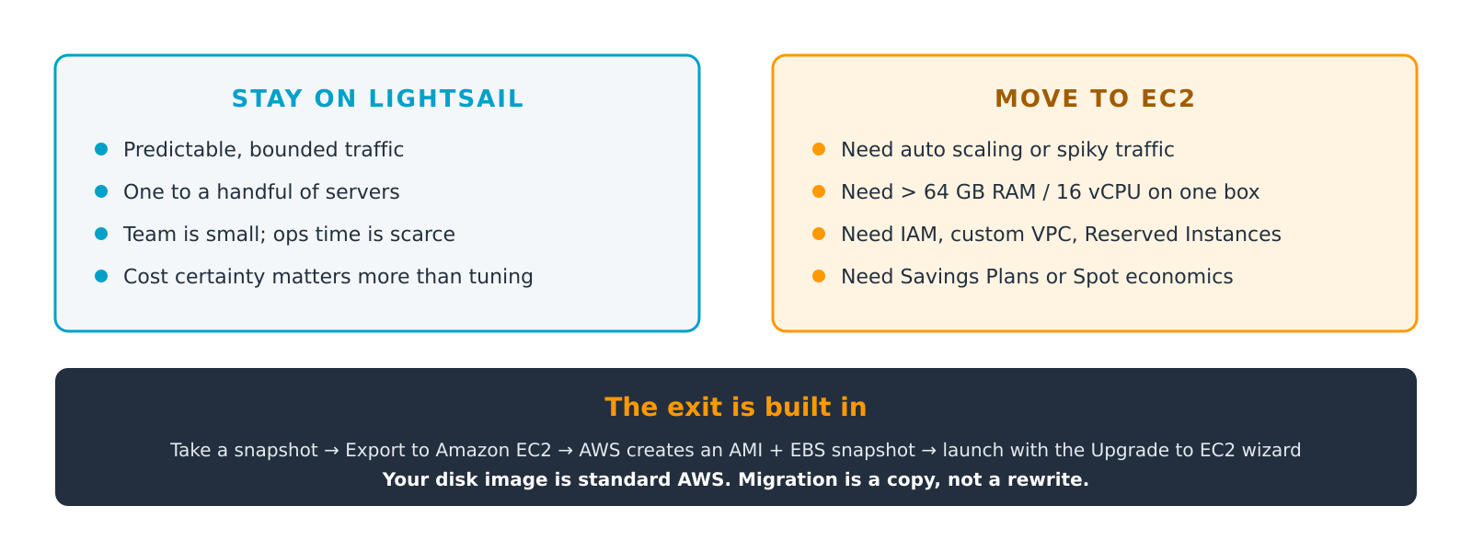
LIFECYCLE
Knowing when to leave — and how
Figure 6 — The decision boundary, and the built-in migration route across it.
This is the case for Lightsail over an independent VPS: the exit is a supported AWS workflow, not a rebuild elsewhere.
Amazon Lightsail (PaaS-Lite) · Hridiyansh Shukla · 2427030591
18
Notes:
[18/20 · target 35s] This is the strategic argument. Deliver it as the strongest claim in the talk. Stay while traffic is predictable, the estate is small, and cost certainty matters more than tuning. Move to EC2 when you need auto scaling, more than sixty-four gigabytes on one machine, proper identity management, or Savings Plans economics. And the exit is built in. Take a snapshot, export it to EC2, and Amazon creates a machine image and a volume snapshot for you to launch. Your disk image is standard AWS — migration is a copy, not a rewrite.

Slide 19
CONCLUSION
Four things worth remembering
1
Lightsail sells predictability, not power
The bundle is a price you know before you deploy. Everything else follows from that one commercial decision.
2
It is PaaS-Lite, not PaaS
AWS pre-builds the operating system and runtime, then still gives you root. Convenience on day one, control on day two.
3
The saving is in the bandwidth
Compute is competitively priced; the included data-transfer allowance is where the fixed model genuinely pays.
4
Its limits are its exit signs
No auto scaling, no Savings Plans, coarse IAM. When those start to hurt, snapshot and export to EC2.
Thank you · Questions welcome
Notes:
[19/20 · target 47s] Slow down. One beat between each of the four points. To conclude, four things worth remembering. First, Lightsail sells predictability, not power — the bundle is a price you know before you deploy. Second, it is PaaS-Lite, not PaaS: Amazon pre-builds the operating system and runtime, then still gives you root. Third, the saving is in the bandwidth, not the compute. And fourth, its limitations are its exit signs — when they start to hurt, snapshot and export to EC2. Lightsail is best understood not as a cheaper AWS, but as a narrower one, deliberately designed so that outgrowing it is the expected outcome rather than a failure. Thank you. I am happy to take questions.

Slide 20
SOURCES
References
All pricing and feature claims verified against these sources in August 2026.
Amazon Web Services. Amazon Lightsail — Pricing. aws.amazon.com/lightsail/pricing
Amazon Web Services. Amazon Lightsail User Guide: instance bundles, blueprints, buckets, container services, and account quotas. docs.aws.amazon.com/lightsail
Amazon Web Services. “Announcing memory-optimized instance bundles for Amazon Lightsail”, What's New, 2 February 2026.
Amazon Web Services. “Announcing compute-optimized instance bundles for Amazon Lightsail”, What's New, April 2026.
Amazon Web Services. “Amazon Lightsail expands blueprint selection with updated support for Node.js, LAMP and Ruby on Rails blueprints”, What's New, January 2026.
Amazon Web Services. “Amazon Lightsail is now available in three additional AWS Regions”, What's New, June 2026.
Amazon Web Services. Lightsail documentation: “Blueprints packaged by Bitnami” — deprecation schedule, 2026–2027.
Amazon Web Services. Lightsail documentation: “Export Lightsail snapshots to Amazon EC2” and the Upgrade to EC2 wizard.
AWS re:Post. “Compare Amazon EC2 and Amazon Lightsail”, AWS Knowledge Center.
Amazon Web Services. Amazon EC2 On-Demand Pricing and Amazon EBS Pricing, us-east-1 (used for the Figure 3 cost model).
DigitalOcean, Akamai (Linode), Heroku and Microsoft Azure published price lists, consulted August 2026 for Slide 14.
Prepared by Hridiyansh Shukla · Registration No. 2427030591 · August 2026
Amazon Lightsail (PaaS-Lite) · Hridiyansh Shukla · 2427030591
20
Notes:
[20/20 · target 12s] Hold this slide during questions. My sources are listed here — principally the AWS Lightsail pricing pages, the user guide, and the service announcements from 2026. I will leave this slide up.

