Slide 1

PROJECT-BASED LEARNING · B.TECH CSE · V SEMESTER
RetainIQ
0.700
AUC of the churn model on customers it had never seen
Deciding who to save: causal retention decisioning for small subscription businesses
−22,823
Prasham Jain · Reg. No. 2427030155
Mentor: Dr. Rishi Gupta
Department of Computer Science and Engineering, Manipal University Jaipur
value lost by giving an offer to that model's top 20%
+8,610
Watch the demo video
Paste the Google Drive link here
same data: causal targeting that abstains (oracle upper bound)
Code github.com/PrashamJ17/PBL-Proj
DOIs paper 10.5281/zenodo.22009470 · software 10.5281/zenodo.22025879 · data 10.5281/zenodo.22025123
Simulated subscription business, 3,589 customers; the loss holds on 6 of 6 seeds.
Notes:
RetainIQ is a retention decision engine for subscription businesses with roughly 200 to 2,000 customers. The three numbers on the right are the whole argument of the project in one place. A gradient-boosted churn model reaches AUC 0.700 on customers it never saw (make killtest). Giving a retention offer to the top 20% it flags loses 22,823 units of value, which is worse than choosing customers at random (-17,035). Using the true treatment effects with abstention earns +8,610 on the same budget; that row is an oracle upper bound, not an achievable result, and it is labelled that way throughout. Paper DOI 10.5281/zenodo.22009470; software 10.5281/zenodo.22025879; data 10.5281/zenodo.22025123. Demo video link: see the button.

Slide 2





01 · CONTEXT AND OBJECTIVES
Why churn prediction is the wrong question
~42%
30%
If contacted
If left alone
stays
churns
of customers lost in a year at 4.5% monthly voluntary churn, the benchmark SubSim is calibrated to
of all churn is involuntary: failed payments, not a customer's decision
stays
Sure Thing
Sleeping Dog
Stays either way. The offer is wasted money.
Would have stayed; leaves because contacted. The offer destroys value.
What most tools do
Score every customer's churn risk, then send the riskiest ones a discount.
Why that fails
Risk is not responsiveness. In field experiments, contact has raised churn (Ascarza et al., 2016; Ascarza, 2018): an offer can remind a dormant payer to cancel.
churns
Persuadable
Lost Cause
Would have left; stays if contacted. The only customer worth paying for.
Leaves either way. Let them go.
Project objectives
Who to treat
Which offer
rank by the offer's effect, not by risk
the cheapest rung that still pays
At what cost
Did it work
In the simulated business, Sleeping Dogs are 59.1% of the churn model's highest-risk decile but only 5.3% of its lowest.
decide in money, with uncertainty
measure against a randomised holdout
RetainIQ · Prasham Jain (2427030155) · Mentor: Dr. Rishi Gupta · Manipal University Jaipur
2 / 8
Notes:
Why it matters: at 4.5% monthly voluntary churn a business keeps 0.955^12 = 57% of customers after a year, so it loses about 42%. Around 30% of churn is involuntary (failed payments). Both are the published SMB-SaaS benchmarks the simulator is calibrated to, and the calibration is enforced in CI. The quadrant is the core idea. A churn score finds people likely to leave, which mixes Persuadables with Lost Causes and Sleeping Dogs. Only Persuadables are worth paying for. Sleeping Dogs are made worse by contact. In the simulated business they make up 59.1% of the model's top predicted-risk decile against 5.3% of the bottom decile (25.7% overall), which is why risk-ranked targeting loses money. That risk targeting fails, and can raise churn, is prior work (Ascarza, JMR 2018) and is not claimed as new. The objectives are the four questions the system answers.

Slide 3






02 · DATA AND PIPELINE
Data and pipeline: from billing export to decision
1
2
3
4
5
6
Ingest
Preflight
Time-safe data
Models
Money and policy
Outputs and proof
Stripe or Razorpay CSV export, or the SubSim simulator
checks units, dates, history; returns BLOCK or READY
features see only what was known at decision time
survival hazard and Bayesian causal effect
benefit = −Δp·V − c; abstain or pick an offer
report, dashboard, worklists, holdout ledger
Datasets
Tools and libraries
Dataset | Size (rows) | Type | Used for
Hillstrom (MineThatData) | 64,000 | RCT · 3 e-mail arms | correlation test; small-n
Criteo-UPLIFT v2.1 | 13,979,592 | RCT · advertising | correlation test
Lenta (scikit-uplift) | 687,029 | RCT · retail promotion | out-of-sample prediction
IBM Telco Customer Churn | 7,043 → 7,032 | subscription churn | survival benchmark
GBSG2 (scikit-survival) | 686 | clinical, censored | negative control
SubSim (this project) | configurable | simulator, exact effects | individual ground truth
Language and core
Python 3.11–3.13 · NumPy · pandas · SciPy
Machine learning
scikit-learn (gradient boosting) · lifelines (Cox) · scikit-survival (RSF) · PyTorch (DeepSurv)
Engineering
pytest (721 tests) · ruff · GitHub Actions CI · headless Chrome and pandoc for reports
Reproducibility
Zenodo archives for software, data and paper
Preprocessing: temporal splits (train only on months before the decision month); person-month rows split by customer, never by row. Telco has no calendar time, so it is split by customer, and TotalCharges is dropped as a tenure proxy (r = 0.83). Third-party data is cited, not redistributed; the Zenodo data record holds a SHA-256 checksum of each file used.
RetainIQ · Prasham Jain (2427030155) · Mentor: Dr. Rishi Gupta · Manipal University Jaipur
3 / 8
Notes:
Pipeline: (1) a billing export or the simulator; (2) preflight refuses unsafe files, for example Stripe amounts in cents, which would overstate every revenue figure 100x; (3) every fact carries occurred_at and available_at, and features only see what was available at decision time; (4) models; (5) the money layer and policy; (6) outputs and the holdout ledger. Datasets (Table 1 of the paper): Hillstrom 64,000; Criteo-UPLIFT v2.1 13,979,592; Lenta 687,029; Telco 7,043 loaded, 7,032 after cleaning; GBSG2 686; SubSim configurable. The three public RCTs have real randomised treatment, which is what allows causal evaluation; Hillstrom's two e-mail arms give four settings. SubSim exists because no public dataset contains individual ground-truth treatment effects. Sources: Hillstrom (2008); Diemert et al. (2018); scikit-uplift; IBM/Kaggle; Schumacher et al. (1994).

Slide 4


03 · METHODOLOGY AND ARCHITECTURE
Methodology: three models, one money-based decision
1 Survival: when is a customer likely to leave?
Training discipline
Discrete-time hazard on a person-month table. Voluntary and involuntary churn are separate competing risks, customers still subscribed are treated as censored, and features can change each month. Benchmarked against Kaplan–Meier, Cox PH, Random Survival Forest and DeepSurv.
Temporal splits only: train on months before the decision
Split person-month rows by customer, never by row
2 Causal effect: would an offer change that?
Hierarchical Bayesian CATE: logit P(churn) = α + βx + T·(τ₀ + γx). Shrinkage on γ guards against noise at small n. The Laplace posterior is validated against NUTS sampling, and reason codes are exact per-feature contributions to τ.
Leakage audit: leaky features would show AUC 0.954 against an honest 0.603
Repeated resplits and seeds; report the win rate, not the mean
3 Decision: is it worth the money?
Δp = σ(η₀ + τ) − σ(η₀) and benefit = −Δp·V − c. Treat only if P(benefit > 0) > 1 − α (α = 0.30, i.e. 70% confidence); otherwise abstain. The offer ladder picks the rung with the best expected value.
Predictions pre-registered before fixes; refutations kept
DEVELOPMENT ITERATIONS
v0 churn-score targeting: loses money
v1 oracle uplift + abstention (upper bound)
v2 Bayesian CATE + abstention
fix units bug: log-odds multiplied by money
v3 offer ladder + reason codes
v4 holdout measurement layer
RetainIQ · Prasham Jain (2427030155) · Mentor: Dr. Rishi Gupta · Manipal University Jaipur
4 / 8
Notes:
Model 1: a discrete-time survival model on person-month rows, with voluntary and involuntary churn as competing risks (Allison 1982; compared with Cox 1972, Ishwaran et al. 2008, Katzman et al. 2018). Model 2: a hierarchical Bayesian conditional average treatment effect, logit P(churn) = alpha + x'beta + T(tau0 + x'gamma), so the effect on the log-odds scale is tau0 + x'gamma. The posterior is a Laplace approximation, checked against NUTS (D-053), with the shrinkage scale marginalised over a grid (Gelman et al., BDA 2013). Model 3 is the decision: convert the log-odds effect to a probability change, then to money, and treat only when the posterior probability of making money exceeds 70%. Training discipline is where most churn projects go wrong: a random split lets the model see the future. The leakage audit shows the size of that error, AUC 0.954 with leaky features against 0.603 honest (Kaufman et al. 2012). The red 'fix' is D-057: the decision rule multiplied a log-odds effect by customer value as if it were a probability. All 337 tests passed at the time because every test was a self-consistency check. The fix makes the error impossible to express: the rule now accepts money only.

Slide 5
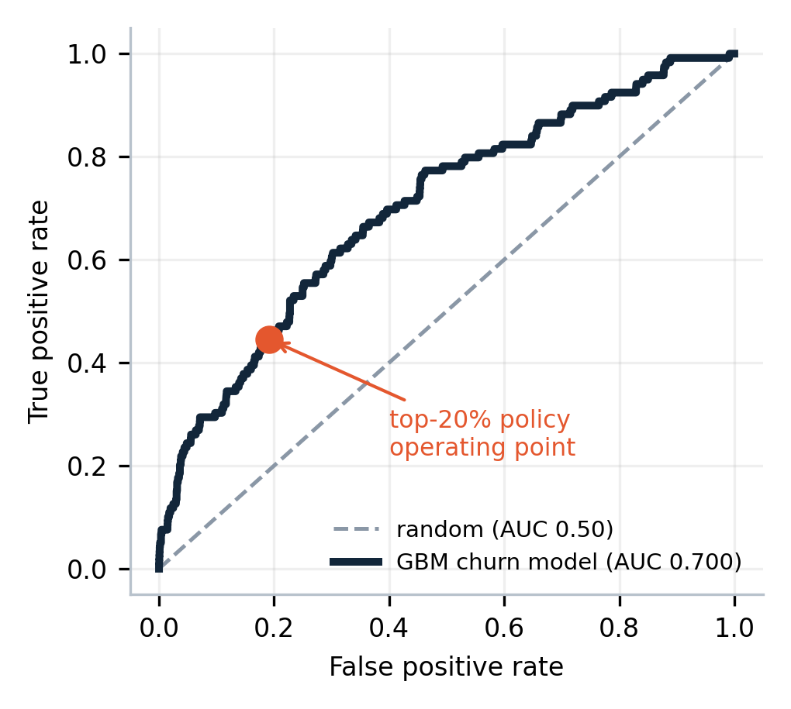
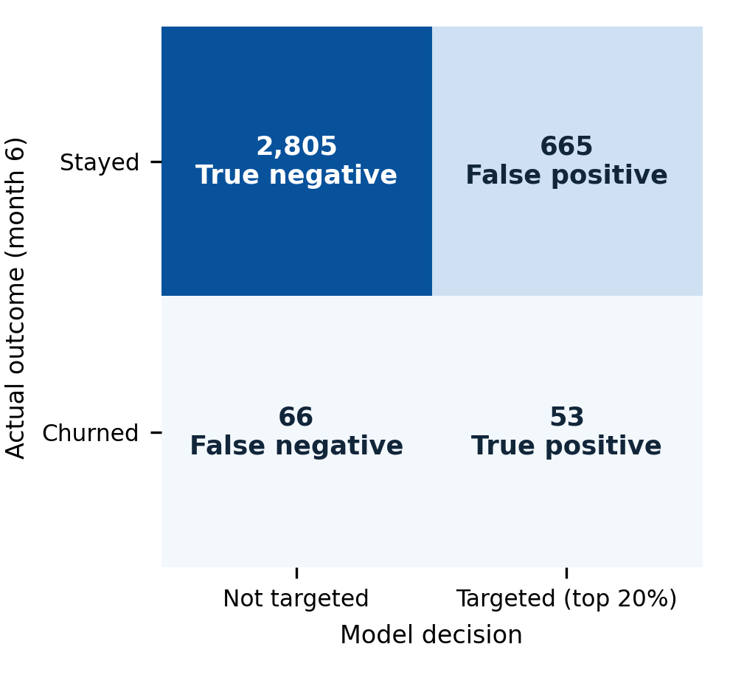
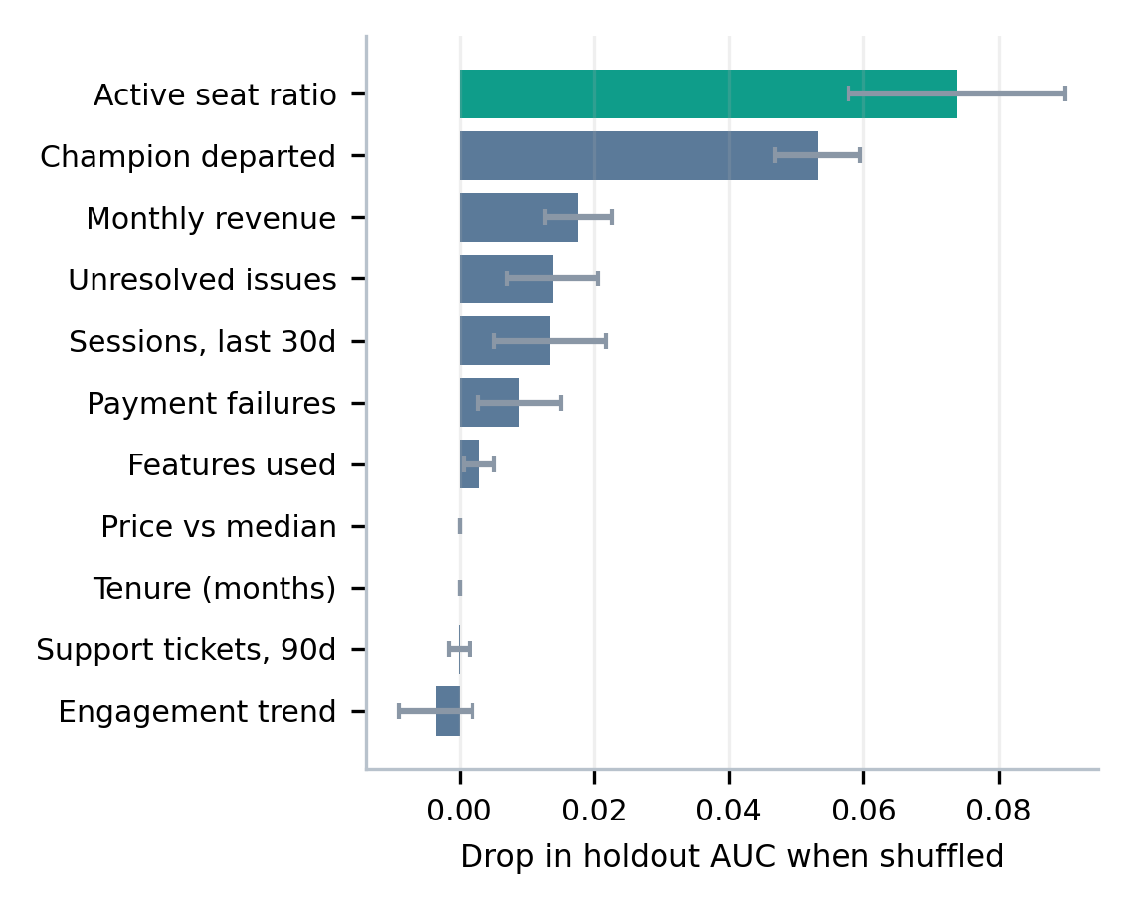
04 · RESULTS I: PREDICTION
Results I: a sound churn model, judged honestly
ROC curve · held-out month
Confusion matrix · top-20% rule
Churn drivers · permutation importance
3,589 unseen customers; 3.3% churned that month
threshold = the rule the policy actually uses
AUC drop when a feature is shuffled (15 repeats)
0.700
44.5%
7.4%
Survival benchmark (Telco, 10 resplits)
Integrated Brier score (lower is better): ties DeepSurv, beats Cox and RSF on 10 of 10 resplits
AUC-ROC
recall
precision
Model | C-index | IBS | Cal. slope
Discrete-time hazard (ours) | 0.865 | 0.0824 | 1.02
DeepSurv | 0.866 | 0.0825 | 0.98
Cox PH | 0.857 | 0.0914 | 1.18
Random Survival Forest | 0.846 | 0.0964 | 1.18
Kaplan–Meier | — | 0.1823 | —
0.127
79.6%
96.7%
F1 score
accuracy
accuracy of always predicting ‘stays’
RetainIQ · Prasham Jain (2427030155) · Mentor: Dr. Rishi Gupta · Manipal University Jaipur
5 / 8
Notes:
All classification metrics are computed from the kill-test model: HistGradientBoosting on 11 observable features, trained on 28,283 person-month rows before month 6 and evaluated on the 3,589 customers at month 6, which it never saw. AUC 0.700; average precision 0.118 against a 3.3% base rate, a 3.6x lift. At the threshold the policy uses (top 20% by predicted risk): TP 53, FP 665, FN 66, TN 2,805; recall 44.5%, precision 7.4%, F1 0.127. Accuracy is 79.6%, which is LOWER than the 96.7% you get by predicting that nobody churns. That is why accuracy is not reported as a headline metric: with a 3% event rate it rewards doing nothing. The strongest drivers are active seat ratio and champion departure. Survival benchmark (paper Table 6): our model's integrated Brier score 0.0824 against DeepSurv 0.0825 (a tie, not a win), Cox 0.0914, RSF 0.0964, Kaplan–Meier 0.1823. On GBSG2, the negative control with fixed covariates, our model loses, as predicted in advance.

Slide 6
05 · RESULTS II: DECISIONS
Results II: better prediction does not mean better decisions
Value created by each targeting policy
When does causal (uplift) targeting pay?
τ = offer effect, π = outcome propensity · correlation after Ascarza (2018)
Same 20% budget · 3,589 simulated customers · from make killtest
Setting | corr(τ, π) | Uplift gain per 1,000
Criteo · advertising | +0.58 [+0.51, +0.65] | +0.1 [−0.1, +0.3]
Hillstrom · men's e-mail | +0.28 [−0.21, +0.66] | −0.1 [−3.0, +2.8]
Hillstrom · women's e-mail | +0.18 [−0.07, +0.49] | +2.6 [−1.9, +6.2]
Lenta · retail promotion | +0.13 [+0.05, +0.22] | +0.6 [−0.1, +1.5]
SubSim · simulated trial* | −0.21 [−0.33, −0.07] | +9.7 [+5.0, +14.4]
Do nothing
0
Treat everyone
−89,869 (off scale)
Random 20%
−17,035
Churn-score top 20%
−22,823
Oracle uplift top 20% *
+5,877
Oracle + abstention *
+8,610
Fitted models; mean of 30 splits [2.5th–97.5th percentile]. Rows 1–4 are public experiments: no gain is clear of zero and they cannot be ordered. On the log-odds scale their correlations are −0.46 to +0.06. * 60,000 simulated customers; the negative correlation is configured.
* oracle rows use the simulator's true effects: an upper bound, not an achievable result
72.5%
93%
58%
≈119,500
of 200 draws where the best method beats random at n = 500 (real Hillstrom RCT; 95% interval 66–79%)
of draws where abstaining beats risk ranking; ahead of Lemmens & Gupta's rule only from n ≈ 1,000; never beats doing nothing
per-customer offer choice vs one well-chosen offer: CI 42–72%, not distinguishable from chance
customers needed to detect the delivered 1.1-point retention lift with a 10% holdout
RetainIQ · Prasham Jain (2427030155) · Mentor: Dr. Rishi Gupta · Manipal University Jaipur
6 / 8
Notes:
Left, from make killtest: with the same 20% budget, targeting by churn score loses 22,823, worse than random (-17,035); treating everyone loses 89,869 (bar truncated). The oracle rows use true effects and are upper bounds. Right, from make correlation-checks (D-074): the risk-lift correlation, which Ascarza (2018, Web Appendix A3.4) varied in a simulation, measured here from fitted models over thirty random splits of four settings from three public randomised experiments, and of a randomised trial of 60,000 simulated customers. Brackets are the 2.5th and 97.5th percentiles across splits. On the four real settings the uplift model's gain cannot be told from zero and the settings cannot be ordered. An earlier version of this table showed one split per row; the Hillstrom men's figure, +0.69, was the highest of the thirty. On the log-odds scale the real correlations are -0.46, +0.06, -0.22 and -0.05, so most of the positive correlation is the probability scale. In the simulated trial the uplift model wins on 30 of 30 splits; the simulator is configured to have a negative correlation. Bottom: at n = 500 on the real Hillstrom experiment the best of five methods beats random on 72.5% of 200 draws (exact 95% interval 66% to 79%; 84.5% at 1,000 and 95.5% at 2,000; the weakest method 62.5%), which is why win rate is reported instead of the mean. The abstention rule beats ranking on 93% of draws but does not beat doing nothing, because the break-even effect is four times the delivered effect. Against a re-implementation of Lemmens and Gupta's (2020) rule on 500 simulated pilots (make baseline, D-075) it is ahead on 78% of the draws that differ from 1,000 customers, on 26% at 250 and 47% at 500; it made money on 25 of the 139 draws on which it acted. The per-customer optimiser wins 58% of draws, CI [0.42, 0.72], which is chance. The holdout estimator is unbiased (88–98% interval coverage), but detecting the delivered lift of 0.0108 at 80% power needs about 119,500 customers with a 10% holdout (make holdout).

Slide 7
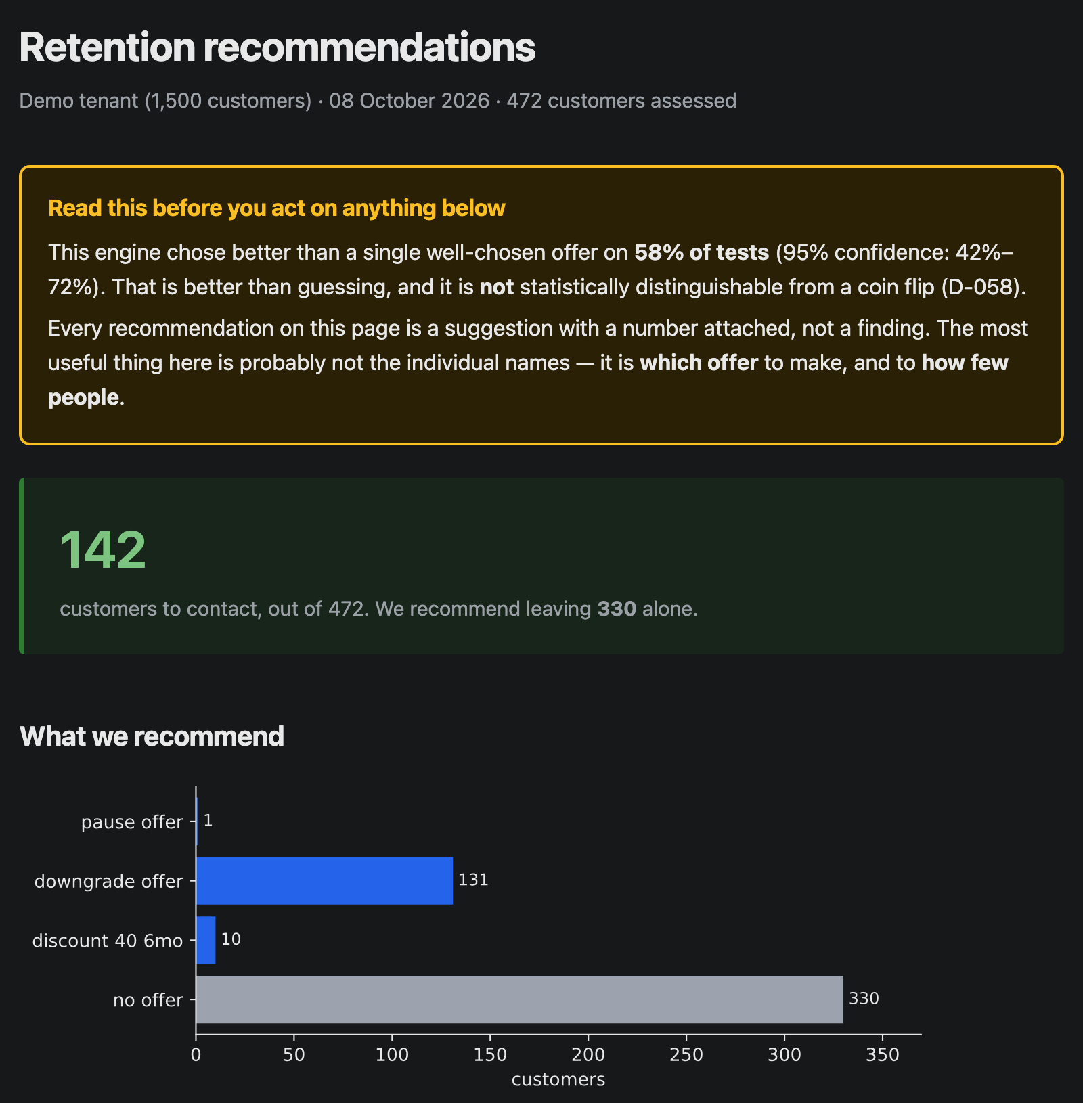
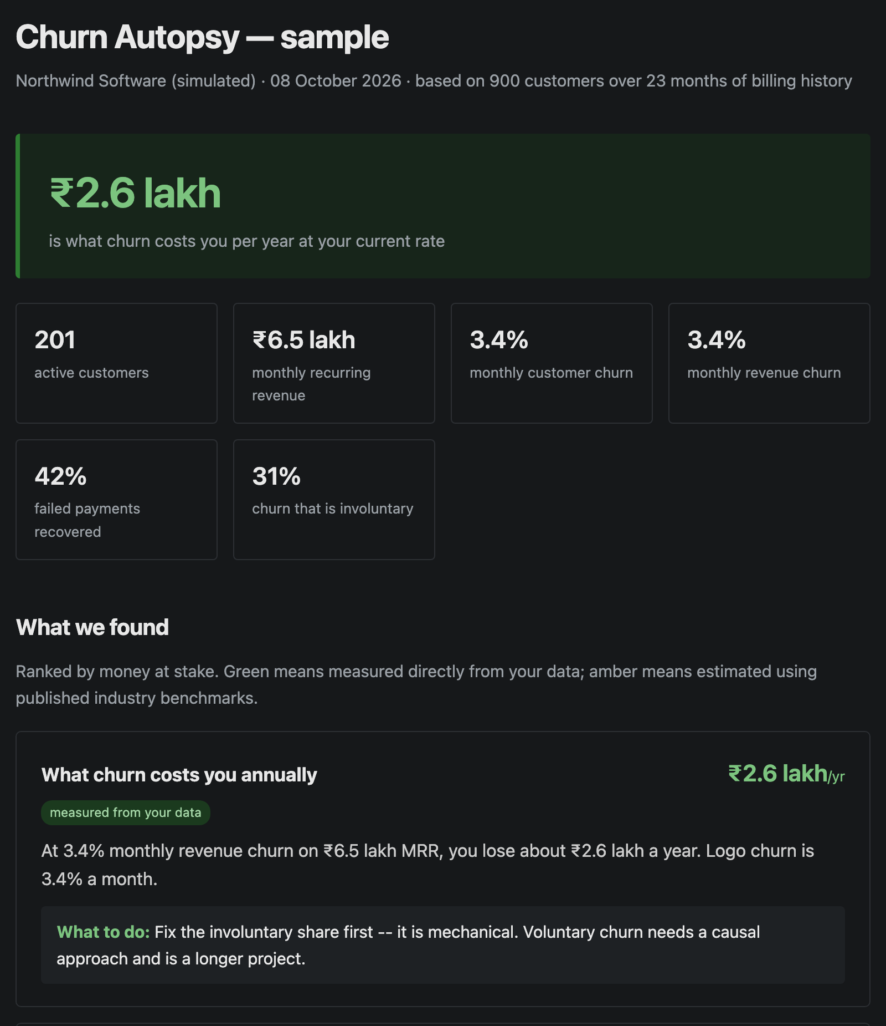




06 · WORKING SYSTEM
Evidence: the system runs end to end
$ python -m retainiq.cli preflight \
--customers customers.csv \
--subscriptions subscriptions.csv
VERDICT: BLOCKED — do not send a report
[BLOCK] median MRR 15,312, all integers:
looks like cents (153.12/month)
-> re-run with --divide-amounts-by 100
$ python -m retainiq.cli autopsy ... \
--divide-amounts-by 100 --worklists
VERDICT: READY
wrote report + 2 worklist CSVs
retainiq/policy/economics.py (simplified)
def benefit_posterior(model, X, value, cost):
eta0, tau = model.joint_samples(X) # log-odds
dp = expit(eta0 + tau) - expit(eta0) # prob.
benefit = -dp * value - cost # money
return MoneyPosterior(benefit, dp)
Retention dashboard
make dashboard: contact 142 of 472; the reliability warning always comes first
Churn Autopsy report
make sample: losses ranked by money; simulated data is labelled
After the D-057 fix the decision rule accepts money only, so a log-odds value can never be multiplied by revenue again.
721 automated tests
CI on every push
4 CI gates
Archived releases
edge cases, fairness, leakage
Python 3.11, 3.12 and 3.13
tests · calibration · leakage · kill test
software, data and paper on Zenodo
RetainIQ · Prasham Jain (2427030155) · Mentor: Dr. Rishi Gupta · Manipal University Jaipur
7 / 8
Notes:
Screenshots are real outputs, generated by the commands named under them. The dashboard (make dashboard) runs the full Phase 5 path on a simulated tenant: a randomised multi-arm pilot, per-offer effect models, a rung per customer and a reason for each choice. It recommends contacting 142 of 472 customers and leaving 330 alone, and its first element is a warning that the engine beats one good offer on only 58% of tests. The Churn Autopsy (make sample) is the report a business receives from its own billing export; the sample is simulated and says so. The terminal shows the command-line path on a Stripe-shaped export (make demo-data): preflight blocks the raw file because Stripe amounts are cents, which would overstate revenue 100x, and runs once the units are corrected. Output is abridged. The code card is the D-057 fix: log-odds become a probability change, then money, in one function, and the decision rule accepts nothing else. CI runs four jobs on every push: the test suite on three Python versions, the calibration gates, the leakage gate and the kill test.

Slide 8



07 · CONCLUSION
Conclusions, readiness and next steps
Key takeaways
Production readiness
Next steps
A churn model can be accurate and still lose money: AUC 0.700, yet targeting its top 20% returns −22,823.
Causal targeting does not always pay: on four public experiments a plain model did as well, and at n = 500 the best method beats random on 72.5% of draws.
For small businesses, reliability and measurability limit results more than the choice of model.
Ready
A first paying Churn Autopsy client (the Phase 2 gate)
A live pilot with a permanent randomised holdout
Pool evidence across businesses to get past the measurement floor
Explain why abstention loses on most of the draws where it acts (114 of 139)
Models for non-contractual (e-commerce) churn
CLI ingest → preflight → Churn Autopsy; dashboard; tests and 4 CI gates; archived releases
Validated offline only
on simulation and public RCTs: survival model; Bayesian CATE with abstention; offer ladder
Not yet shown
ROI on a real client; beating ‘do nothing’; beating one well-chosen offer
Demo video
Key references
Ascarza (2018), JMR · Ascarza, Iyengar & Schleicher (2016), JMR · Lemmens & Gupta (2020), Marketing Science
Devriendt et al. (2021), Information Sciences · Künzel et al. (2019), PNAS · Kaufman et al. (2012) Leakage
Cox (1972) · Ishwaran et al. (2008) RSF · Katzman et al. (2018) DeepSurv · Gelman et al. (2013) BDA
Full reference list: paper, DOI 10.5281/zenodo.22009470 · code: github.com/PrashamJ17/PBL-Proj
Paste the Google Drive link here
RetainIQ · Prasham Jain (2427030155) · Mentor: Dr. Rishi Gupta · Manipal University Jaipur
8 / 8
Notes:
Takeaways: prediction quality and decision quality are different things; modelling the effect is not always worth its extra variance: on four public experiments, over thirty splits each, a plain model did as well (the correlation is Ascarza's, 2018; the measurement on public experiments is ours); and at small-business scale, reliability and measurability are the binding limits. Readiness is stated precisely because the evidence differs by component. Ready: the delivery path from a billing export to a report, the dashboard, and the engineering around them (tests on three Python versions, four CI gates, archived releases). Validated only on simulation and public RCTs: the survival model, the causal model with abstention and the offer ladder. Not yet demonstrated: a real client ROI figure, a policy that beats doing nothing, and an optimiser that beats one well-chosen offer. The next steps follow directly: a paying client, a live pilot with a permanent holdout, and pooling evidence across businesses because no single small business can measure the effect alone.

