Slide 1

SMART INDIA HACKATHON 2026
TITLE PAGE
• Problem Statement ID – SIH 26160
• Problem Statement Title- AI-Powered IPsec VPN Protocol Analyzer and Security Assessment Framework
• Theme- Blockchain & Cybersecurity
• PS Category- Software
• Team ID- SIH 163
• Team Name (Registered on portal)- Highlanders
IPsec Sentinel — passive IPsec protocol analysis and security assessment

Slide 2
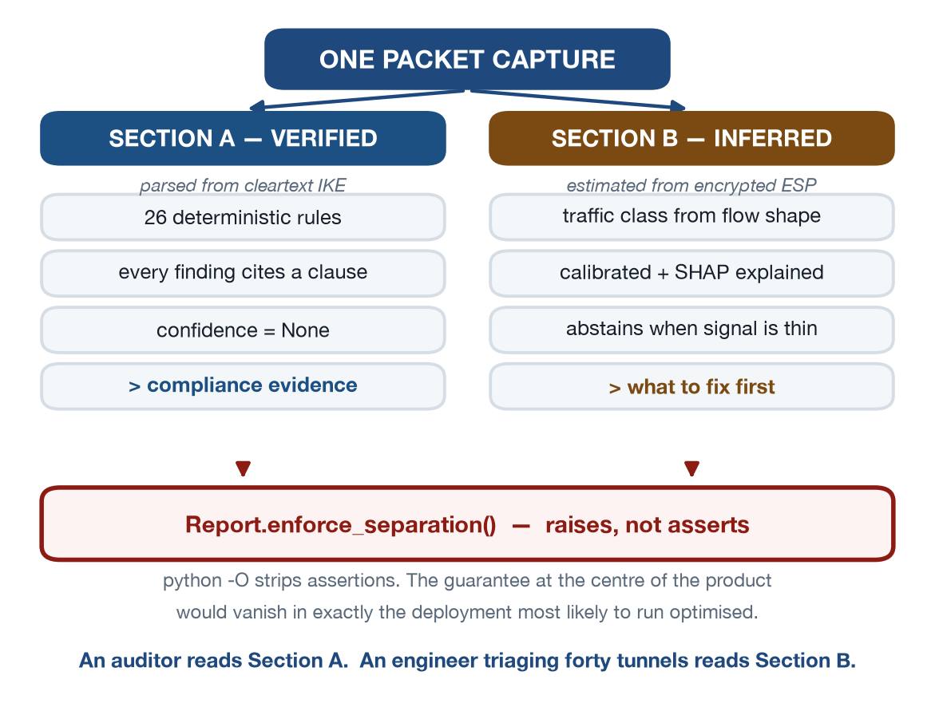
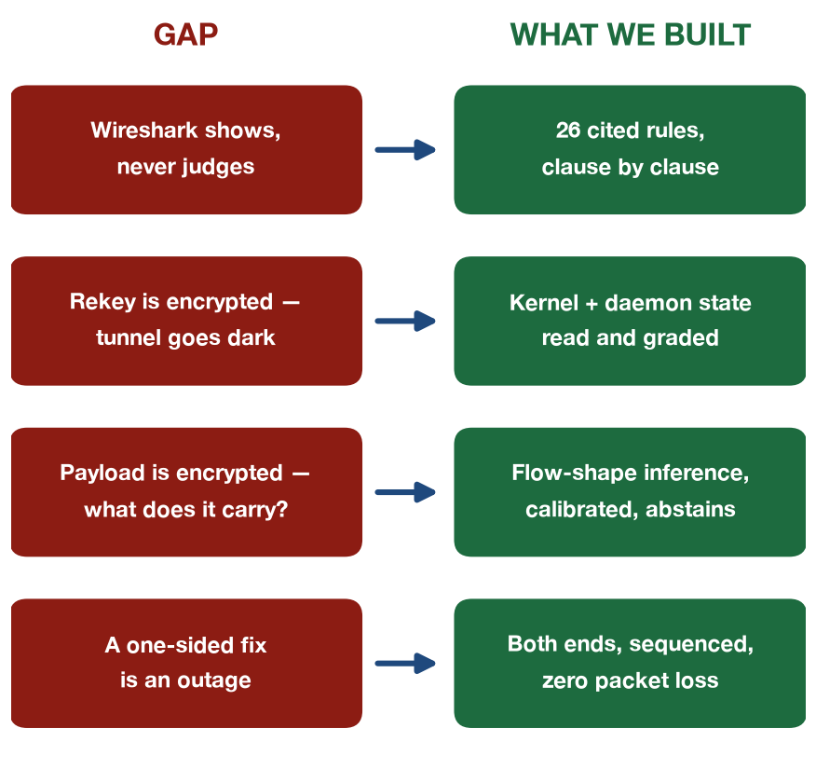
Highlanders
PROPOSED SOLUTION
❖ IPsec Sentinel — passive IPsec assessment with auditable evidence
Real-world issue:
Wireshark decodes an IKE exchange but has no opinion about it. Weak IPsec survives for years because nothing judges what it sees.
How it addresses the problem:
26 deterministic rules, each citing the clause it applies, across NIST, CNSA, BSI, RFC 8221/8247, ITSAR and CERT-In.
Innovation and uniqueness:
Facts are parsed. Estimates are inferred. A validator refuses to build a report that mixes them — the split is enforced, not promised.
Working prototype — v1.0.0 tagged, M11 acceptance 20/20, nothing skipped
Dashboard, demo video and source: github.com/PrashamJ17/SIH_PS160
@SIH Idea submission- Template
2

Slide 3
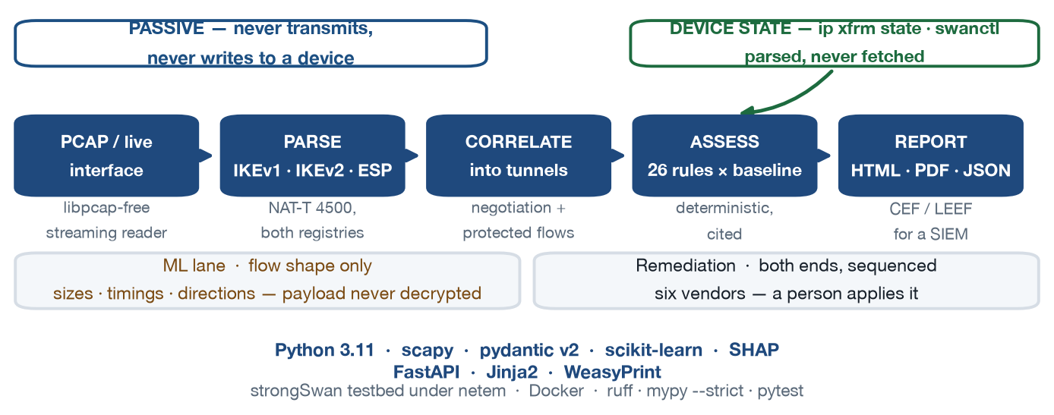
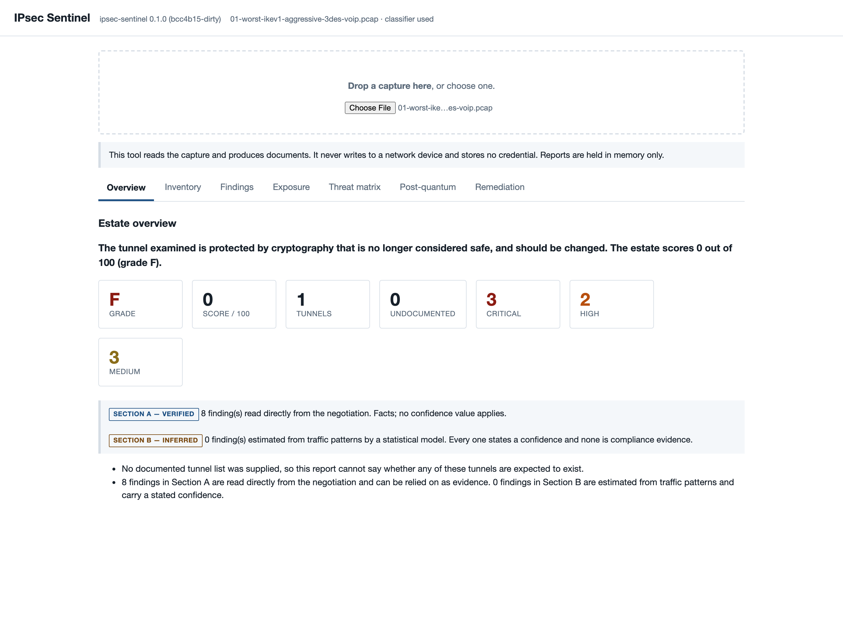
Highlanders
TECHNICAL APPROACH
❖ Technologies and methodology
26 rules
6 baselines + 2 tags
6 vendor generators
IKEv1 · IKEv2 · ESP
Working prototype — the dashboard on a real capture
Two boundaries the design will not cross:
It never writes to a network device and stores no credential — an AST sweep over every module enforces both. Configuration is generated; a person applies it.
Reproducible build — git 5da6698
@SIH Idea submission- Template
3

Slide 4
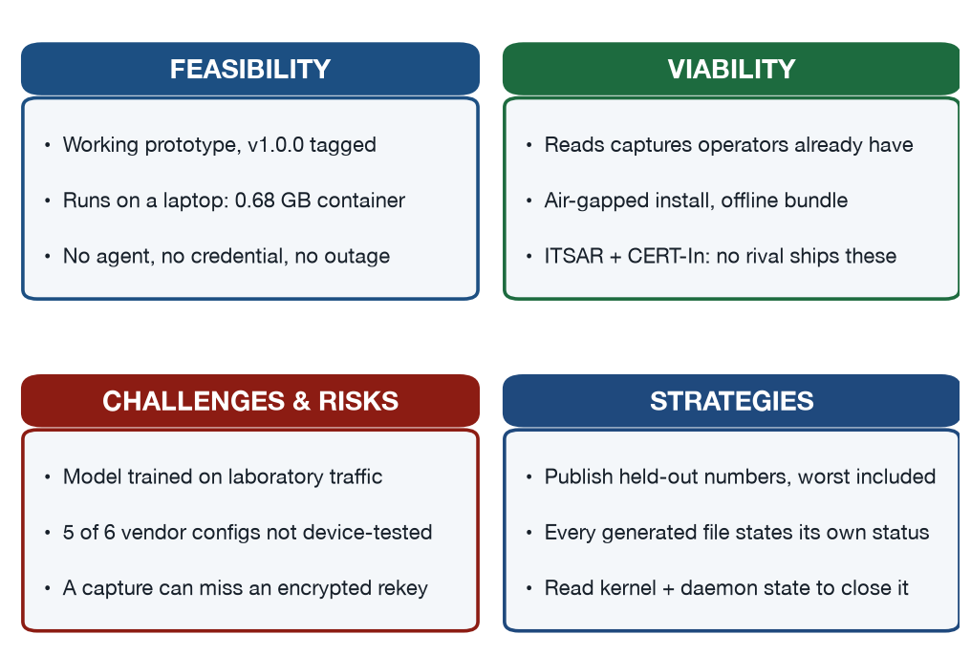
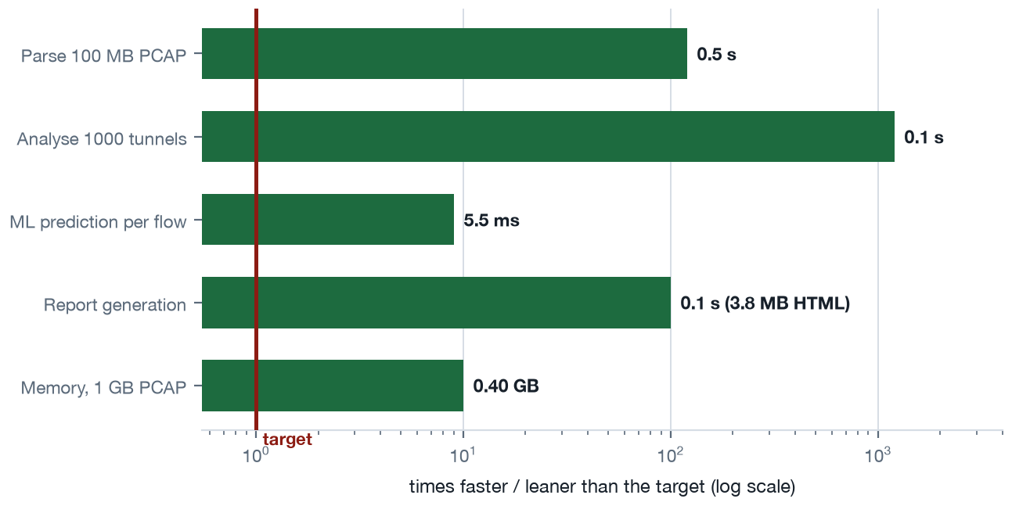
Highlanders
FEASIBILITY AND VIABILITY
❖ Feasibility, the risks, and the strategies for overcoming them
2,613
306
93.8%
20/20
unit tests
integration, on live pairs
coverage
M11 acceptance
Deployable today:
0.68 GB container, non-root, runs under --network none.
@SIH Idea submission- Template
4

Slide 5
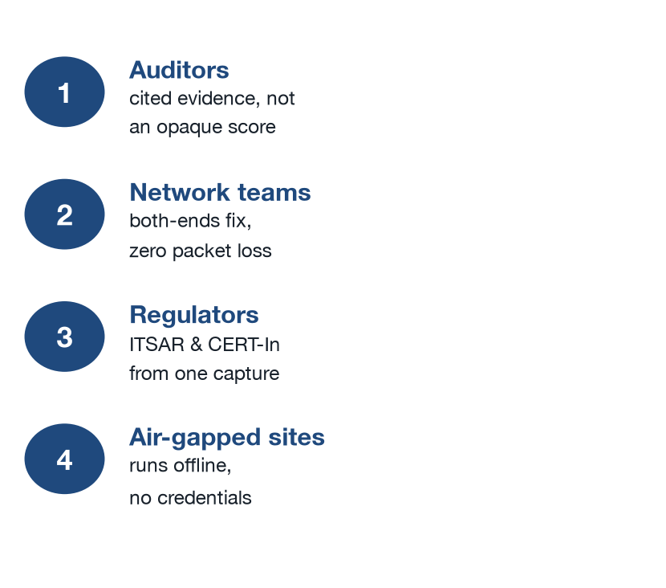
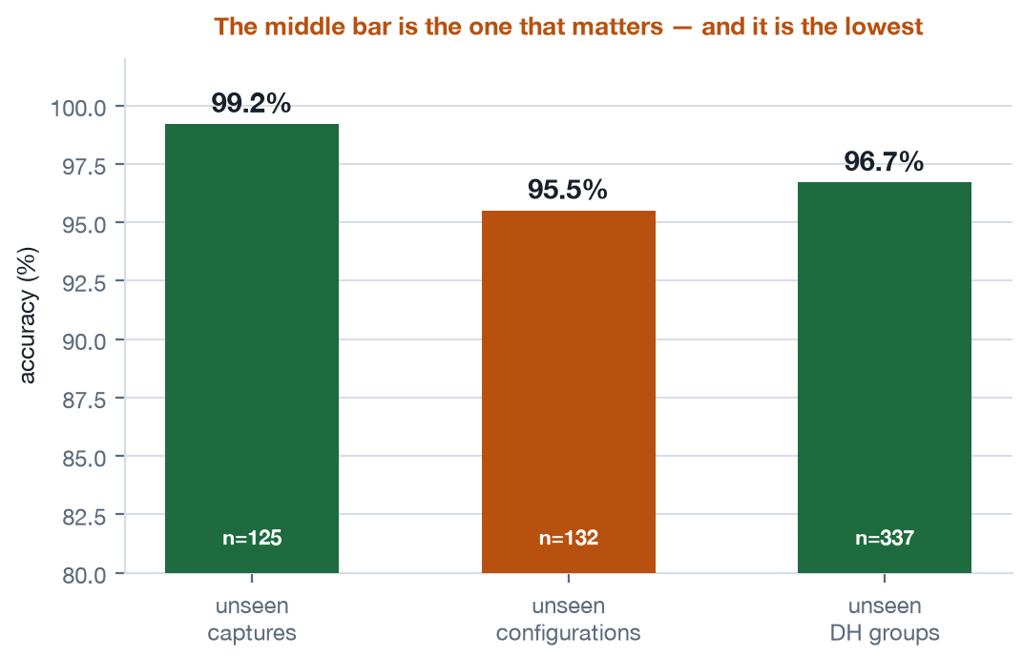
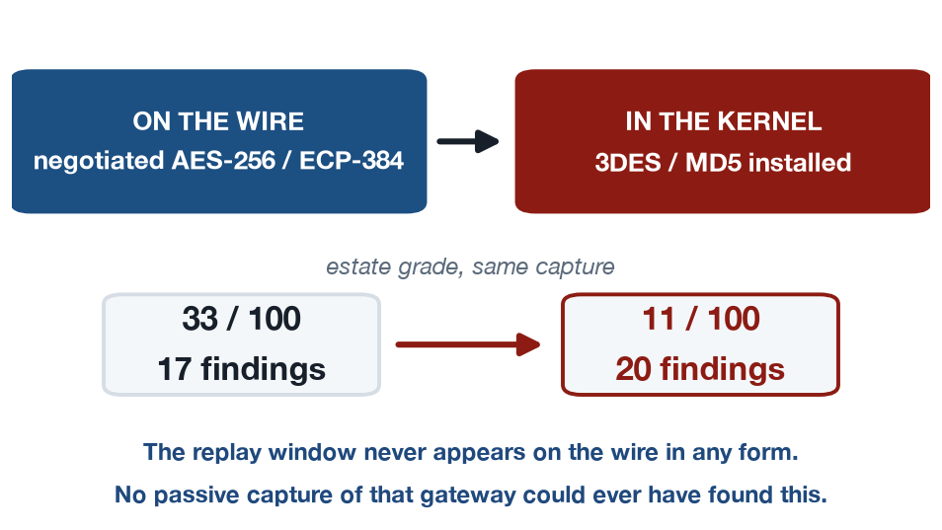
Highlanders
IMPACT AND BENEFITS
❖ Impact on the target audience, and the benefits
Honest about its own limits
Trained on 637 rows across 7 classes of laboratory traffic. The unflattering number is published, not the best one.
Endpoint visibility
A gateway's own kernel state is parsed and graded against the same rules — never fetched, never with a credential.
Social and economic benefit:
Government, telecom and enterprise VPN estates get audit-grade evidence from a capture they already have — no agent, no credential, no outage, and an Indian baseline (ITSAR, CERT-In) that no comparable tool ships.
@SIH Idea submission- Template
5

Slide 6
Highlanders
RESEARCH AND REFERENCES
❖ Details / Links of the reference and research work
RFC 7296
IKEv2 — the protocol the parser implements
RFC 2408 / 2409
ISAKMP and IKEv1, including aggressive mode
RFC 8221 / 8247
Algorithm implementation requirements for ESP and IKEv2
RFC 4303
ESP, and the anti-replay window SA-03/SA-04 judge
RFC 9370 / 8784
Post-quantum: additional key exchanges, PPKs
NIST SP 800-77 Rev. 1
IPsec VPN guidance — the default baseline
NIST SP 800-131A Rev. 2
3DES disallowed after 2023; DES, MD5, SHA-1
CNSA 1.0 · BSI TR-02102-3
The strict and German baselines
ITSAR (NCCS) · CERT-In
Indian telecom security assurance requirements
MITRE ATT&CK
Technique mapping for every finding
Our own published research:
GENERALISATION.md — held-out results including the lowest. CONFOUND_AUDIT.md — did the model learn traffic or cipher? DATASET.md — methodology and limits. LIMITATIONS.md — what it cannot do. external_dataset_audit.md — the named datasets contain no IPsec.
Code, evidence and demo:
github.com/PrashamJ17/SIH_PS160 — v1.0.0, M11 acceptance 20/20. Testbed: real strongSwan pairs under netem. Published JSON report schema 1.3. docs/SECURITY.md names the test behind every security claim.
@SIH Idea submission- Template
6

