Slide 1
INTRODUCTION
1)Demonstrates basic data cryptography using C++
2)Secure login and user registration
3)Uses Vigenere Cipher for encryption
4)Decrypts data using the correct key
5)Handles Encryption, Decryption and Files

Slide 2
OBJECTIVES
To develop a lightweight Cryptographic system in C++ using OOP concepts
To provide secure login and registration
To encrypt and decrypt stored data
To apply file handling in practice

Slide 3
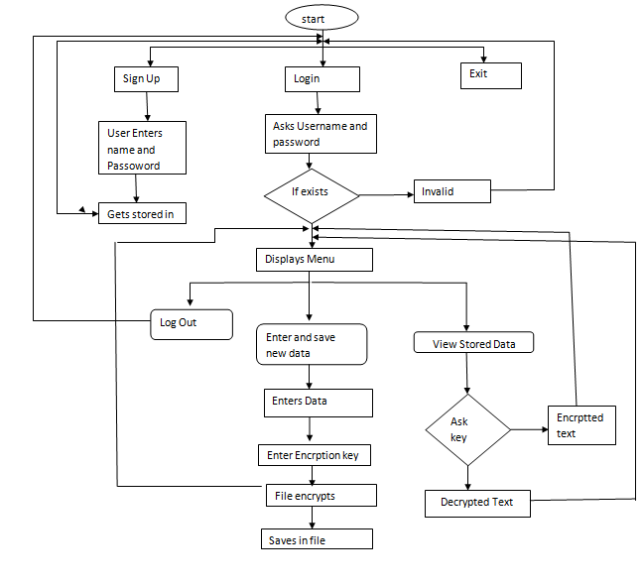
SYSTEM DESIGN

Slide 4
KEY FEATURES
Allows users to login using a username and password
Encrypts sensitive data before storing it in a file
Stores encrypted data securely to prevent unauthorized access
Allows authorized users to decrypt and view the original data

Slide 5
UTILITIES USED
Programming Language : C++
Core Libraries : iostream, fstream, string, limit
Development Environment: VS code
Compiler: MinGW
Testing Utility :Login Testing , Wrong Key Testing

Slide 6
conclusion
Successfully Implemented a functional academic Cryptographic-system
Improved understanding of Encryption, Decryption and File handling
Built a strong foundation for future security and scalability improvement

Slide 7
Thank you! Q & A

