Slide 1
NETWORK DESIGN PROPOSAL FOR A UNIVERSITY
Prashant Sharma
19bcs2333, Cse-11/B
First Progress PPT

Slide 2
Scope and Utility
Scope
The project is primarily intended for small organizations, which include startups & other organizations, and small to medium-sized universities.
The project has been made keeping in mind both cost and efficiency.
Lastly, the project can be used both as a blank slate, and for upgrading a pre-existing network.
Utility
I firmly believe that the template provided by this design is applicable for any network – provided it is not large enough.

Slide 3
INTERNET SERVICE PROVIDER
NETWORK ADMINISTRATOR
RECEPTION
ACADEMIC BUILDING
STAFF BUILDING
HOSTEL
GUEST HOUSE
BOYS HOSTEL
GIRLS HOSTEL
HOSTEL – A
HOSTEL – B
HOSTEL - C
HOSTEL – D
HOSTEL - E
STAFF BUILDING – A
STAFF BUILDING - B
LIBRARY
DIRECTOR’S RESIDENCE
RECEPTION AREA
DIRECTOR’S OFFICE
CSED DEPT.
MECHANICAL DEPT.
CIVIL DEPT.
CHEMICAL DEPT.
DEPT. HEAD
PROFESSORS
LAB
CSLAB – 1
CSLAB - 2
DEPT. HEAD
PROFESSORS
ELECTRICAL DEPT.
DEPT.HEAD
PROFESSORS
DEPT. HEAD
PROFESSORS
DEPT. HEAD
PROFESSORS
Network Topology Diagram

Slide 4
Tools used, and key highlights
Tools
The main tool used is Cisco Packet Tracer, provided free of charge for educational or academic use, by Cisco Inc.
Highlights
ISP
Network Administration
Interconnection of various departments
VLANs
Network access for Library/Guesthouse
Open Wi-Fi for guests

Slide 5
Professional & technical learning
Professional
Broadened my horizons - learnt that there is more to life than studies.
Managed to set deadlines, and abide by them – so that there is no undue pressure near the end.
Technical
Learned the OSI and the TCP/IP model in great detail.
Learned about various protocols, and why they are (or not) in use.
Learned to build complex networks using Packet Tracer.
Learned in great detail about various components of a network – switches, routers, servers, connecting wires, etc.

Slide 6
IMPLEMENTATION

Slide 7
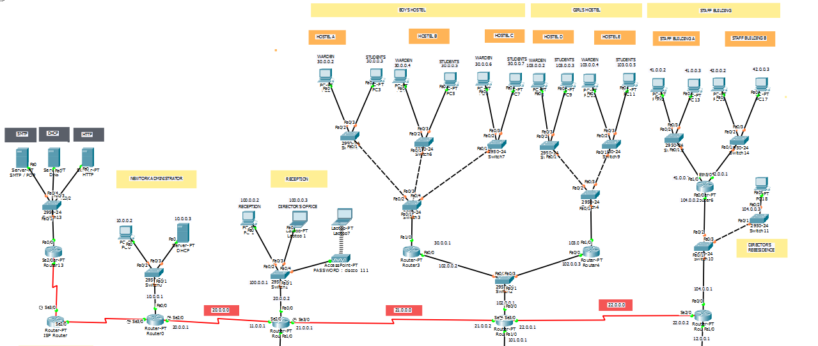

Slide 8
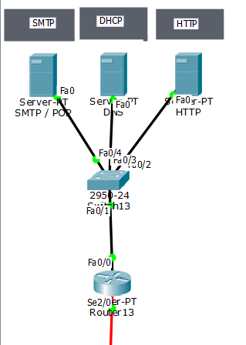
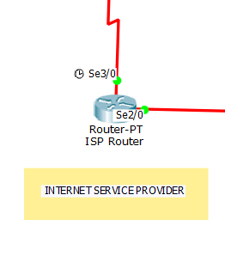
INTERNET SERVICE PROVIDER(192.168.1.0)
FTP
192.168.1.2
USER ID Cisco
PASS = 123
DNS
192.168.1.3
HTTP
192.168.1.4

Slide 9
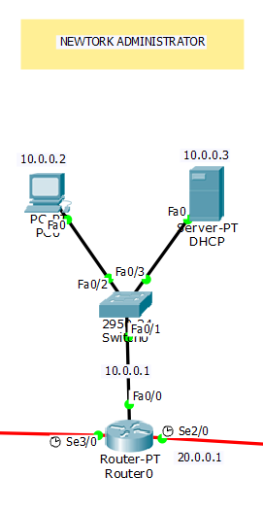
NETWORKADMINISTARTION(10.0.0.0)
Router
IP 10.0.0.1
PC0 10.0.0.2
DHCP ServerIP
10.0.0.3

Slide 10
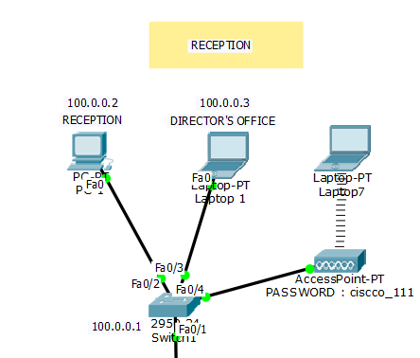
RECEPTION (100.0.0.0)
Router IP
100.0.0.1
PC1(Reception desk)
100.0.0.2
Director’s Office
Laptop1
100.0.0.3
100.0.0.4(connected to Access Point)
Access Point Password: Cisco_11

Slide 11
ALL HOSTELS

Slide 12
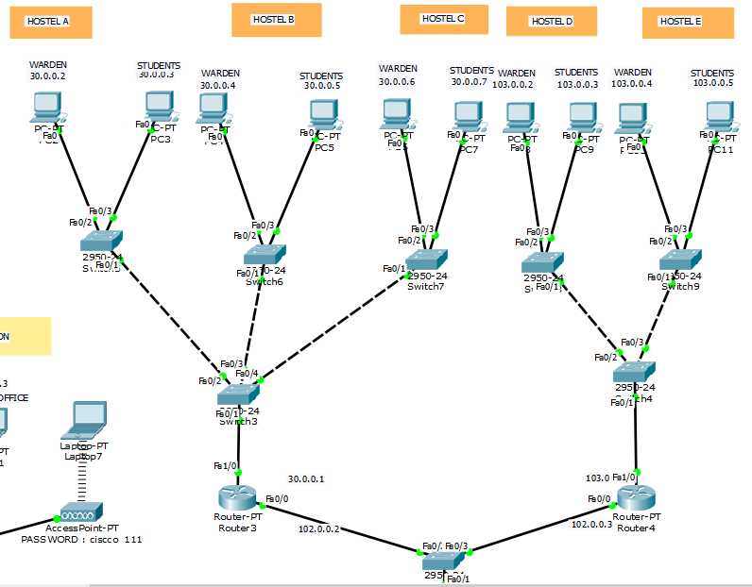

Slide 13
HOSTEL
BOYS HOSTEL(30.0.0.0)
ROUTER 3 IP : 30.0.0.1(same for Hostel A ,B ,C)
ROUTER 4 IP: 103.0.0.1(same for Hostel D , E)
HOSTEL A
PC2(Warden) : 30.0.0.2
PC3(Hostel): 30.0.0.3
HOSTEL B
PC4(WARDEN): 30.0.0.4
PC5(STUDENT): 30.0.0.5
HOSTEL C
PC6(WARDEN): 30.0.0.6
PC7(STUDENT): 30.0.0.7
GIRLS HOSTEL
HOSTEL D
PC8(WARDEN): 103.0.0.2
PC9(STUDENT): 103.0.0.3
HOSTEL E
PC10(STUDENT): 103.0.0.5
PC11(WARDEN): 103.0.0.4

Slide 14
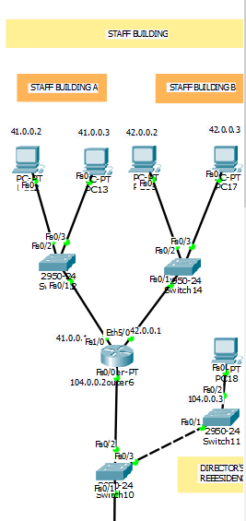
STAFF BUILDING
STAFF BUILDING A (41.0.0.0)
ROUTER 6 IP: 41.0.0.1
PC12: 41.0.0.2
PC13: 41.0.0.3
STAFF BUILDING B (42.0.0.0)
ROUTER 6 IP: 42.0.0.1
PC14: 42.0.0.2
PC13: 42.0.0.3
DIRECTIOR’S OFFICE:
ROUTER 5 IP: 104.0.0.1
PC16: 104.0.0.2

Slide 15
Innovation in Project
Affordable
Flexible
It includes:
Adaptibility
Security
Integration
Resilience

Slide 16
THANK YOU

