Slide 1
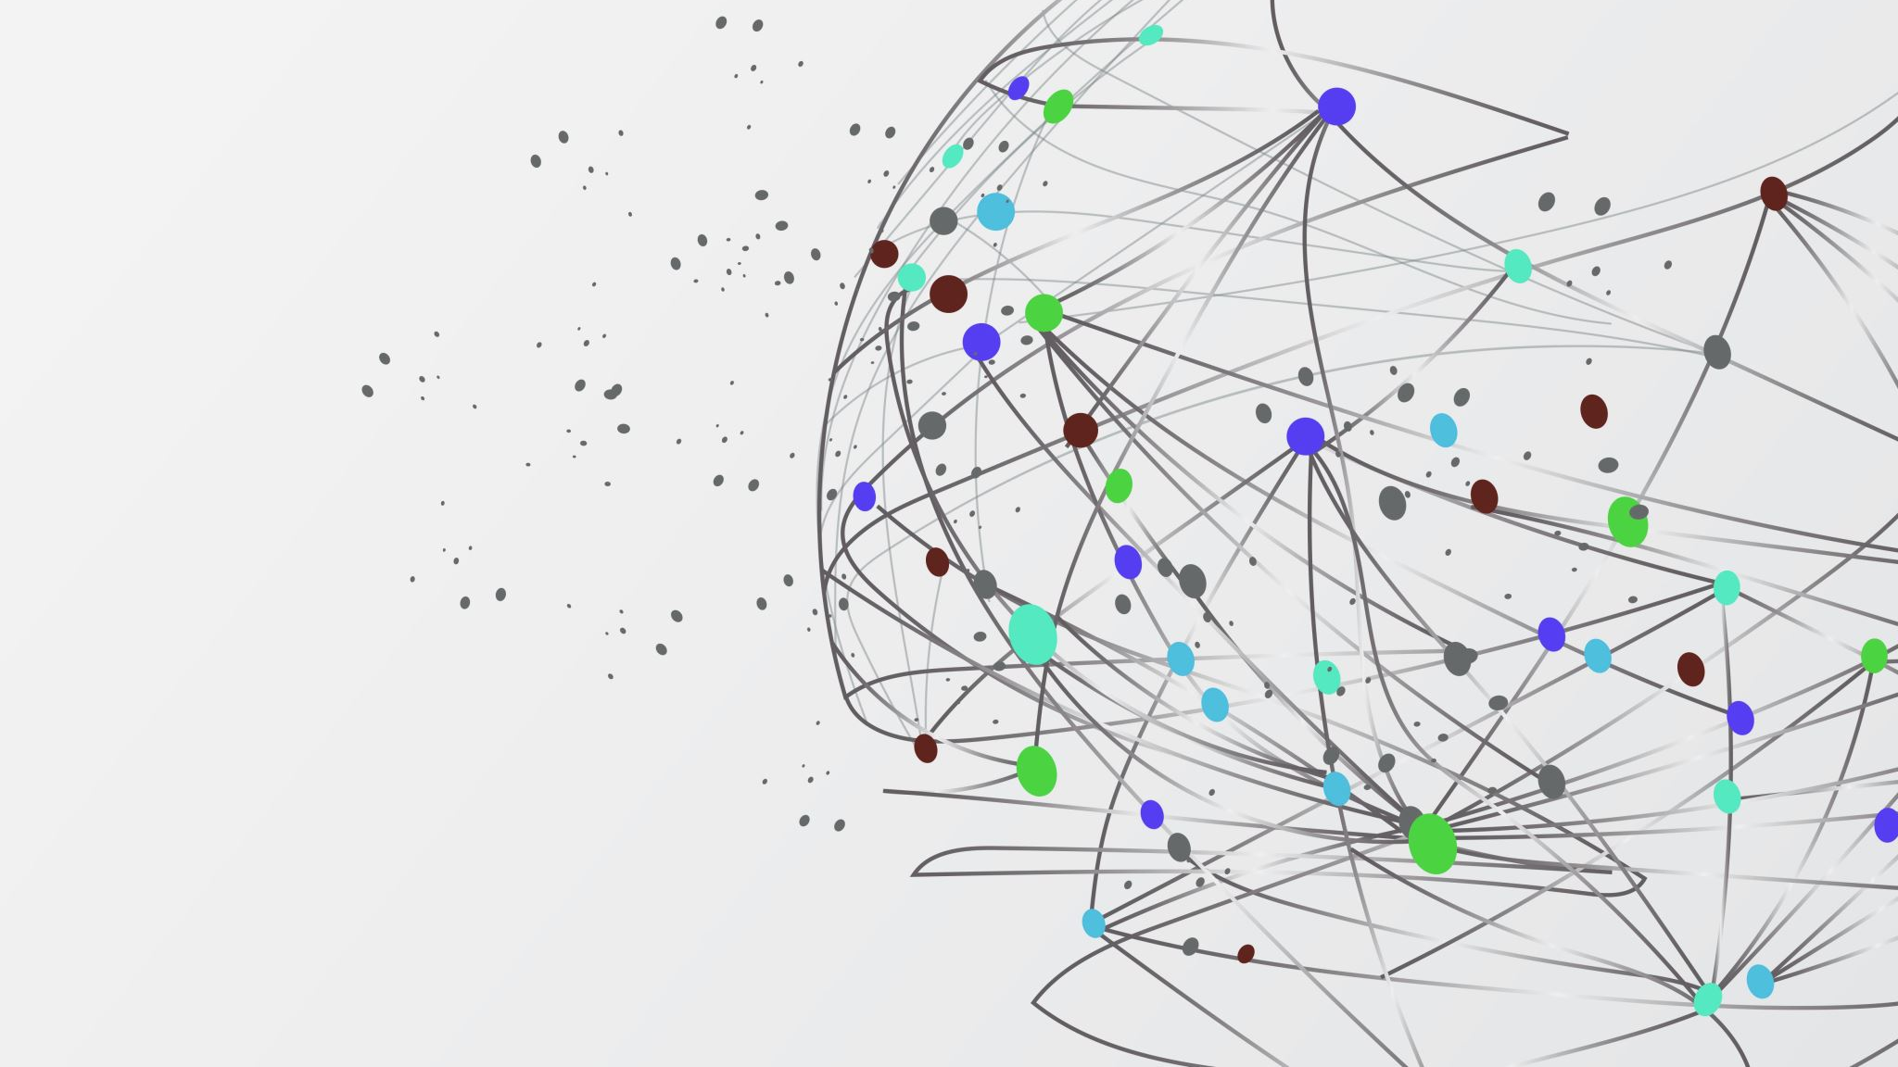
DIGICADE

Slide 2
FEATURES
Based on the tasks given we have implemented a gaming platform
This site enables players to buy tokens and bet them on a game he or she chooses
The platform itself is a medium to connect the player to the games he wants to play
The platform also sets a minimum number of tokens for a chosen game creating an innovative gaming and betting platform.
The platform also chooses players of equal rating or ranking to play against each other by using a ML algorithm

Slide 3

THOUGHT PROCESS
It is known to everyone that any matched played must be fair. The players must be of same level so that the competition remains tight and interesting. Otherwise, it can demotivate the beginner level player if they play with advanced players. So we build an ML model which can match the players based on their rating. The player gets an opponent of similar rating. This way the match stays fair and tight. The players will also enjoy gaming and thrive to win the match

Slide 4

SOLUTION
In order to achieve this, we have developed a algorithm using simple LSTM architecture.
Basically each registered id would be given a rating out of 10 based on the record of the person’s previous 10 games. The factors affecting the rating are:
Bitcoins earned/loss per game.
Game Difficulty
Opponents rating
The algorithm matches the players to their opponents having similar rating in order to keep the competition tight.

