Slide 1



JEPPIAAR ENGINEERING COLLEGE
DEPARTMENT OF COMPUTER SCIENCE AND ENGINEERING
E-COMMERCE APPLICATION USING MERN
TEAM LEADER : VIGNESHWARAN B(31082110407)
TEAM MEMBER 1 : PRASHANT S(310821104069)
TEAM MEMBER 2 : VIGNESH V(310821104106)
TEAM MEMBER 3 : RAJU S (310821104077)

Slide 2
FULLSTACK DEVELOPMENT PROJECT
WITH MERN
1. Introduction:
Project Title : ShopEZ E-commerce Application
ShopEZ is a robust e-commerce platform enabling seamless
interaction between buyers and sellers.
Buyers can browse products, manage carts, and make secure
payments, while sellers can list products, manage inventory,
and track orders.

Slide 3
2. Project Overview:
Purpose :
ShopEZ offers a seamless shopping experience with an easy-to-navigate interface and a wide range of
products. Find what you need quickly with detailed descriptions, customer reviews, and discounts.
Enjoy secure checkout and instant order confirmation. Sellers benefit from efficient order management
and data-driven insights to grow their business.
Features :
Effortless Product Discovery
Personalized Shopping Experience
Efficient Order Management for sellers
Insightful analytical business growth
Cart & Wishlist.

Slide 4
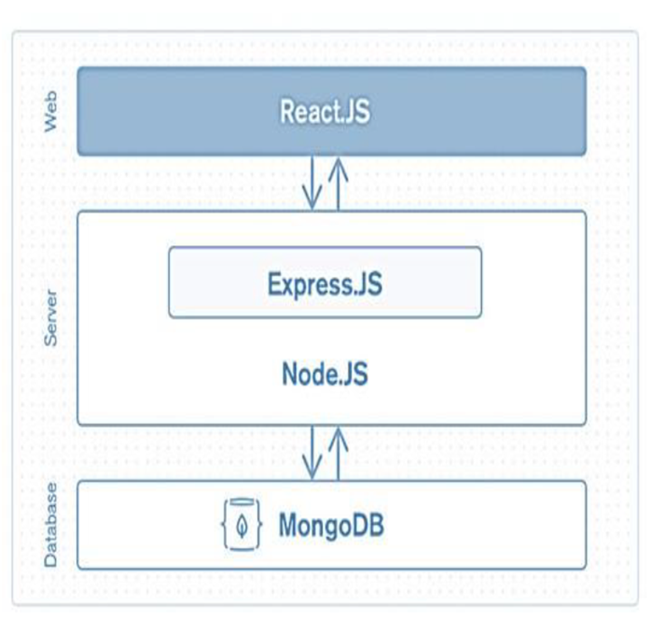
3. Architecture:
Frontend:
1. Setup React Application:
• Create a React app in the frontend folder.
• Install required libraries
• Create required pages and components and add
routes.
2.Design UI components:
• Create Components.
• Implement layout and styling.
• Add navigation.
3.Implement frontend logic:
• Integration with API endpoints.
• Implement data binding.

Slide 5
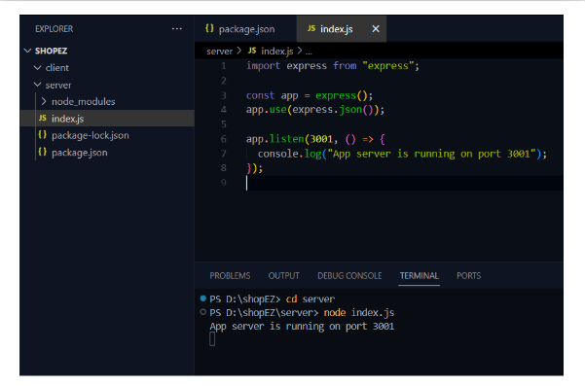
Backend :
1. Setup express server:
• Create index.js file.
• Create an express server on your desired port number.
• Define API’s

Slide 6
2.Set project structure:
Set up a new project directory with a package.json file and install necessary dependencies like Express.js, Mongoose, and other required packages.
Configure a MongoDB database (local or cloud) and create collections for admin, users, products, and orders.
Set up an Express.js server to handle requests and serve API endpoints, using middleware like body-parser and cors.

Slide 7
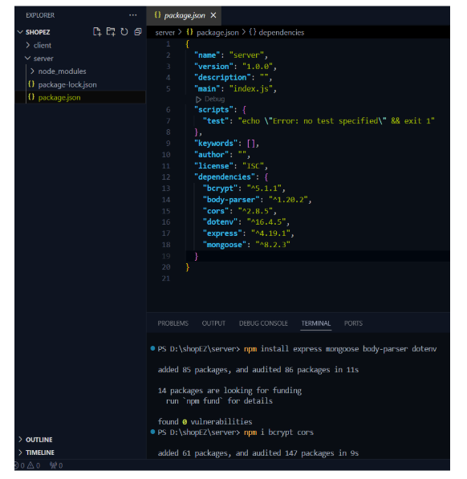
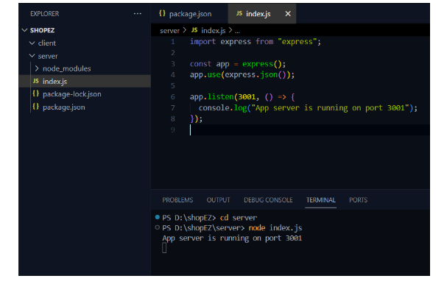
Reference images:

Slide 8
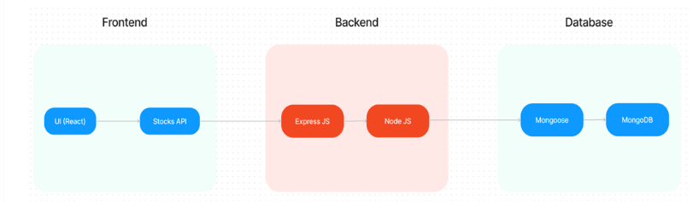
3. Set up Database:
Create database in cloud
• Install Mongoose.
• Create database connection.
Create the following schema
User Schema
Product Schema
Order Schema
Cart Schema
Admin Schema

Slide 9
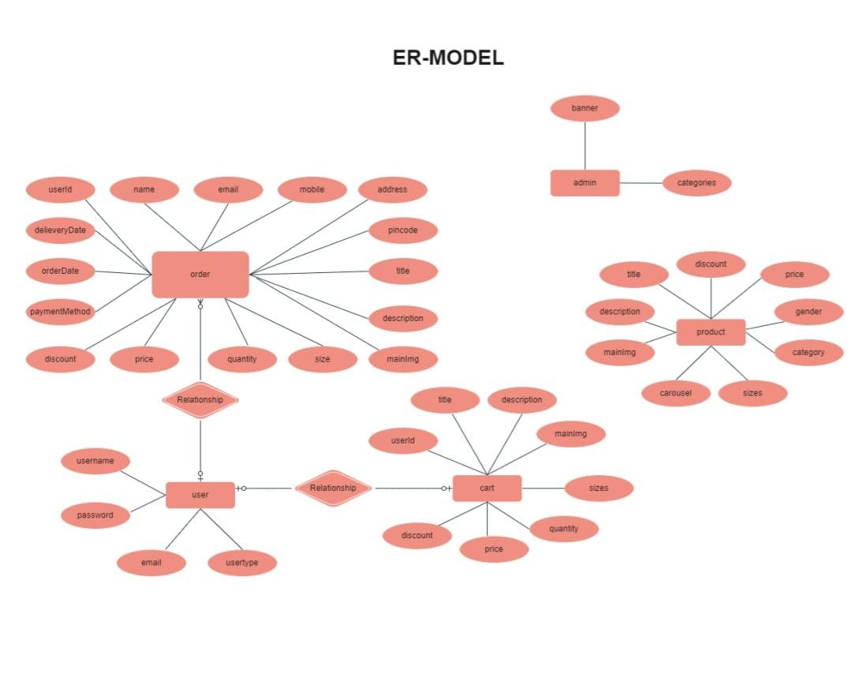
4. ER Diagram:
The ShopEZ ER Diagram represents the entities and relationships involved in the e-
commerce system. It illustrates how users, products, carts, and orders are interconnected.

Slide 10
5. Setup Instruction:
Prerequisites:
To develop a full-stack e-commerce app, there are several prerequisites are required.
The key prerequisites for developing such an application: Node.js and npm ,
MongoDB , Express.js , React.js , HTML, CSS, and JavaScript , Version
Control: GitHub , Development Environment:Visual Studio Code, Sublime Text,
or WebStorm.
Installation:
• Navigate into the cloned repository directory:
cd ShopEZ_e-commerce-App-MERN
• Install the required dependencies by running the following command:
npm install

Slide 11
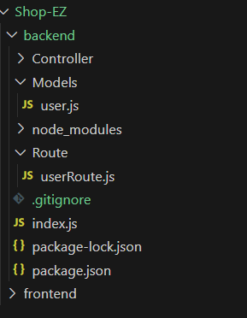
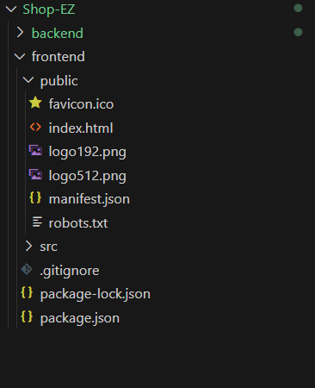
6. Folder Structure:
This structure assumes a React app and follows a modular approach.
Here's a brief explanation of the main directories and files:
• src/components: Contains components related to the application such as, register, login, home, etc.,
• src/pages has the files for all the pages in the application.

Slide 12
7. Running the application:
1.Frontend:
Navigate to the client directory:
cd client/
Install dependencies and start the React server
npm install
npm start
Access the frontend at http://localhost:3000.
2. Backend:
Navigate to the server directory:
cd server/
Install dependencies and start the backend server:
npm install
npm start
Verify the backend at http://localhost:5000 (or your configured port).

Slide 13
8. API Documentation:
User Authentication
Register : POST /api/auth/register
Login : POST /api/auth/login
Product Management
Add Product (Admin) : POST /api/products
Get Products : GET /api/products
Cart Management
Add to cart : POST /api/cart
View Cart : GET /api/cart
Order Management
Place Order : POST /api/orders
Get Orders : GET /api/orders

Slide 14
9. Authenication:
Method:
JSON Web Tokens (JWT) are used for secure authentication.
Tokens are issued upon login and stored in the client’s local storage.
Authorization:
Protected routes ensure only authenticated users can access specific functionalities
like placing orders or managing products.
JWT-Based: Users log in to receive a token, stored on the frontend and sent with requests for secure access.
Secure Passwords: Passwords are hashed with Bcrypt.
Protected Routes: Tokens are verified using a secret key for authorization.
Session Management:
The frontend stores the JWT token in the browser’s local Storage or session Storage.

Slide 15
10. User Interface:
The user interface is designed to be simple, modern, and easy to navigate. Below are some key UI features:
The following screenshots illustrate the user interface:
Homepage: Displays categories and featured products.
Product Page: Lists products with details and an "Add to Cart" button.
Cart Page: Shows items added to the cart.
Admin Dashboard: Provides product and order management options.
Checkout page: Order summary along with payment gateway.
User Dashboard: Contains info about the user like name, address, order list.

Slide 16
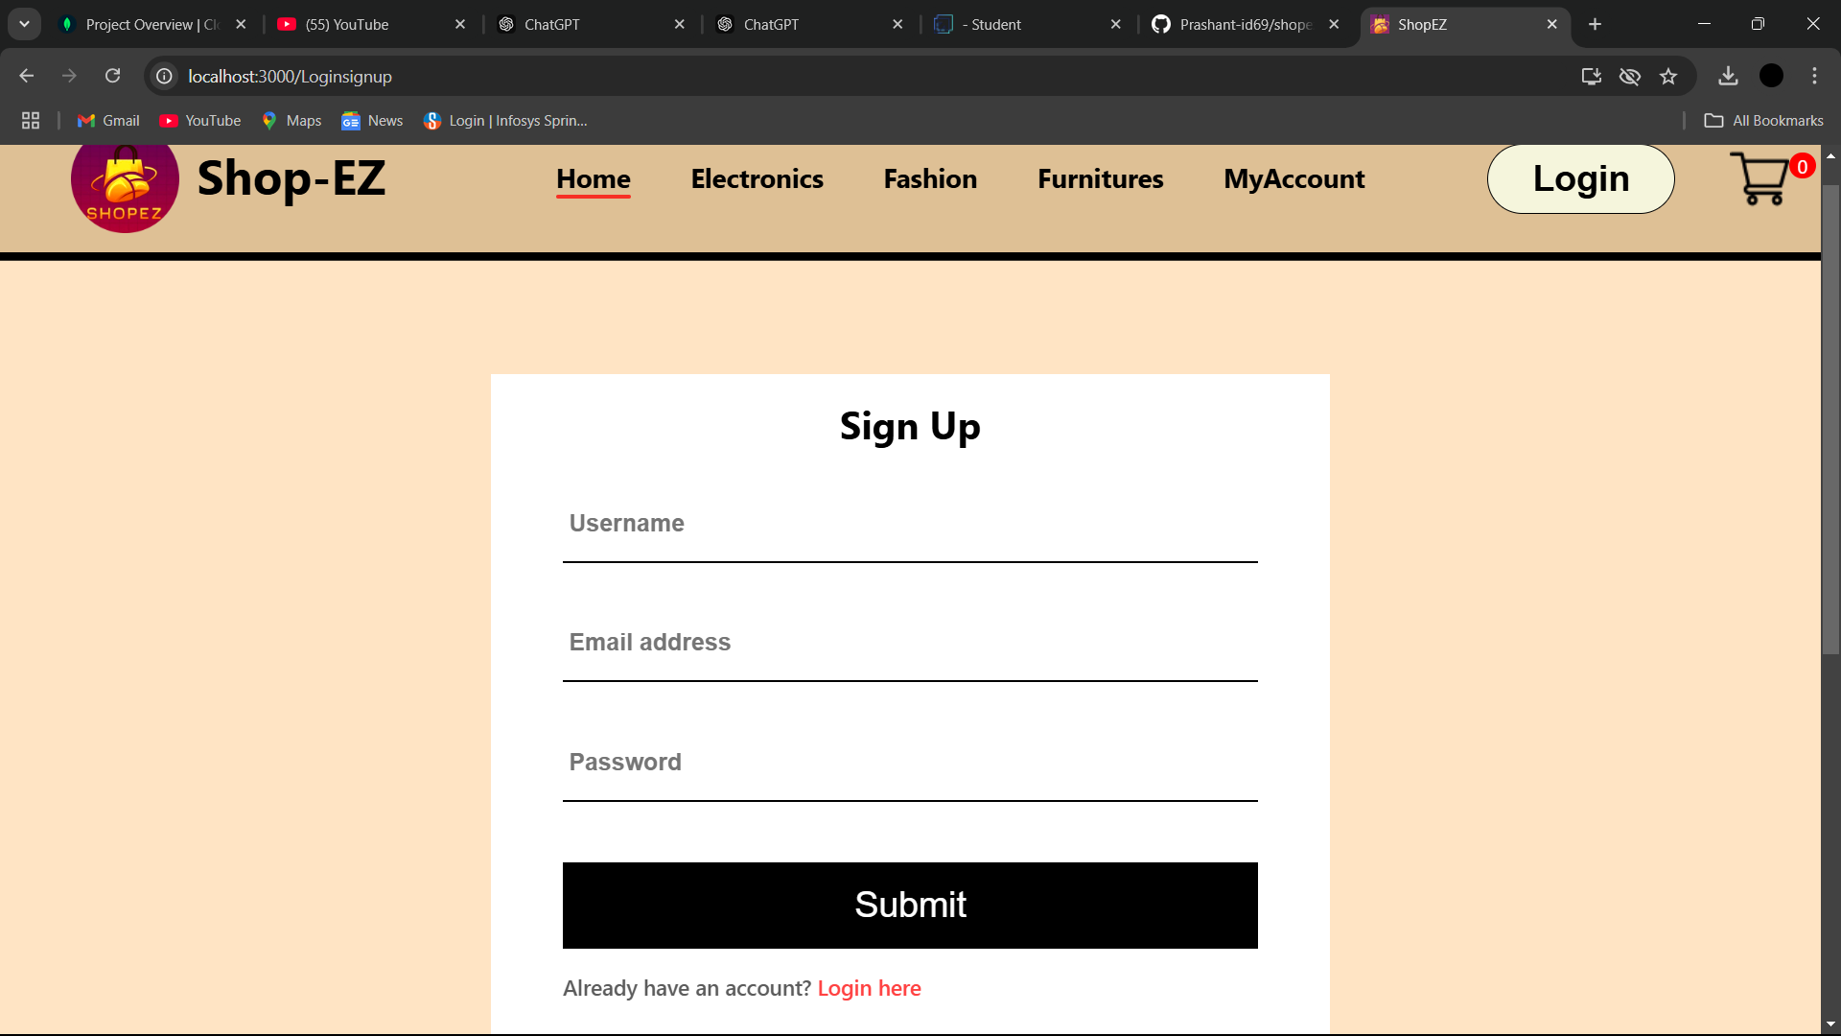
11. Screen Shots:
Customer Register Page :

Slide 17
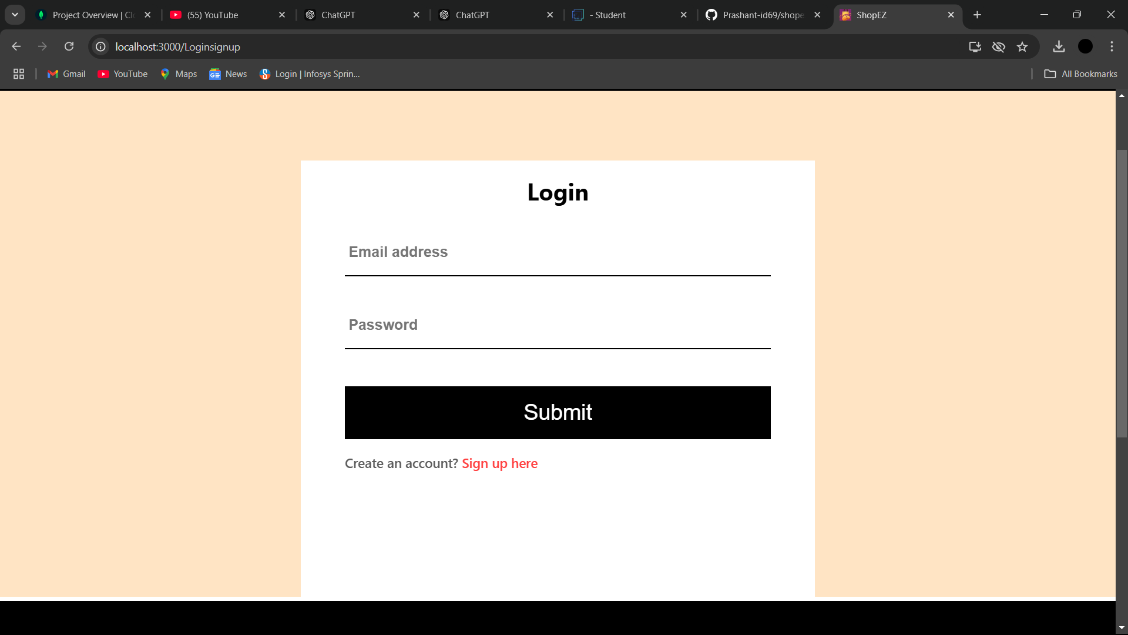
Customer Login Page :

Slide 18
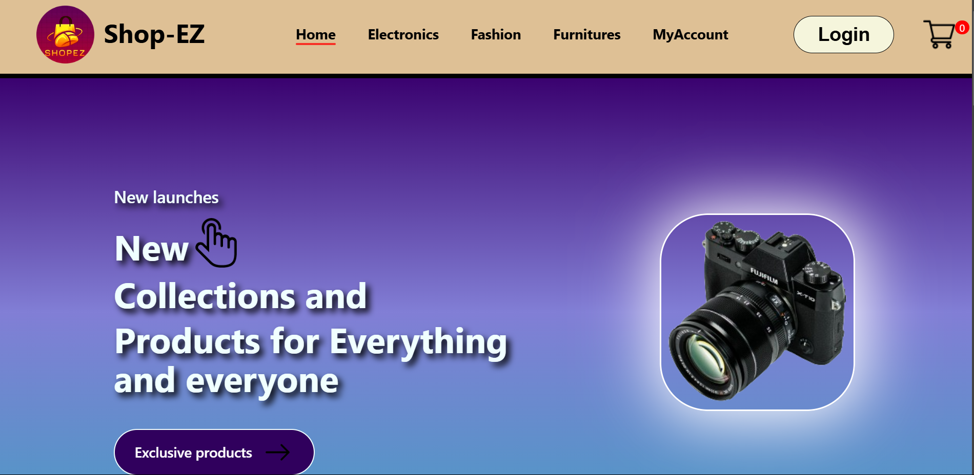
Homepage :

Slide 19
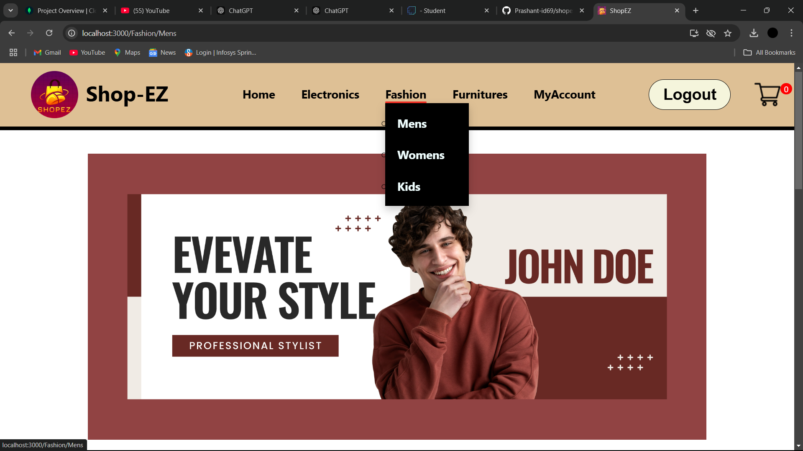
Product page :

Slide 20
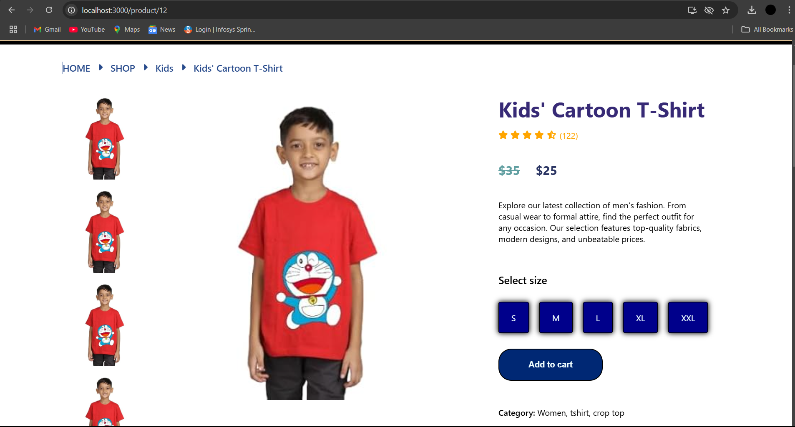
Add to cart page :

Slide 21
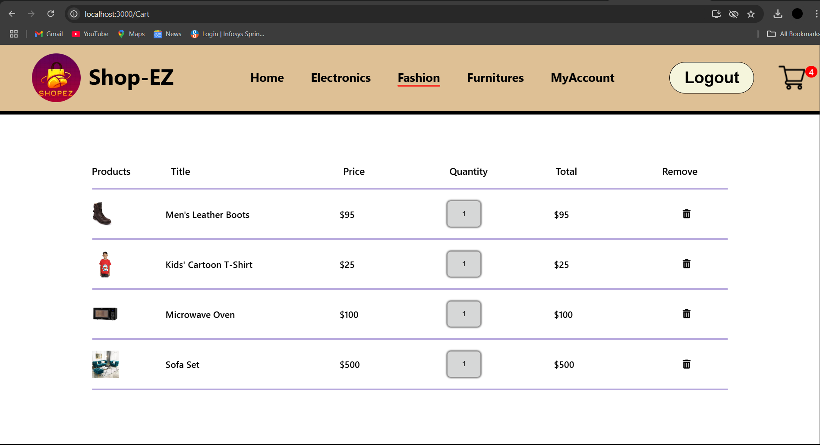
Checkout page: (cart)

Slide 22
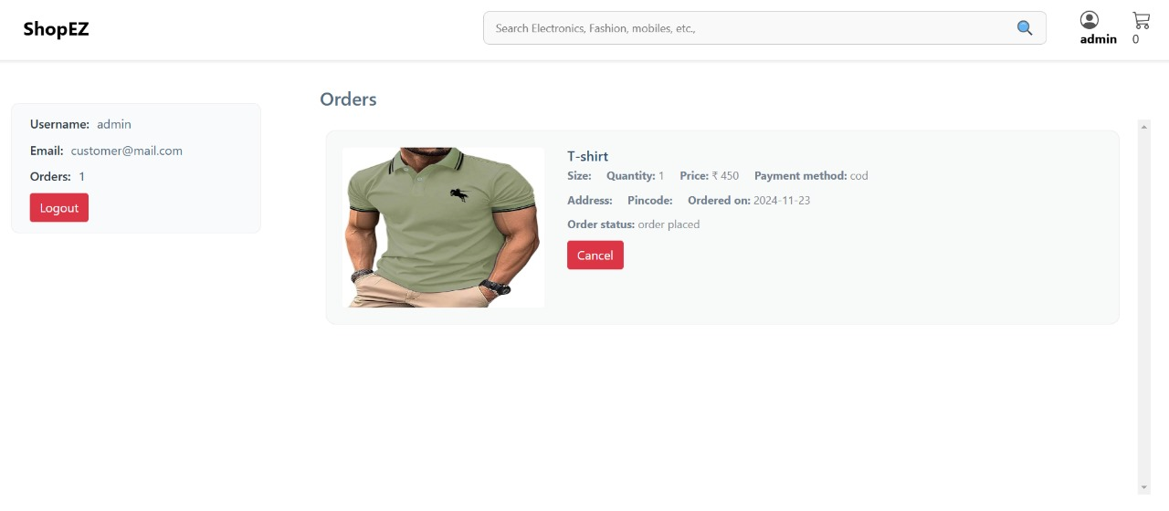
Customer checkout order details :

Slide 23
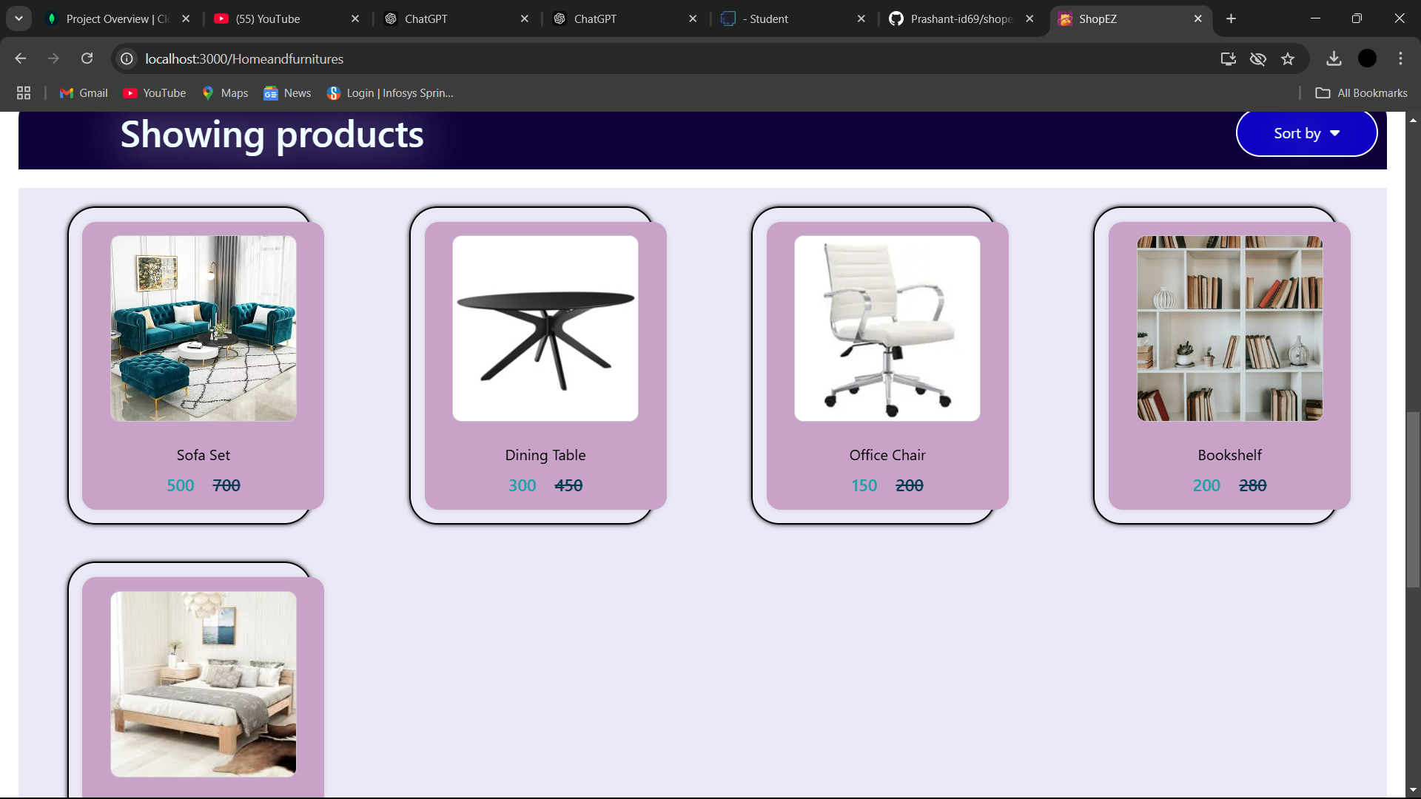
Product page :

Slide 24
12.Testing :
Test Cases:
1. User login with valid and invalid credentials.
2. Adding products to the cart and verifying the total.
3. Ensuring admins can add, update, and delete products.
Types:
Performance testing – To validate the performance of the application.
Security testing – Evaluating the app to protect from SQL Injection, XSS, CSRF.
Regression testing – New changes doesn’t affect the existing functions.

Slide 25
13.Technical Issue:
1.Payment Issues:
The payment feature are not yet fully integrated due to issues with third party API’s.
2.API Rate Limits:
The Node.js backend may struggle to handle many simultaneous requests without proper optimizations (e.g., clustering or caching).
3.State management :
During development of the ShopEZ E-Commerce Application, managing state
across multiple components was a challenge. Prop drilling and maintaining
UI consistency made synchronization complex.

Slide 26
4.Database schema complexity :
Designing complex relationships in MongoDB, such as one-to-many
(user to orders) and many-to-many (products to categories), was challenging.
Embedding documents led to large data sizes, while referencing slowed down data joins.
5.Handling Edge case :
Edge cases like invalid user input, unexpected API responses,
race conditions, server outages, and invalid data inputs impacted application stability.

Slide 27
14.Future Enhancement:
ShopEZ E-Commerce Application aims to continually enhance the shopping experience for users and
administrators by introducing innovative features. Here are some key future improvements planned
to elevate its functionality and service:
The enhancement features :
AI-Powered Product Recommendations
Real-Time Order Tracking
Gamified Reward System
Augmented Reality (AR) Shopping Experience
Voice Search and Ordering

