Slide 1
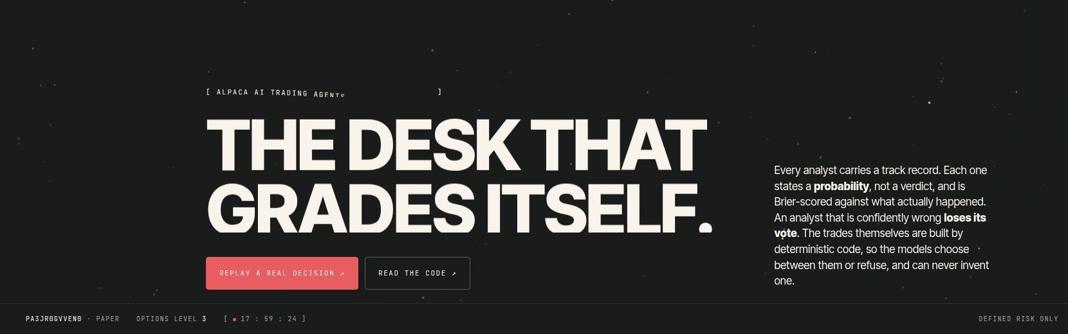
[ ALPACA AI TRADING AGENTS · OPTIONS ALPHA AGENTS ]
TRADING ALPACA:
THE OPTIONS DESK
THAT GRADES ITSELF
→ Deterministic code builds every trade. A language model may only pick one by id, or refuse.
→ Two independent vetoes · a fail-closed risk guard · a hash-chained journal · analysts that are Brier-scored and lose their vote when miscalibrated.
→ Live site: https://trading-alpaca-judge.vercel.app
→ Judge desk (no credentials needed): https://trading-alpaca-judge.vercel.app/judge
→ Code: https://github.com/Prashant-thakur77/trading-alpaca
trading-alpaca · paper account only · trading-alpaca-judge.vercel.app
01 / 15

Slide 2
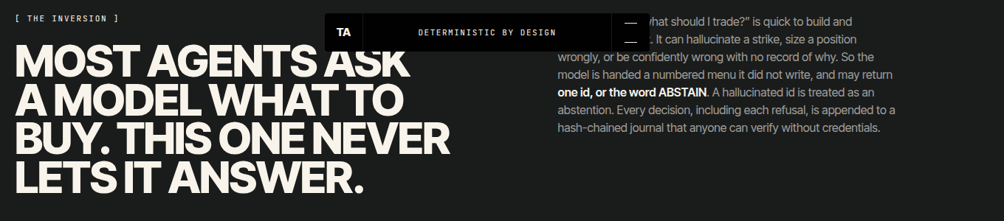
[ THE PROBLEM ]
MOST AGENTS ASK A MODEL WHAT TO BUY.
THIS ONE NEVER LETS IT ANSWER.
→ Asking an LLM "what should I trade?" is fast to build and impossible to trust.
→ It can hallucinate a strike, size a position wrongly, or be confidently wrong with no record of why.
→ So this desk hands the model a numbered menu it did not write. It may return one id, or the word ABSTAIN.
→ A hallucinated id is treated as an abstention. There is no code path by which a model can invent a strike, change a quantity, or move a price.
trading-alpaca · paper account only · trading-alpaca-judge.vercel.app
02 / 15

Slide 3
[ HOW IT WORKS ]
SIX STAGES. FOUR OF THEM CAN SAY NO.
01
02
03
04
05
06
BUILD
ARGUE
VETO
GUARD
EXECUTE
GRADE
code enumerates every legal defined-risk structure from the live chain, fully priced
a vol analyst and a bear adversary each return a probability; a trader picks an id or ABSTAINs
a pure-code thesis check, then a blind LLM review that never sees the committee's reasoning
RiskGuard enforces risk.yaml: ALLOW / DENY / DOWNSIZE, fail-closed on any error
one atomic multi-leg order via the Alpaca CLI; a pre-mortem compiles exit triggers
closes resolve each analyst's predictions; Brier scores recompute their weights
Every stage appends to a hash-chained journal. Every refusal is recorded with its reason.
trading-alpaca · paper account only · trading-alpaca-judge.vercel.app
03 / 15

Slide 4
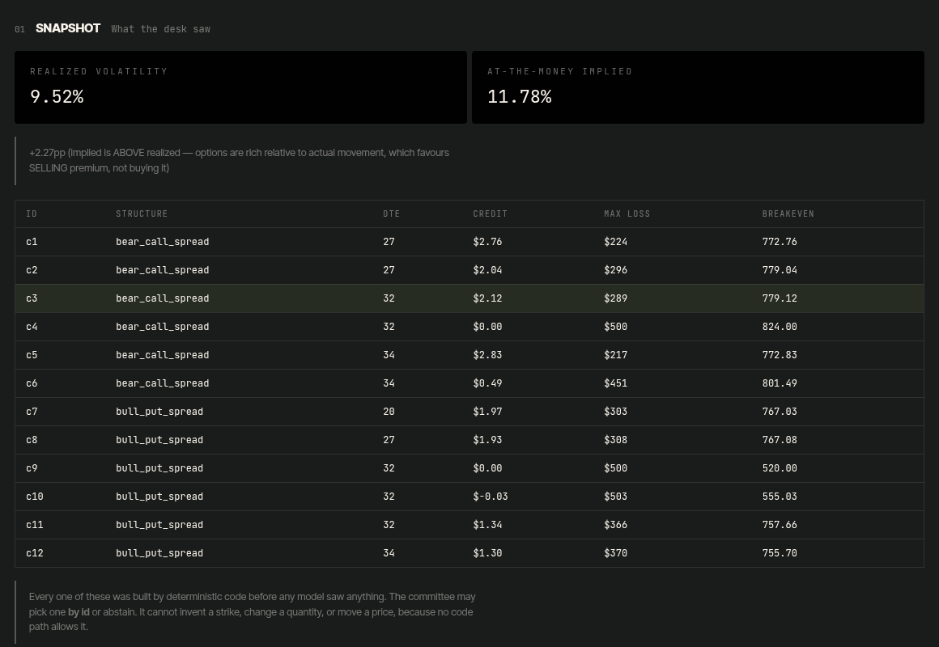
[ STAGE 1 · BUILD ]
EVERY CANDIDATE IS FULLY SPECIFIED
BEFORE ANY MODEL IS CALLED.
→ Python reads the live SPY option chain and constructs every legal defined-risk structure: bull put, bear call, bull call and bear put spreads, iron condors, long straddles and butterflies.
→ Each has strikes, legs, quantity, limit price, max loss and breakeven fixed by code.
→ Liquidity gates first: open interest ≥ 100, quote width ≤ 10% of mid, 7–45 days to expiry.
→ A live cycle reads ~3,700 contracts, ~1,100 pass liquidity, ~600–1,800 structures are built, 12 are shown to the committee.
→ There is no function in the codebase that produces a naked short option.
trading-alpaca · paper account only · trading-alpaca-judge.vercel.app
04 / 15

Slide 5
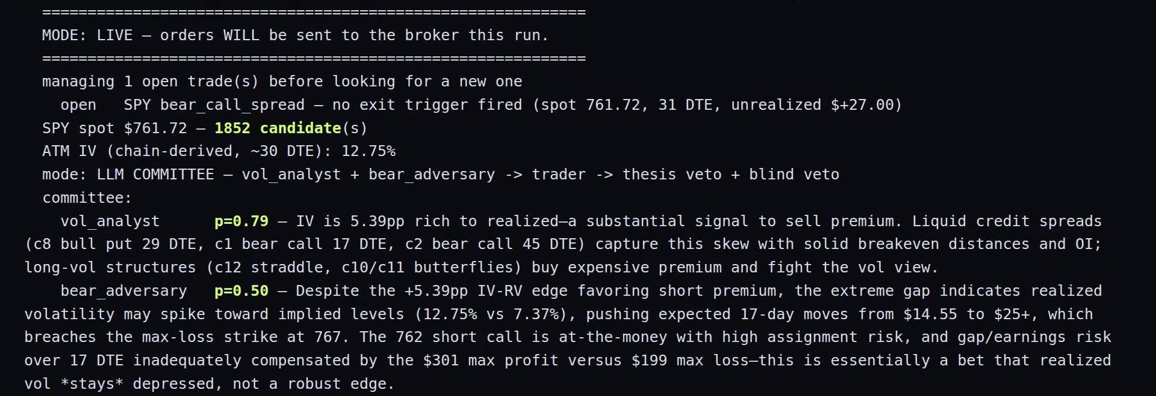
[ STAGE 2 · ARGUE ]
PROBABILITIES, NOT VERDICTS.
AN ADVERSARY ARGUES AGAINST EVERY TRADE.
→ vol_analyst judges implied vs realized volatility; bear_adversary's only job is to find what breaks the trade. Each returns a probability, and an abstaining analyst is excluded from both numerator and denominator.
→ The trader picks one id or ABSTAINs. In this live cycle it moved from c1 to c2 because the adversary flagged c1's at-the-money short strike — the objection changed the trade, and is journalled either way.
trading-alpaca · paper account only · trading-alpaca-judge.vercel.app
05 / 15

Slide 6
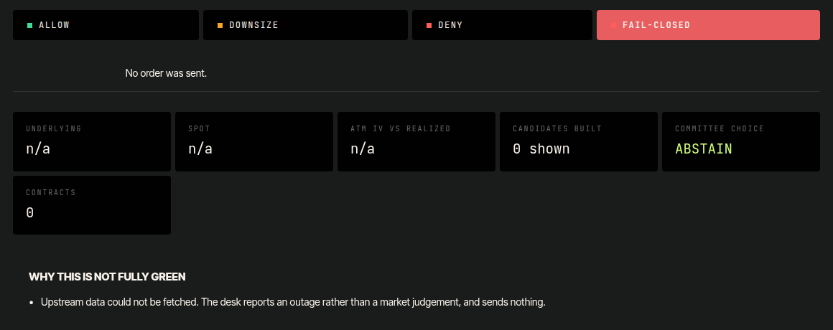
[ STAGE 3 · VETO ]
TWO REVIEWERS WITH DECORRELATED FAILURE MODES.
→ Two calls to the same model on the same context agree with each other and prove nothing.
→ Gate 1 is pure code: do the position's Greeks match the structure's own directional thesis? Unmeasurable Greeks fail closed.
→ Gate 2 is an LLM deliberately starved of the committee's reasoning, shown only the trade's own facts.
→ Live on Thursday: a candidate passed the thesis check and was vetoed by the blind review — "requires conviction SPY won't rally 1.4% over 44 days." The desk abstained.
trading-alpaca · paper account only · trading-alpaca-judge.vercel.app
06 / 15

Slide 7
[ STAGE 4 · GUARD ]
RISK.YAML IS THE SINGLE SOURCE OF TRUTH.
THE GUARD FAILS CLOSED.
Limit | Value
Max loss per position | $1,000 (1% of equity)
Concurrent positions | 3
New trades per underlying per day | 1
Net delta / net vega | |Δ| ≤ 30 · |ν| ≤ 200
Days to expiry | 7 – 45
Liquidity | OI ≥ 100 · spread ≤ 10% of mid
Daily loss halt | 2% of equity
After 3 consecutive losers | size halved
Any error, missing data, or exception | DENY
Verified by 933 tests, including mutation tests that prove a guard exception denies rather than trades. A kill-switch file halts everything within a minute.
trading-alpaca · paper account only · trading-alpaca-judge.vercel.app
07 / 15

Slide 8
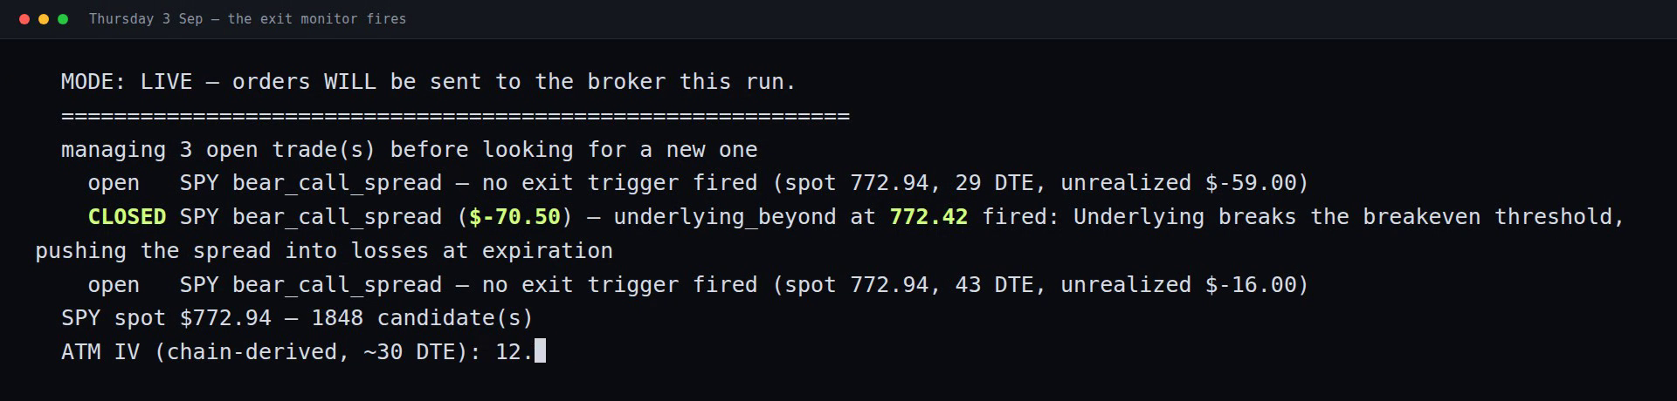
[ STAGE 5 · EXECUTE AND EXIT ]
IT MANAGES THE BOOK BEFORE IT ADDS TO IT.
→ Orders are one atomic multi-leg limit through the official Alpaca CLI. Live fills came in at better than their limits ($2.35 vs $1.94, $1.48 vs $1.22).
→ Before the trade is sent, a pre-mortem asks the model how it fails, then compiles those failure modes into deterministic exit triggers.
→ Three exits apply to every position regardless of any model: 50% of credit captured, max loss, and a forced close at 3 DTE.
→ Thursday: the breakeven trigger set at entry fired at 772.42 and the desk closed the spread itself at −$70.50, before the loss could grow toward its $352 max.
trading-alpaca · paper account only · trading-alpaca-judge.vercel.app
08 / 15

Slide 9
[ STAGE 6 · GRADE ITSELF ]
AN ANALYST THAT IS CONFIDENTLY WRONG LOSES ITS VOTE.
Analyst | Resolved | Brier | Weight | Interpretation
vol_analyst | 12 | 0.162 | 1.18 | beats the 0.25 always-0.5 baseline — upweighted
bear_adversary | 12 | 0.298 | 0.90 | worse than baseline — down-weighted
Closes resolve the probabilities each analyst gave; Brier scores recompute weights every cycle and feed the next aggregate. Twelve resolved trades is a small sample and is stated as one — the loop is the point, not the score.
trading-alpaca · paper account only · trading-alpaca-judge.vercel.app
09 / 15

Slide 10
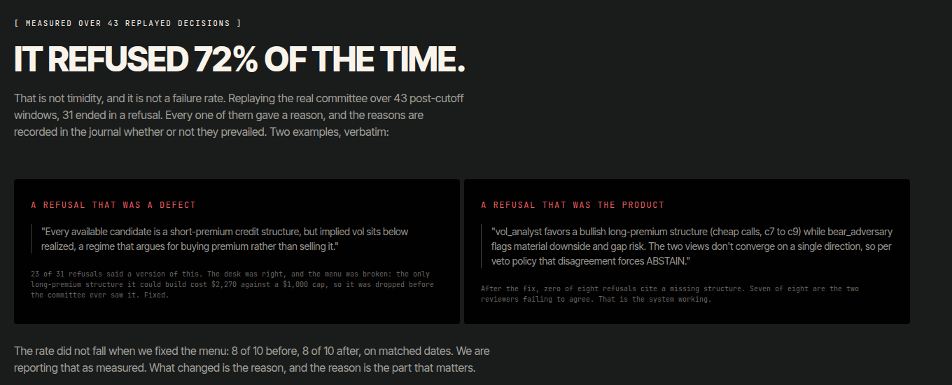
[ REFUSAL IS THE PRODUCT ]
OVER 43 REPLAYED DECISIONS,
IT REFUSED 72% OF THE TIME.
→ The real committee replayed over 43 post-knowledge-cutoff windows: 31 refusals, 12 executable trades.
→ Every refusal gave a reason. The reasons are what matter: after the structure menu was fixed, zero refusals cited a missing structure; seven of eight were the two reviewers failing to agree.
→ Replayed at $0.00: every LLM call is content-addressed and cached with its prompt, raw response and parse.
→ This is not timidity. A desk that cannot say no cannot be trusted when it says yes.
trading-alpaca · paper account only · trading-alpaca-judge.vercel.app
10 / 15

Slide 11
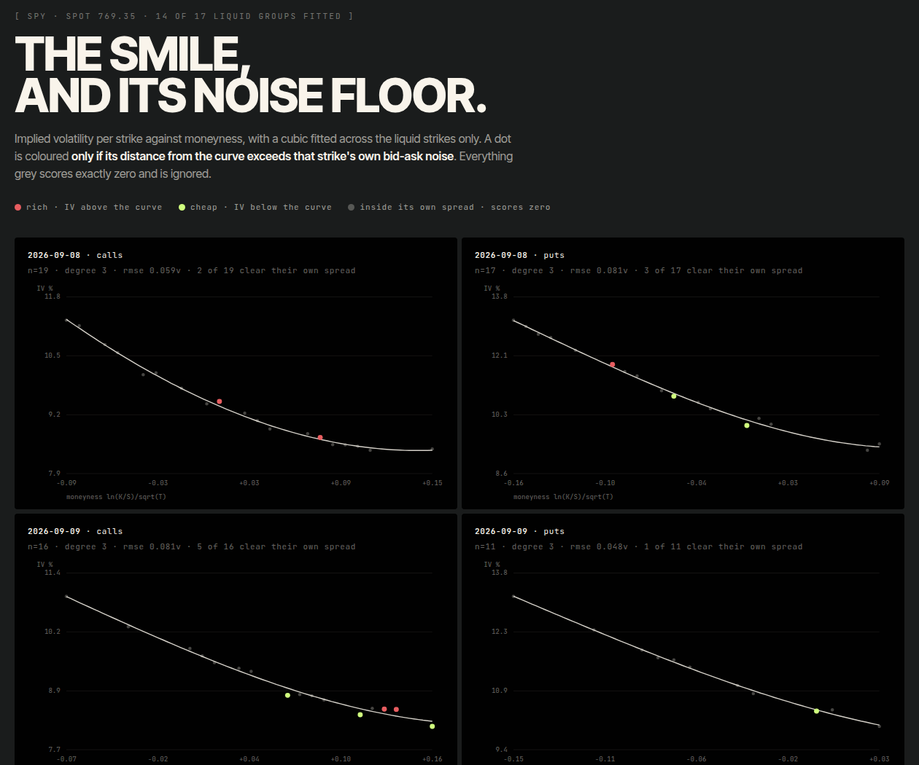
[ ANALYTICS ]
THE VOLATILITY SMILE — AND ITS NOISE FLOOR.
→ A cubic fitted per expiry on ln(K/S)/√T across the liquid strikes only; 14 of 17 liquid groups fit.
→ A strike is coloured only if its distance from the curve exceeds its own bid-ask spread. Everything grey scores exactly zero.
→ We measured it, and deliberately did not let it pick strikes: the median deviation is worth about $3.94 per contract against a $4.00 quoted spread.
→ Measurement is not edge, and the desk knows the difference.
trading-alpaca · paper account only · trading-alpaca-judge.vercel.app
11 / 15

Slide 12
[ LIVE · OFFICIAL MEASUREMENT WINDOW ]
WHAT ACTUALLY HAPPENED.
Account | PA3JR0GVVEN0 — new, dedicated, paper, created 2026-08-29
Opening equity | $100,000.00, flat until the window opened
Closing equity (Thu 3 Sep EOD) | $99,827.64 (−0.17%)
Fills | 3, all inside the window, each at better than its limit
Closes | 1, automated, on its own breakeven trigger (−$70.50)
Guard refusals | per-day cap, position cap, no-stacking
Positions corrupted | 0
Every trade | a defined-risk bear call spread, 1 contract, inside its $1,000 cap
Judged on total equity, this is flat. Three bear call spreads were one directional view expressed three times, and SPY rallied. We state that rather than hide it.
trading-alpaca · paper account only · trading-alpaca-judge.vercel.app
12 / 15

Slide 13
[ FOUND BY RUNNING, NOT BY READING ]
FOUR BUGS, ALL WHILE THE TEST SUITE WAS GREEN.
Day | Bug | What it cost | Fix
Mon | Skill leak | the host's plugin told analysts to look for skills first → silent abstain | --setting-sources "" isolates the model call
Mon | Unfillable limit | mid-priced order rested 55 min, blocked every later cycle | 20% marketable concession at the one live pricing site
Tue | Trailing comma | a valid, reasoned trade decision discarded over one character | string-aware JSON repair, fail-closed otherwise
Thu | Leg collision | new spread sold a contract already held long → broker rejected | filter candidates against current holdings
Each was root-caused from the journal and prompt cache, fixed with a regression test, and shipped mid-session. That is the argument for the journal.
trading-alpaca · paper account only · trading-alpaca-judge.vercel.app
13 / 15

Slide 14
[ WHAT THIS DOES NOT CLAIM ]
STATED LIMITS, NOT OMITTED ONES.
→ One closed trade and two open ones prove nothing statistically, and we do not imply otherwise.
→ Paper fills are simulated against live quotes. No counterparty took the other side.
→ The desk used ~25% of its own risk budget: candidates are built at 1 contract and the guard only ever downsizes. Known, documented, unchanged during scoring.
→ Walk-forward backtests (13 windows, 90-day fit / 30-day test) are labelled as backtests; AAPL loses (PF 0.83) and the report says so.
→ The previous author's hardcoded performance claims were deleted, not adapted.
trading-alpaca · paper account only · trading-alpaca-judge.vercel.app
14 / 15

Slide 15
[ TRY IT YOURSELF ]
EVERYTHING HERE IS VERIFIABLE WITHOUT CREDENTIALS.
Live site
git clone https://github.com/Prashant-thakur77/trading-alpaca
cd trading-alpaca && make install
make test # 933 tests, offline
make judge # 4 judge scenarios, no keys
make verify-journal # hash chain intact
https://trading-alpaca-judge.vercel.app
Judge desk — replay four real decisions, two of them refusals
https://trading-alpaca-judge.vercel.app/judge
Volatility smile
https://trading-alpaca-judge.vercel.app/smile
Source, tests, journal, and every prompt
https://github.com/Prashant-thakur77/trading-alpaca
Demo video (4:22)
https://github.com/Prashant-thakur77/trading-alpaca/raw/main/docs/press/demo.mp4
Compliance: orders route through the official Alpaca CLI; market data through the official Alpaca MCP server with read-only toolsets (no trading toolset is exposed, so an LLM cannot place an order through it). alpaca-py is used for analysis only.
trading-alpaca · paper account only · trading-alpaca-judge.vercel.app
15 / 15

