Slide 1
Historic Weather Data Analysis
Presented By:
Prashant Mourya
Sumedha Sirikonda

Slide 2
Project Description
Historic weather data analysis and prediction by storing data in HDFS and integrating with Spark and visualization using Matplotlib
Problem Statement
Predicting Temperature,Windspeed and Heat index by using machine learning models Spark ML Lib Random Forest Regressor, SARIMA and Sklearn Linear regression using Train and test data

Slide 3
Changes
Used an API to get data

Slide 4
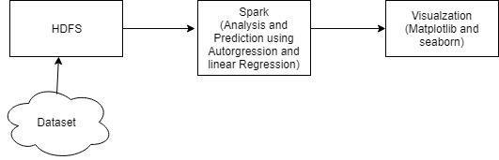
Implementation
Retrieved Dataset from an API
Installed and Configured Hadoop
Loaded the data set in HDFS
Installed and Configured Spark
Integrated Hadoop and Spark
Loaded data from HDFS to Spark
Used RDD concept to parallelize the data and created
data frame
Data Exploration
Prediction of Temperature using Spark Ml Lib Random Forest Regresor
Prediction of Windspeed using Seasonal Autoregressive
integrated Moving Average
Visualization using Matplotlib
Prediction of Heat Index using Linear Regression
Visualization using Seaborn

Slide 5
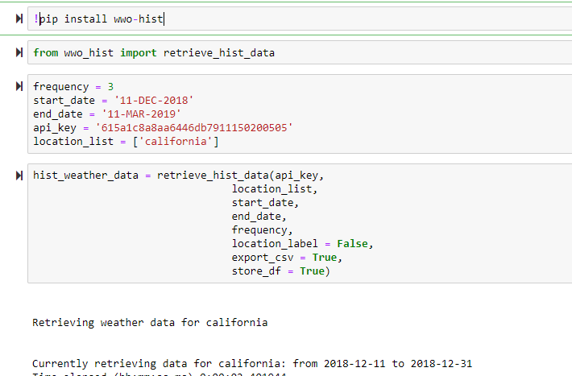
Code for getting Dataset

Slide 6
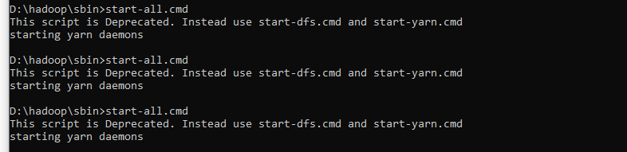
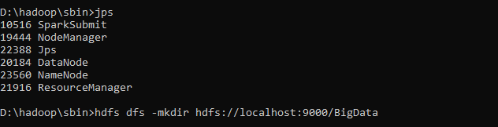
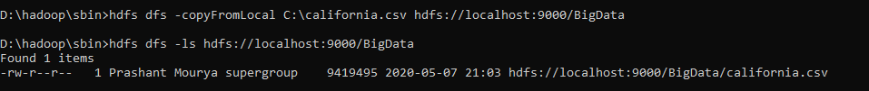
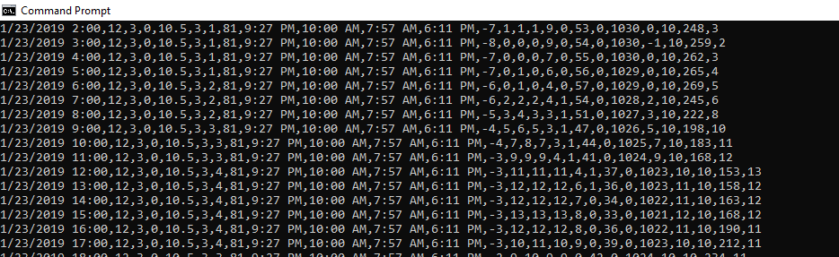
Installed and Configured Hadoop Loaded the data set in HDFS
Start CMD
Start all Hadoop Daemons
Check if all daemons started using jps command
Create Directory in Local Machine
Load data from Local Machine to HDFS

Slide 7

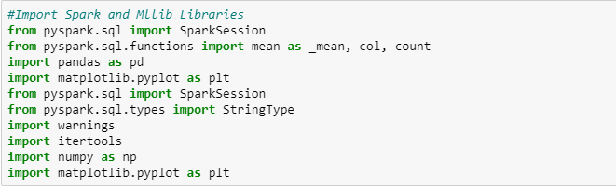
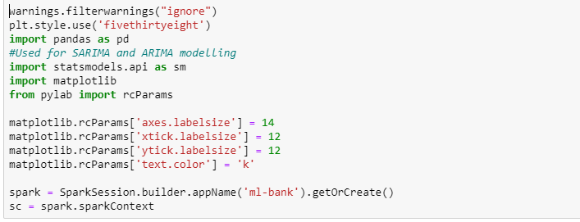
Importing Libraries
Creating Spark Instance
and Spark Context

Slide 8
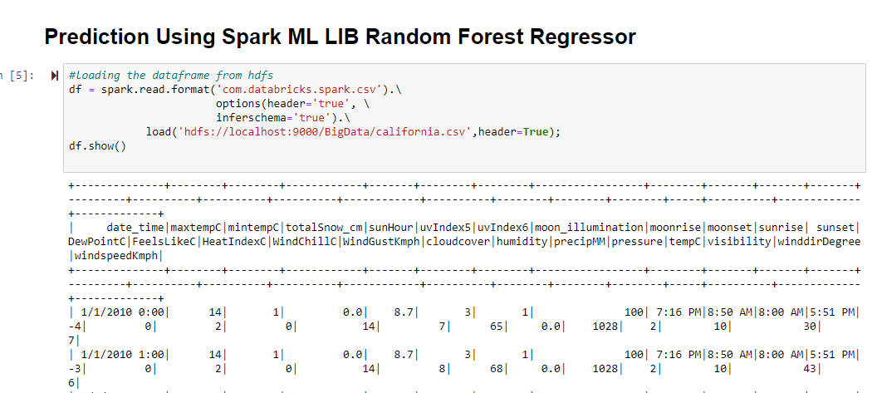
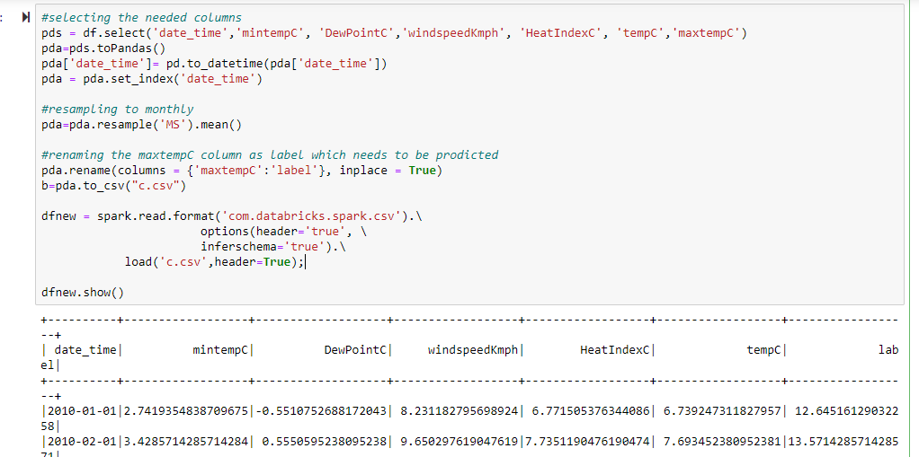
Loading Data from Hdfs
Creating Spark Data Frame
Resampling to Monthly
Creating a new Spark DataFrame and renaming maxtempC to label as we want to predict that column

Slide 9
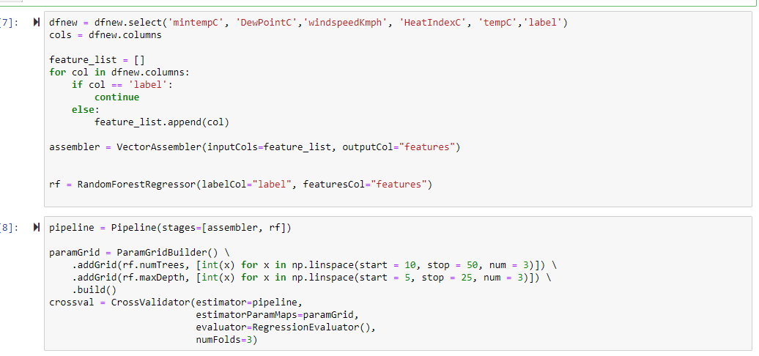
Separating Label and other features
Creating a Vector Assembler
Creating a Random Forest Regressor
Creating a pipeline with vector assembler and RF
Creating a Suitable Parameter for Cross Validator

Slide 10
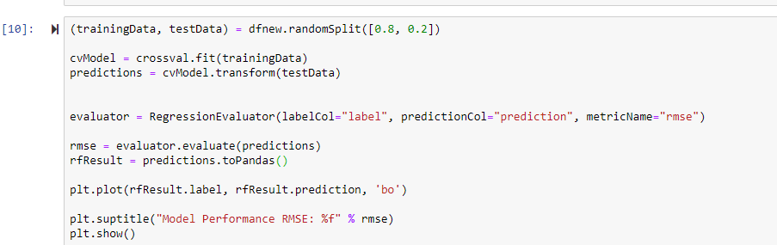
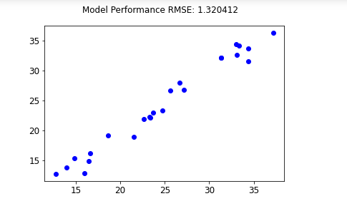


Slide 11
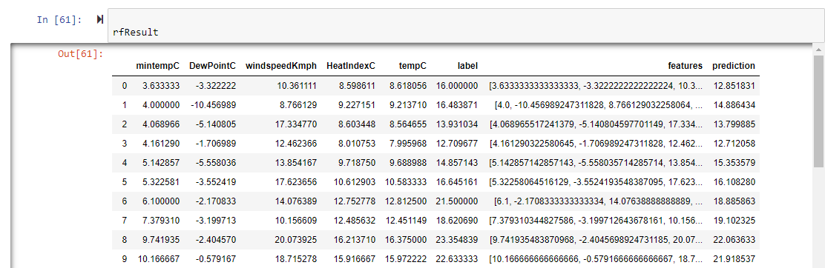
Label is the test data
Prediction is the predicted data

Slide 12
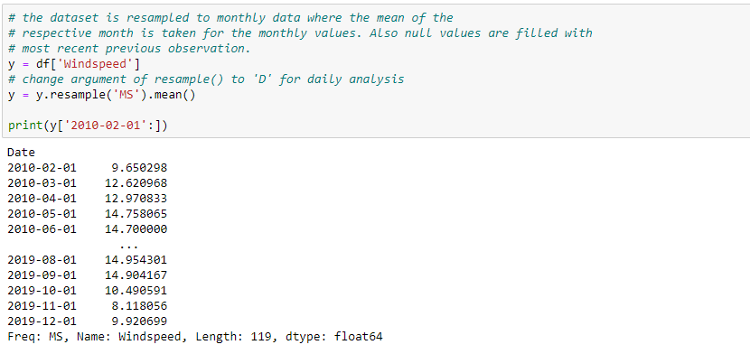
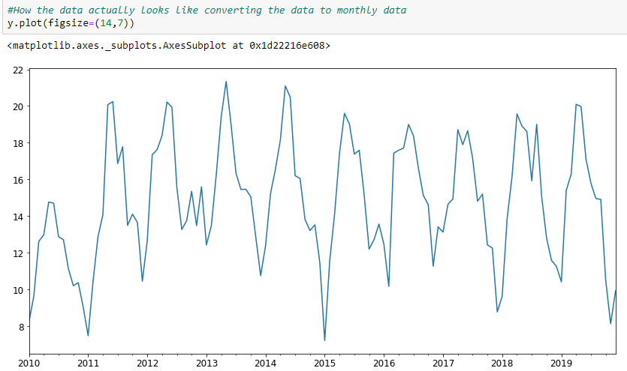
Predicting Windspeed with SARIMA
Resampling the daily data to monthly
Visualizing the data

Slide 13
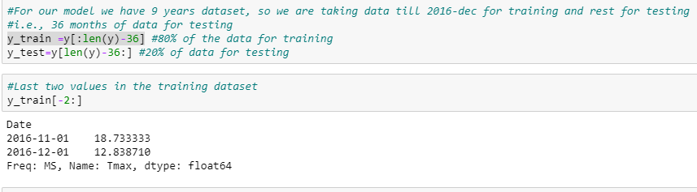
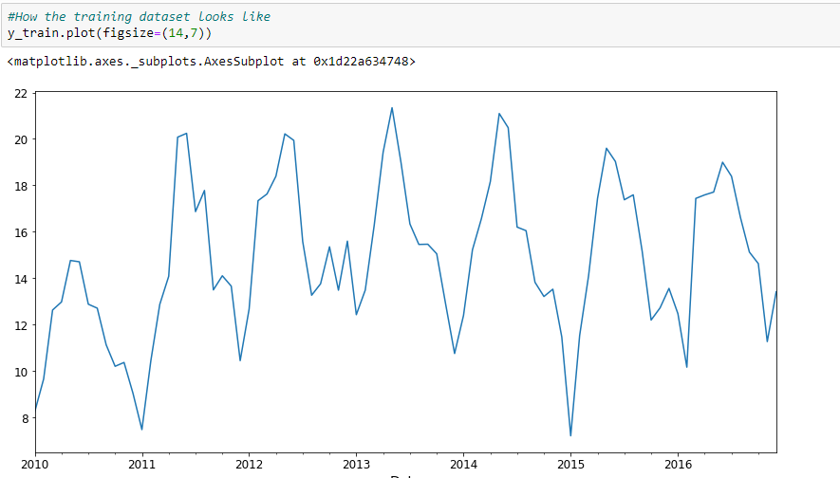
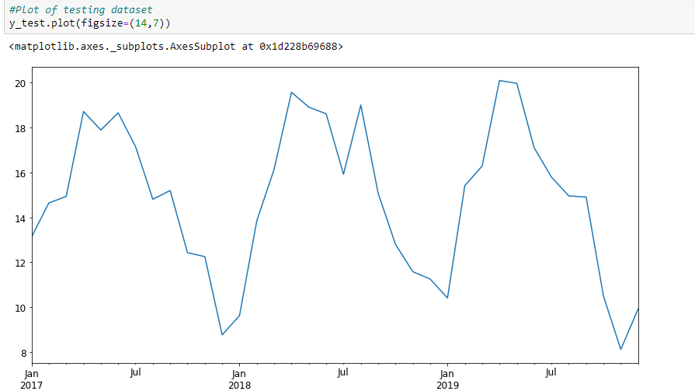
Splitting the data into Train and Test data
Visualizing the data

Slide 14
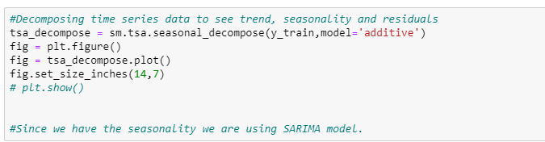
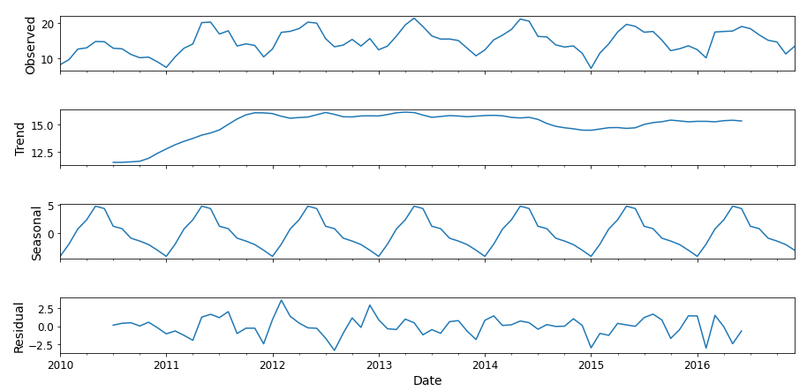
Decomposing the Train data
Checking for Trends and Seasonality

Slide 15
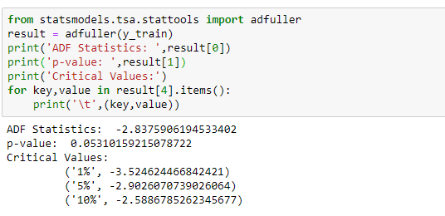
Taking Ad fuller Test to check the stationarity of data
If ADF Statistics value is greater than Critical value, then the data is stationary

Slide 16
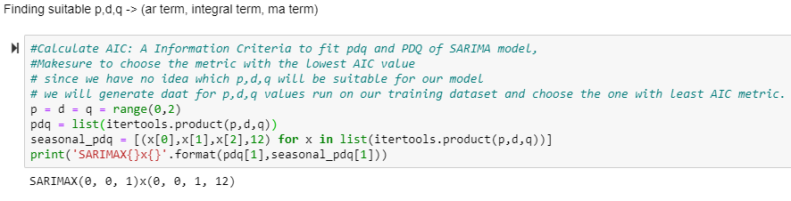
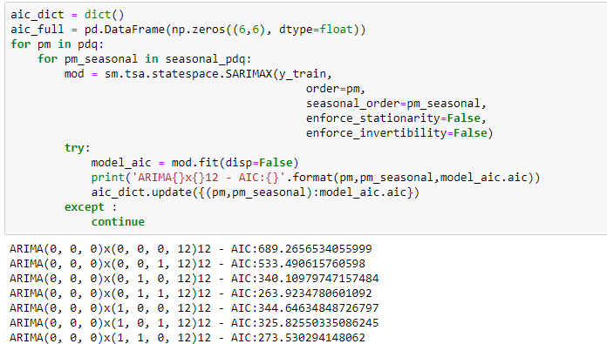
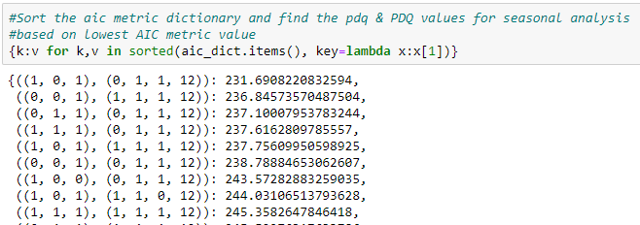
Sarima takes arguments (p,q,d)(P,Q,D,S)
where p,P->AR Term (Autoregressor)
q,Q->Integral Term
D-> Moving Average
S->Seasonality
Creating a set of (p,d,q) and (P,D,Q,S) arguments and fitting it on our training dataset.
The suitable argument would produce least AIC value

Slide 17
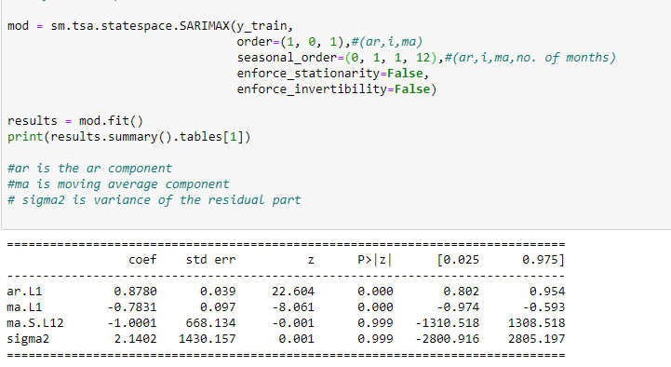
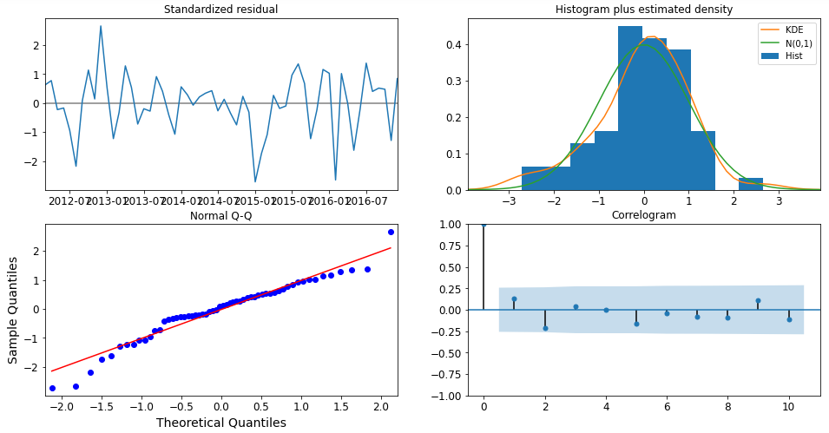
Fitting the model with the least AIC value arguments to SARIMAX
Checking the diagnostics for the result model to
check for unusual behavior

Slide 18
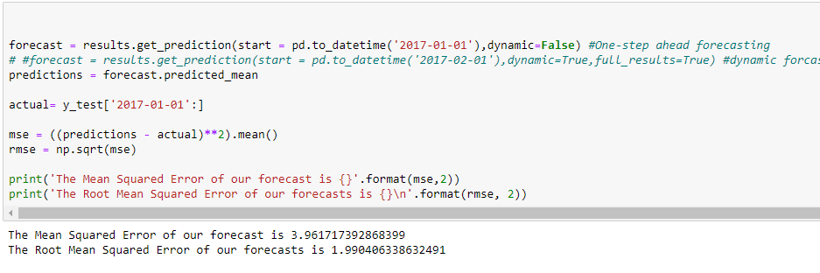
Getting a one step ahead forecasting
Calculating Mean Squared and Root Mean Squared Error

Slide 19
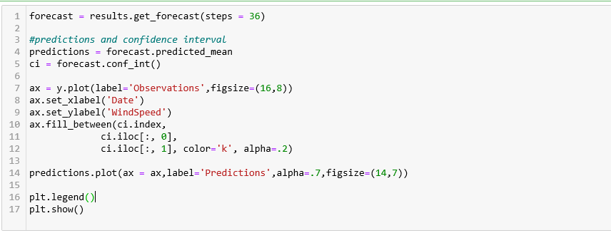
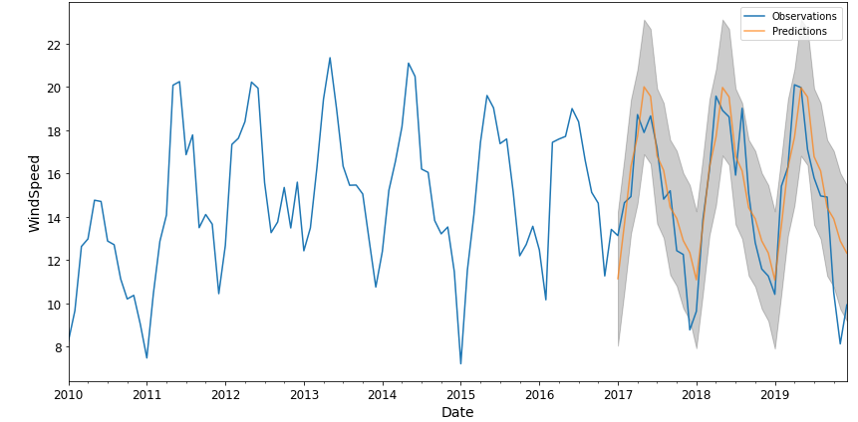
Predicting for next 3 years
Visualizing using Matplotlib

Slide 20
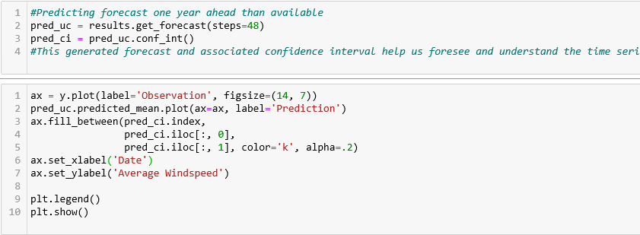
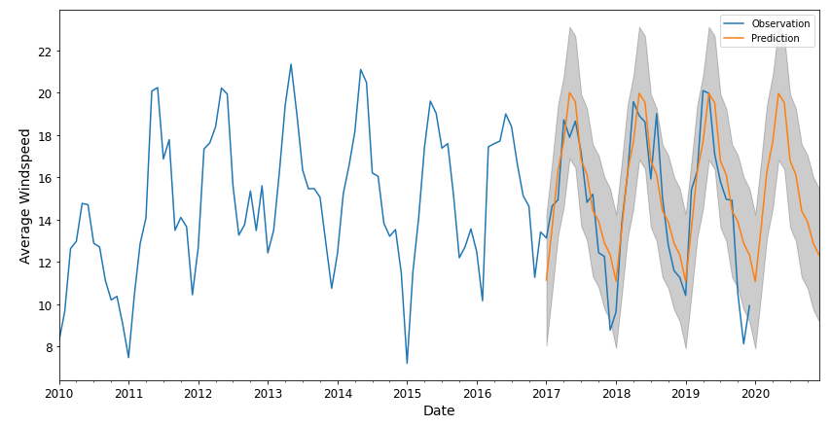
Predicting for next 1 year
Visualizing using Matplotlib

Slide 21
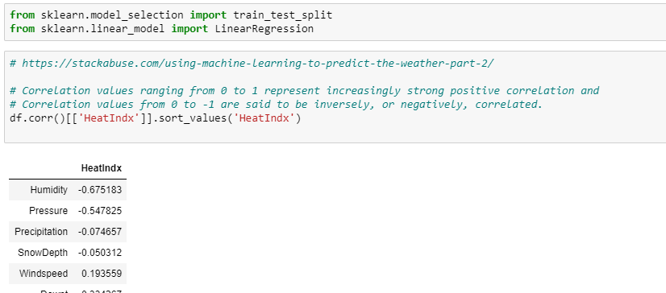
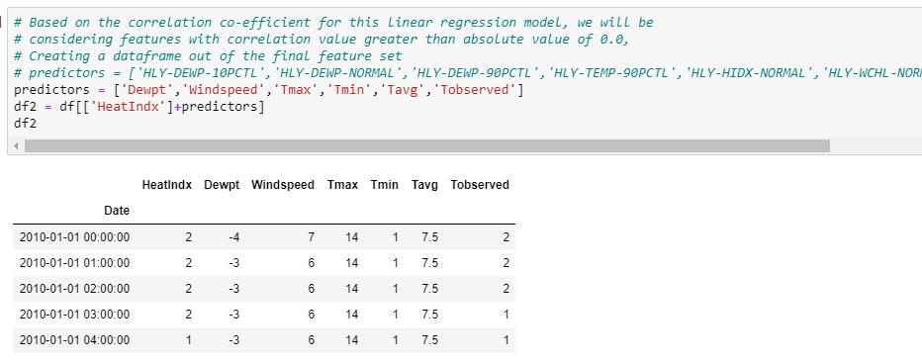
Predicting Heat Index using Linear Regression
Finding Correlation Between HeatIndex and Other Variables
Seperating HeatIndex and other Predictors

Slide 22
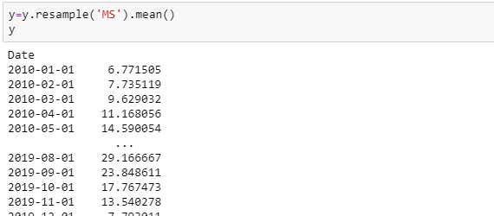
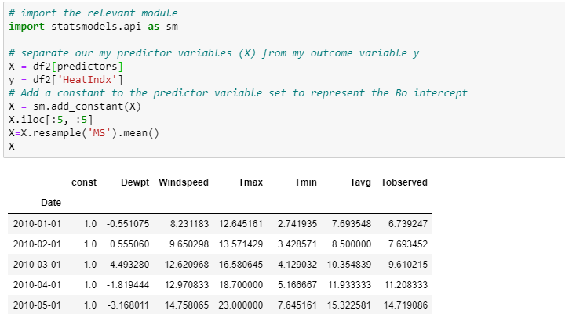
Resampling data to Monthly

Slide 23
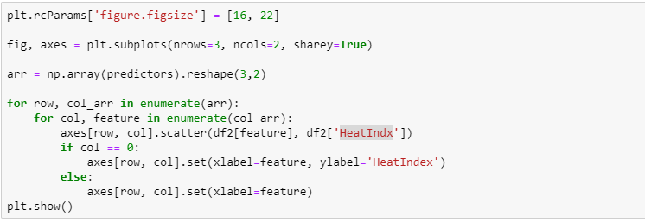
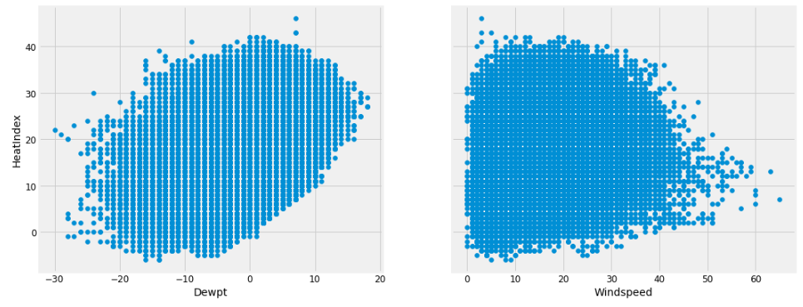
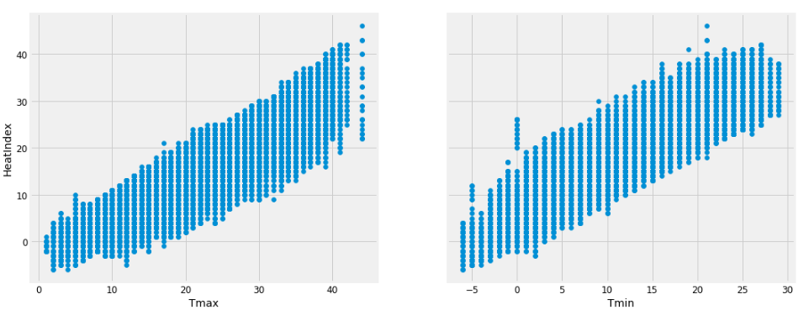
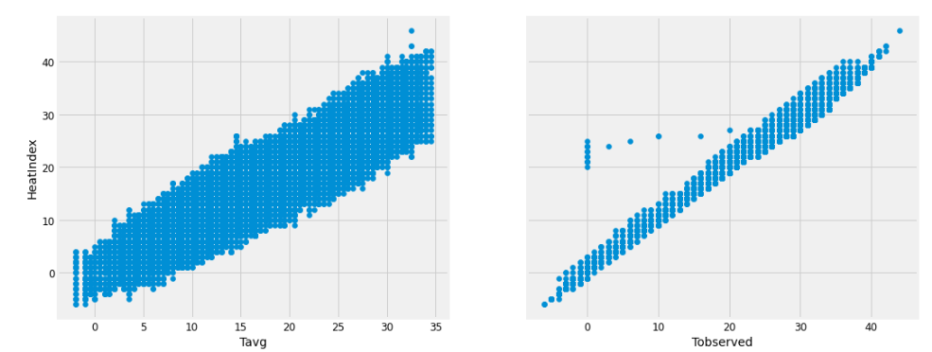
Plotting the Correlation

Slide 24
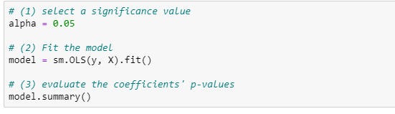
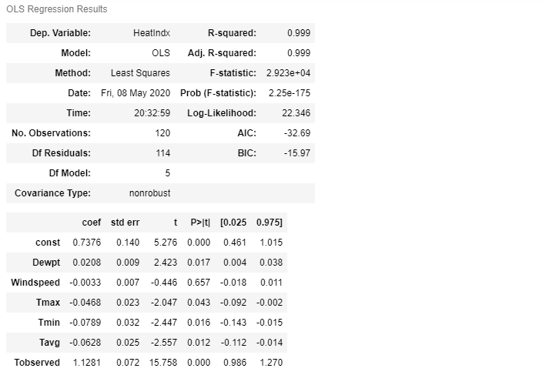
Checking the fitness of model by sm.OLS
Dropping the columns where p values > alpha

Slide 25
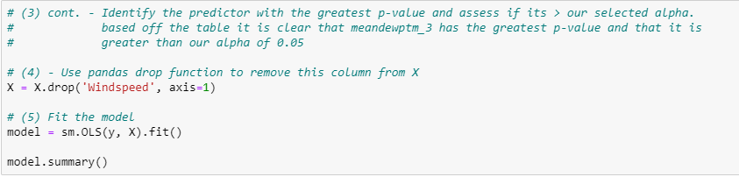
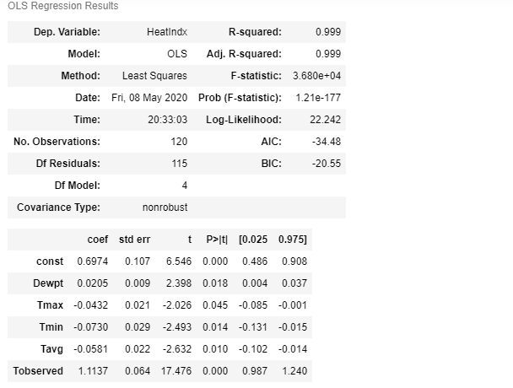
Dropped Windspeed

Slide 26
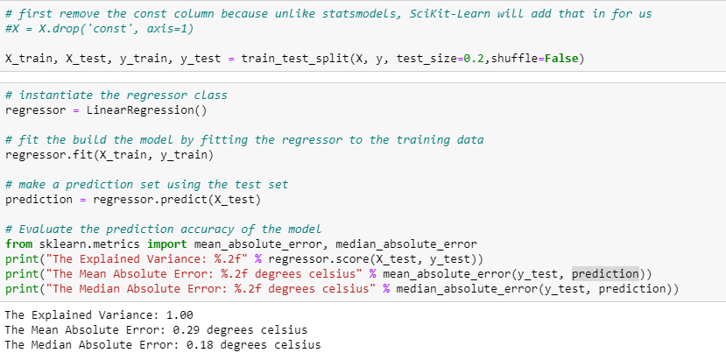
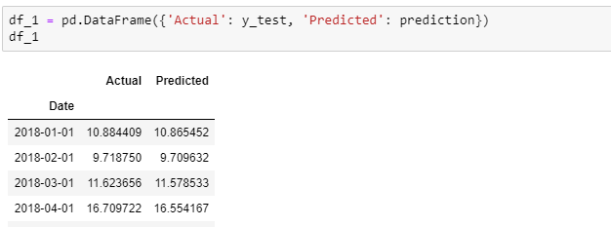
Splitting the data Into train and test data
Using Linear regression to predict the outcome

Slide 27

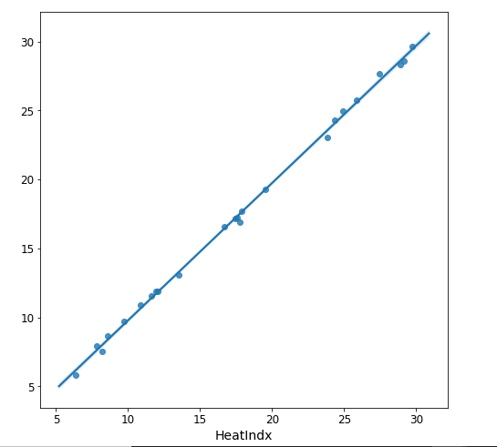
Visualizing the outcome using Seaborn

Slide 28
Conclusion and Lesson Learned
Configuring anf using HDFS
Using Spark ML LIB
Implementing different regression machine
Choosing best suitable models for prediction

Slide 29
Thank You!!

