Slide 1
IPv4 ADDRESSES
An IPv4 address is a 32-bit address that uniquely and universally defines the connection of a device (for example, a computer or a router) to the Internet.
19.<number>

Slide 2

Note
An IPv4 address is 32 bits long.
19.<number>

Slide 3
Note
The IPv4 addresses are unique
and universal.
19.<number>

Slide 4
Note
The address space of IPv4 is
2³² or 4,294,967,296.
19.<number>

Slide 5

Addresses for private networks
19.<number>

Slide 6
IPv6 ADDRESSES
Despite all short-term solutions, address depletion is still a long-term problem for the Internet. This and other problems in the IP protocol itself have been the motivation for IPv6.
19.<number>

Slide 7
Note
An IPv6 address is 128 bits long.
19.<number>

Slide 8

IPv6 address in binary and hexadecimal colon notation
19.<number>

Slide 9
128-bit IPv6 Address
3FFE:085B:1F1F:0000:0000:0000:00A9:1234
8 groups of 16-bit hexadecimal numbers separated by “:”
Leading zeros can be removed
3FFE:85B:1F1F::A9:1234
:: = all zeros in one or more group of 16-bit hexadecimal numbers

Slide 10

Example
Expand the address 0:15::1:12:1213 to its original.
Solution
We first need to align the left side of the double colon to the left of the original pattern and the right side of the double colon to the right of the original pattern to find how many 0s we need to replace the double colon.
This means that the original address is.
19.<number>

Slide 11
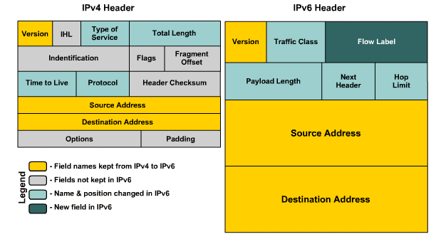
19.<number>

Slide 12
IPv4 Header
Version (4 bits)
  Indicates the version of IP and is set to 4.
Internet Header Length (4 bits)
  Indicates the number of 4-byte blocks in the IPv4 header.
  Because an IPv4 header is a minimum of 20 bytes in size, the smallest value of the Internet Header Length (IHL) field is 5.
Type of Service (8 bits)
  Indicates the desired service expected by this packet for delivery through routers across the IPv4 internetwork.
  Contains a 6-bit Differentiated Services Code Point (DSCP) field (RFC 2472) and two flags to support Explicit Congestion Notification (RFC 3168).
IPv6 Packet Format

Slide 13
IPv4 Header - Review
Total Length (16 bits)
  Indicates the total length of the IPv4 packet (IPv4 header + IPv4 payload) and does not include link layer framing.
  indicate an IPv4 packet that is up to 65,535 bytes long.
Identification (16 bits)
  Identifies this specific IPv4 packet.
  The Identification field is selected by the originating source of the IPv4 packet. If the IPv4 packet is fragmented, all of the fragments retain the Identification field value so that the destination node can group the fragments for reassembly.
Flags (3 bits)
  Identifies flags for the fragmentation process.
  There are two flags—one to indicate whether the IPv4 packet might be fragmented and another to indicate whether more fragments follow the current fragment.
Fragment Offset (13 bits)
  Indicates the position of the fragment relative to the original IPv4 payload.
IPv6 Packet Format

Slide 14
IPv4 Header - Review
Time to Live ( 8 bits)
  Indicate the maximum number of links on which an IPv4 packet can travel before being discarded.
  Originally used as a time count with which an IPv4 router determined the length of time required (in seconds) to forward the IPv4 packet, decrementing the TTL accordingly. Modern routers almost always forward an IPv4 packet in less than a second and are required by RFC 791 to decrement the TTL by at least one. Therefore, the TTL becomes a maximum link count with the value set by the sending node. When the TTL equals 0,an ICMP Time Expired-TTL Expired in Transit message is sent to the source IPv4 address and the packet is discarded.
Protocol (8 bits)
  Identifies the upper layer protocol.
  For example, TCP uses a Protocol of 6, UDP uses a Protocol of 17, and ICMP uses a Protocol of 1.
  The Protocol field is used to demultiplex an IPv4 packet to the upper layer protocol.
IPv6 Packet Format

Slide 15
IPv4 Header - Review
Header Checksum (16 Bits)
  Provides a checksum on the IPv4 header only.
  The IPv4 payload is not included in the checksum calculation as the IPv4 payload and usually contains its own checksum. Each IPv4 node that receives IPv4 packets verifies the IPv4 header checksum and silently discards the IPv4 packet if checksum verification fails. When a router forwards an IPv4 packet, it must decrement the TTL. Therefore, the Header Checksum is recomputed at each hop between source and destination.
Source Address ( 32 bits)
  Stores the IPv4 address of the originating host.
Destination Address (32 bits)
  Stores the IPv4 address of the destination host.
Options (multiple of 32 bits)
  Stores one or more IPv4 options.
  If the IPv4 option or options do not use all 32 bits, padding options must be added so that the IPv4 header is an integral number of 4-byte blocks that can be indicated by the Internet Header Length field.
IPv6 Packet Format

Slide 16
IPv6 Header Format Simplification
Fixed Length for the basic header
  IPv4 header of variable length = min^{m} 20 bytes
  IPv6 = main header length fixed at 40 bytes
    Leads to fast header processing
    No need of Header Length (Hd Len) field in IPv4 – obsolete
Fragmentation only by traffic source
  Source does Path MTU (PMTU) discovery.
  Freeing routers from having to fragment them
  No need of IPv4 Identification, Flag, Fragment Offset
IPv6 Packet Format
Notes:
The Options field leads to an IPv4 header of variable length (minimum 20 bytes). By contrast, IPv6 has the main header length fixed at 40 bytes, a benefit to fast header processing because routers do not have to implement lookup processes that account for variable-length headers. The fixed length makes the Header Length field obsolete. The functionality provided by the options is delivered through extension headers, a concept described later in the section. The options and padding are also removed from the main packet header.
Fragmentation is done only by the traffic source--Before sending IPv6 traffic, the source does Path MTU (PMTU) Discovery. It then sends packets at the discovered PMTU, thus freeing the routers from having to fragment them. For this reason, the three IPv4 header fields related to fragmentation (Identification, Flags, and Fragment Offset) become irrelevant in IPv6.

Slide 17
IPv6 Header Format Simplification
Header checksums are eliminated
  IP header checksum recalculated by every node switching the packet due to changing TTL values, thus taxing router resources.
  Improvements on L2 technologies and their 32-bit CRC support since the introduction of IPv4 combined with layer 4 checksums provides sufficient protection to make the layer 3 header checksum unnecessary.
  Packet Header Checksum was eliminated in IPv6 and is in turn enforced at upper layers.
IPv6 Packet Format

Slide 18
IPv6 Header Fields
Based on these rules, RFC 2460 defines the following IPv6 header fields:
  Version (4 bits)
    4 bits are used to indicate the version of IP and is set to 6
  Traffic Class (8 bits)
    same function as the Type of Service field in the IPv4 header.
  Flow Label (20 bits)
    identifies a flow and it is intended to enable the router to identify packets that should be treated in a similar way without the need for deep lookups within those packets.
    set by the source and should not be changed by routers along the path to destination.
    unique & powerful tool to IPv6
    Can be used with differentiated services (DiffServ) as well as integrated services (IntServ) and Resource ReSerVation Protocol (RSVP2).
IPv6 Packet Format

Slide 19
IPv6 Header Fields
Payload Length (16 bits)
  With the header length fixed at 40 bytes, it is enough to indicate the length of the payload to determine the length of the entire packet.
Next Header (8 bits)
  Indicates either the first extension header (if present) or the protocol in the upper layer PDU (such as TCP, UDP, or ICMPv6).
  When indicating an upper layer protocol above the Internet layer, the same values used in the IPv4 Protocol field are used here.
Hop Limit (8 bits)
  In IPv6, the IPv4 TTL was appropriately renamed Hop Limit because it is a variable that is decremented at each hop, and it does not have a temporal dimension.
IPv6 Packet Format

Slide 20
IPv6 Header Fields
Source IPv6 Address (128 bits)
  Stores the IPv6 address of the originating host.
Destination IPv6 Address (128 bits)
  Stores the IPv6 address of the current destination host.
IPv6 Packet Format

Slide 21
IPv6 Next Header (Extension)
The IPv4 header includes all options.
Each intermediate router must check for their existence and process them when present → cause performance degradation in the forwarding of IPv4 packets.
With IPv6, delivery and forwarding options are moved to extension headers.
The only extension header that must be processed at each intermediate router is the Hop-by-Hop Options extension header.
This increases IPv6 header processing speed and improves forwarding process performance.
In a typical IPv6 packet, no extension headers are present.
IPv6 Packet Format

Slide 22
IPv6 Next Header (Extension)
RFC 2460 defines the following IPv6 extension headers that must be supported by all IPv6 nodes:
  Hop-by-Hop Options header
  Destination Options header
  Routing header
  Fragment header
  Authentication header
  Encapsulating Security Payload header
IPv6 Packet Format

Slide 23
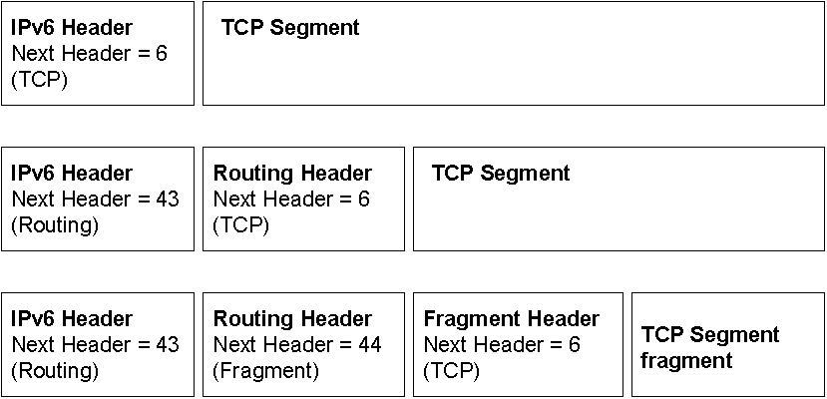
IPv6 Next Header (Extension)
If special handling is required by either the intermediate routers or the destination, one or more extension headers are added by the sending host.
Each extension header must fall on a 64-bit (8-byte) boundary.
Extension headers of variable size contain a Header Extension Length field and must use padding as needed to ensure that their size is a multiple of 8 bytes.
Next Header field in the IPv6 header and zero or more extension headers that form a chain of pointers. Each pointer indicates the type of header that comes after the immediate header until the upper layer protocol is ultimately identified.
IPv6 Packet Format

Slide 24
ARP and RARP
Note:
  The Internet is based on IP addresses
  Data link protocols (Ethernet, FDDI, ATM) may have different (MAC) addresses
The ARP and RARP protocols perform the translation between IP addresses and MAC layer addresses
We will discuss ARP for broadcast LANs, particularly Ethernet LANs

Slide 25
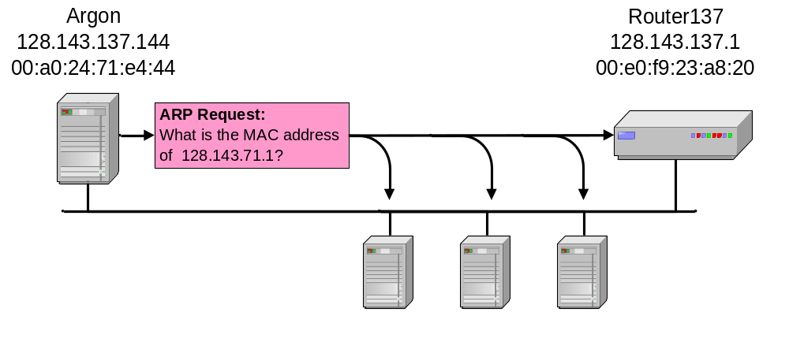
Address Translation with ARP
ARP Request:
Argon broadcasts an ARP request to all stations on the network: “What is the hardware address of Router137?”

Slide 26
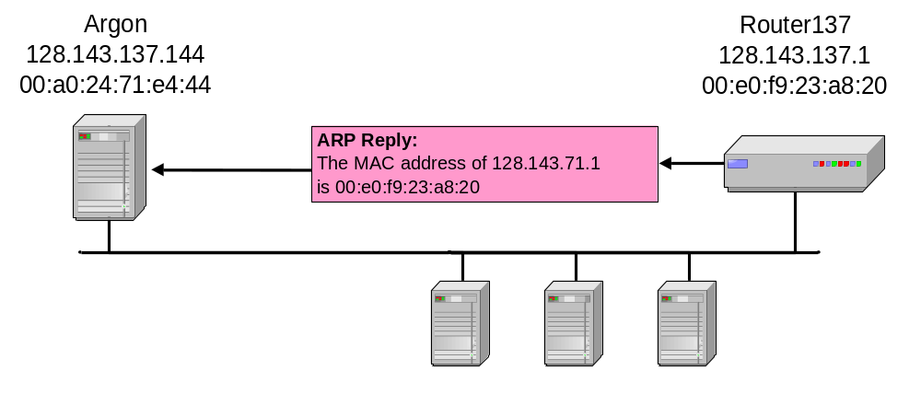
Address Translation with ARP
ARP Reply:
Router 137 responds with an ARP Reply which contains the hardware address

Slide 27
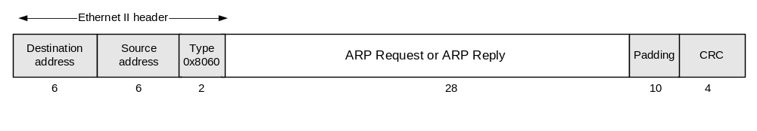
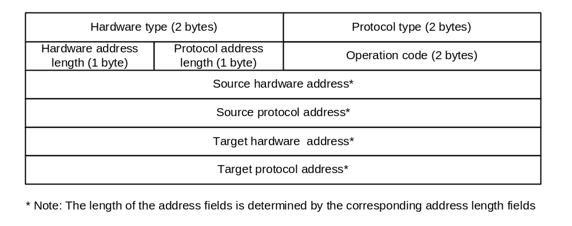
ARP Packet Format

Slide 28
Hardware type (HTYPE)This field specifies the Link Layer protocol type. Example: Ethernet is 1.
Protocol type (PTYPE)This field specifies the upper layer protocol for which the ARP request is intended. For IPv4, this has the value 0x0800.
Hardware length (HLEN)Length (in octets) of a hardware address. Ethernet addresses size is 6.
Protocol length (PLEN)Length (in octets) of addresses used in the upper layer protocol. (The upper layer protocol specified in PTYPE.) IPv4 address size is 4.

