Slide 1
IP Addresses
An Internet Protocol address (IP address) is a numerical label assigned to each device participating in a computer network that uses the Internet Protocol for communication
Notes:
IANA (Internet Assigned Number Authority) handles IP addresses allocated globally, typically to Regional Internet Registries. In the Unites States, IP address allocation is managed by ARIN (American Registry for Internet Numbers).

Slide 2

An IP address is a
32-bit
address.
The IP addresses
are
unique.

Slide 3
The address space of IPv4 is
2³²
or
4,294,967,296.

Slide 4
In classful addressing,
the address space is
divided into five classes:
A, B, C, D, and E.

Slide 5
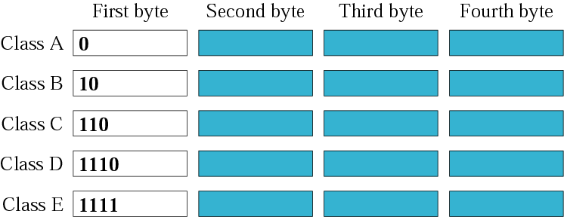
Finding the class in binary notation

Slide 6

Finding the class in decimal notation

Slide 7
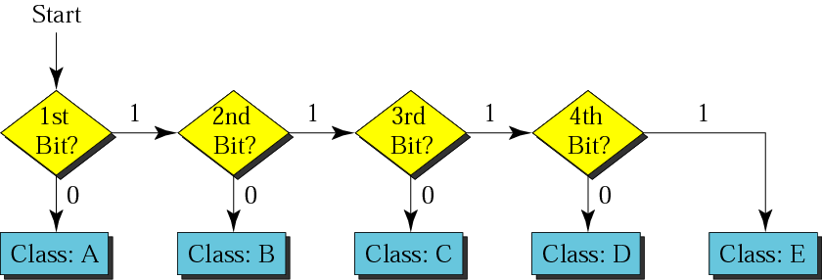
Finding the address class

Slide 8
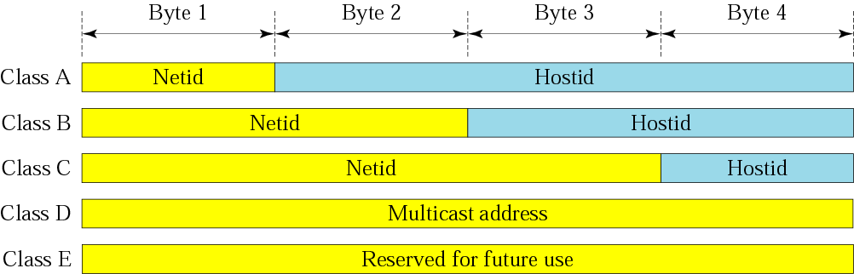
Netid and hostid

Slide 9

Class A Address
The first bit of the first octet is always set to 0 (zero). Thus the first octet ranges from 1 – 127, i.e.
Class A addressing can have 126 networks (2⁷-2) and 16777214 hosts (2²⁴-2).
Class A IP address format is thus: 0NNNNNNN.HHHHHHHH.HHHHHHHH.HHHHHHHH
Notes:
Class A addresses only include IP starting from 1.x.x.x to 126.x.x.x only. The IP range 127.x.x.x is reserved for loopback IP addresses.

Slide 10

Class B Address
An IP address which belongs to class B has the first two bits in the first octet set to 10, i.e.
Class B IP Addresses range from 128.0.x.x to 191.255.x.x. Class B has 16384 (2¹⁴) Network addresses and 65534 (2¹⁶-2) Host addresses
Class B IP address format is: 10NNNNNN.NNNNNNNN.HHHHHHHH.HHHHHHHH
Notes:
Class A addresses only include IP starting from 1.x.x.x to 126.x.x.x only. The IP range 127.x.x.x is reserved for loopback IP addresses. Loopback address is a special IP number (127.0.0.1) that is designated for the software loopback interface of a machine. The loopback interface has no hardware associated with it, and it is not physically connected to a network. The loopback interface allows IT professionals to test IP software without worrying about broken or corrupted drivers or hardware.

Slide 11

Class C Address
The first octet of Class C IP address has its first 3 bits set to 110, that is:
Class C IP addresses range from 192.0.0.x to 223.255.255.x.
Class C gives 2097152 (2²¹) Network addresses and 254 (2⁸-2) Host addresses.
Class C IP address format is: 110NNNNN.NNNNNNNN.NNNNNNNN.HHHHHHHH
Notes:
Class A addresses only include IP starting from 1.x.x.x to 126.x.x.x only. The IP range 127.x.x.x is reserved for loopback IP addresses.

Slide 12
The network address is the
beginning address of each block.
It can be found by applying
the default mask to
any of the addresses in the block
(including itself).
It retains the netid of the block
and sets the hostid to zero.

Slide 13
Given the network address 17.0.0.0, find the class, the block, and the range of the addresses.
Solution
The class is A because the first byte is between 0 and 127.
The block has a netid of 17.
The addresses range from 17.0.0.0 to 17.255.255.255.
Notes:
The class is A because the first byte is between
0 and 127. The block has a netid of 17.
The addresses range from 17.0.0.0 to
17.255.255.255.

Slide 14
Given the network address 132.21.0.0, find the class, the block, and the range of the addresses.
Solution
The class is B because the first byte is between 128 and 191.
The block has a netid of 132.21. The addresses range from
132.21.0.0 to 132.21.255.255.
Notes:
The class is B because the first byte is between
128 and 191. The block has a netid of
132.21. The addresses range from
132.21.0.0 to 132.21.255.255.

Slide 15
Given the network address 220.34.76.0, find the class, the block, and the range of the addresses.
Solution
The class is C because the first byte is between
192 and 223.
The block has a netid of 220.34.76.
The addresses range from 220.34.76.0
to 220.34.76.255.

Slide 16
Mask
A mask is a 32-bit binary number that gives the first address in the block (the network address) when bitwise ANDed with an address in the block.

Slide 17
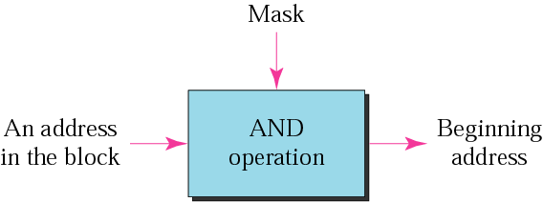
Masking concept

Slide 18
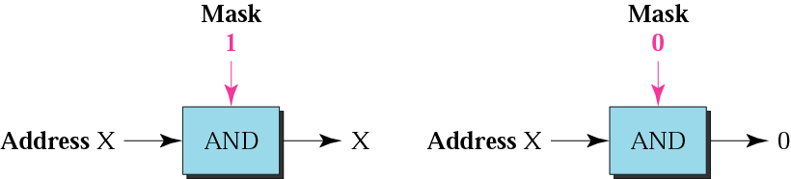
AND operation

Slide 19

Default masks for classful addressing
Notes:
CIDR--Classless Inter-Domain Routing

Slide 20
A block of addresses is granted to a small organization. We know that one of the addresses is 205.16.37.39/28. What is the first address in the block?
Solution
The binary representation of the given address is
11001101 00010000 00100101 00100111
Mask is 11111111 11111111 11111111 11110000
If we set 32−28 rightmost bits to 0, we get
11001101 00010000 00100101 0010000
or
205.16.37.32.

Slide 21
What is the network address if one of the addresses is 167.199.170.82/27?
Solution
The prefix length is 27, which means that we must keep the first 27 bits as is and change the remaining bits (5) to 0s. The 5 bits affect only the last byte. The last byte is 01010010. Changing the last 5 bits to 0s, we get 01000000 or 64. The network address is 167.199.170.64/27.

Slide 22
A small organization is given a block with the beginning address and the prefix length 205.16.37.24/29 (in slash notation). What is the range of the block?
Solution
The beginning address is 205.16.37.24. To find the last address we keep the first 29 bits and change the last 3 bits to 1s.
Beginning:11001111 00010000 00100101 00011000
Ending : 11001111 00010000 00100101 00011111
There are only 8 addresses in this block.

Slide 23
Subnetting
Subnetting is the strategy used to partition a single physical network into more than one smaller logical sub-networks (subnets).
Subnets are designed by accepting bits from the IP address's host part and using these bits to assign a number of smaller sub-networks inside the original network.
Subnetting helps to reduce the network complexity.
Subnetting is essential when a single network number has to be allocated over numerous segments of a local area network (LAN).

Slide 24
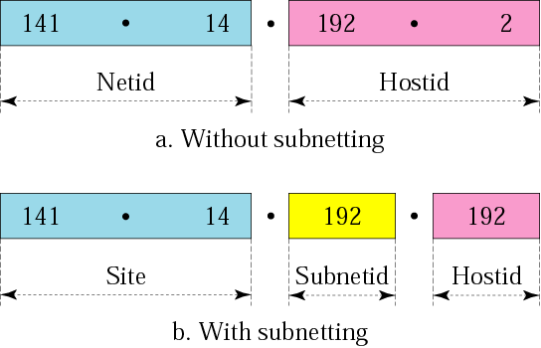
Addresses in a network with
and without subnetting

Slide 25
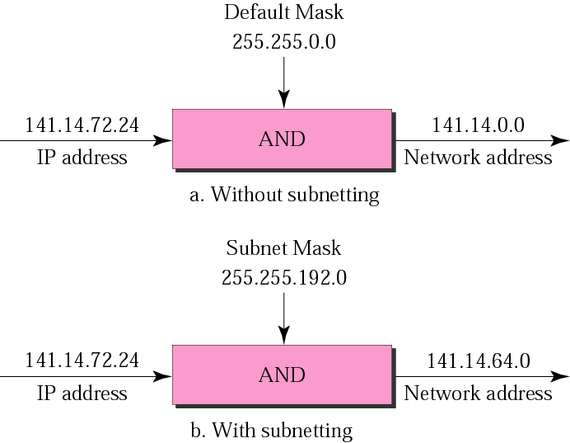
Default mask and subnet mask

Slide 26
Finding the Subnet Address
Given an IP address, we can find the subnet address the same way we found the network address. We apply the mask to the address. We can do this in two ways: straight or short-cut.

Slide 27
Finding the Subnet Address
Straight Method
In the straight method, we use binary notation for both the address and the mask and then apply the AND operation to find the subnet address.

Slide 28
Example 1
What is the subnetwork address if the destination address is 200.45.34.56 and the subnet mask is 255.255.240.0?

Slide 29
Solution
11001000 00101101 00100010 00111000
11111111 11111111 11110000 00000000
11001000 00101101 00100000 00000000
The subnetwork address is 200.45.32.0.

Slide 30
Short-Cut Method
    ** If the byte in the mask is 255, copy the byte in the address.
    ** If the byte in the mask is 0, replace the byte in the address with 0.
    ** If the byte in the mask is neither 255 nor 0, we write the mask and the address in binary and apply the AND operation.

Slide 31
Example 2
What is the subnetwork address if the destination address is 19.30.80.5 and the mask is 255.255.192.0?
Solution

Slide 32
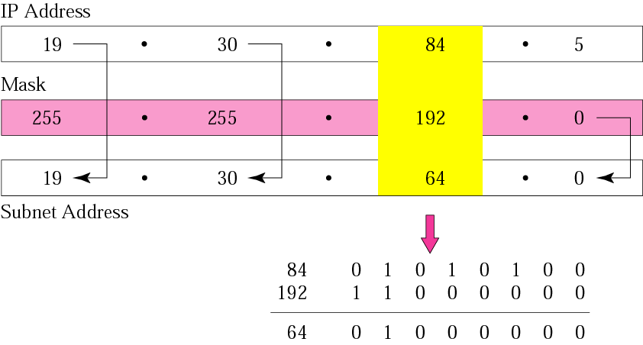

Slide 33
The number of subnets must be
a power of 2.

Slide 34
A company is granted the site address 201.70.64.0 (class C). The company needs six subnets. Design the subnets.
Solution
The number of 1s in the default
mask is 24 (class C).

Slide 35
Solution (Continued)
The company needs six subnets. This number 6 is not a power of 2. The next number that is a power of 2 is 8 (2³). We need 3 more 1s in the subnet mask. The total number of 1s in the subnet mask is 27 (24 + 3).
The total number of 0s is 5 (32 − 27). The mask is

Slide 36
Solution (Continued)
11111111 11111111 11111111 11100000
or
255.255.255.224
    The number of subnets is 8.
    The number of addresses in each subnet is 2⁵ (5 is the number of 0s) or 32.
See Figure 5.8

Slide 37
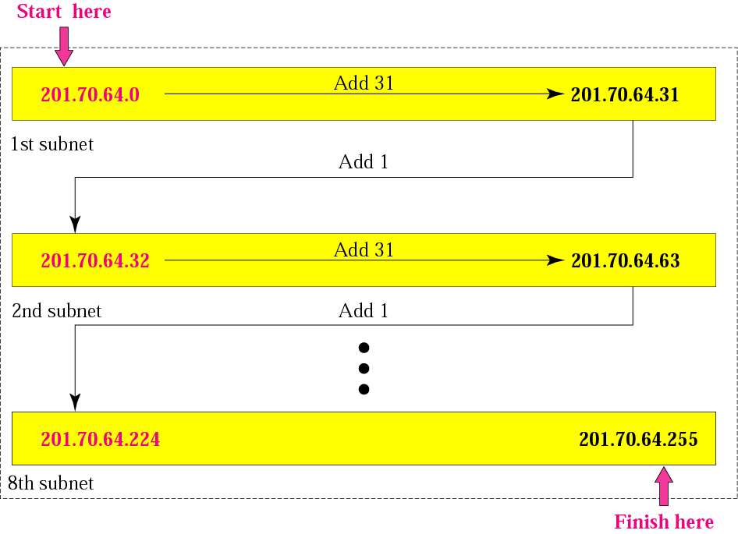

Slide 38
Example 4
A company is granted the site address 181.56.0.0 (class B). The company needs 1000 subnets. Design the subnets.
Solution
The number of 1s in the default mask is 16 (class B).

Slide 39
Solution (Continued)
The company needs 1000 subnets. This number is not a power of 2. The next number that is a power of 2 is 1024 (2¹⁰). We need 10 more 1s in the subnet mask.
The total number of 1s in the subnet mask is 26 (16 + 10).
The total number of 0s is 6 (32 − 26).

Slide 40
Solution (Continued)
The mask is
11111111 11111111 11111111 11000000
or
255.255.255.192.
The number of subnets is 1024.
The number of addresses in each subnet is 2⁶ (6 is the number of 0s) or 64.
See Figure 5.9

Slide 41
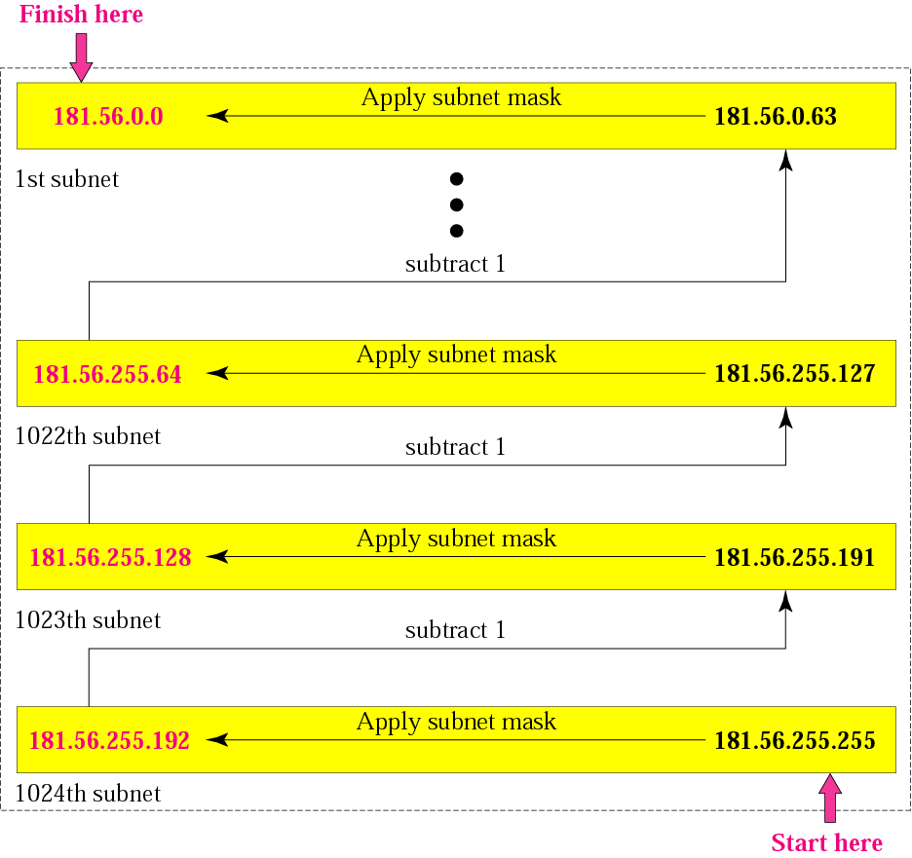

Slide 42
Example 14
An organization is granted the block 130.34.12.64/26. The organization needs to have four subnets. What are the subnet addresses and the range of addresses for each subnet?
Solution
The suffix length is 6. This means the total number of addresses in the block is 64 (2⁶). If we create four subnets, each subnet will have 16 addresses.

Slide 43
Solution (Continued)
Let us first find the subnet prefix (subnet mask). We need four subnets, which means we need to add two more 1s to the site prefix. The subnet prefix is then /28.
Subnet 1: 130.34.12.64/28 to 130.34.12.79/28.
Subnet 2 : 130.34.12.80/28 to 130.34.12.95/28.
Subnet 3: 130.34.12.96/28 to 130.34.12.111/28.
Subnet 4: 130.34.12.112/28 to 130.34.12.127/28.

Slide 44
An ISP is granted a block of addresses starting with 190.100.0.0/16. The ISP needs to distribute these addresses to three groups of customers as follows:
1. The first group has 64 customers; each needs 256 addresses.
2. The second group has 128 customers; each needs 128 addresses.
3. The third group has 128 customers; each needs 64 addresses.
Design the subblocks and give the slash notation for each subblock. Find out how many addresses are still available after these allocations.

Slide 45
Solution
Group 1
For this group, each customer needs 256 addresses. This means the suffix length is 8 (2⁸ = 256). The prefix length is then 32 − 8 = 24.
01: 190.100.0.0/24  ➔190.100.0.255/24
02: 190.100.1.0/24 ➔190.100.1.255/24
…………………………………..
64: 190.100.63.0/24➔190.100.63.255/24
Total = 64 × 256 = 16,384

Slide 46
Solution (Continued)
Group 2
For this group, each customer needs 128 addresses. This means the suffix length is 7 (2⁷ = 128). The prefix length is then 32 − 7 = 25. The addresses are:
001: 190.100.64.0/25 ➔190.100.64.127/25
002: 190.100.64.128/25 ➔190.100.64.255/25
003: 190.100.127.128/25 ➔190.100.127.255/25
Total = 128 × 128 = 16,384

Slide 47
Solution (Continued)
Group 3
For this group, each customer needs 64 addresses. This means the suffix length is 6 (2⁶ = 64). The prefix length is then 32 − 6 = 26.
001:190.100.128.0/26 ➔190.100.128.63/26
002:190.100.128.64/26 ➔190.100.128.127/26
…………………………
128:190.100.159.192/26 ➔190.100.159.255/26
Total = 128 × 64 = 8,192

