Slide 1


Air Wiremind:
Data-Driven Performance Analysis
Assignment: AI Product Owner Intern - Wiremind

Slide 2
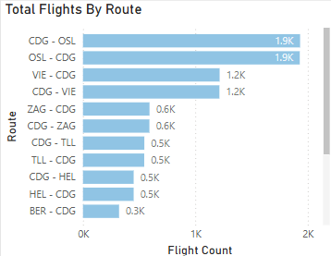
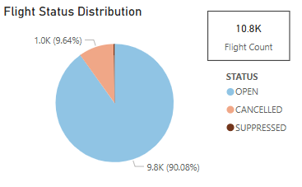
Descriptive Analysis
The airline majorly operates between CDG and OSL, with roughly 3,800 flights scheduled from October 2023 to October 2024. The second most frequent route is between CDG and VIE, summing around 2,400 flights.
The total number of flights was approximately 10.8K between October 2023 and October 2024. Of these, around 9.8K flights (~90.1%) operated successfully, and about 1K flights (~9.6%) were cancelled. This shows a poor operational performance. This issue is worsening, as the cancellation rate for future scheduled flights is even higher.

Slide 3
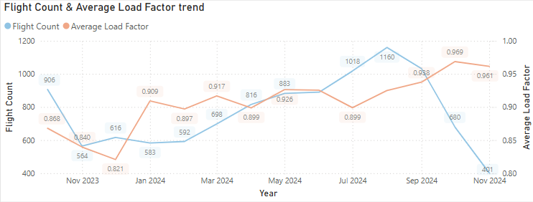
Descriptive Analysis
We can see spikes in summer (July/August) and drop during winters, this tells. airline's seasonal demand trend.
We can tell how well their capacity planning (Flight Count) matches the market’s demand (Load Factor) for each route (after filtering).
What this graph tells:
  FlightCount increases, and LoadFactor also increases: Airline is successfully adding capacity to a strong market.
  FlightCount increases, but LoadFactor starts to drop: This is a warning sign. It means the airline is adding flights faster than it can fill them.
  FlightCount is flat, but LoadFactor is very high: There are unmet demand, and the airline might have to add more flights.

Slide 4
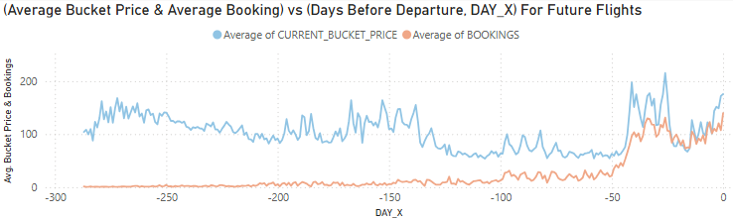
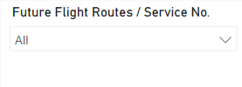
Descriptive Analysis
This chart is built using the future flights data (pre-departure, DAY_X < 1). It's important to note that this is a cross-sectional analysis, averaging many different flights. This data makes more sense for the single flight bucket price and booking evolution. Use this filter:
It can be seen that the prices are moderately high initially for DAY_X from roughly -300 to -150, which is meant to capture early planners. Following this, from about -150 to -50, there’s a price dip to allure leisure travellers and boost demand. The final ramp up from -50 to 0 is evident in the chart, as the flight fills up and departure nears, causing inventory to become scarce. This trend suggest dynamic pricing strategy, showing industry best practices.

Slide 5
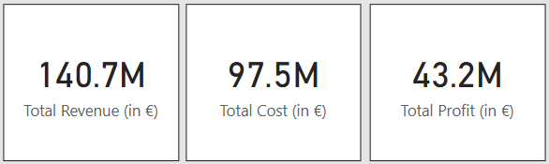
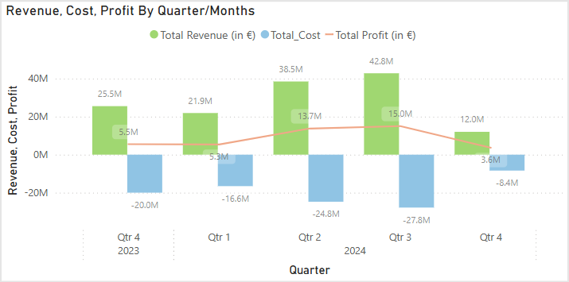
Financial Performance Analysis
Over the period from October 2023 to October 2024, the airlines generated €91.0M in profit on €188.5M in revenue.
The performance is peaks in the summer months (i.e., Q2 and Q3), suggesting strong seasonal cycle.

Slide 6
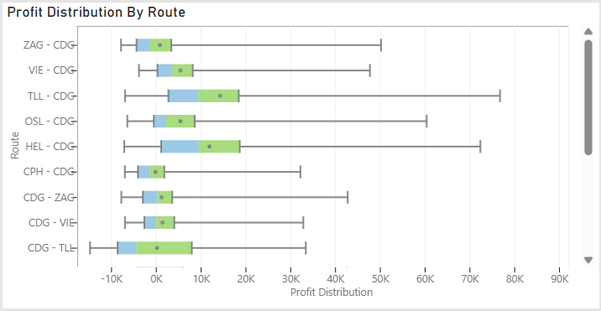
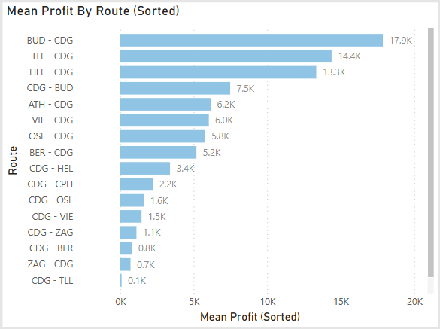
Financial Performance Analysis
From the charts above, it is evident the route that are high profit and low risk, are as follows:
  BUD - CDG (€17.9K), TLL - CDG (€14.4K), HEL - CDG (€13.3K) are exceptionally high performers. However, the number of flights in this route sums to 1.1K, which is very less.
  CDG – TLL (€0.1K, and the profit is very volatile), CPH – CDG (- €0.3K) are the worst performers.

Slide 7
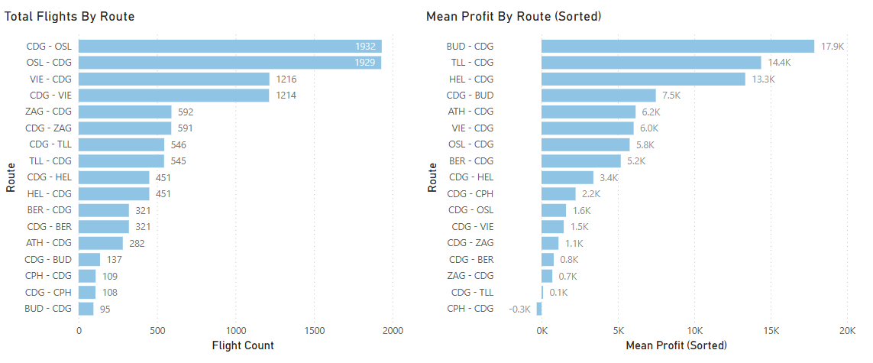
Insights
First of all, it is a priority to protect the route with high profit and act on potential growth.
One important thing to note is that there is an inverse relationship between flight frequency and profit per flight. There could be two possibilities I can think of:
  Demand low, Competition low: There is not much demand, but the demand that exist is high quality and willing to pay high or maybe the competition is low, making Air Wiremind to command higher prices
  Demand high, Competition high: There is demand but low quality. A competitor might be winning the volume by throwing low prices.

Slide 8
Recommendations
High-frequency routes (CDG-OSL, CDG-VIE and vice versa) are very vital, likely generating the most total profit. Maintain this market and operational efficiency in these route.
Low-frequency, high-margin routes (BUD-CDG, TLL-CDG) are extremely profitable per flight. Evaluate the business case (scenario) cautiously for adding more flights.
Carry out pricing and cost review for the bottom routes. If a route cannot be made profitable, it becomes meaningless to operate on the route. The idea is to raise the breakeven point.
There is poor operational performance which is evident from high cancellation rate (~ 10%), which is way worse than the industry standards. It is essential to identify the root causes as it leads to lost revenue.

Slide 9
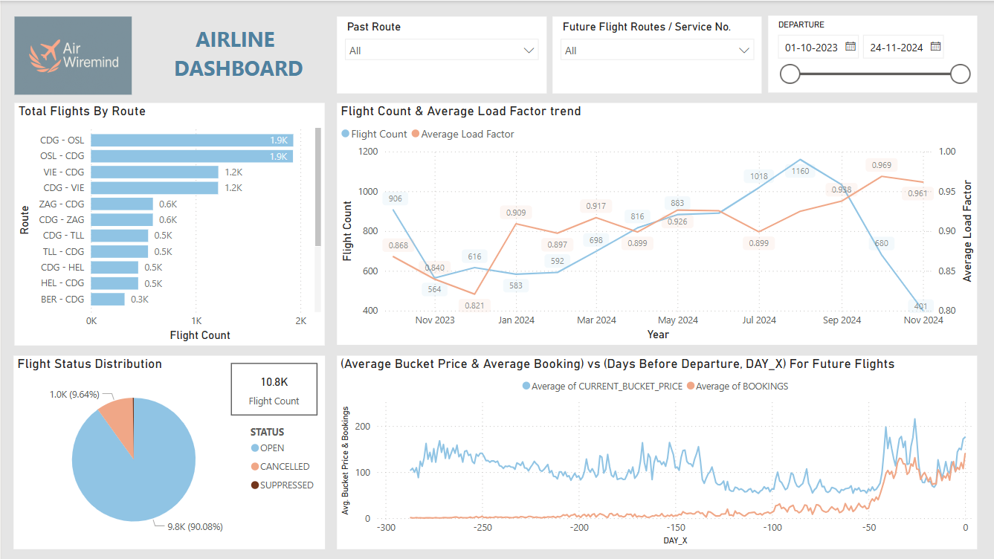
Recommendations

Slide 10
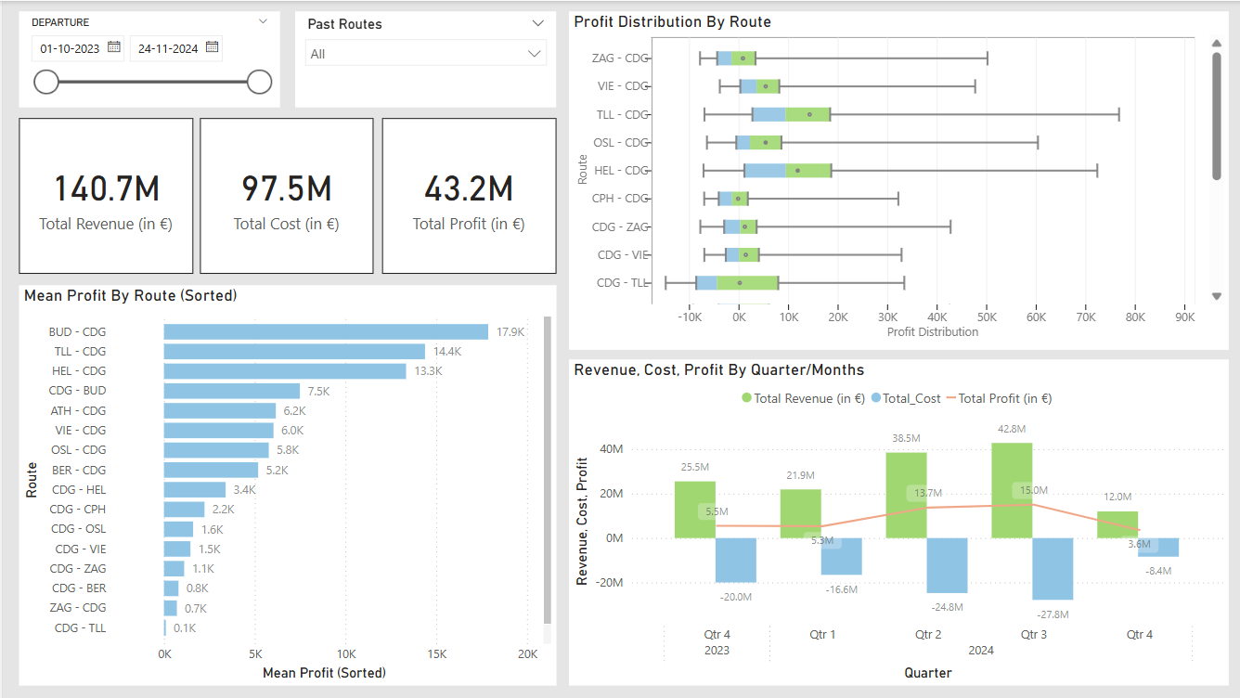

Slide 11
THANK
YOU

