Slide 1

E – COMMERCE ANALYTICS

Slide 2
Objective
To study and understand the E-Commerce Data Sets of Olist Store.
Clean and prepare a Data Model using the multiple sources of Data provided.
Analyse the data using various Key Performance Indicators.
Prepare visual reports using interactive analytical tools :
Excel
Power BI
Tableau
MySQL
Provide insights & Suggestions based on the visual reports.
Recommend strategies to potentially enhance the overall performance of the store.

Slide 3
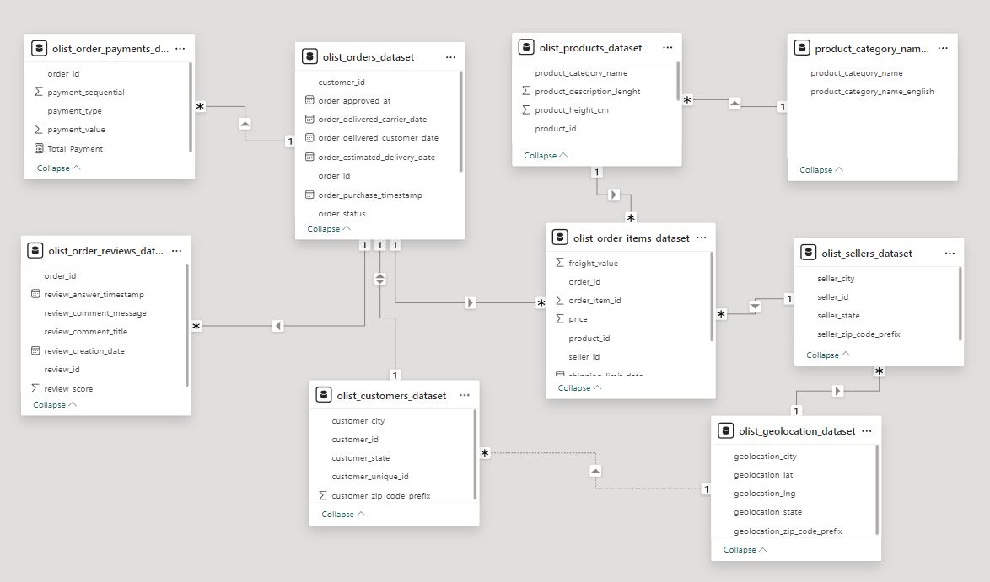
Data Model

Slide 4
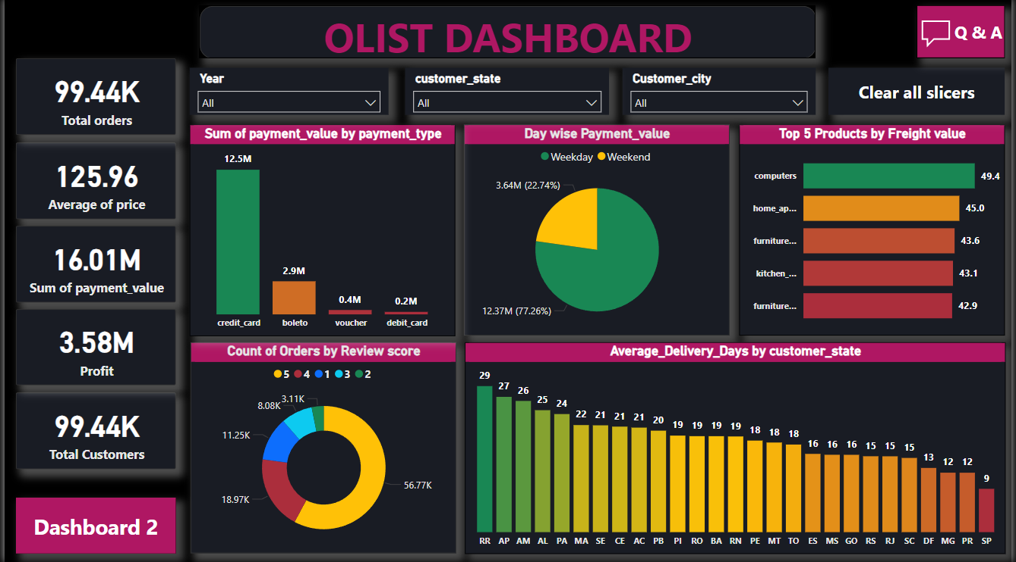
Dashboard

Slide 5
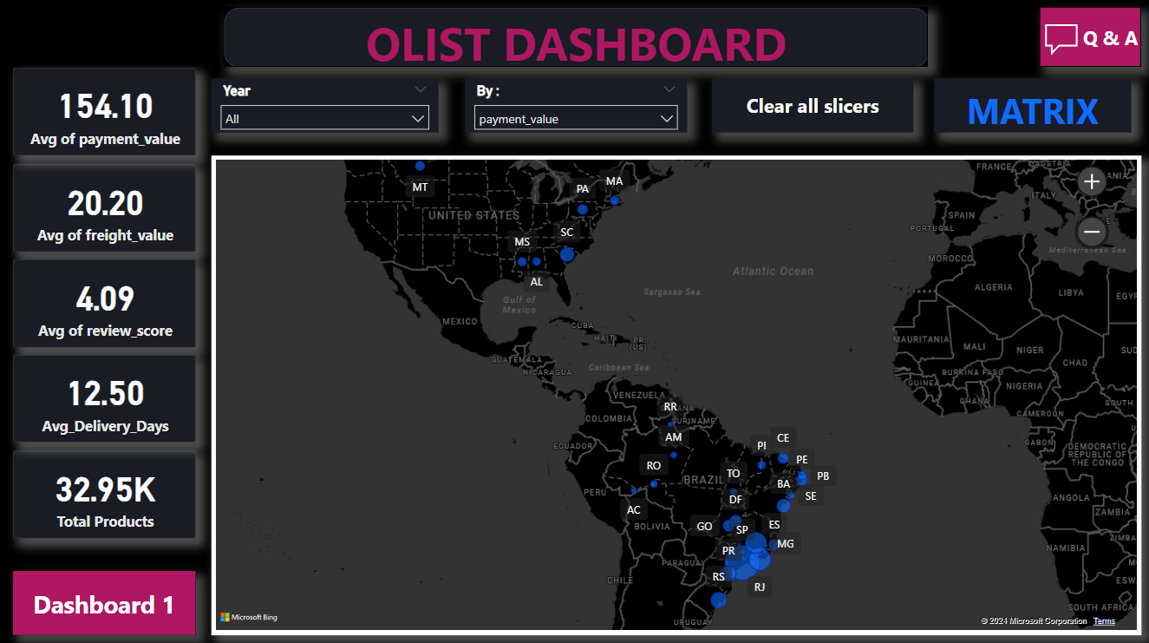
Dashboard

Slide 6
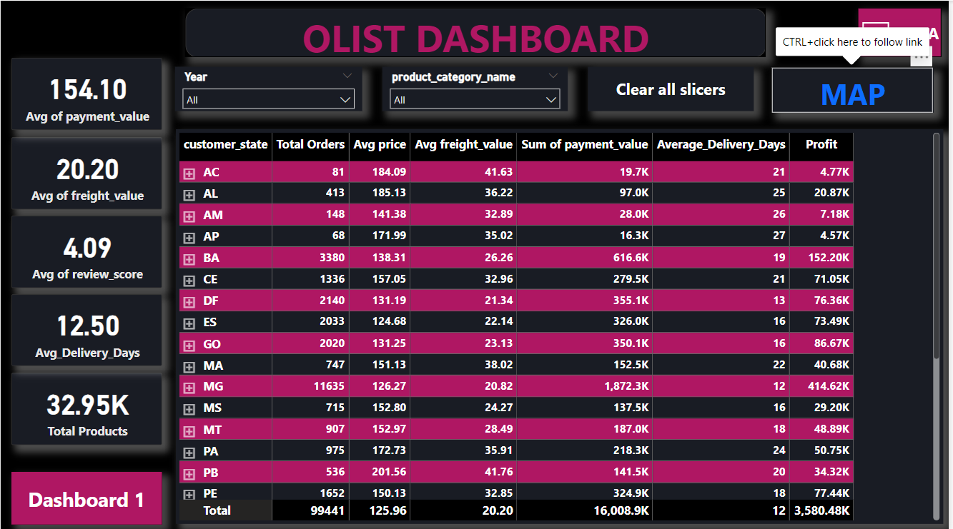
Dashboard

Slide 7
Card Indicators
Total Number of Orders
Total Revenue Generated
Total Profit Accumulated
Total Payment Value
Total Number of Customers
Total Number of Products
Average Payment Value per Order
Average Price Amount per Order
Average Review Score per Order
Average Days to Delivery per Order
Average Freight Amount per Order
Total Products

Slide 8
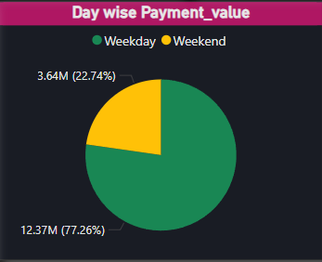
Key Performance Indicators
Revenue Generated by Day Type ( Weekend / Weekday )
The Revenue generated on all days of a week
Monday – R$ 2.6 M
Tuesday – R$ 2.6 M
Wednesday – R$ 2.5 M
Thursday – R$ 2.4 M
Friday – R$ 2.3 M
Saturday – R$ 1.9 M
Sunday – R$ 1.8 M

Slide 9
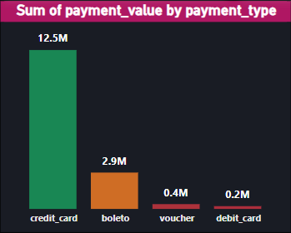
Key Performance Indicators
Payment Value by Payment Type
Payment made with credit card has the highest payment compared to other payment modes.
Credit card (Highest) – R$ 12.5 M
Debit card (Lowest) – R$ 0.2 M

Slide 10
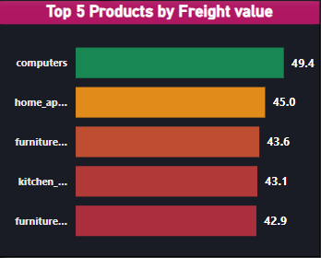
Key Performance Indicators
Freight value based on Top 5 Product Category
Computers– R$ 49.4
Home appliances 2– R$ 45
Furniture Bedroom– R$ 43.6
﻿Kitchen dining laundry garden furniture - R$ 43.1
Furniture Mattress and upholstery - R$ 42.9

Slide 11
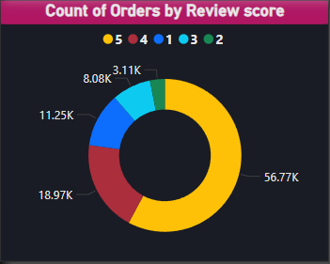
Key Performance Indicators
Number of Orders by Review Score
Score 1 : 11.25 K orders
Score 2 : 3.11 K orders
Score 3 : 8.08 K orders
Score 4 : 18.97 K orders
Score 5 : 56.77 K orders

Slide 12
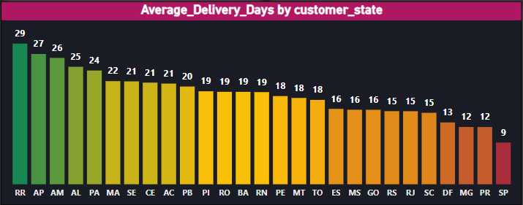
Key Performance Indicators
Average Days to Delivery by Customer State
The overall average delivery day is 12 days

Slide 13
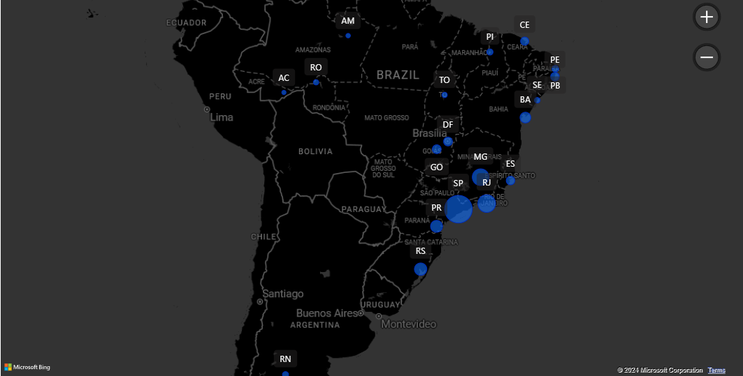
Key Performance Indicators
Payment value by Customer state

Slide 14
Insights & Suggestions
The Top Preferred Payment Options based on Order Volume are Credit cards with 75% of the Orders, followed by the country’s local payment option, Boleto with 20% of the Orders suggesting a need for the businesses to prioritize seamless transaction experiences.
The Top Performing Product Categories based on Order Volume are Bed Bath Table with 10 % of the Orders followed by Health Beauty with 9% of the Orders, and Sports Leisure with 8% of the Orders. Retailers should focus on optimizing inventory and marketing strategies to capitalize on this demand.
The city of Sao Paulo has the highest Average Payment and Average Price Values compared to other cities. Businesses should consider designing strategies and product offerings to profit from the higher purchasing power in the city.
The State of Sao Paulo has the highest order volume with 42% of the Orders followed by Rio de Janeiro and Minas Gerais amounting to 25% of the Orders.

Slide 15
Insights & Suggestions
The Average Days to Delivery has significantly decreased by 87% between September 2016 and August 2018. This indicates an improvement in logistics and fulfillment processes, enhancing customer satisfaction and retention.
The significant increase in Orders from 2016 to 2018 reflects a thriving e-commerce landscape, presenting opportunities for businesses to expand their market presence and invest in the growing online retail sector.
The Product Categories like Sports Leisure, Toys, Houseware, Health Beauty, and Auto have 400 sellers each on an average. Sellers can also procure more inventory for products of Computer Accessories, Furniture Décor as these have higher order volumes compared to Auto, Toys, and Houseware which would help increase the profits while decreasing the days to delivery.

Slide 16
Recommendations
Based on the Analytical Insights, we would recommend the following strategies :
Implement targeted Marketing Campaigns to capitalize on the popularity of top-selling categories and regions.
Explore Partnerships or Incentives to encourage increased usage of credit cards or other preferred payment methods.
Offer Promotions to drive weekend sales and balance the distribution of payment value throughout the week.
Invest in technology and infrastructure to streamline order processing, improve delivery times, and enhance overall customer experience.
Continuously monitor customer feedback and satisfaction metrics to identify areas for improvement and maintain high-quality service standards.

Slide 17
Thank you !!

