Slide 1
Reliance Industries Stock Price Prediction

Slide 2
Project Flow:
Kick off and Business Objective discussion
Data set Details
Exploratory Data Analysis (EDA)
Model Building
Model Evaluation
Deployment/Final presentation

Slide 3
Business Problem:
Objective:
Predict the Reliance Industries Stock Price for the next 30 days. This includes:
Obtaining Open, High, Low, and Close prices from 2014 to 2024 for Reliance Industries stock.
Splitting the last year into a test set to build a model to predict stock prices.
Finding short-term and long-term trends.
Understanding the impact of external factors or significant external events.
Forecasting for the next 30 days.

Slide 4
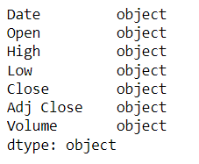
Understanding the data
Data Source: finance.yahoo.com/quote/RELIANCE.NS/history
Description:
Historical stock prices from 2014 to 2024.
Variables: Date, Open, High, Low, Close, Adj Close, Volume.
Key Points:
There are total 7 features available in the dataset all 7 features are object data type. The data types will be converted to their correct form in data cleaning part.
‘Volume’ feature has some missing values which will be taken care of in data cleaning.

Slide 5
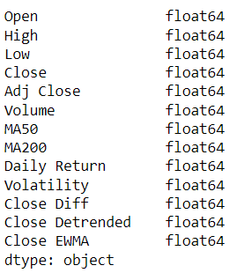
Feature engineering and data cleaning:
Converting date column from object data type to date-time(Date-month-year format) data type.
Setting the date column as index and converting the index frequency to “B” i.e. Business day
Removing the commas in the dataset.
Converting all object columns to numeric.
Filled the missing values of ‘Volume’ by using the mean value.
Created 7 new features from existing features.
All the features (MA50, MA200, Daily Return, Close Diff, Close Detrended and Close EWMA) except Volatility are created by using the ‘Close’ feature.
Volatility feature is created by using the ‘Daily Return’ feature.

Slide 6
EDA

Slide 7
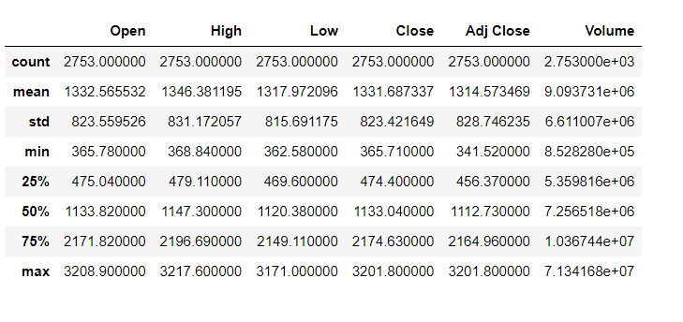
Descriptive statistics:
The average values for Open, High, Low, and Close are relatively close, indicating that the stock price doesn't fluctuate wildly on a daily basis.
Volume has a standard deviation of around 6.6 million, suggesting that trading activity can vary significantly from day to day.
The stock price has a wide range from around 365 to over 3200, indicating substantial growth or fluctuations over the period covered.
The close proximity of the mean, median (50th percentile), and other percentiles suggests a relatively symmetric distribution of prices, though the higher max values indicate occasional large jumps in price.

Slide 8
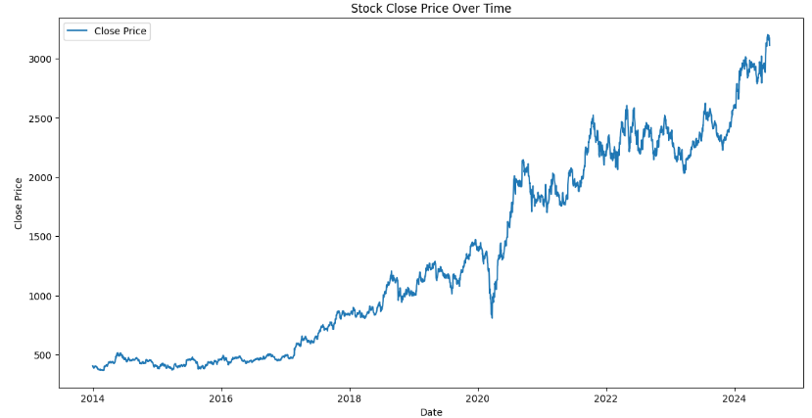
Line Plot:
Trend: The stock price has experienced a significant upward trend from 2014 to 2024, with noticeable growth starting around 2017. The price shows several peaks and troughs, reflecting periods of volatility.

Slide 9
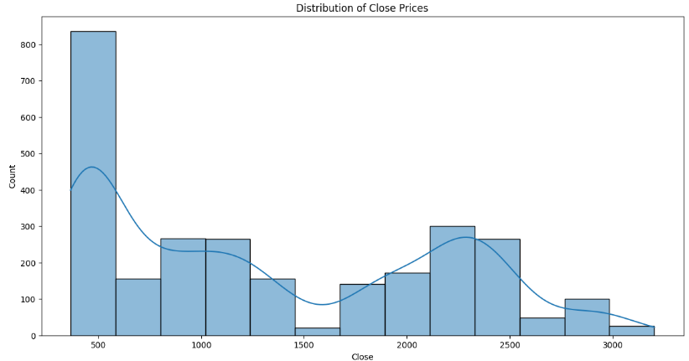
Histogram:
Distribution Shape: The histogram of the stock's closing prices is right-skewed, with a large concentration of values around the lower price ranges (500-1000).

Slide 10
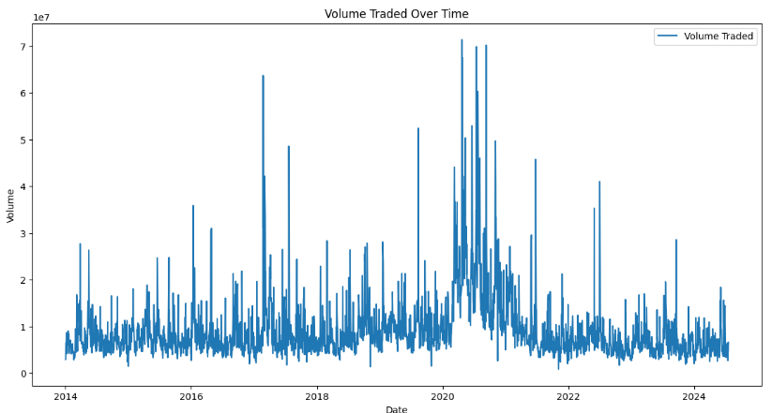
Volume Traded Over Time:
Volume Fluctuations: The traded volume shows significant spikes, particularly around 2017 to 2020, suggesting periods of high trading activity.

Slide 11
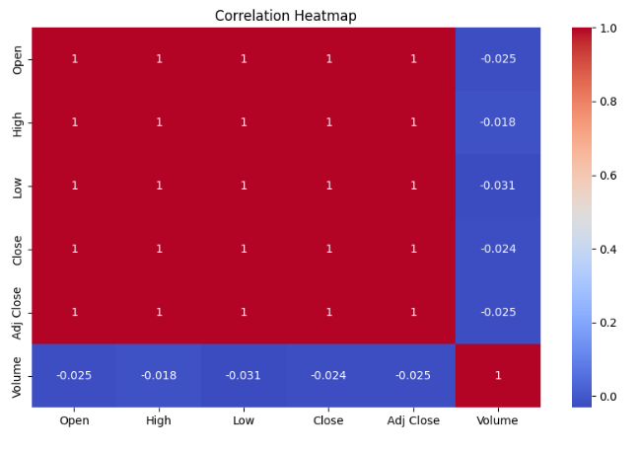
Correlation Heatmap:
Correlation Heatmap: Price variables are perfectly correlated, while Volume shows little to no correlation with price variables.

Slide 12
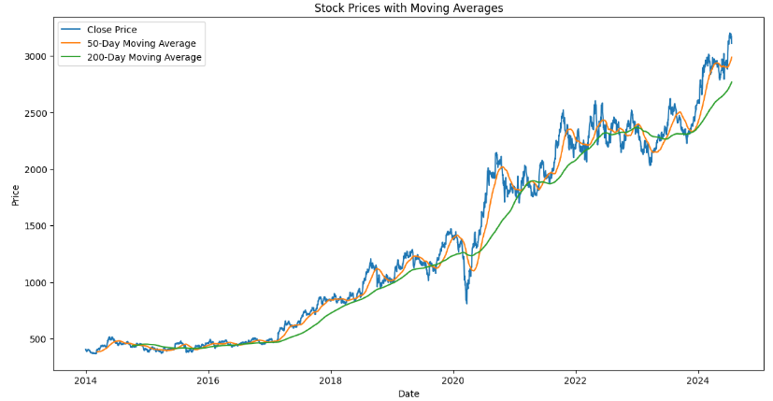
Time Series Analysis:
Stock Prices with Moving Averages: The stock has shown a consistent upward trend over the years, with short-term fluctuations captured by moving averages.

Slide 13
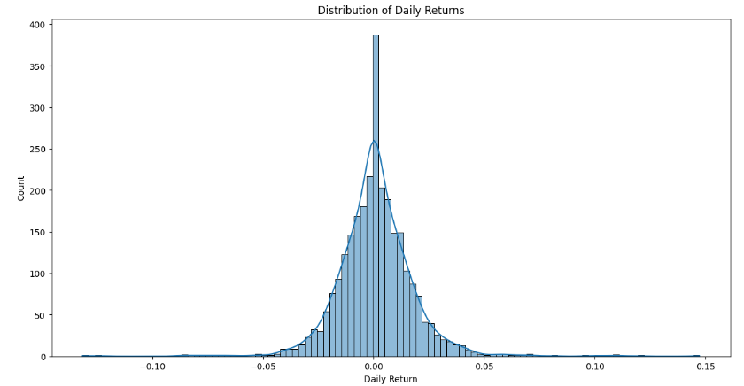
Distribution of Daily Returns:
Distribution of Daily Returns: Daily returns are mostly centered around zero, with occasional larger positive and negative swings.

Slide 14
Data Pre-processing

Slide 15
Data Pre-processing:
Performing some test like Augmented Dickey-Fuller (ADF) test, KPSS test and ACF and PACF Analysis to check whether the data is stationary or not.
To make the data stationary performing both Differencing and Detrending method on “Close” feature and selecting the method that gives stationary data.
Performing Phillips-Perron test, ACF and PACF Analysis to confirm again if the data is stationary or not.
Splitting the data into training and test sets:
Training set range: 2014-01-01 to 2023-07-18
Test set range: 2023-07-19 to 2024-07-19

Slide 16

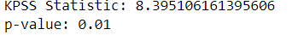
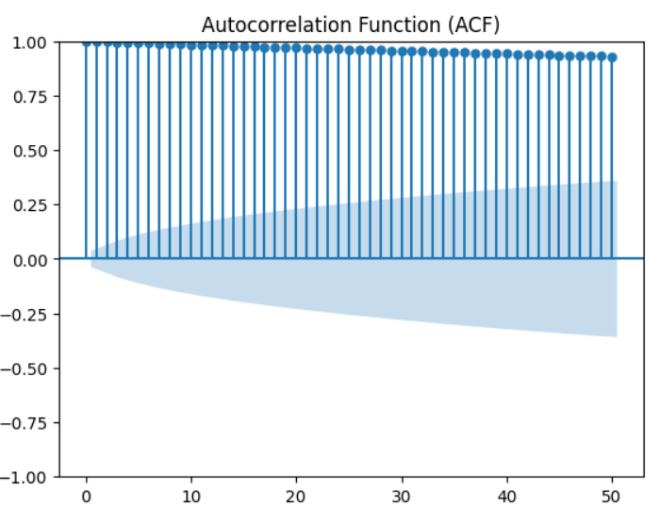
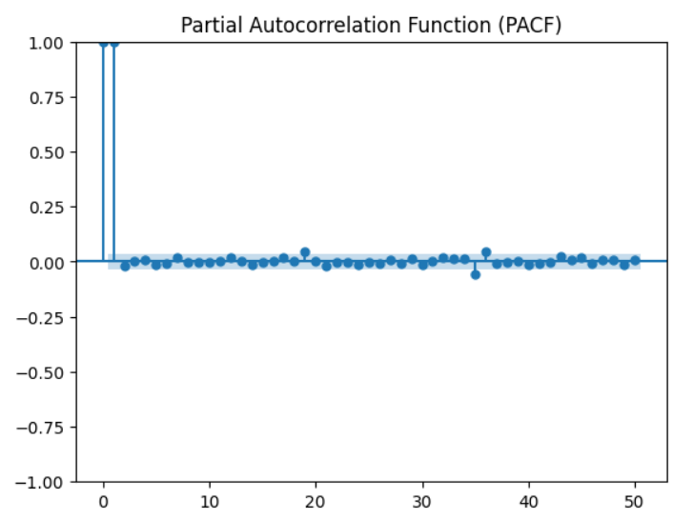
Before Differencing:
The high p-value (> 0.05) suggests that the null hypothesis (that the series has a unit root and is non-stationary) cannot be rejected. This indicates the series is likely non-stationary.
KPSS test checks for stationarity against a null hypothesis that the series is stationary. A very low p-value suggests rejecting the null hypothesis, indicating non-stationarity.
Pattern: Slow decay: Indicates a non-stationary series.

Slide 17
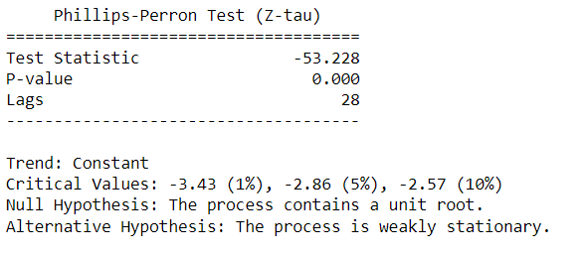
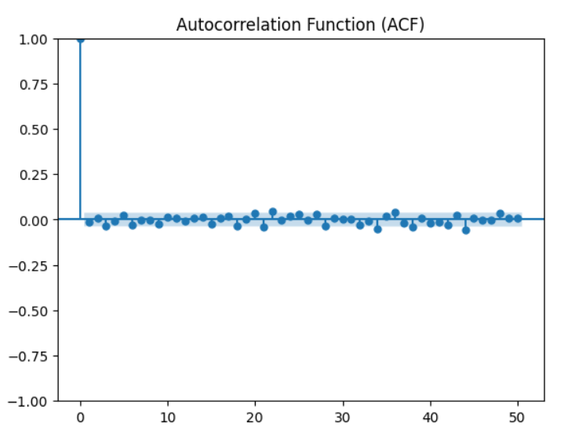
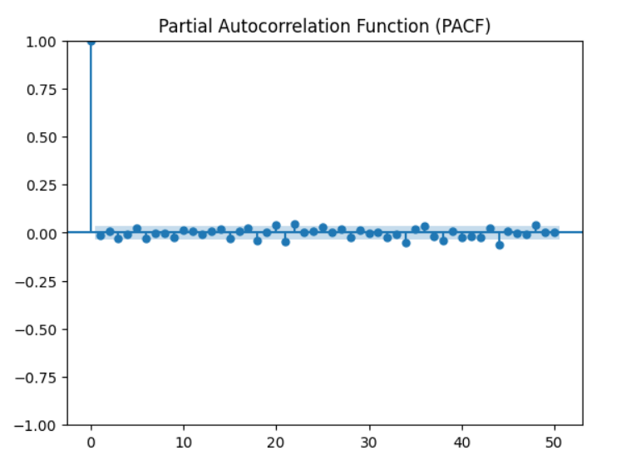
After Differencing:
Given the test statistic (-53.228) is much smaller than the critical values at all standard significance levels (1%, 5%, 10%), and the p-value is effectively zero, you can reject the null hypothesis. This means there is strong evidence that the time series is stationary.
Pattern: Sharp drop-off: Indicates a stationary series.

Slide 18
Overall Insights and information

Slide 19
Overall Insights and information:
Consistent Upward Trend (2014-2024): The stock has shown a strong and consistent upward trend, with significant growth starting around 2017 and reaching its highest value in 2024.
Volatility Spikes Around 2020: There was a significant increase in volatility around 2020, likely due to the COVID-19 pandemic, with sustained higher volatility levels post-2020, reflecting ongoing market uncertainty.
High Trading Volume (2017-2020): Significant spikes in trading volume were observed between 2017 and 2020, which often corresponded with major price movements, indicating periods of heightened market interest.
Strong Correlation Among Price Variables: All price-related variables (Open, High, Low, Close, Adj Close) are perfectly correlated, while Volume shows a slight negative correlation with these price variables.
Distribution of Daily Returns: Daily returns are mostly centered around zero with occasional large swings, indicating a mix of stability and periods of significant market reactions.
Moving Averages Indicating Trend Stability: The 50-day and 200-day moving averages highlight short-term fluctuations and long-term trend stability, respectively, reinforcing the overall upward trend of the stock.
Differenced Close Price Indicates Increased Volatility: After 2018, the differenced close prices show increased volatility with larger fluctuations, suggesting higher market uncertainty or stronger reactions to market events.
SARIMAX Model Insights: The SARIMAX model shows significant autoregressive and moving average components, capturing the influence of past prices and errors, with a notable seasonal component reflecting monthly patterns in stock prices.

Slide 20
Model Building

Slide 21
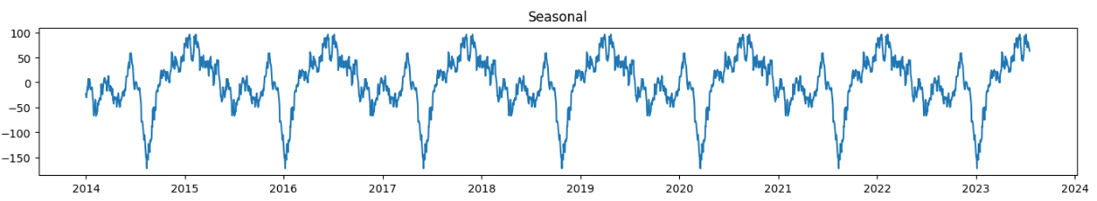
Model Building:
Models Explored:
ARIMA and SARIMAX
Final Model Choice:
Used decomposition method on the data to get trends, pattern and seasonality and since the data shows strong seasonality I will directly go for SARIMAX model.

Slide 22

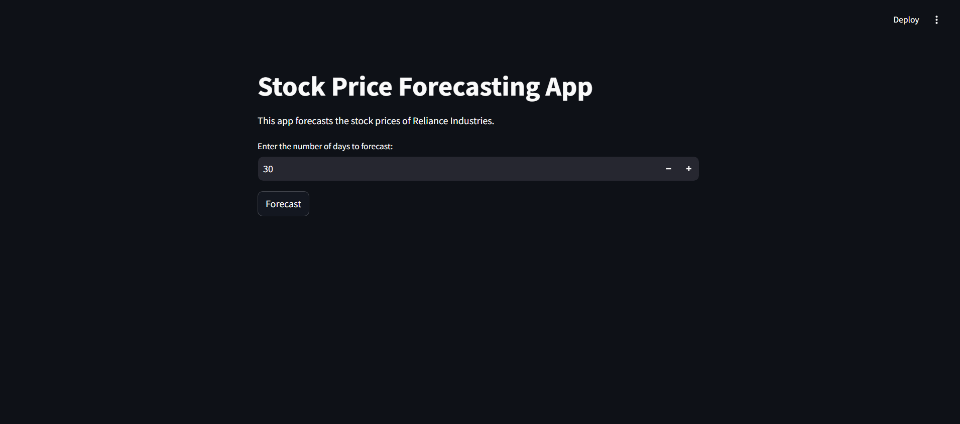
Model deployment using streamlit: Screenshots:

Slide 23
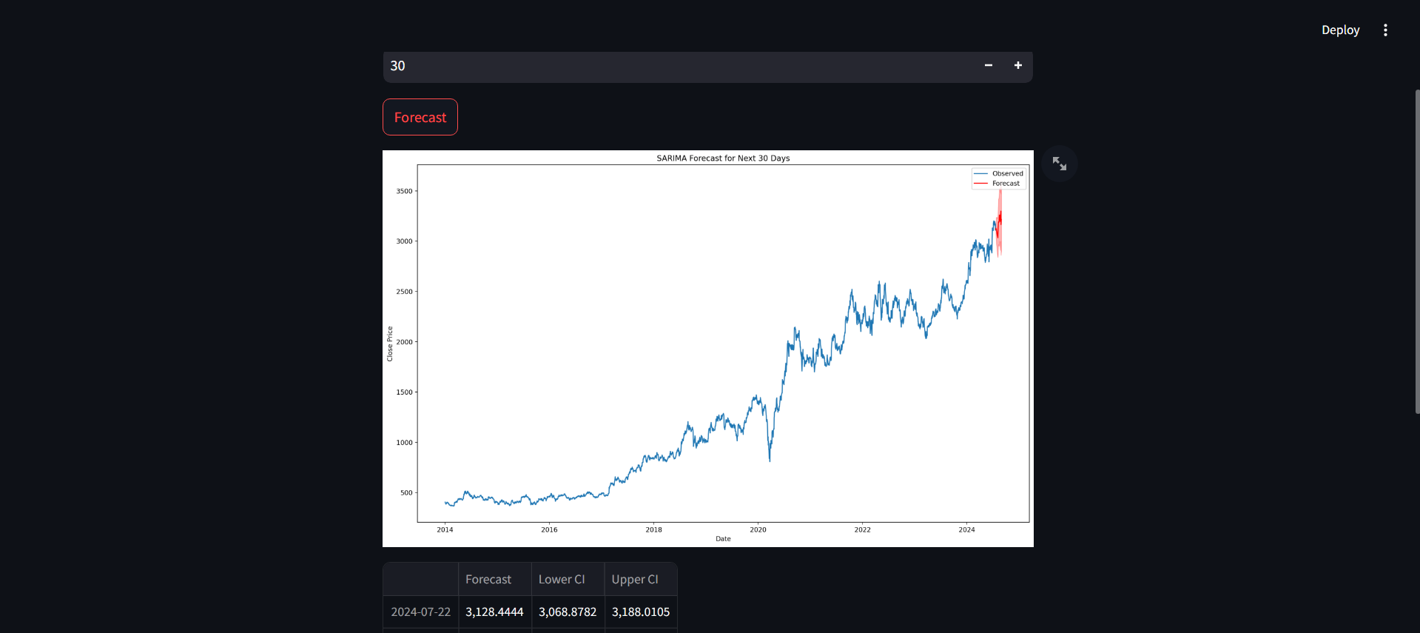

Slide 24
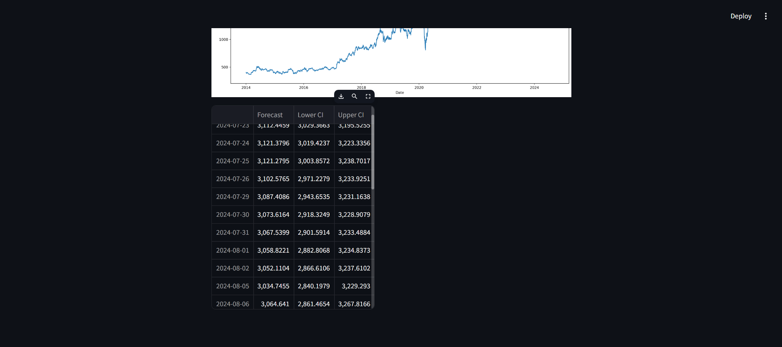

Slide 25
Challenges faced during project:
Data Stationary issues:
The data was initially non-stationary, which posed a challenge for time series modeling. Extensive pre-processing was needed, including tests like ADF, KPSS, and Phillips-Perron, and transformations such as differencing and detrending.
Volatility and External Events:
The stock price data showed significant volatility, especially around the COVID-19 pandemic in 2020, which made it difficult to model consistent patterns.
Understanding and accounting for the impact of external events on stock prices was challenging due to the complex and unpredictable nature of such events.
Model Selection and Tuning:
Selecting the appropriate model (SARIMAX) that could effectively capture the seasonality and trends in the data was challenging.
Balancing model complexity with forecasting accuracy required careful consideration, especially when dealing with residual heteroskedasticity.
Real-Time Prediction and Automation:
Implementing real-time prediction and automation posed technical challenges, especially in ensuring that the forecasting pipeline could handle real-time data without significant lag.

Slide 26
Conclusion and Future work

Slide 27
Conclusion:
Strong Upward Trend: Over the past decade, the stock has demonstrated a robust upward trend, particularly from 2017 onwards, reflecting substantial growth and potential bullish market conditions.
Volatility and Market Events: Significant spikes in volatility were observed around 2020, likely due to major market events like the COVID-19 pandemic. This period also saw increased trading activity, which corresponds to the fluctuations in stock prices.
Price and Volume Correlation: Price-related variables are strongly correlated, while trading volume shows a slight negative correlation, indicating that high trading activity does not necessarily drive price increases.
Predictive Modeling: The SARIMAX model captured key seasonal and autoregressive patterns, providing a reasonable framework for forecasting future stock prices despite the challenges posed by heteroskedasticity in the residuals.

Slide 28
Future work:
Model Refinement: Explore more complex predictive models, such as deep learning-based approaches (e.g., LSTM or GRU networks), to potentially improve forecasting accuracy, especially in capturing non-linear patterns.
Automation and Real-Time Prediction: Implement real-time data processing and automated forecasting pipelines to provide up-to-date predictions and insights for timely decision-making in dynamic market conditions.

Slide 29
Thank You

