Slide 1
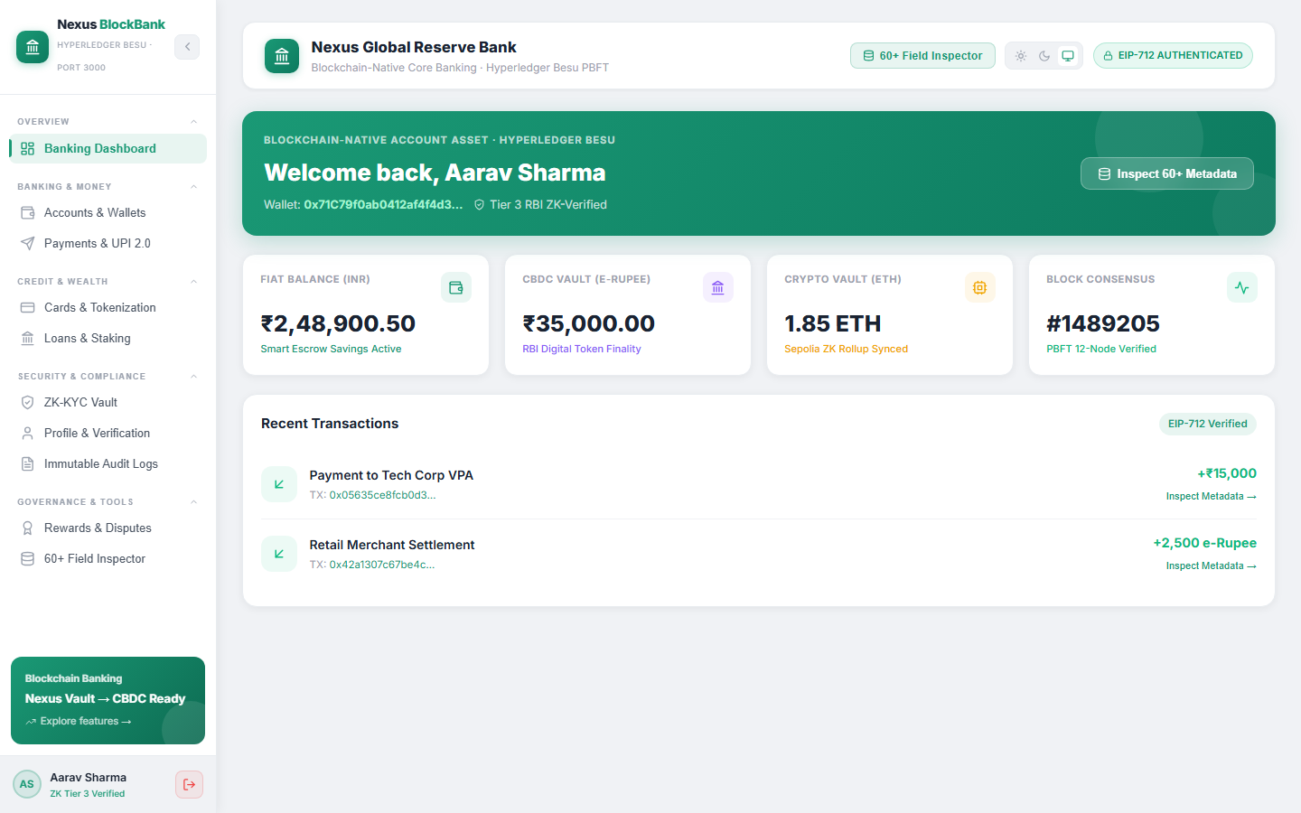
THE TRUST LEDGER
FRONT PAGE / TRUST INFRASTRUCTURE
NEXUS BLOCKBANK / PAGE 01
SPECIAL EDITION
Banking that knows
the human, not just
the password.
Nexus BlockBank adds a continuous trust layer to everyday banking—so sensitive actions are checked, explained and recorded in real time.
REAL MVP SCREEN / CUSTOMER PORTAL / PORT 3000
<15 ms
4 / 4
■ INSIDE
Live trust scores. Step-up controls. Dual-portal governance. Proofs for every critical action.
REPOSITORY DEMO TARGET FOR TRUST EVALUATION
AUTOMATED TEST SUITES PASSED LOCALLY
PRASHANT / PROJECT LEAD & CORE DEVELOPER

Slide 2
THE TRUST LEDGER
PROBLEM STATEMENT / WHY NOW
NEXUS BLOCKBANK / PAGE 02
PROBLEM STATEMENT
A valid login can still become
a dangerous banking session.
THE RISK BEGINS
AFTER LOGIN.
01
LOGIN ≠ TRUST
02
SILOED CONTROLS
03
WEAK EVIDENCE
Passwords and one-time checks cannot judge every transfer, device change or high-risk action.
Customer banking, fraud review and regulator oversight often live in separate tools.
A blocked action without clear reasons creates disputes, slow reviews and audit friction.
IMPACT CHAIN
STOLEN OR SHIFTING SESSION
→
UNUSUAL ACTION LOOKS VALID
→
FRAUD OR FALSE BLOCK
→
LOSS + AUDIT BURDEN
THE REAL QUESTION: DOES THIS ACTION STILL LOOK SAFE—RIGHT NOW?

Slide 3
THE TRUST LEDGER
SOLUTION / CONTINUOUS TRUST
NEXUS BLOCKBANK / PAGE 03
SOLUTION
One trust decision for every sensitive action.
Nexus BlockBank quietly reads context, scores risk, takes the least disruptive action and leaves an explainable proof.
1 READ SIGNALS
2 SCORE TRUST
3 CHOOSE ACTION
4 RECORD PROOF
Behavior 35%
Device 35%
Context 30%
→
0–100 live score
Reason codes
Session-aware
→
Allow
Step-up
Restrict / revoke
→
Audit event + SHA-256 proof hash + transaction metadata
THE DIFFERENTIATOR
Authentication is no longer an entry gate. It becomes a continuous, evidence-based conversation with every banking action.
LOW FRICTION FOR GENUINE USERS
CONTINUOUS TRUST / EXPLAINABLE ACTION / AUDITABLE PROOF

Slide 4
THE TRUST LEDGER
MVP / CUSTOMER EXPERIENCE
NEXUS BLOCKBANK / PAGE 04
WORKING PROTOTYPE
The trust layer stays quiet—
until risk appears.
A familiar banking dashboard covers money movement, identity and proof without forcing users into a separate security tool.
EVERYDAY BANKING
Accounts · UPI · cards · loans
IDENTITY
ZK-KYC vault · profile verification
TRANSPARENCY
Trust badge · immutable audit logs
REAL SCREENSHOT / CLIENT PORTAL / PORT 3000
WHEN RISK RISES: STEP-UP VERIFICATION APPEARS. WHEN TRUST RETURNS: BANKING CONTINUES.

Slide 5
THE TRUST LEDGER
TECHNOLOGY / DECISION LOGIC
NEXUS BLOCKBANK / PAGE 05
TRUST ENGINE
Three signals. Four safe outcomes.
The rules are intentionally simple enough to explain to a customer, investigator or regulator.
80–100
ALLOW
Low risk
Known device + strong signals
WHAT THE ENGINE EXPLAINS
50–79.9
STEP UP
Medium risk
Ask for extra proof
01 KNOWN ATTESTED DEVICE
02 UNUSUAL IP OR TIME
0–49.9
RESTRICT
High risk
Pause the sensitive action
03 ANOMALOUS BEHAVIOR
04 SESSION TAKEOVER RISK
REVOKED
REVOKE
Admin override
Freeze access immediately
Code-backed weights: behavior 35% · device 35% · context 30%.
CLEAR THRESHOLDS MAKE THE PROTOTYPE TESTABLE TODAY—AND TUNABLE WITH REAL DATA LATER.

Slide 6
THE TRUST LEDGER
ARCHITECTURE / BUILT TO INTEGRATE
NEXUS BLOCKBANK / PAGE 06
ARCHITECTURE
A trust layer around the bank—not a replacement for it.
REST handles banking actions. WebSockets stream live trust. Portal isolation keeps customer and regulator privileges separate.
CLIENT PORTAL
FASTAPI CORE
TRUST ENGINE
PROOF LAYER
⇄
⇄
⇄
React · Vite
Port 3000
REST + WebSocket
Port 8000
Weighted score
Reasoned action
SHA-256 records
Besu / Sepolia model
↗
CENTRAL BANK GOVERNANCE
PROTOTYPE BOUNDARY
Separate React portal · Port 3001
Validator health · AML · KYC review · revocation · audit
Current state is in-memory and blockchain data is simulated. Production requires durable encrypted storage, managed secrets, rate limits and real node connectivity.
DESIGNED FOR INTEGRATION / EXPLICITLY LABELED AS A HACKATHON DEMO

Slide 7
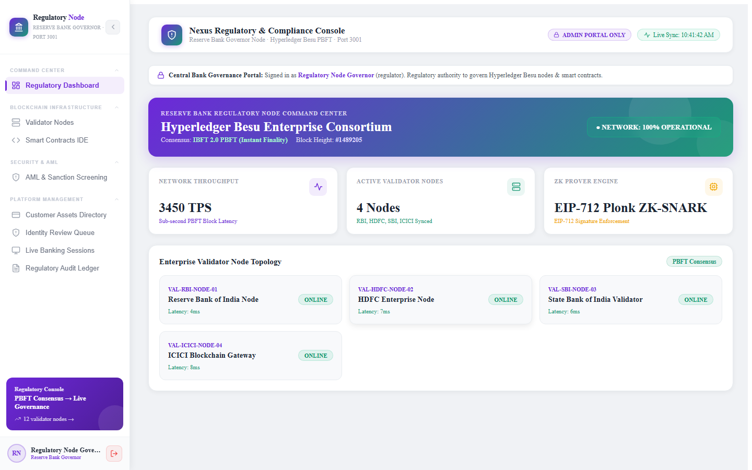
THE TRUST LEDGER
GOVERNANCE / DUAL-PORTAL CONTROL
NEXUS BLOCKBANK / PAGE 07
REGULATOR VIEW
Customers bank. Regulators govern.
The roles never blur.
A separate command center gives authorized teams visibility and intervention without exposing controls to customers.
VALIDATORS
AML + KYC
Node health + consensus
Alerts + review queue
REVOCATION
AUDIT
Freeze credentials
Trace every decision
REAL SCREENSHOT / GOVERNANCE PORTAL / PORT 3001
AUTHORIZATION IS AN ARCHITECTURAL BOUNDARY—NOT JUST A MENU ITEM.

Slide 8
THE TRUST LEDGER
INNOVATION / MEANINGFUL DIFFERENCE
NEXUS BLOCKBANK / PAGE 08
INNOVATION
Not another banking app. A missing trust layer.
The advantage is not one feature—it is the way identity, action and evidence stay connected.
COMPARISON
CONVENTIONAL DIGITAL BANKING
NEXUS BLOCKBANK
WHEN TRUST IS CHECKED
At login
Continuously during the session
HOW RISK IS HANDLED
Generic block or alert
Allow · step-up · restrict · revoke
WHAT THE TEAM SEES
A score without context
Reason codes + action history
WHO CONTROLS WHAT
Shared operational surface
Isolated customer and regulator portals
WHAT GETS RECORDED
Mutable application log
Hash-backed proof record in the prototype
DIFFERENTIATOR: TRUST FOLLOWS THE ACTION—AND THE EVIDENCE FOLLOWS THE TRUST.

Slide 9
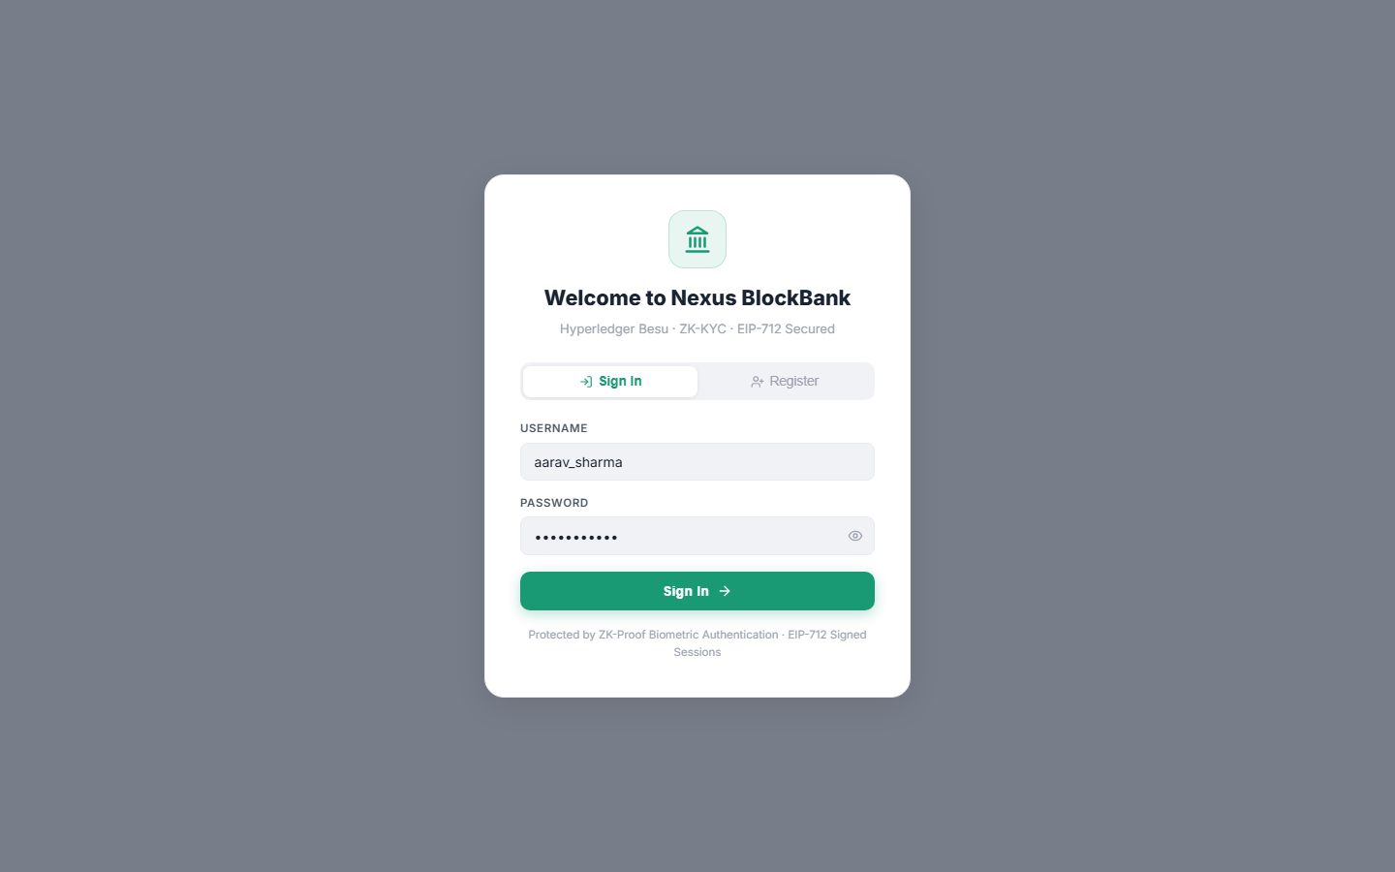
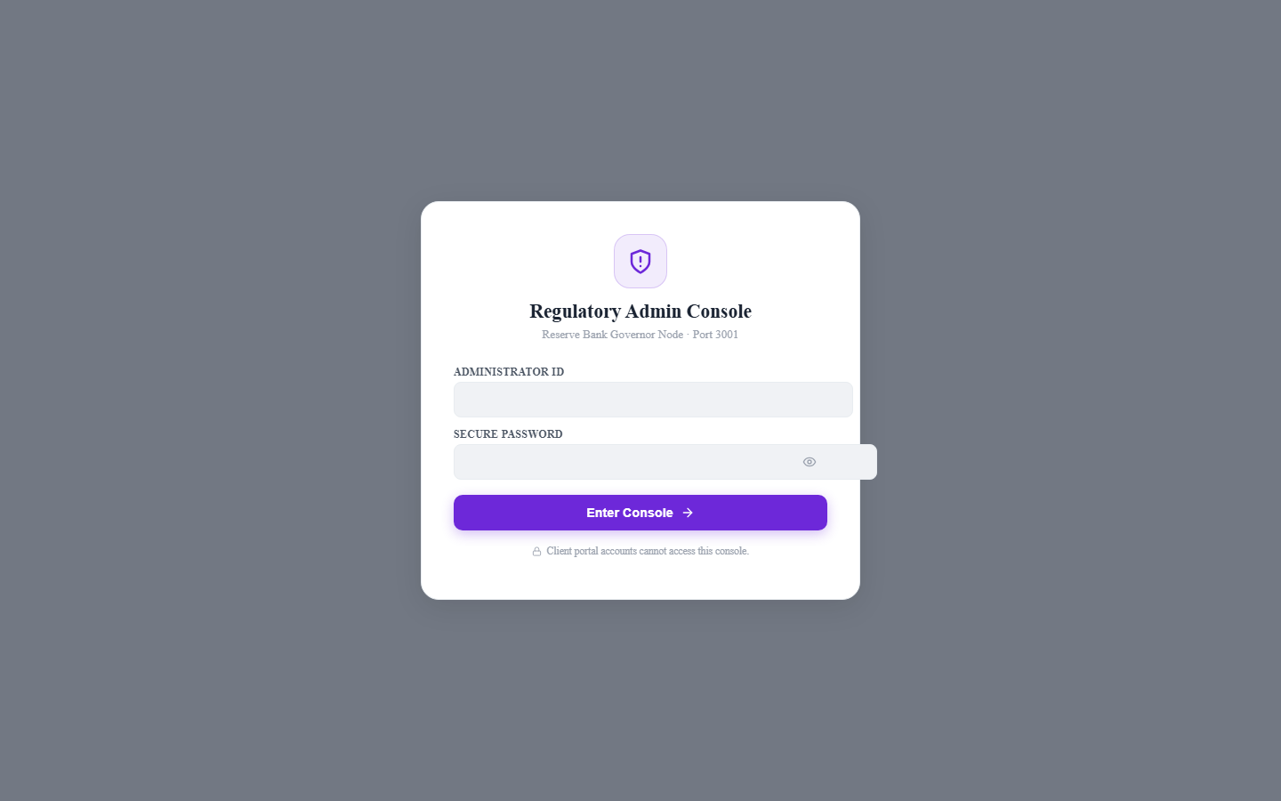
THE TRUST LEDGER
MVP EVIDENCE / WHAT WORKS TODAY
NEXUS BLOCKBANK / PAGE 09
DEMO EVIDENCE
Two live portals. One tested backend.
The repository runs as a public hackathon demonstration with real screens, authenticated flows and role isolation.
4 / 4
AUTOMATED SUITES PASSED
Authenticated customer flow
Admin / customer isolation
Anonymous-access rejection
Transaction input validation
<15 ms
84 ms
3,450
4
TRUST EVALUATION
P95 FINALITY
TPS MODEL
VALIDATOR NODES
HONEST LABEL: PERFORMANCE, THROUGHPUT AND BLOCKCHAIN FIGURES ARE REPOSITORY DEMO TARGETS—NOT PRODUCTION BENCHMARKS.

Slide 10
THE TRUST LEDGER
FEASIBILITY / PATH TO DEPLOYMENT
NEXUS BLOCKBANK / PAGE 10
FEASIBILITY
Start beside the bank. Prove value. Then integrate.
The lowest-risk rollout begins as a decision layer for selected sensitive actions—not a core-banking replacement.
NOW
NEXT
SCALE
HACKATHON DEMO
CONTROLLED PILOT
ENTERPRISE ROLLOUT
Local three-service stack
In-memory state
Simulated proofs
→
Durable database
KMS + rate limits
One bank workflow
→
Managed observability
Real node connectivity
Recovery + compliance
₹0 LOCAL INFRA
₹25K–₹75K / MONTH*
LOAD-PRICED
DEPLOYMENT GATES
01 Encrypted durable storage
02 Signed wallet nonce
03 Rate limits + lockout
04 Load / recovery / security tests
*Indicative small-pilot cloud estimate; validate after load testing and vendor selection.
FEASIBLE BECAUSE THE INTEGRATION SURFACE IS SMALL AND THE DECISION LOGIC IS EXPLICIT

Slide 11
THE TRUST LEDGER
IMPACT / SUCCESS METRICS
NEXUS BLOCKBANK / PAGE 11
IMPACT
Safer actions. Fewer false alarms. Faster answers.
The pilot should be judged by measurable outcomes—not by blockchain vocabulary.
<100 ms
100%
−30%
DECISION LATENCY
REASON-CODE COVERAGE
MANUAL REVIEW TARGET
Keep security invisible in the customer journey.
Every sensitive decision has an explanation.
Use step-up evidence to reduce avoidable investigations.
ROADMAP
01
CALIBRATE
02
PILOT
03
CONNECT
04
EXPAND
Real anonymized session data
→
One sensitive banking workflow
→
Durable ledger + real node
→
Cross-bank trust portability
PROPOSED PILOT KPIs—TO BE VALIDATED WITH REAL BANK TRAFFIC.

Slide 12
THE TRUST LEDGER
THE CLOSING ARGUMENT
LIVE DECISION PATH
Trust every action.
Not just every login.
BEHAVIOR
→
TRUST
CORE
DEVICE
→
SCORE + REASONS
CONTEXT
→
Nexus BlockBank makes digital banking safer without making it feel harder.
↑ ACTION + EVIDENCE
ALLOW
STEP-UP
DEMO READY
Client 3000 · API 8000 · Admin 3001
Prashant / Project Lead & Core Developer
RESTRICT
PROOF
REAL SYSTEM FLOW. CLEAR DECISIONS. AUDITABLE OUTPUT.

