Slide 1
Raspberry Pi
Raspberry Pi (v1.0) by Prashant Gonarkar is licensed under a
Creative Commons Attribution-NonCommercial 2.5 India License

Slide 2
Introduction
What is it ?
It's a credit-card sized computer that plugs into your moniter & keyboard. It’s capable little PC which can be used for many of the things that your desktop PC does.
Open Source Hardware.!!
Developed by the Raspberry Pi Foundation
in United Kingdom

Slide 3
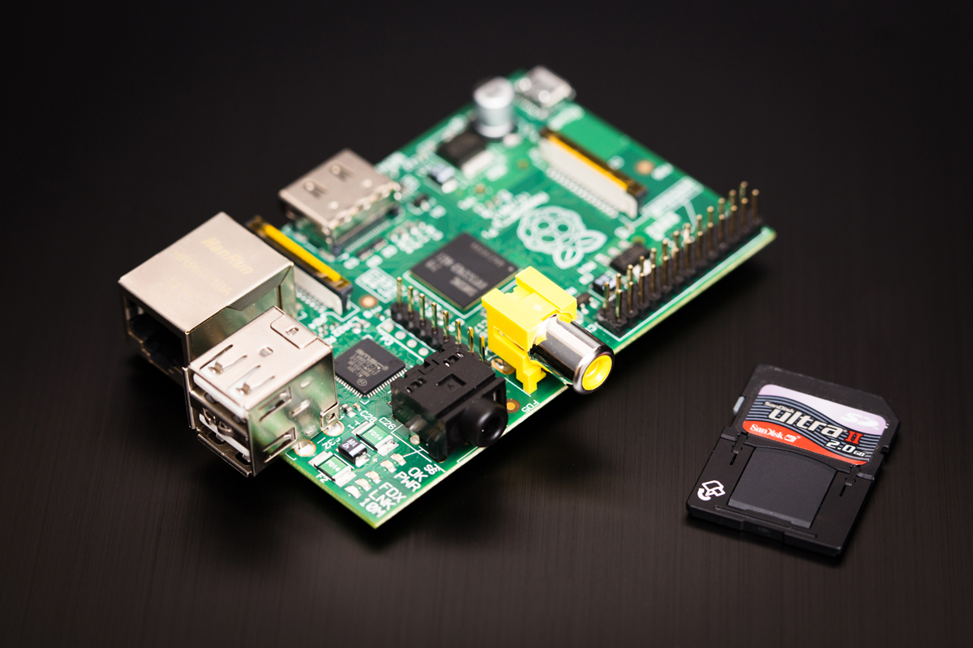

Slide 4
Where did it come from
It was desgined to inspire new generation of children to become programmars.
Students are good at using computers & fondling touch screens, but computer scientists are worried that our kids are not learning to be creative with programming. Instead, they use software developed by others.

Slide 5
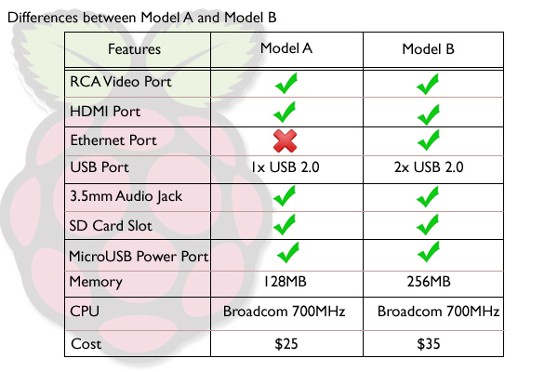
Features
Most important cost – 25$ (2500 india)
Runs linux operating system e.g raspian,debian wheezy,

Slide 6
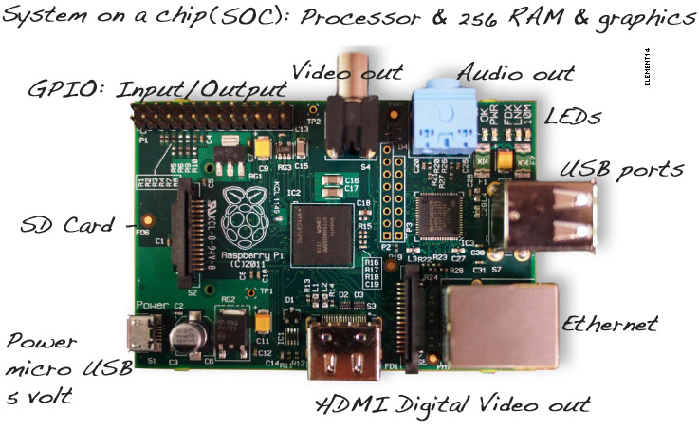
Let's have a look

Slide 7
What you can do with it ?
You have 700MHz arm processor,256 MB ram, 32 GB hard disk with 2 usb and 1 RJ45
Unlimited possibilites .....
You can make own server,tablet,embedded system, automation device, private dropbox.

Slide 8
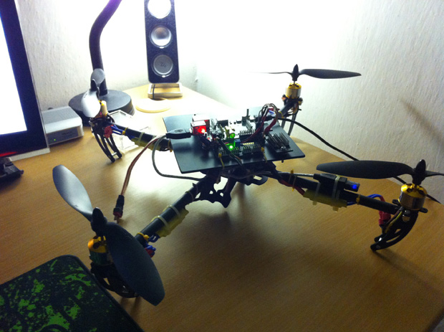
Building robots

Slide 9
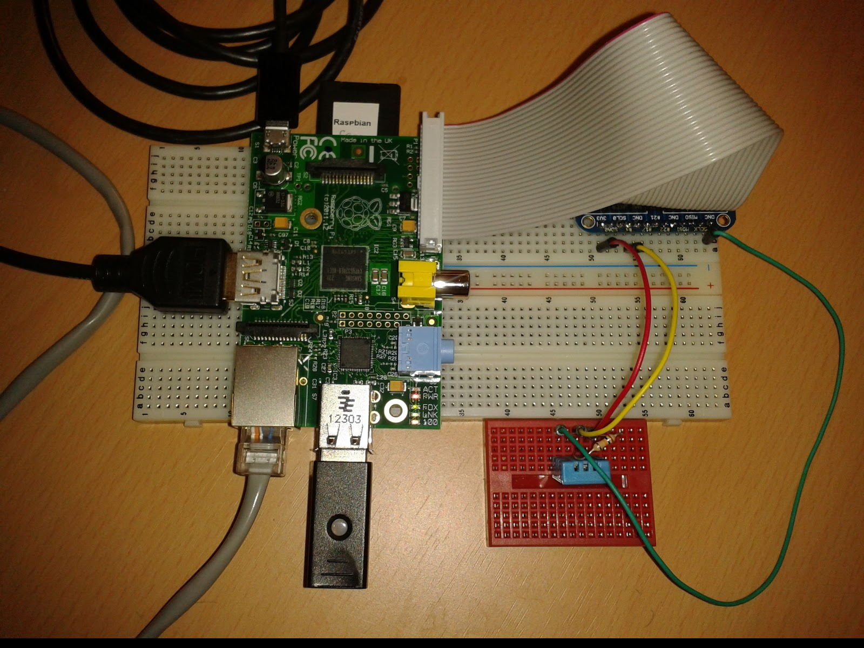
Temperature sensor

Slide 10
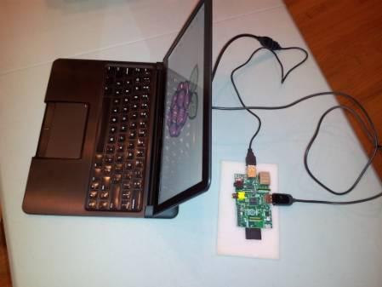
Building a laptop

Slide 11
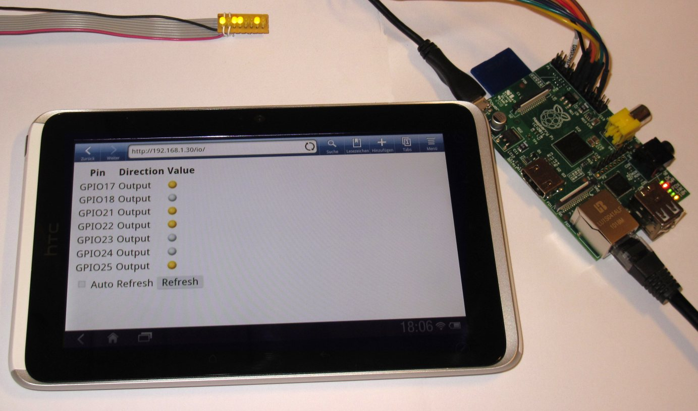
Tablet form Raspberry Pi

Slide 12
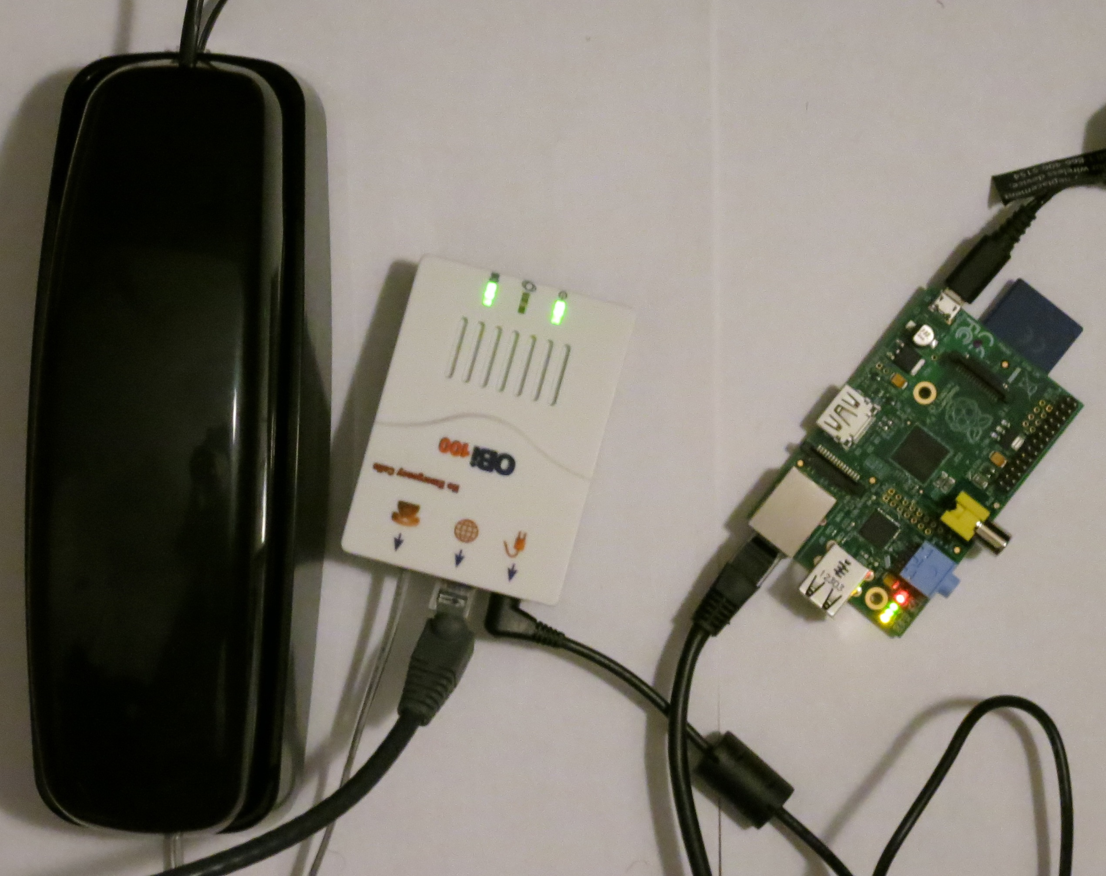
Home automation

Slide 13

Reception & Success
Raspberry Pi won T3 "Innovation of the Year" award
Raspbrry Pi was awarded Greates British Future innovation award
2 million copies are sold

Slide 14
Demo
Let's have Demo of Raspberry Pi with qemu

Slide 15
Thank You
Any Questions..?

Slide 16
References
http://www.raspberrypi.org/phpBB3/viewtopic.php?t=16081
http://www.topbritishinnovations.org/FutureInnovations/RaspberryPi.aspx
Www.arm.com/v117/processor
Www.qemu.org/raspberry_pi.html
Www.howtogeek.com/raspberry_pi_config.html
ARM Processor architecture paper - James alan[1999]

