Slide 2
Locking
Xv6 is multiprocessor OS.
Protecting important data structures need locks
Void acquire(struct spinlock *lk){
    for (;;)
      if(ll->locked == 0){
        lk->locked = 1;
        break;
        }
        }
Xv6 relies on special atomic intruction xchg(started from 80386) which swaps the vaule

Slide 3
xchg
For example, the x86 xchg %eax, addr instruction does the following:
freeze other CPUs' memory activity for address addr
temp := *addr
*addr := %eax
%eax = temp
un-freeze other memory activity

Slide 4
Modularity
F(){ g(){
lock on data x; lock on data x;
g(); }
..... }
Sol: recurssive lock
Not ideal transperant solution, The programmar must arrange funtions s.t. They don't invoke fun g while holding a lock that f needs.

Slide 5
Using locks
Locks reduce parallelism.
If efficiency wasn't imp, then one could go for uniprocessor system & don't worry about locks.
For protecting kernel DS, it's sufficient to create a big lock that must be acquired while entering the kernel.
Many uniprocessor system, used this approach while convering to multiprocessor system, but this sacrifices concurrency.
Xv6 have few coarse DS specific locks, e.g it uses a lock for protecting the process table & its invariants.
A fine approach will be entry specific lock in process table so that other thread working on different entry in process table can be proceed in parallel.

Slide 6
Interrupt Handlers
Example: iderw locks on idelock and got interrupted to run ideintr which want a lock on idelock --deadlock--
Xv6 follows conservative approach “never holds any lock with interrupts enabled”
Use pushcli() and popcli() in acquire and release to clear and set interrupt flags.
Recursive locks are problematic.

Slide 7
Memory Re-ordering
Processors execute instruction out of order to achieve higher performacne.
e.g A B B A
May cause incorrect behavior.
In release code, instead of xchg, we could have used lk-locked = 0 but this may be re-ordered with popcli() and maye a cause deadlock allowing interrupts.
Hence xchg is used which guarantee not to reorder.

Slide 8
Scheduling
Simple scheduling policy round robin with time quantum 100 msec.
Any process wanted to give up cpu follow the sequence
1. acquire process table lock
2. release any other locks
3. update proc->state
4. call sched()
(these things done through one of these funtions yield, sleep, exit)
5. sched() call swtch(assembly code ) which switch the context from current process to scheduler context.
6. scheduler() seek for new process to be executed on cpu make it RUNNABLE and call swtch which switches it form scheduler to that process

Slide 9
What may be the condition of a process while switching.
1. incomplete: proc->state = RUNABLE
  call yield()
2. sleeping: proc-> state = SLEEPING
  call sleep()
3. finished: proc-> state = ZOMBIE
call exit()

Slide 10
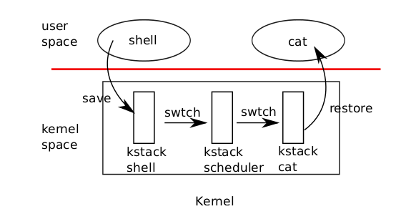
Switching from one process to another

Slide 11
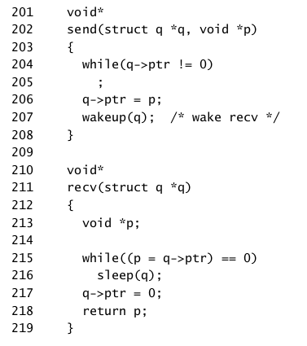
Sleep and wakeup
s

Slide 12
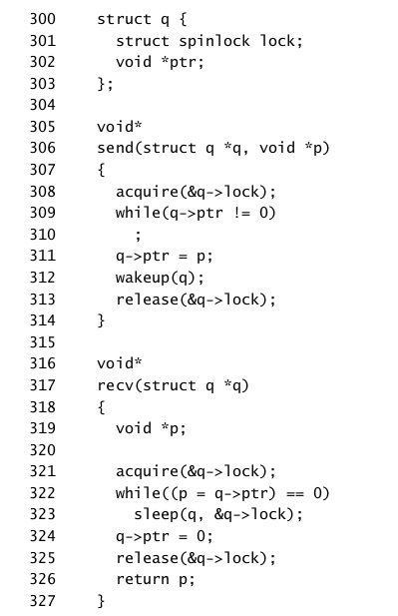
Solving lost and wakup problem

Slide 13
Solving lost and wakup problem
Sleep will hold two lock
1. one for protecting process table i.e p.table.lock
2. for ensuring no wakeup will call untill it goes to sleep.
Wakeup will wakeup the process which are sleeping & on chan. So that may wakeup more than one process.
So in xv6 sleep always written in loops.

Slide 14
Wait() and exit()
When child exits it doesn't die immediately but switches to ZOMBIE state, until the parent learn of the exit.
Parent responsible of freeing memory associated.
If parent exits, before child init will adopt it.

