Slide 1
.EXE & .COM files
.exe &.com files (v1.0) by Prashant Gonarkar is licensed under a Creative Commons Attribution-NonCommercial 2.5 India License

Slide 2
Topic introduction
MS-DOS application programs
Executable file formats
a.out, elf, pef,com, exe
.exe
DOS – MZ, NE
OS/2 - LX
Windows – PE(32 & 64bit)

Slide 3
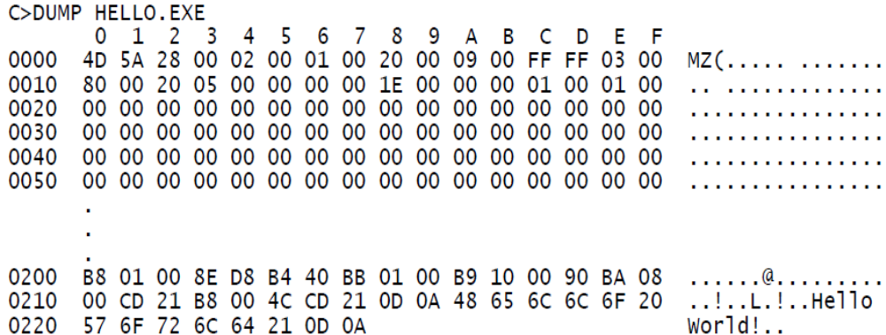

Slide 4
Transient programs
It owns the memory block it has been allocated & has nearly total control of system’s resources while it’s executing.
When it terminates either because abortion by OS or its completion,frees the memory for other programs use.
EXEC

Slide 5
.COM file
.com stands for “command file”
Executable format used in CP/M and DOS
.com files resides an absolute image of the machine instructions to be executed.
No relocation -> compact & slightly faster than .exe
No signature or checksum
It simply brings any file with .com extension into memory and jumps to it.

Slide 6
No header, metadata
No segments, code & data placed in same segment
Max size = 64k
No far procedures

Slide 7
PSP (Program Segment Prefix)
It’s reserved area, 256 bytes long, that is set up by DOS at the base of the memory block allocated to transient program.
The PSP is most often used to get the command line arguments of a DOS program
It contains some linkage to DOS that can be used by transient program.

Slide 8

Image_01
Complete PSP table

Slide 9
Memory map of .com file

Slide 10
Example of .com file
TITLE Hello Program in COM format (HelloCom.asm)
.model tiny
.codeorg 100h ; must be before main
main PROC
mov ah,9
mov dx,OFFSET hello_message
int 21h
mov ax,4C00h
int 21h
main ENDP
hello_message BYTE 'Hello, world!',0dh,0ah,'$'
END main

Slide 11
Disadvantages of .com
Size is limited
Stack, Code & Data all have to reside in the same segment. Hence, is not favorable in multi-tasking environments.

Slide 12
.EXE files
.EXE is a common extension denoting a executable file or program in DOS
Overcome all drawbacks of .com file
A .EXE program also places the code, data and stack in separate parts of the file.
A .EXE program can be practically unlimited in size(up to the limit of the computer’s available memory).

Slide 13
.EXE files provides the ability to load different parts of large programs into several separate memory fragments, that can be shared by several tasks, making it suitable for multitasking environments.

Slide 14
Linking different object modules
Each module need to use unique code segment name
Procedures can be near or far.
Linked modules must have only one seg with STACK attribute
Only one entry point defined with END ad

Slide 15
Memory map of .exe file
draw

Slide 16

Format of .exe load module

Slide 17
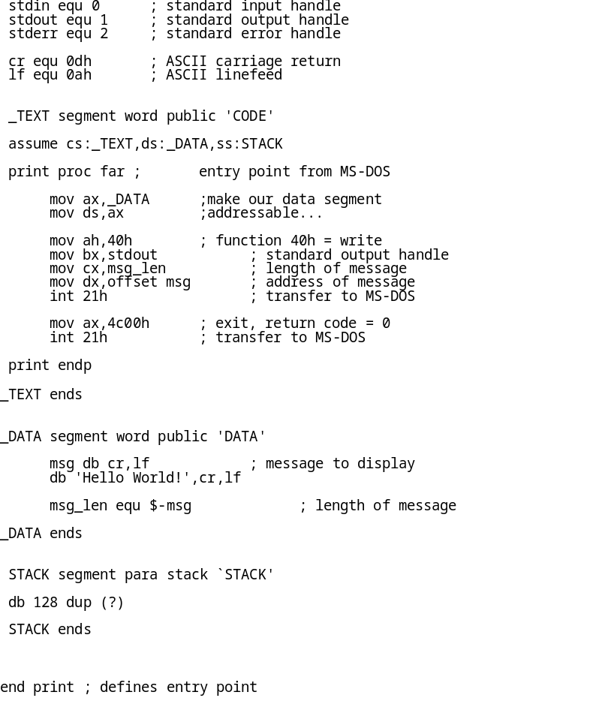
Example of .exe program

Slide 18
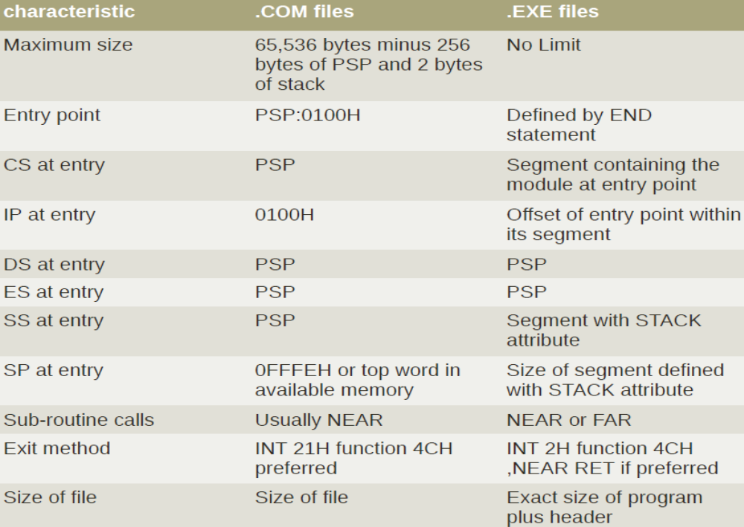

Slide 19
When you run a program…
MS-DOS performs the following steps, in order:
  checks for a matching internal command name
  looks for a matching file with .COM, .EXE, or .BAT extensions, in that order, in the current directory
  looks in the first directory in the PATH variable, for .COM, .EXE, and .BAT file
  continutes to second directory in the PATH, and so on
  If everything fails gives error “bad command or filename”

Slide 20
Today’s .exe & .com
.com files just for backward compatibilities
.exe file are PE (portable executable) formated which allows encapsulation, executable compression
How to make .exe files?

Slide 21
MS-DOS Demo
I hear I forget
I see I remember
I do I understand

Slide 22
References
Advanced MS-DOS programming – Ray duncan
Expert MS-DOS programming
http://www.scribd.com/doc/53566261/Expert-MS-DOS-Programming
Program segment prefix –
http://www.sxlist.com/techref/dos/psps.htm
Exe header
http://www.tavi.co.uk/phobos/exeformat.html

