Slide 1
What Are Document Loaders?
Components that load data from various sources into a standardized format
Data Sources:
Output Format:
✓ PDF Files
✓ Text Documents
✓ Web Pages
✓ Databases
✓ Cloud Storage
Document Object
1. Page Content
Actual text/data
2. Metadata
Source, dates, author,
page numbers, etc.

Slide 2
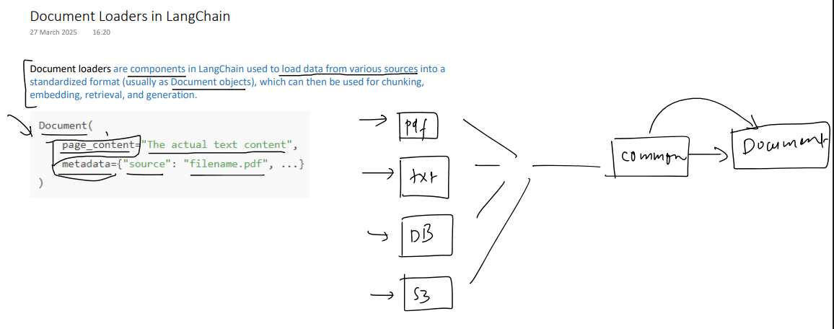

Slide 3
Purpose of Document Loaders:
• These utilities in LangChain whose job is to bring data from different data sources and convert it into a standardized format
• That standardized format is the Document Object

Slide 4
Today's Focus: Four Essential Loaders
LangChain offers 100+ loaders - we'll cover the most commonly used
📝
Text Loader
📄
PDF Loader
Log files, code snippets, transcripts
Academic papers, reports, documentation
🌐
Web Loader
📊
CSV Loader
Articles, blog posts, public websites
Spreadsheets, tabular data, datasets
All loaders share the same foundation - easy to learn one, use them all!

Slide 5
1. Text Loader - The Simplest Loader
Best Use Cases:
Purpose
Loads plain text (.txt) files and converts them into Document objects
• Processing log files
• Loading code snippets
• Reading transcripts
• Any plain text data
Limitation:
⚠️ Works only with .txt files - won't process PDFs, Word docs, or other formats

Slide 6
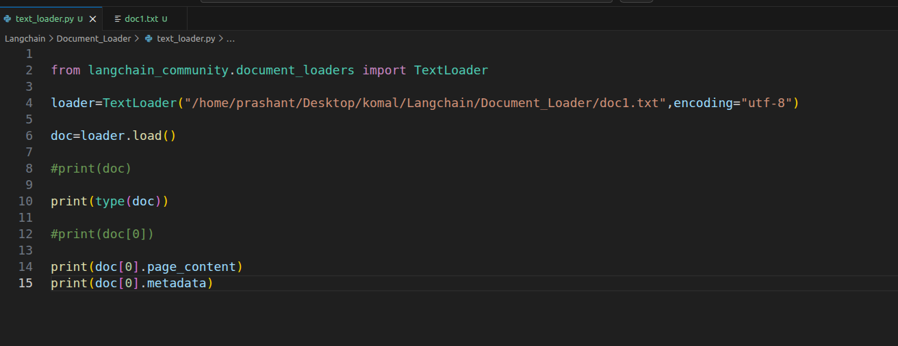

Slide 7
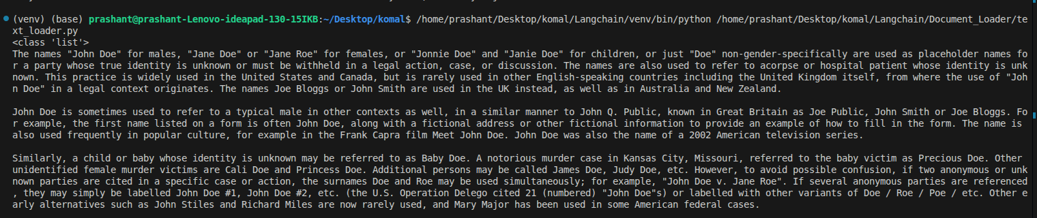

Slide 8
Document structure (as explained earlier):
• Has two things:
◦ Page Content
◦ Metadata
Output characteristics:
• You get a Python list as output
• What's happening is any document loader you use, when it loads the document, it loads it as a list of documents
• You'll notice going forward that whatever document loaders we cover, each one's output will be a list of documents

Slide 9
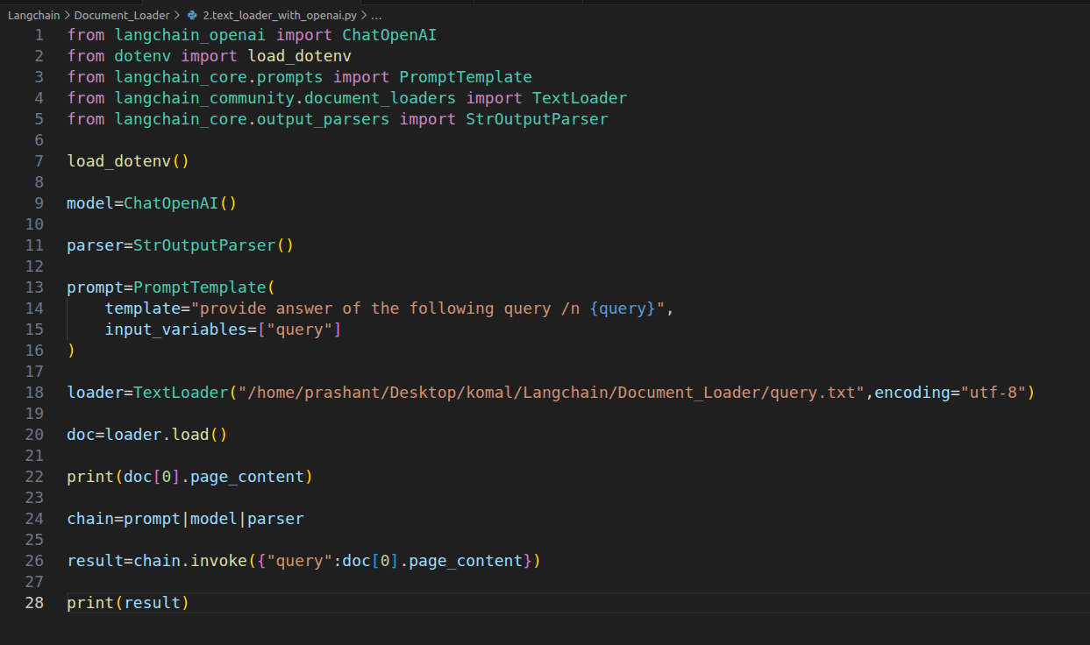

Slide 11
Text Loader - Code Implementation
from langchain_community.document_loaders import TextLoader
# Create loader instance
loader = TextLoader(
file_path="sports_article.txt",
encoding="UTF-8"
)
# Load the document
documents = loader.load()
# View results
print(documents)
• Returns a Python list of Document objects
• Each Document contains:
- page_content: The actual text from the file
- metadata: {'source': 'sports_article.txt'}
• Access content: documents[0].page_content
• Access metadata: documents[0].metadata
Output Structure:

Slide 12
2. PDF Loader (PyPDF Loader)
Key Feature:
Purpose
Extracts text from PDF files - processes each page separately
Page-by-page processing:
25-page PDF → 25 Document objects
When to Use PyPDF Loader:
✓ Text-based PDFs (reports, papers, documentation)
✓ Digital documents with searchable text
✓ Simple, straightforward PDF extraction
Limitations:
✗ Scanned image PDFs (use UnstructuredPDFLoader instead)
✗ Complex layouts with tables (use PDFPlumberLoader)
✗ PDFs requiring layout preservation (use PyMuPDFLoader)

Slide 13
