Slide 1
Other PDF Loaders Available
The speaker mentions several alternatives and provides tutorial links:
1. PDF Plumber Loader - For PDFs with lots of tabular structures, to extract table data
2. Unstructured PDF Loader - If working with scanned image PDFs
3. Amazon Textract PDF Loader - Another option for image extraction
4. PyMuPDF Loader - For layout extraction and structure extraction from PDFs

Slide 2
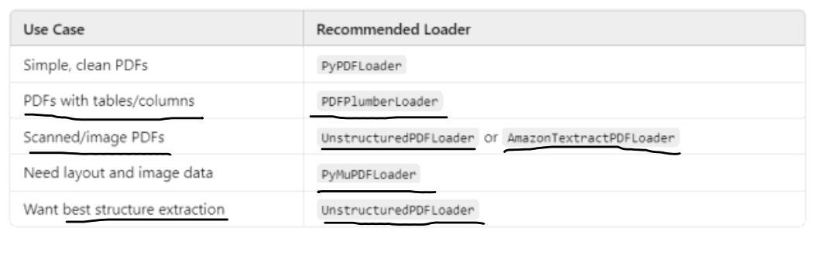

Slide 3
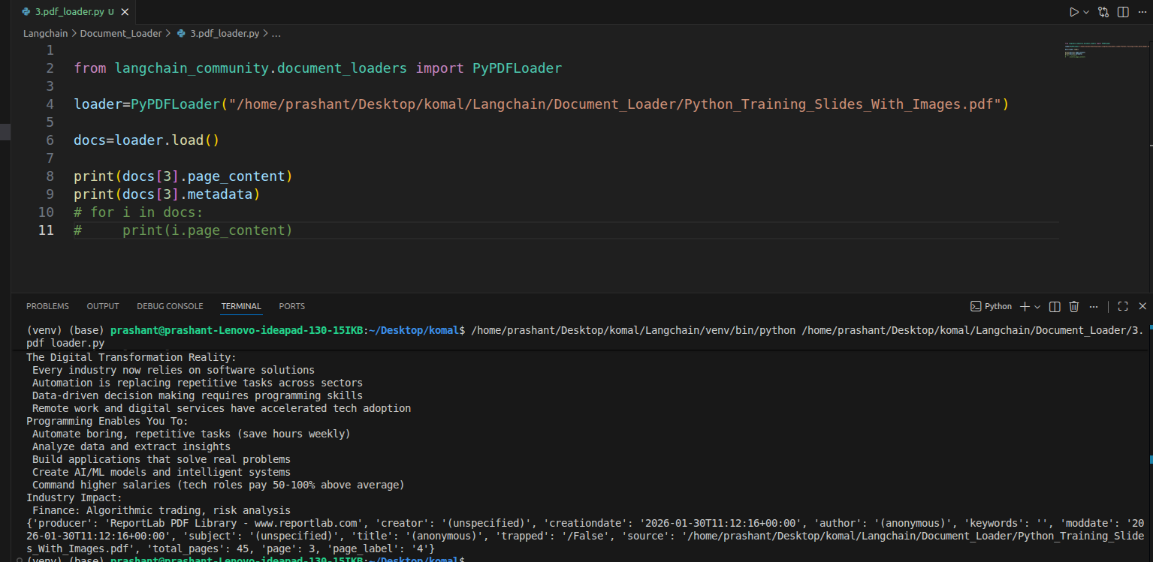

Slide 4
Key Characteristics of PyPDF Loader
Page-by-page processing:
• The biggest feature is that it works on a page-by-page basis
• Suppose you have a PDF with 25 pages
• When you send this 25-page PDF to the PDF document loader
• It will create 25 document objects for this 25-page PDF document
• Basically, after processing, you'll have a list of 25 document objects
• Each document object has its own page content and its own metadata
• In the metadata, you'll get the page number and source extra
Example output:
• If you have a PDF with 23 pages
• When you load it, you get 23 documents
• Each page becomes one document
• For the first page: docs[0].page_content
• For the last page (page 326): docs[325] (because indexing starts from 0)

Slide 5
PDF Loader - Code Implementation
from langchain_community.document_loaders import PyPDFLoader
# Create loader with PDF path
loader = PyPDFLoader("machine_learning_guide.pdf")
# Load all pages
documents = loader.load()
# Check number of pages
print(len(documents)) # Output: 23
Sample Output:
Page 0 content:
documents[0].page_content # First page text
Page 0 metadata:
{
'source': 'machine_learning_guide.pdf',
'page': 0,
'total_pages': 23,
'creator': 'PyPDF',
'creation_date': '2024-01-15'
}

Slide 6
Loading Multiple Files: Directory Loader
Load all files from a folder at once - specify file types with glob patterns
Scenario: Books folder with 3 PDFs
Result:
• ml_fundamentals.pdf (326 pages)
• python_for_ml.pdf (392 pages)
• advanced_techniques.pdf (468 pages)
1,186 Document objects
(326 + 392 + 468)
Each page = 1 document
Common Glob Patterns:
*.pdf → All PDF files in root directory
**/*.txt → All text files in all subfolders
data/*.csv → CSV files in 'data' folder
**/* → All files in all folders

Slide 7
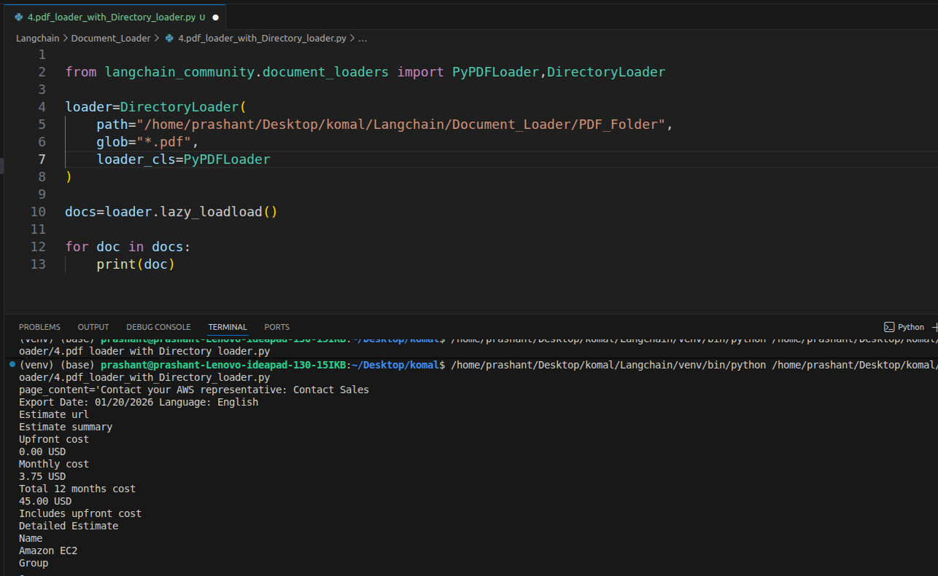

Slide 8
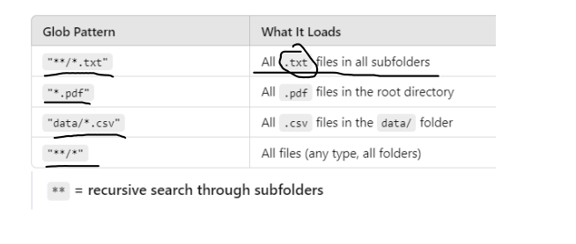

Slide 9
Directory Loader - Code Example
from langchain_community.document_loaders import DirectoryLoader, PyPDFLoader
# Configure directory loader
loader = DirectoryLoader(
path="reference_books/",
glob="*.pdf", # Load only PDFs
loader_cls=PyPDFLoader # Use PDF loader for each file
)
# Load all documents
all_docs = loader.load()
print(f"Loaded {len(all_docs)} documents")
Output:
Loaded 1186 documents
First document:
all_docs[0].metadata
→ {'source': 'reference_books/ml_fundamentals.pdf', 'page': 0}
Last page of first book (page 325):
all_docs[325].metadata
→ {'source': 'reference_books/ml_fundamentals.pdf', 'page': 325}

Slide 10
1. load() → Loads everything at once (Eager Loading)
✔ What it does
Reads all documents immediately
Stores them in memory as a list
✔ Returns
list[Document]
✔ Example
docs = loader.load()
print(type(docs)) # list
print(len(docs)) # total documents
print(docs[45]) # 46th document
✔ Memory Diagram
PDF Files
↓
load()
↓
[List of all Documents in RAM]
✔ Pros
✔ Easy indexing
✔ Fast access
✔ Simple to use
✔ Cons
❌ High RAM usage
❌ Slow if thousands of PDFs

Slide 11
2. lazy_load() → Loads one by one (Lazy Loading)
✔ What it does
Loads documents only when needed
Uses generator
Does NOT load everything into memory
✔ Returns
generator object
✔ Example
docs = loader.lazy_load()
for doc in docs:
print(doc)
✔ Memory Diagram
PDF Files
↓
lazy_load()
↓
Loads ONE document at a time

Slide 12
Load vs Lazy Load: Memory Management
load() - Eager Loading
lazy_load() - Stream Loading
How it works:
• Loads ALL documents into
memory at once
• Returns a complete list
• Immediate access to all data
Best for:
✓ Small datasets
✓ Few documents
✓ Need everything upfront
Drawbacks:
✗ High memory usage
✗ Slow initial load time
How it works:
• Loads ONE document at a
time
• Returns a generator
• Process and discard each
Best for:
✓ Large datasets
✓ Many/large documents
✓ Stream processing
Benefits:
✓ Low memory footprint
✓ Immediate start

Slide 13
Lazy Load - Code Comparison
# Regular load - loads everything upfront
documents = loader.load() # Returns list immediately after loading ALL
# Process all at once
for doc in documents:
print(doc.metadata)
# Lazy load - loads one at a time
for doc in loader.lazy_load(): # Returns generator
print(doc.metadata) # Process, then discard
Memory Impact Example:
Loading 1,186 documents (from 3 PDFs):
load() → Waits ~15 seconds, loads all 1,186 into RAM, then processes
lazy_load() → Starts immediately, only 1 document in RAM at a time

Slide 14
When to Use PyPDF Loader
• You should use PyPDF Loader when you have PDFs with mostly textual data and you want to load text
• But PyPDF Loader doesn't work well in many scenarios
• Like if you have scanned images PDFs, PyPDF Loader won't work that well
• For such use cases, you have some other PDF loaders present in LangChain

