Slide 1
3. Web-Based Loader (WebBaseLoader)
How It Works:
Purpose
Extracts text content from web pages using Beautiful-soup and Requests
1. Makes HTTP request to URL
2. Parses HTML structure
3. Removes HTML tags
4. Extracts visible text
Best Use Cases:
Limitations:
✓ Blog posts and articles
✓ News websites
✓ Static public websites
✓ Documentation pages
✗ JavaScript-heavy pages
✗ Dynamic content loaded after
page render
→ Use SeleniumURLLoader instead
💡 Project Idea: Chrome plugin to chat with any webpage!

Slide 2
Web Loader - Code Implementation
from langchain_community.document_loaders import WebBaseLoader
# Single URL
url = "https://blog.example.com/ai-trends-2024"
loader = WebBaseLoader(web_path=url)
# Load the webpage
documents = loader.load()
# Multiple URLs (list)
urls = ["url1.com", "url2.com", "url3.com"]
loader = WebBaseLoader(web_path=urls) # 3 documents
f

Slide 3
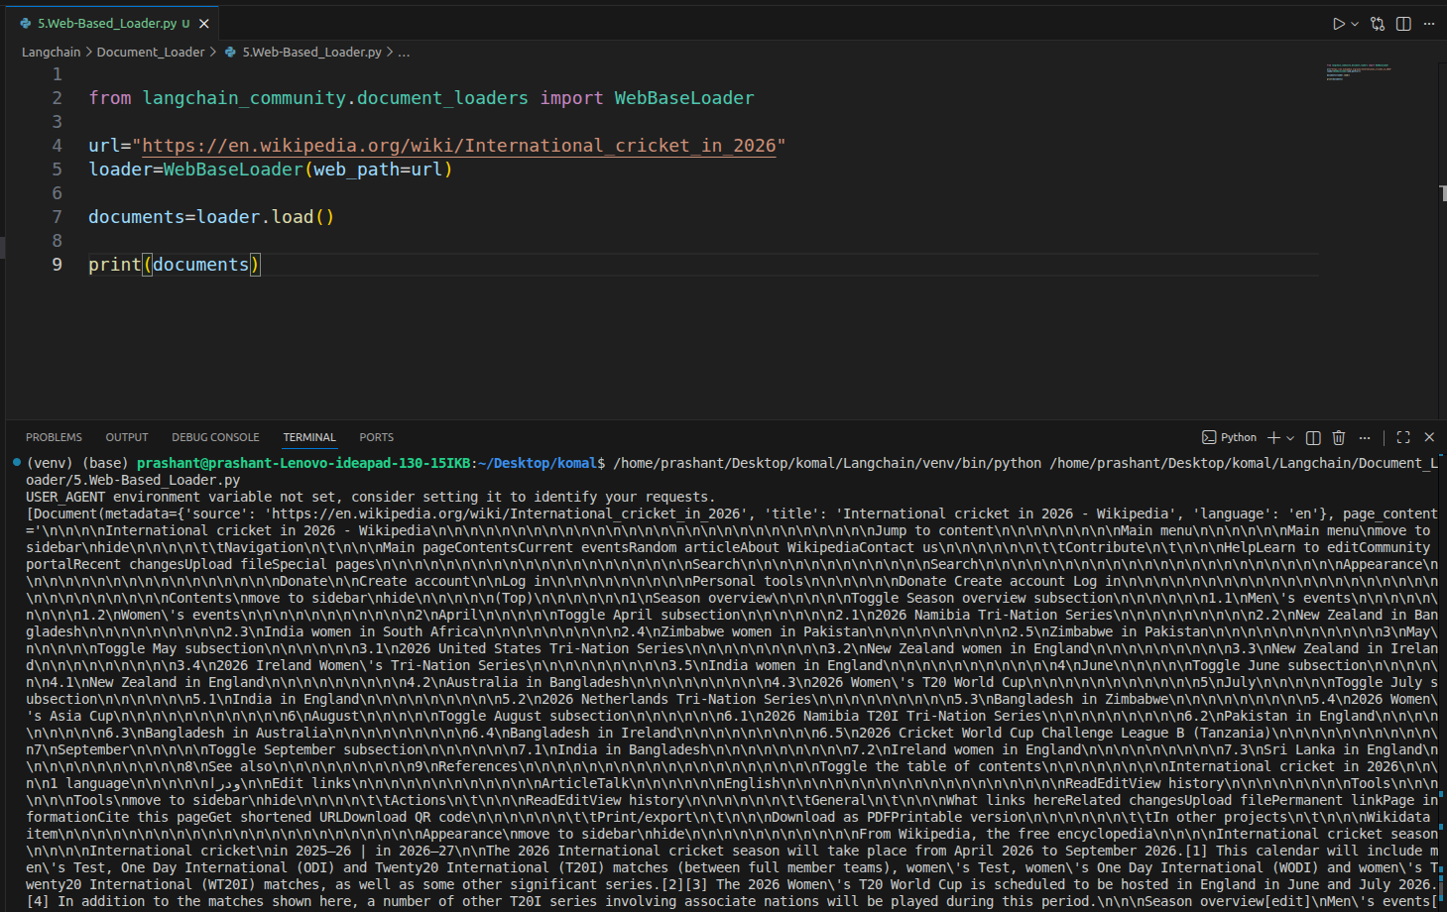

Slide 4
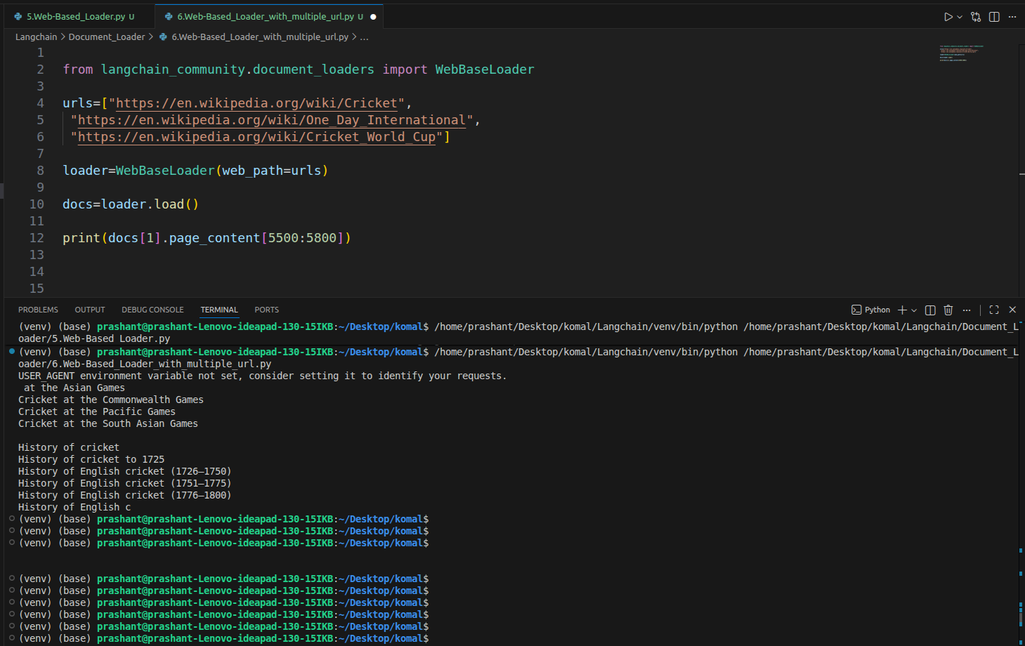

Slide 5
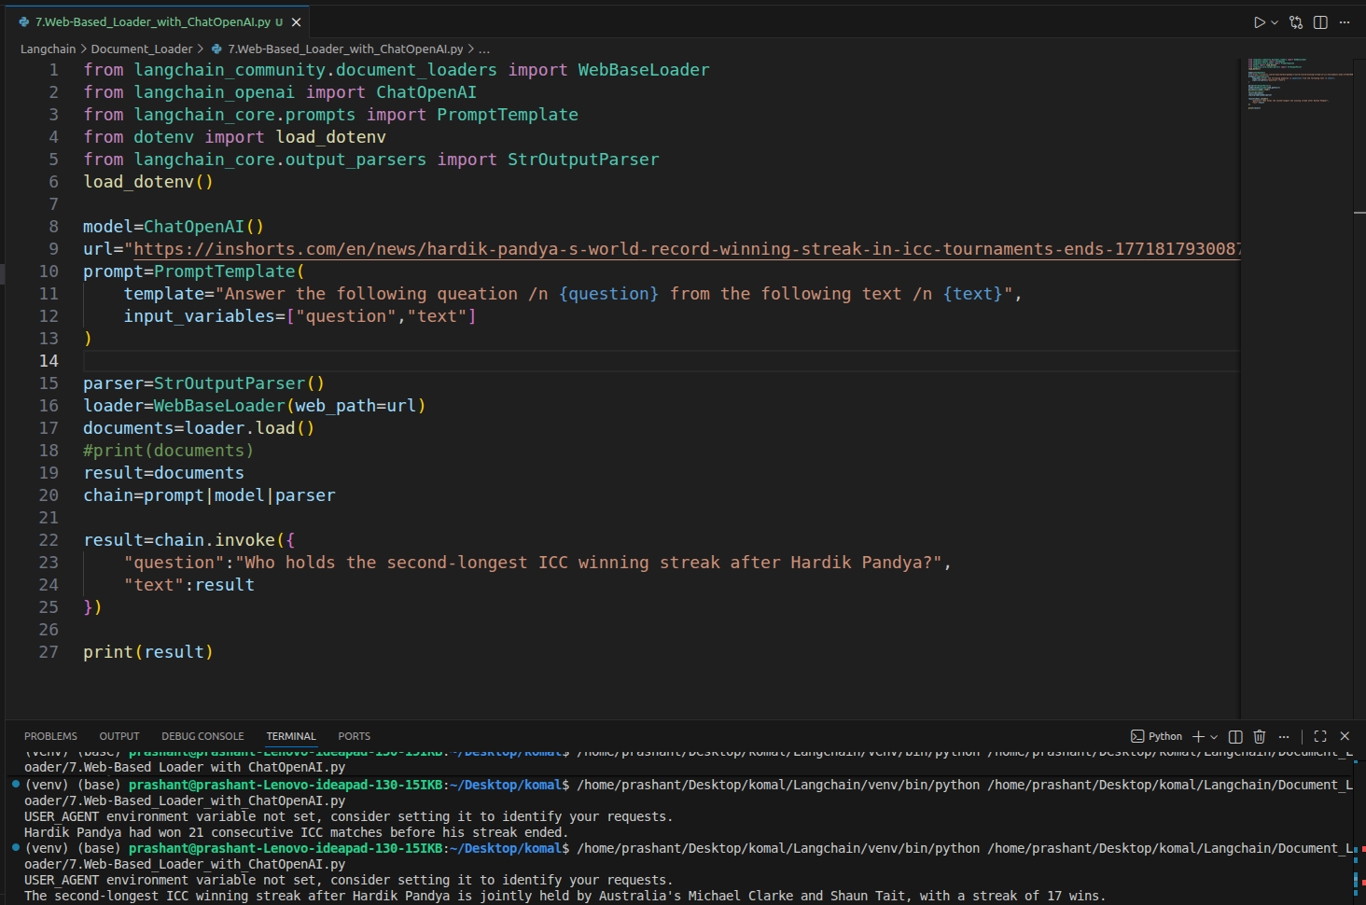

Slide 6
4. CSV Loader (CSVLoader)
Key Feature:
Purpose
Loads CSV files - converts each row into a separate Document object
Row-by-row processing:
400 rows → 400 Document objects
Example Dataset:
File: customer_data.csv
Columns:
• UserID | Gender | Age | EstimatedSalary | Purchased
Sample Rows:
15624510 | Male | 19 | 19000 | 0
15810944 | Male | 35 | 20000 | 0
15668575 | Female | 26 | 43000 | 0
Total: 400 rows

Slide 7
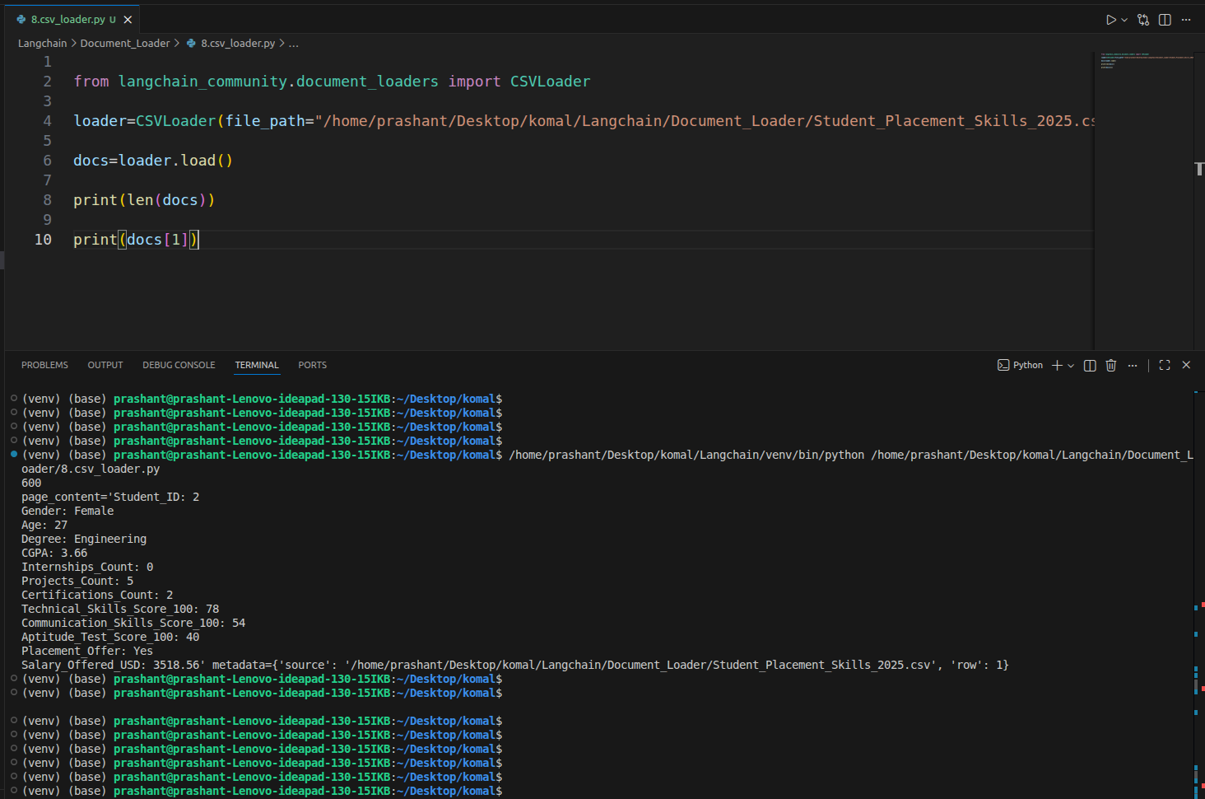

Slide 8
CSV Loader - Code Implementation
from langchain_community.document_loaders import CSVLoader
loader = CSVLoader(file_path="customer_data.csv")
documents = loader.load()
print(len(documents)) # Output: 400
Document Structure:
First row (index 0):
documents[0].page_content:
"""UserID: 15624510
Gender: Male
Age: 19
EstimatedSalary: 19000
Purchased: 0
"""
documents[0].metadata:
{'source': 'customer_data.csv', 'row': 0}

Slide 9
Beyond PyPDF: Specialized PDF Loaders
Choose the right loader based on your PDF type:
PyPDFLoader
PDFPlumberLoader
Simple text PDFs
Tables & structured data
UnstructuredPDFLoader
PyMuPDFLoader
Scanned images/OCR
Layout & structure preservation
💡 Tip: Start with PyPDFLoader, switch only if you encounter issues

