Slide 1
Introduction to LangChain
Building LLM-Powered Applications Made Easy
Lesson 1

Slide 2
What is LangChain?
LC
LangChain is an open-source framework for building applications powered by Large Language Models (LLMs)
Key Concept:
If you want to build any LLM-based application, LangChain is the framework that helps you orchestrate all the components, manage data flow, and simplify development.
To truly understand LangChain, we must first understand:
• Why it was needed in the first place
• What problems it solves
• How it makes LLM application development easier

Slide 3
The Brain Component (LLM)
The Brain needs two capabilities:
1.NLU (Natural Language Understanding)
Understand the query properly in any language (English, Hindi, etc.)
Comprehend text/queries accurately
2.Context-Aware Text Generation
The Brain's job: Understand the query and extract the answer from the given documents
Generate relevant answers based on the provided pages
Final Output: The Brain reads the pages, extracts the what is linear regression, generates text, and provides the final answer.

Slide 4
Complete Detailed System Flow
📊
1
PDF Upload & Storage
User uploads PDF → Store in cloud (AWS S3, GCP)
2
Document Loading
Use Document Loader to bring PDF into system
3
Text Splitting
Divide PDF into chunks (by pages, chapters, or paragraphs)
4
Generate Embeddings
Convert each chunk to vector using Embedding Model
5
Store in Database
Save embeddings in vector database for future queries
6
Query Processing
Convert user query to embedding → Find similar vectors
7
LLM Processing
Send query + relevant pages to LLM → Generate answer

Slide 5
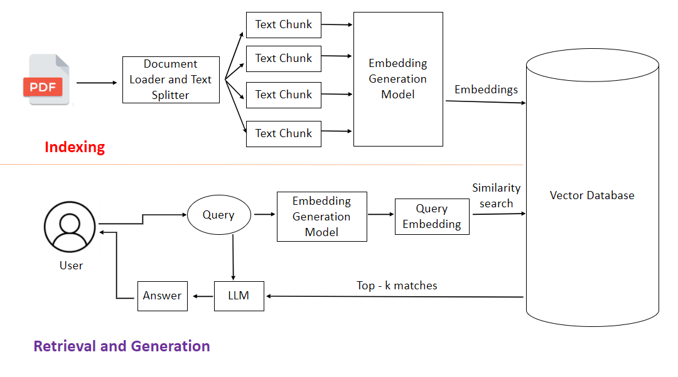

Slide 6
Challenges in Building This System
⚡
Challenge #1: Building the Brain (SOLVED ✓)
Problem:
Need NLU + context-aware text generation
Solution:
LLMs (GPT, Claude, Gemini) provide both capabilities out-of-the-box!
Challenge #2: Computation (SOLVED ✓)
Problem:
Hosting heavy LLMs is expensive and complex
Solution:
Use LLM APIs (OpenAI, Anthropic, Google) - pay-as-you-go model!
Challenge #3: Orchestration (WHERE LANGCHAIN HELPS! 🎯)
Problem:
Connecting 5+ components (S3, embeddings, DB, LLM, etc.) is complex
Solution:
LangChain provides plug-and-play interfaces for all components!

Slide 7
Key Benefits of LangChain
✨
1. Chains Concept 🔗
Create workflows of any complexity. Output of one component automatically becomes input of the next. Build parallel or conditional chains easily.
2. Model Agnostic Development 🔄
Switch between OpenAI, Google Gemini, Anthropic Claude with just 2 lines of code. Focus on logic, not implementation details.
3. Complete Ecosystem 📦
50+ document loaders, text splitters, embedding models, and databases. Every component you need is available with built-in interfaces.
4. Memory & State Handling 🧠
Maintains conversation context automatically. Users can reference previous queries without repeating information.

Slide 8
What Can You Build with LangChain?
🚀
Conversational Chatbots 💬
Build AI customer service agents that understand context and provide solutions. Most popular use case!
AI Knowledge Assistants 📚
Create chatbots trained on your company's data. Answer questions about courses, documentation, or internal knowledge.
AI Agents (Chatbots on Steroids) 🤖
Not just talk, but take actions! Book flights, schedule meetings, execute tasks autonomously.
Workflow Automation ⚙️
Automate personal, professional, or company-level workflows using LLM intelligence.
Summarization & Research Tools 📝
Process large documents, generate summaries, answer questions - perfect for research and analysis.

Slide 9
Popular Alternatives to LangChain
🔀
LlamaIndex (formerly GPT Index)
• Very popular framework - sometimes more popular than LangChain
• Specializes in data indexing and retrieval
• Great for building RAG (Retrieval-Augmented Generation) applications
Haystack by deepset
•Production-ready framework for building search systems
• Strong focus on enterprise applications
• Excellent for semantic search and question-answering systems
Choosing the Right Framework:
Decision depends on: pricing, specific use case, ease of use, and team familiarity. All three are excellent choices for building LLM applications!

Slide 10
Key Takeaways
✓
LangChain is an open-source framework for building LLM-powered applications
✓
It solves the orchestration challenge of connecting multiple components
✓
Semantic search is more efficient than keyword search for finding relevant content
✓
Major challenges (Brain, Computation) are solved by LLMs and APIs
✓
LangChain provides chains, model-agnostic development, and complete ecosystem
✓
Use cases: Chatbots, Knowledge Assistants, AI Agents, Automation, Research
✓
Alternatives include LlamaIndex and Haystack
✓
Future looks bright for LLM-based applications - LangChain will play a key role

