Slide 1


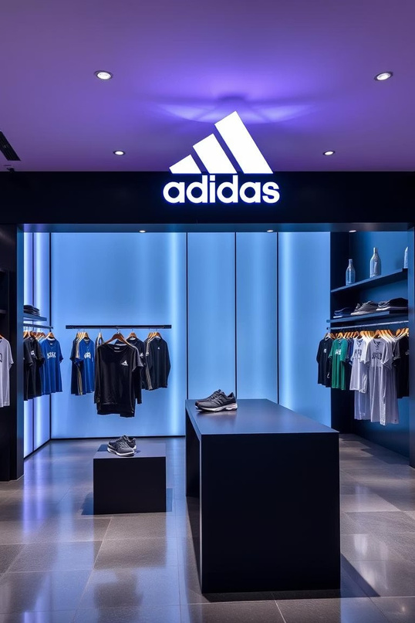
Adidas Sales Data Analysis
This presentation provides an overview of Adidas sales data, highlighting key trends and insights across various dimensions. We will explore sales performance by region, product category, sales method, and gender type.

Slide 2

Sales Performance by Region
$300,000,000.00
$200,000,000.00
$100,000,000.00
$0.00
West
Nor theast
Southeast
South
Midwest
The West region leads in total sales, significantly outperforming other regions. The Northeast and Southeast show moderate sales, while the South and Midwest have similar, lower sales figures.

Slide 3
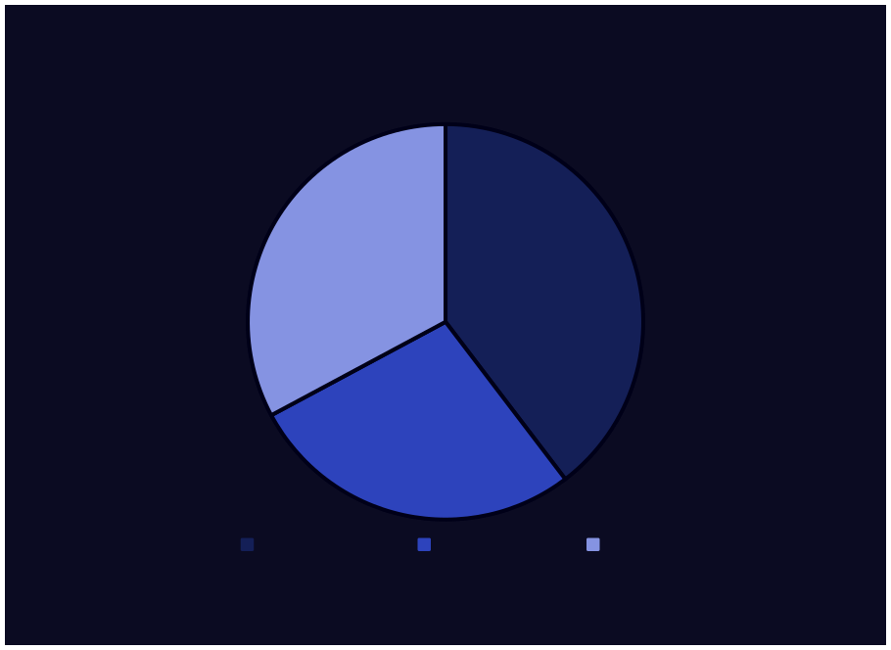
Sales Distribution by Method
In-store
Online
Outlet
In-store sales account for the largest share at 39.6%. Outlet sales follow closely at 32.8%, indicating strong performance. Online sales
represent 27.5% of the total distribution.

Slide 4
Units Sold by Product Category
1,200,000
800,000
400,000
0
Street Footwear
Athletic Footwear
Apparel
Street Footwear leads in units sold with 980,000 units. Athletic Footwear and Apparel follow with 750,000 and 720,000 units, respectively. This highlights the strong demand for footwear products.

Slide 5

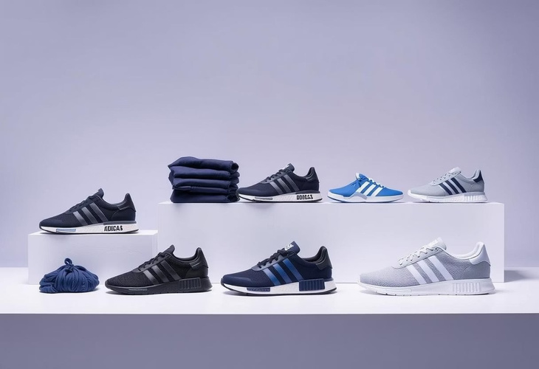
Total Sales by Product Category
Street Footwear generates the highest total sales. Apparel also contributes significantly. Athletic Footwear has the lowest total sales among the categories.
Street Footwear
Apparel
Athletic Footwear
$0.00
$150,000,000.00
$300,000,000.00
$450,000,000.00

Slide 6

Sales by Product Category and Gender
Men's Street Footwear leads in sales. Women's Apparel also shows strong performance. Athletic Footwear sales are lower for both genders.
$150,000.00
$100,000.00
$50,000.00
$0.00
Apparel
Street Footwear
Athletic Footwear
Men's Sales
Women's Sales

Slide 7
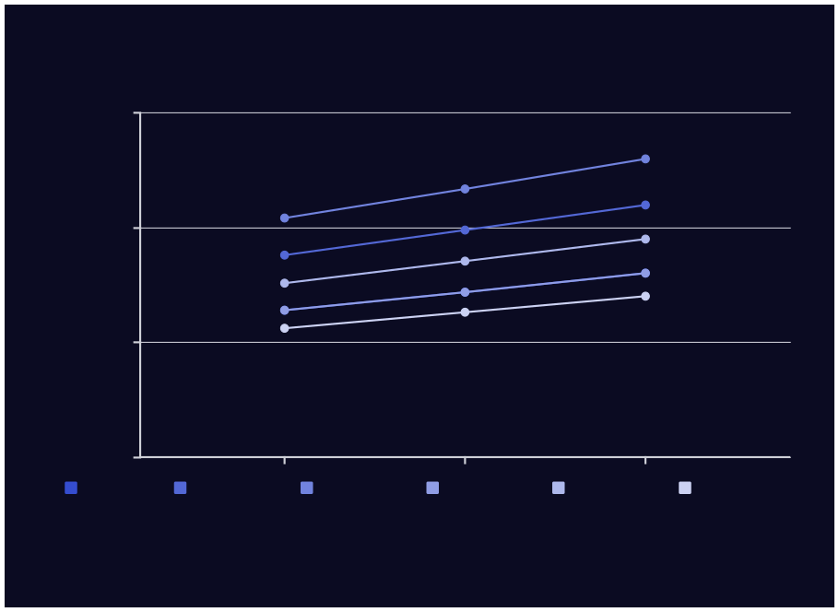
Sales Over Time by Gender and Product
$150,000.00
$100,000.00
$50,000.00
$0.00
2000-01
2000-02
2000-03
Men's Apparel
Women's Apparel
Men's Street Footwear
Women's Street Footwear
Men's Athletic Footwear
Women's Athletic Footwear
Sales trends vary across gender and product categories over time. Some categories show consistent growth, while others fluctuate.
Detailed analysis reveals specific seasonal or market impacts.

Slide 8

Key Takeaways and Next Steps
1
Regional Focus
Prioritize the West region for continued growth opportunities.
2
Sales Channel Optimization
Balance efforts across in-store, online, and outlet channels.
3
Product Strategy
Leverage strong performance in Street Footwear and Apparel.
4
Gender-Specific Marketing
Tailor campaigns to target male and female preferences effectively.

